Slide 1
KEY ENGLISH TEST 2
SPEAKING TEST 3

Slide 2
KET SPEAKING
Time allowed - 8-10 minutes
Normally you will do the speaking test with another candidate. The two of you will meet two examiners. One of the examiners will talk to you, the other does not particpate in the conversations.
There are two parts to the speaking test:
Speaking part 1: short questions and answers between you and the examiner
Speaking part 2: the examiner gives you some information or a card with some ideas for questions. You have to talk with the other candidate and ask or answer questions.
How to prepare for KET Speaking
Speak as much as you can, with your friends
Practise asking and asnwering questions about daily life
Practise giving information about yourself

Slide 3

Part 1:
What do you usually do in your freetime?
Do you like watching TV?
How many hours a day do you spend on watching TV?
What kinds of programmes do you often watch on TV?
Do you prefer listening to radio to watching TV?
Talk about your favorite programme.
Remember to add more details to your answer to make it longer

Slide 4
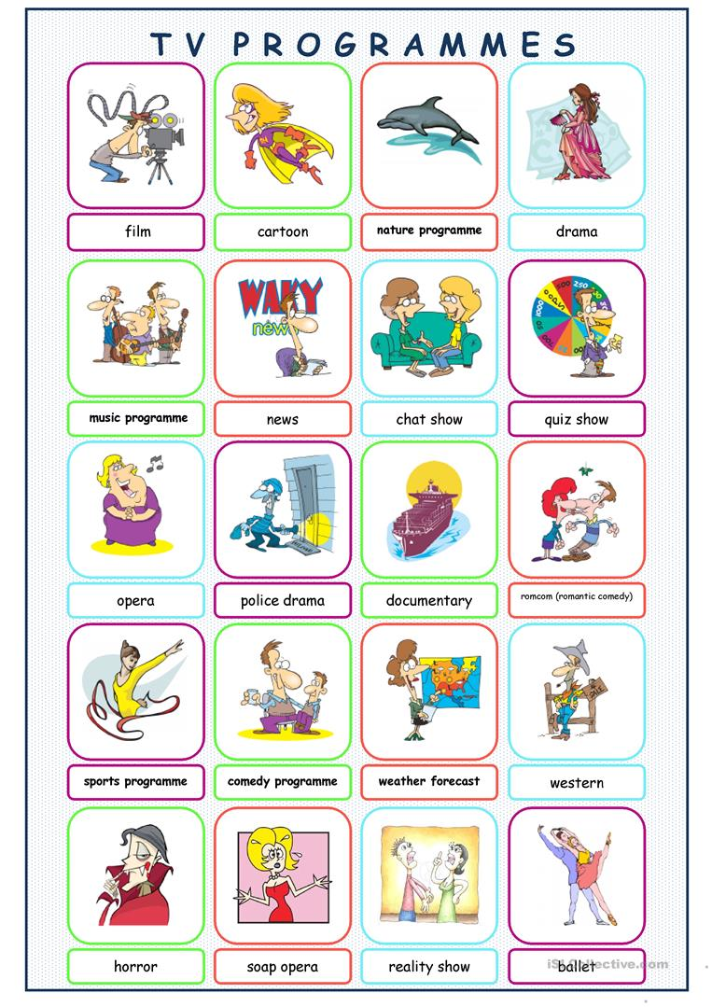

Slide 5
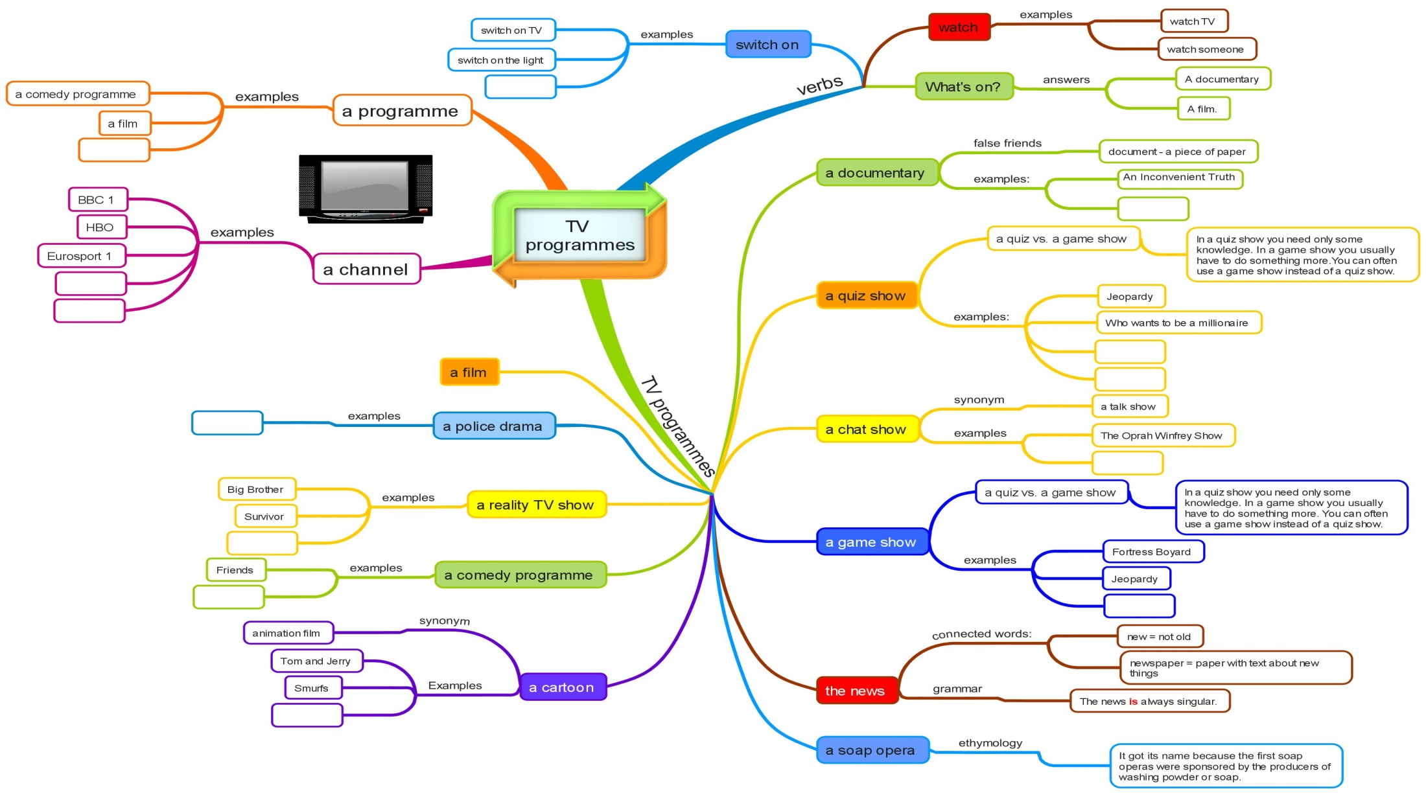

Slide 6
Sample answers:
What do you usually do in your freetime?
Do you like watching TV?
How many hours a day do you spend on watching TV?
What kinds of programmes do you often watch on TV?
Do you prefer listening to radio to watching TV?
I often read books, listen to music and watch TV
Yes, I like it a lot. Watching TV is a great way to relax and reduce stress
I spend about 1 hour a day on watching different programmes on TV
I like watching cartoons, films and I also watch the official news, too.
No, I prefer watching TV to listening to radio because I not only can listen but also can look at what is happening.
Not only… but also

Slide 7
A Favorite program
The answer should be at least 3 sentences
Helpful outline and vocabulary
Program
Name – What kind of program it is
What is it about/ What can you learn from the program
When do you watch this program

Slide 8
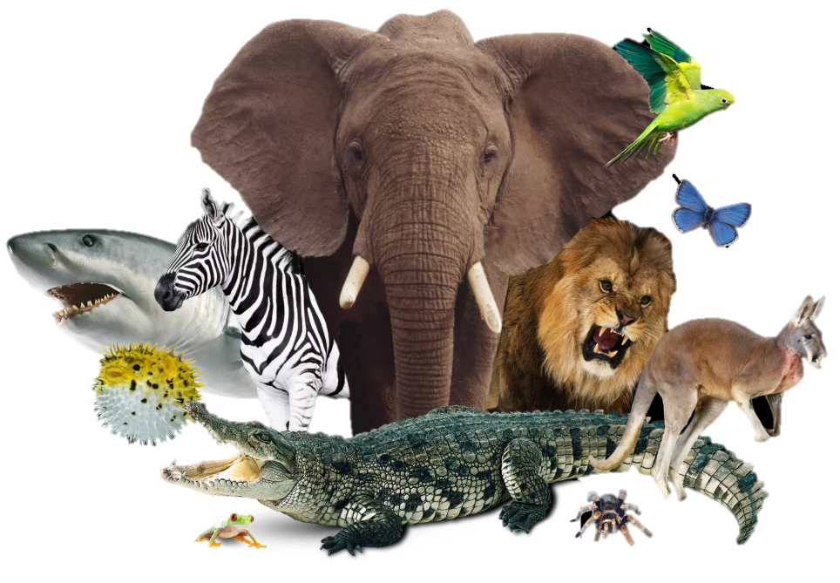
The animal world
My favorite TV program is the animal world. It is often shown on VTV2 channel at 8.30 in the evening and it often lasts for 45 minutes. In this program, they present the animals’ life and their habitats in a very lively way. Therefore, I learn that we should protect these animals and their living environment

Slide 9
SPEAKING
PART 2
Asking and answering questions using these prompt cards

Slide 10
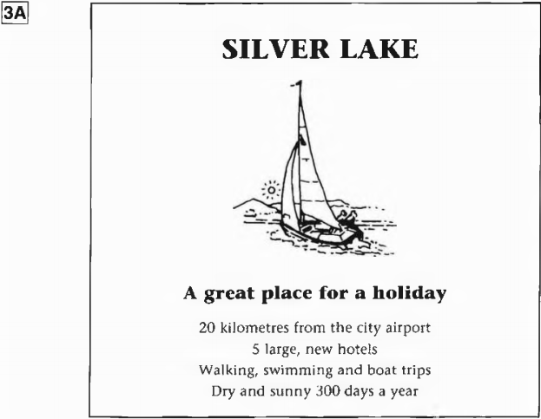
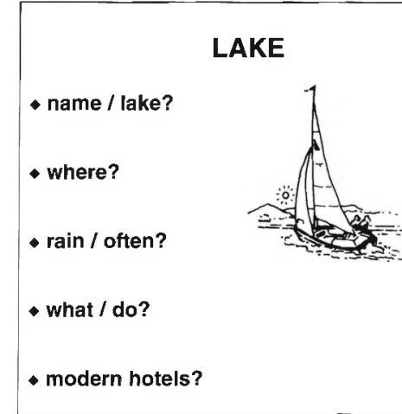
What is the name of the lake?
Where is it?
Does it often rain?
What can I do there?
Are there modern hotels?
It is Silver Lake
It is 20 km from the city airport
No, it doesn’t.
You can walk, swim and enjoy the boat trips
Yes. There are 5 large and new hotels

Slide 11
Imagine that you are the tour guide. Introduce the Silver Lake based on the given informattion

Slide 12
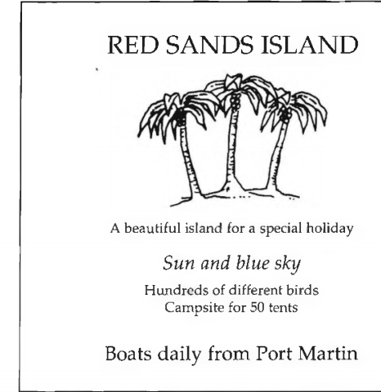
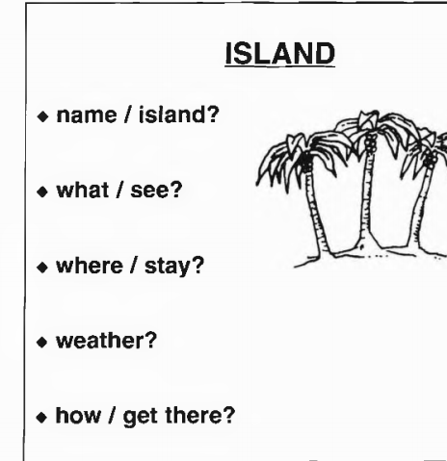
What is the name of the island?
What can I see there?
Where can I stay?
How is the weather there?
How can I get there?
Can you think of other ways of asking and answering the questions?

