Slide 1
KEY ENGLISH TEST 3
SPEAKING TEST 1

Slide 2
KET SPEAKING
Time allowed - 8-10 minutes
Normally you will do the speaking test with another candidate. The two of you will meet two examiners. One of the examiners will talk to you, the other does not particpate in the conversations.
There are two parts to the speaking test:
Speaking part 1: short questions and answers between you and the examiner
Speaking part 2: the examiner gives you some information or a card with some ideas for questions. You have to talk with the other candidate and ask or answer questions.
How to prepare for KET Speaking
Speak as much as you can, with your friends
Practise asking and asnwering questions about daily life
Practise giving information about yourself

Slide 3

Part 1:
Do you like playing sports?
What is your favourite sport?
What is its types of sport?
Why do you like playing that sport?
Who do you often play sports with?
Talk about a football match that you saw

Slide 4
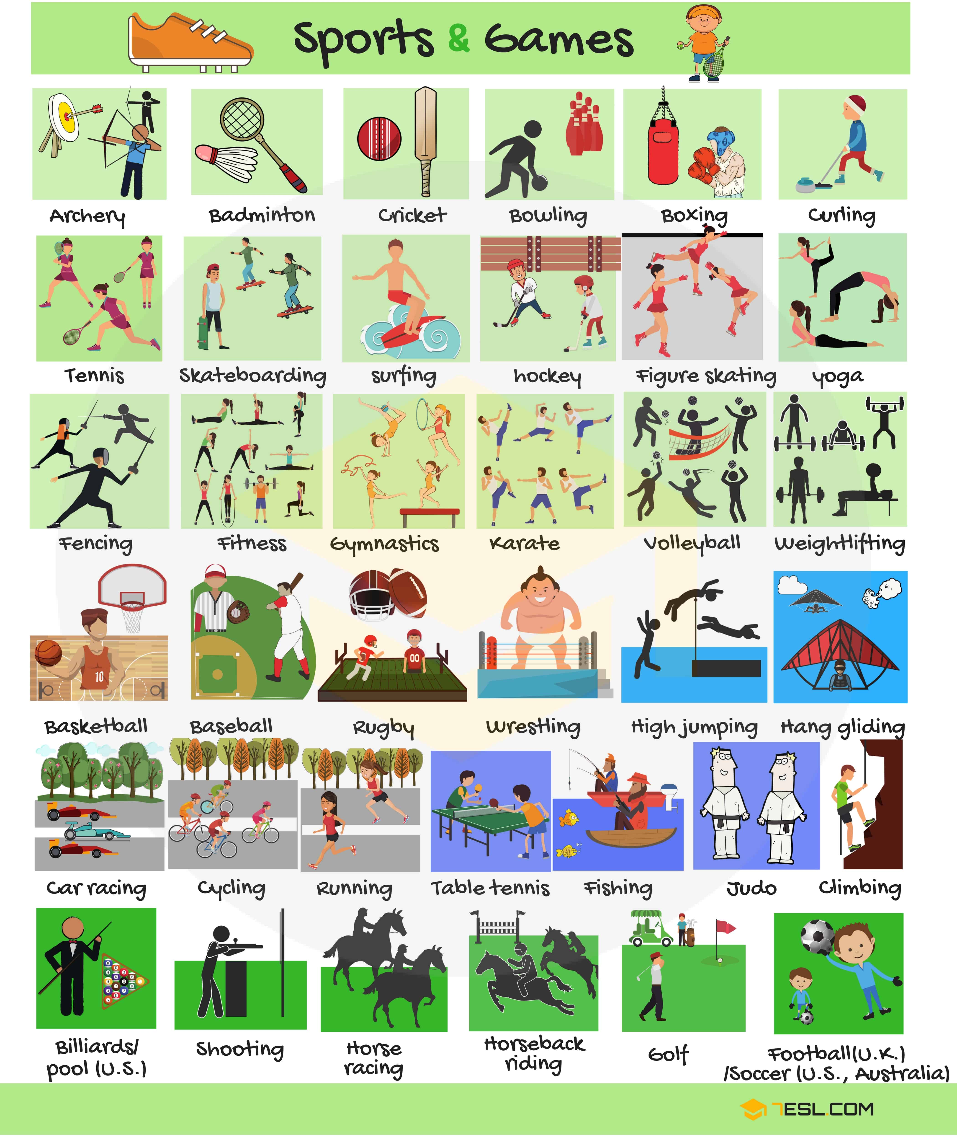

Slide 6
Sports
Type of sports
Advantages of playing sports
In my free time I…
I’m interested in (+ noun / gerund)
I’m keen on (+ noun / gerund)
I’m into (+ noun / gerund)
I enjoy (+ noun / gerund)
Individual sport
Team sport
summer sport
it keeps me fit./ get in shape
…it’s sociable. I’ve met lots of new friends and play team sports
It improves my mental health as well as my physical health
Winter sport

Slide 7

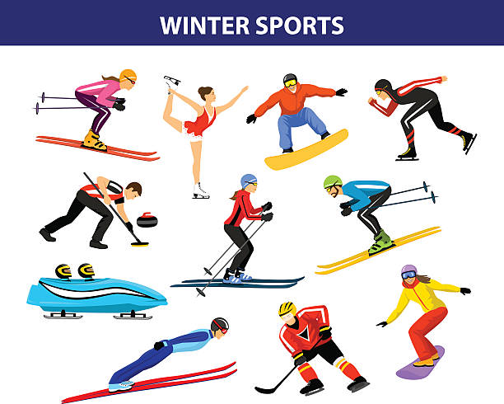
Name some individual sports and some team sports

Slide 8
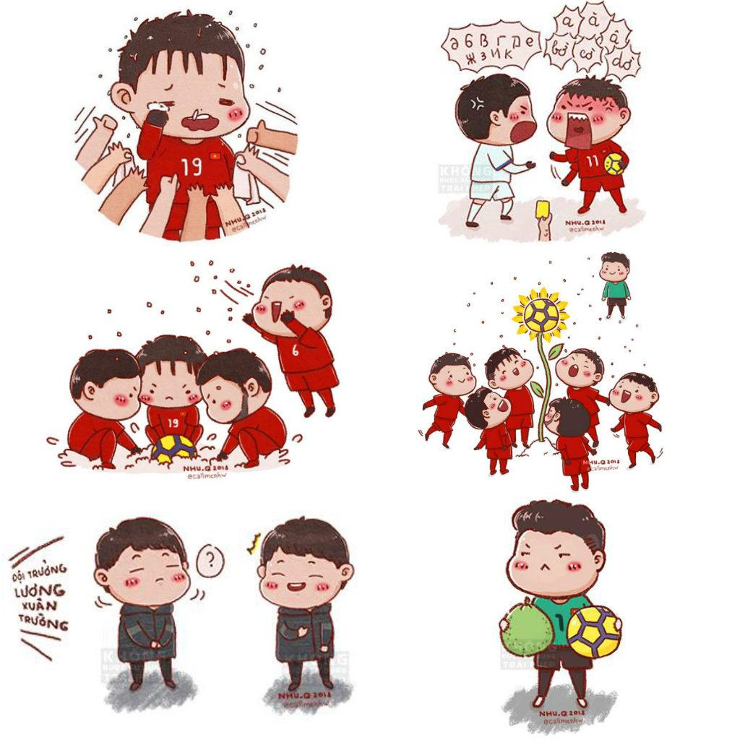
A FOOTBALL MATCH
The answer should be at least 3 sentences

Slide 9
SPEAKING pART 2
Asking and answering questions using these prompt cards

Slide 10

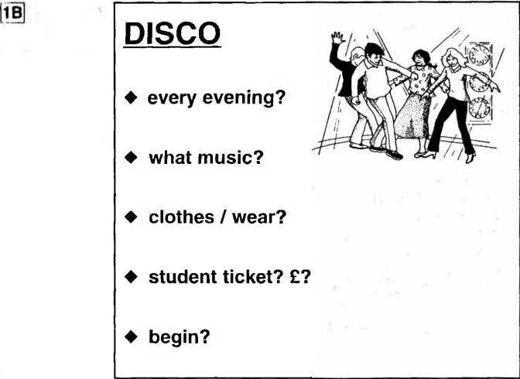
Ask and answer questions using the words given.
What are other questions and answers you can think of?

Slide 11
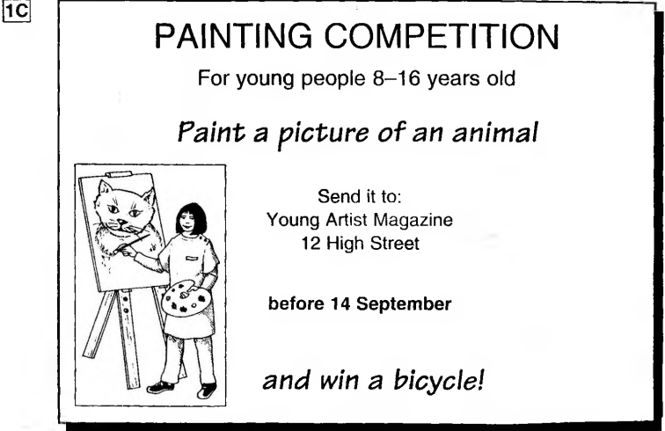
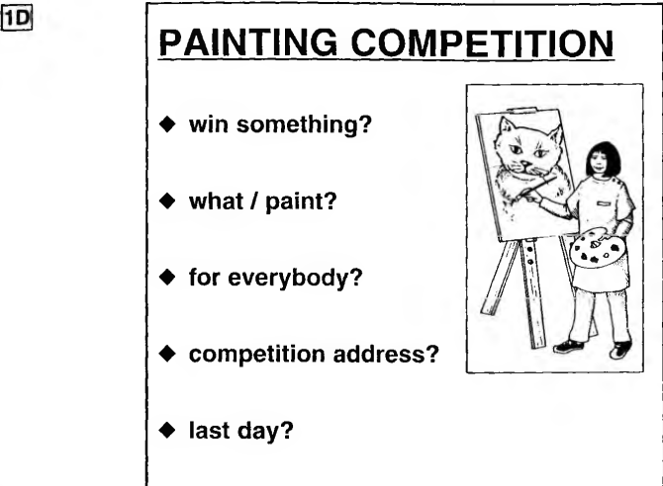
Ask and answer questions using the words given.
What are other questions and answers you can think of?

Slide 12
Imagine that you are the organizer of the competition. Talk about it based on the given information

