Slide 1


Slide 2
Unit
3
CITIES OF THE FUTURE
Unit
FAMILY LIFE
COMMUNICATION AND CULTURE / CLIL
LESSON 7

Slide 3
LESSON 7
COMMUNICATION AND CULTURE / CLIL
WARM-UP
Things of the future
Task 1: Listen and complete the conversation.
Task 2: Make similar conversations.
COMMUNICATION
Task 1: Read the text and decide in which city you can do the following.
Task 2: Discussion.
CULTURE
CONSOLIDATION
Wrap-up
Homework

Slide 4
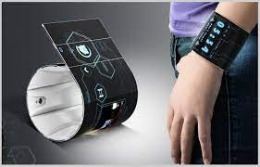
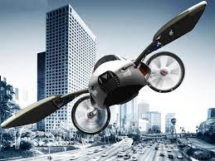
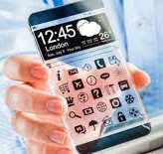
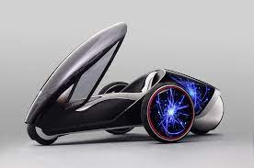
WARM-UP
THINGS OF THE FUTURE

Slide 5

EVERYDAY ENGLISH
1
Listen and complete the conversations.
1
Minh: I heard that in the future people will build cities on the ocean. do you think that will be possible?
Anna: (1) _______________________. with the help of modern technologies, we can build cities on water, and people can live there safely.
2
Mike: do you think the government can build our first smart city in this area?
Long: (2) ________________________. smart technologies are very expensive. we don’t have AI experts either.
I have no doubt about it
I’m not really sure about it

Slide 6
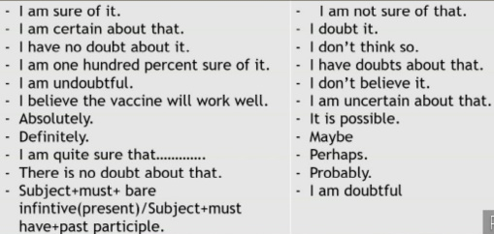
EVERYDAY ENGLISH
Useful expressions

Slide 7
EVERYDAY ENGLISH
2
Work in pairs. Use the models in 1 to make similar conversations about these predictions for the future. One of you is Student A, the other is Student B. Use the expressions below to help you.
1. Student A thinks we’ll use driverless buses and flying cars. Student B expresses certainty or uncertainty, and gives reasons.
2. Student B thinks AI robots will do all the household chores. Student A expresses certainty or uncertainty, and gives reasons.

Slide 8
CULTURE
1
Read the text on page 36 and decide in which city you can do the following.
1. book a parking space via a mobile app | Singapore
2. have a medical check-up online
3. use your bank card to pay for travelling on the bus or underground
4. unlock your bike from one station and return it to any other station in the city
5. use a mobile app to help you choose the best route to cycle in the city
Toronto
London
New York
Copenhagen

Slide 9
CULTURE
2
Work in groups. Discuss the questions.
Which of the technologies in the text would you like to have in your city or neighbourhood? Why?

Slide 10
CONSOLIDATION
1
Wrap-up
What have you learnt today?
Review expressions for certainty and uncertainty
Technologies used in some smart cities in the world

Slide 11
CONSOLIDATION
2
Homework
Do exercises in the workbook.
Prepare for Lesson 8 - Unit 3.

Slide 12

Website: hoclieu.vn
Fanpage: facebook.com/www.tienganhglobalsuccess.vn

