Slide 1
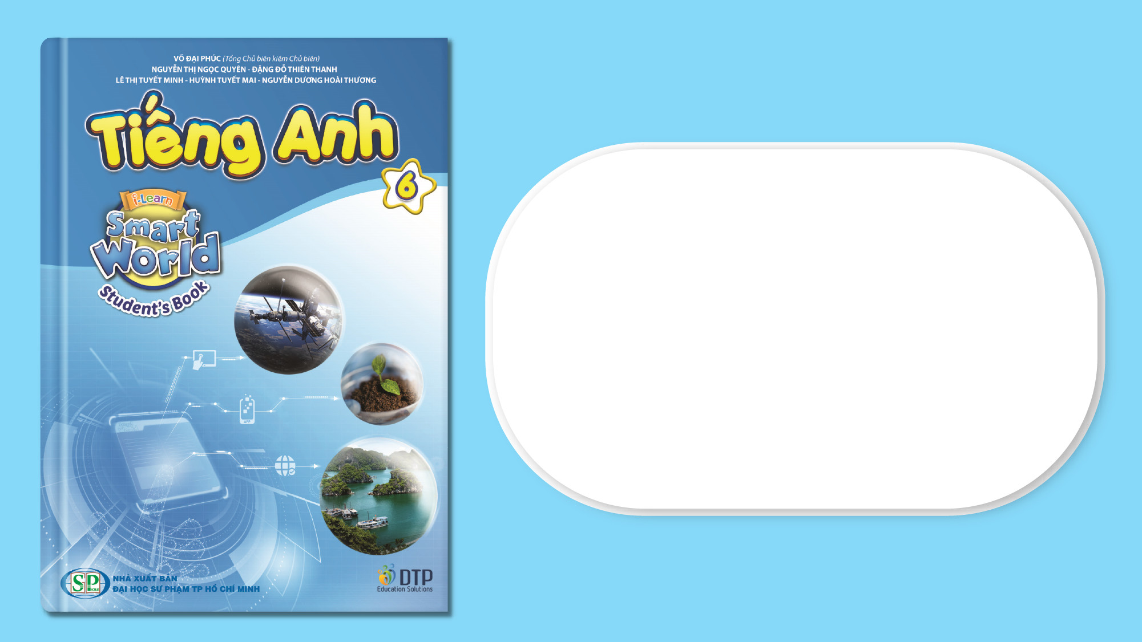
Unit 6: Community Services
Lesson 2.2: Grammar
Page 50

Slide 2
Lesson Outline
Warm-up
Grammar
Consolidation
Wrap-up

Slide 3
Objectives
By the end of this lesson, students will be able to…
- Use imperatives correctly.
- Write sentences about how to save the environment.

Slide 4

WARM-UP

Slide 5

Work in pairs.
Pick out one redundant letter in each word to make the correct words
1. plastiic
2. reccycle
3. prrotect
4. throw awaay
5. clothees

Slide 6
Work in pairs.
Pick out one redundant letter in each word to make the correct words
1. plastcic
2. recdycle
3. prsotect
4. throw aweay
5. clothoes
1. plastic
2. recycle
3. protect
4. throw away
5. clothes
ANSWER

Slide 7

Presentation
Imperatives

Slide 8
Reuse glass bottles and jars.
Don't throw away old glass.

Slide 9
Lead in
1. What do we call Sentences 1, 2?
Imperatives.
2. When do we use Imperatives?
→ To give instructions, orders, or advice.

Slide 10
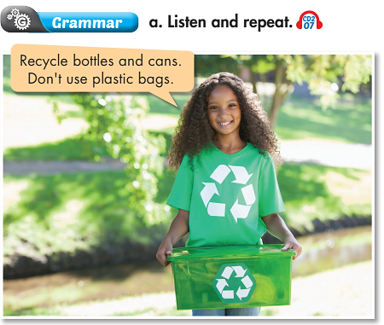

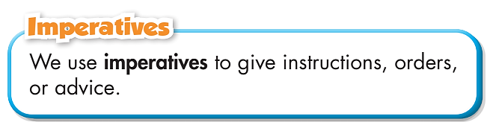

Slide 11

Practice

Slide 12
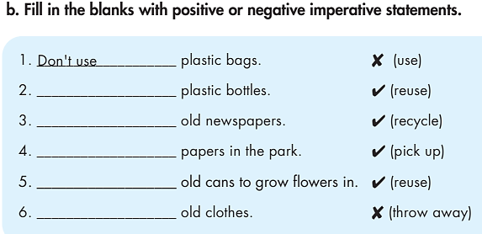
Practice
How many sentences are there?
→ There are 6.
What are you going to do?
Fill in the blanks.

Slide 13
Practice
Fill in the blanks with positive or negative imperative statements.
1. ___________ plastic bags. ✗ (use)
2. ___________ plastic bottles. ✓ (reuse)
3. ___________ old newspapers. ✓ (recycle)
4. ___________ papers in the park. ✓ (pick up)
5. ___________ old cans to grow ﬂowers in. ✓ (reuse)
6. ________________ old clothes. ✗ (throw away)
Don’t use
Reuse
Recycle
Pick up
Reuse
Don’t throw away

Slide 14
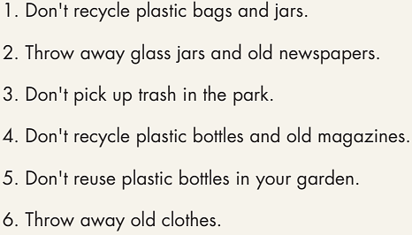
Practice
How many sentences are there?
→ Six.
What are you going to do?
Rewrite the sentences as negative or positive imperatives.
Rewrite the sentences as negative or positive imperatives.

Slide 15
Practice
Rewrite the sentences as negative or positive imperatives.
Don't recycle plastic bags and jars.
_________________________________________
2. Throw away glass jars and old newspapers. _________________________________________
3. Don't pick up trash in the park.
_________________________________________
Recycle plastic bags and jars.
Don’t throw away glass jars and old newspapers.
Pick up trash in the park.

Slide 16
Practice
Rewrite the sentences as negative or positive imperatives.
4. Don't recycle plastic bottles and old magazines. _________________________________________
5. Don't reuse plastic bottles in your garden. _________________________________________
6. Throw away old clothes.
_________________________________________
Recycle plastic bottles and old magazines.
Reuse plastic bottles in your garden.
Don’t throw away old clothes.

Slide 17
Extra Practice
WB, page 35
Fill in the blanks using the words in the box. Some words can be used more than once.
pick up reuse recycle turn off
1. ____________________ jars.
2. ____________________ trash.
3. ____________________ cans.
pick up, reuse, recycle
pick up, recycle
pick up, reuse, recycle

Slide 18
Extra Practice
WB, page 35
Fill in the blanks using the words in the box. Some words can be used more than once.
pick up reuse recycle turn off
4. ____________________ plastic bottles.
5. ____________________ computer.
6. ____________________ newspapers.
7. ____________________ glass bottles.
pick up, reuse, recycle
turn off
reuse, recycle
pick up, reuse, recycle

Slide 19

Production

Slide 20
Practice
Practice saying the sentences with a partner.
Recycle plastic bags and jars.
2. Don’t throw away glass jars and old newspapers.
3. Pick up trash in the park.
4. Recycle plastic bottles and old magazines.
5. Reuse plastic bottles in your garden.
6. Don’t throw away old clothes.

Slide 21

CONSOLIDATION

Slide 22
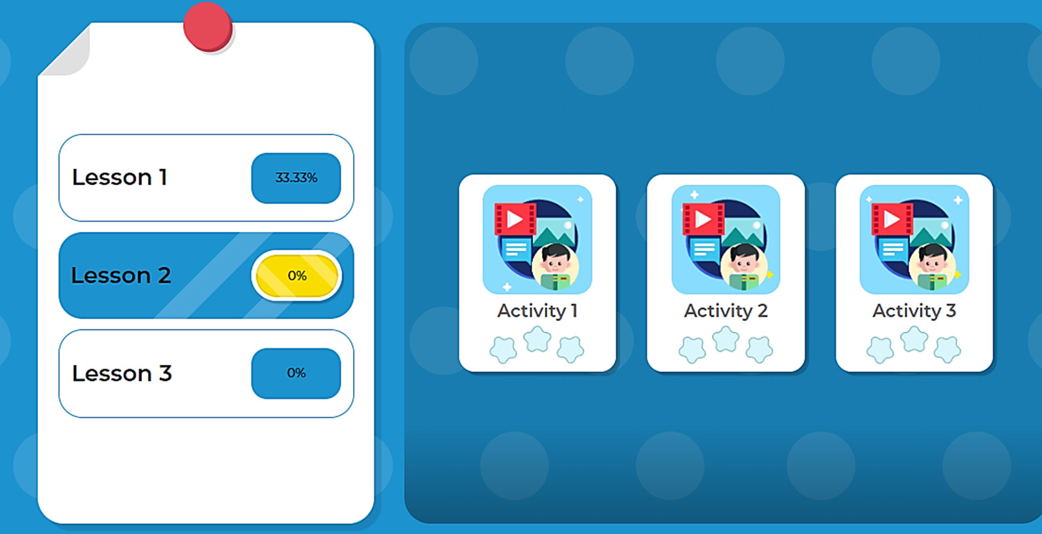
LET’S PLAY!
Click here to play the games.

Slide 23
Extra Practice
WB, page 35
1. ______________________________________________.
2. ______________________________________________
3. ______________________________________________
4. ______________________________________________
5. ______________________________________________
Don’t throw away old clothes. Give them to your friends

Slide 24

WRAP-UP

Slide 25
Today’s lesson
Grammar: Practice and use imperatives correctly.
Writing: Write sentences about how to save the environment.

Slide 26
Homework
Learn by heart the use of imperatives and make sentences using them.
Do the exercises on page 35 WB.
Do the exercises in Tiếng Anh 6 i-Learn Smart World Notebook on page 37.
Prepare the next lesson (page 51 - SB).
Play the consolidation games in Tiếng Anh 6 i-Learn Smart World DHA App on www.eduhome.com.vn

Slide 27

Enjoy your day!

