Slide 1

Hello
Pages 13-14-15

Slide 2
Lesson Outline
Warm-up
Vocabulary
Grammar
Consolidation
Wrap-up
Notes:
File Sách TB trang 14 chữ sixteen bị lỗi chưa in xanh

Slide 3
Objectives
By the end of this lesson, students will be able to…
- Revise the vocabulary about numbers (1-100).
- Revise the structure “have got” (interrogative and short answers).
- Practise asking about telephone numbers.
- Revise the articles (a/an- the).

Slide 4

WARM-UP

Slide 5
Rewrite the sentences in the negative.
1 She has got three sons.
__________________________________________
2 Harry and Gary have got cats.
__________________________________________
3 Paula has got a husband.
__________________________________________
4 Sebastian and I have got a dog
__________________________________________
She hasn’t got three sons.
Harry and Gary haven’t got cats.
Paula hasn’t got a husband.
Sebastian and I haven’t got a dog.

Slide 6

It’s time to learn …

Slide 7
Grammar

Slide 8

Presentation

Slide 9
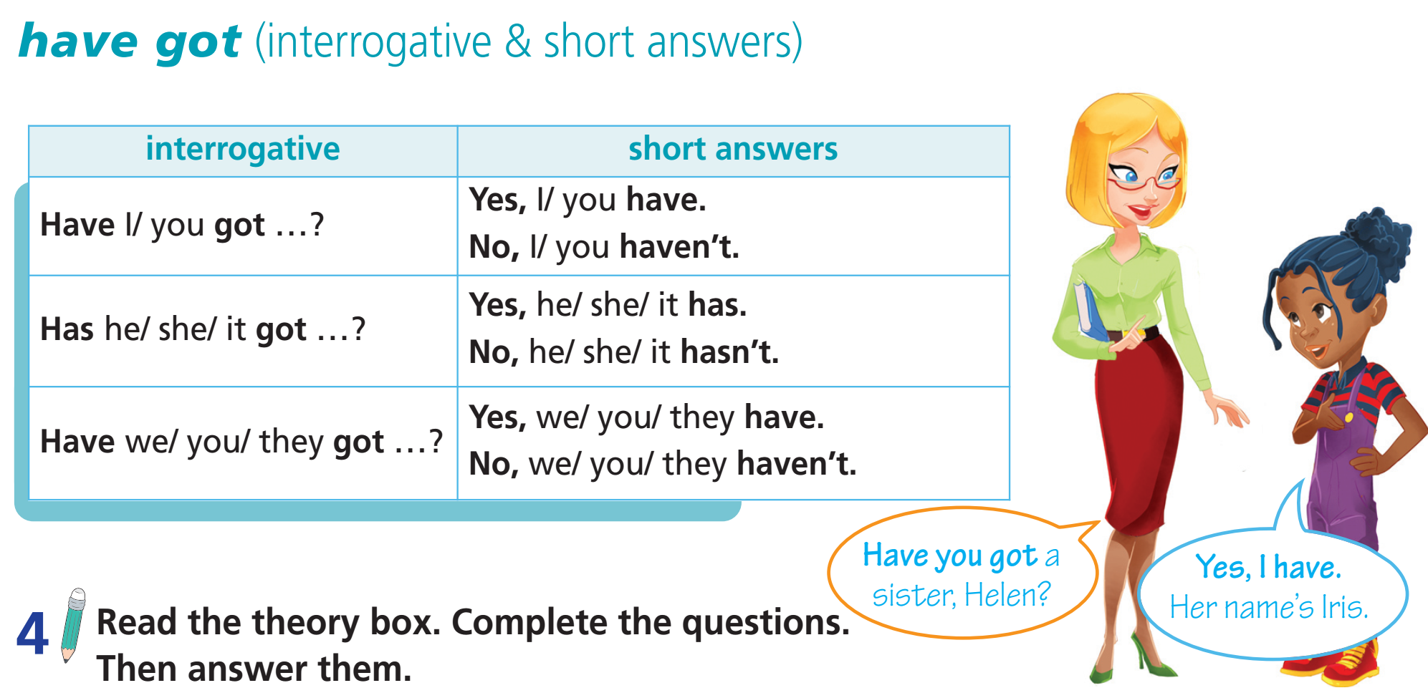

Slide 10
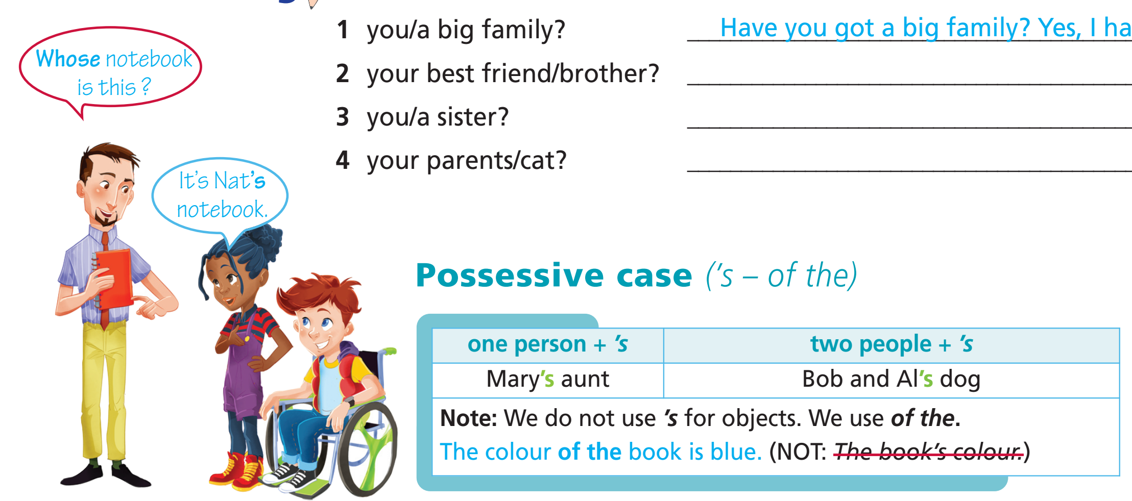

Slide 11

Practice

Slide 12
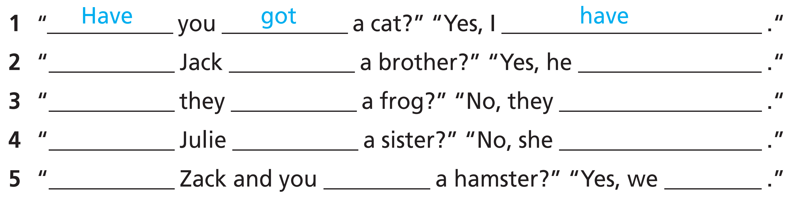
4 Complete the questions. Then answer them.
Has
got
has
Have
got
haven’t
Has
got
hasn’t
Have
got
have

Slide 13
5 Form complete questions, then answer them as in the example.
1 you/a big family?
Have you got a big family?
=> Yes, I have.
2 your best friend/brother?
Has your best friend got a brother?
=> Yes, he/she has./No, he/she hasn't.
3 you/a sister?
Have you got a sister?
=> Yes, I have./No, I haven't.
4 your parents/cat?
Have your parents got a cat?
=> Yes, they have./ No, they haven’t.

Slide 14
6 Read the theory box. Then choose the correct item.
1 It’s the book of the girl/girl’s book.
2 The bag’s colour/colour of the bag is red.
3 Kate’s sister/The sister of Kate has got a frog.
4 Mark and Sam’s dog/The dog of Mark and Sam is small.

Slide 15
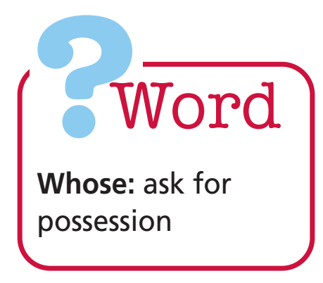
7 Write questions and answers as in the example.
1 book? Ann
Whose book is this?
=> It’s Ann’s book.
2 hamster? Mario
Whose hamster is this?
=> It’s Mario’s hamster.
3 ball? Tom and Peter
Whose ball is this?
=> It’s Tom and Peter’s ball.

Slide 16

Production

Slide 17
Work in pairs. Ask and answer questions about yourself, use “have got” and possessive case.

Slide 18
Vocabulary

Slide 19
Presentation

Slide 20


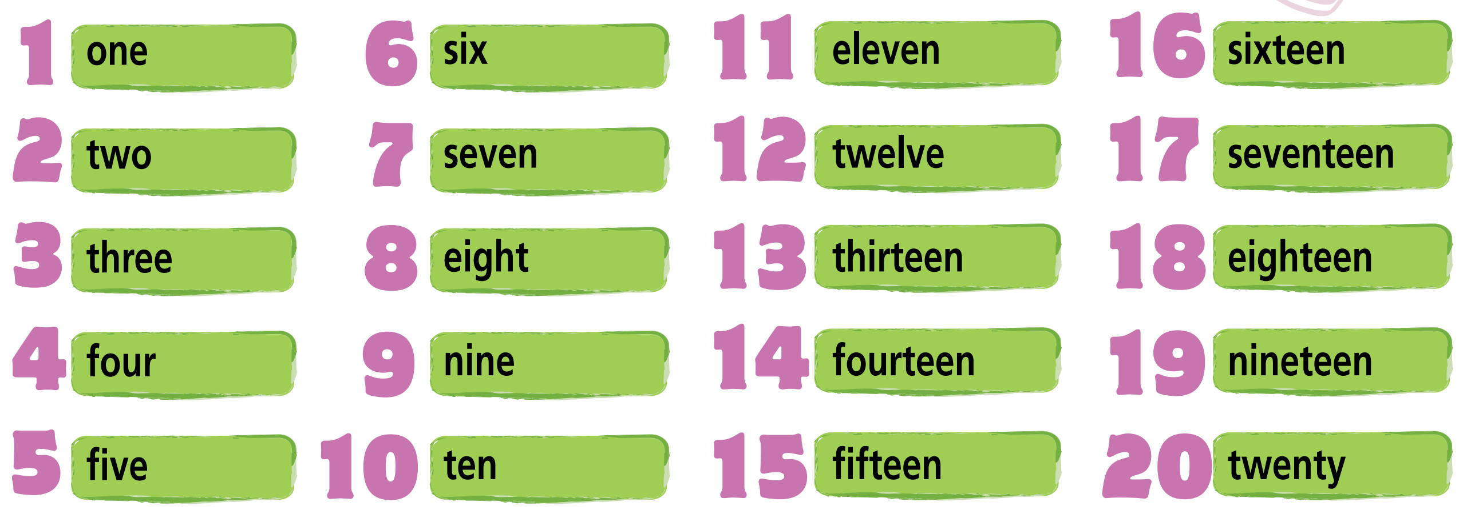
1 Listen and repeat.

Slide 21

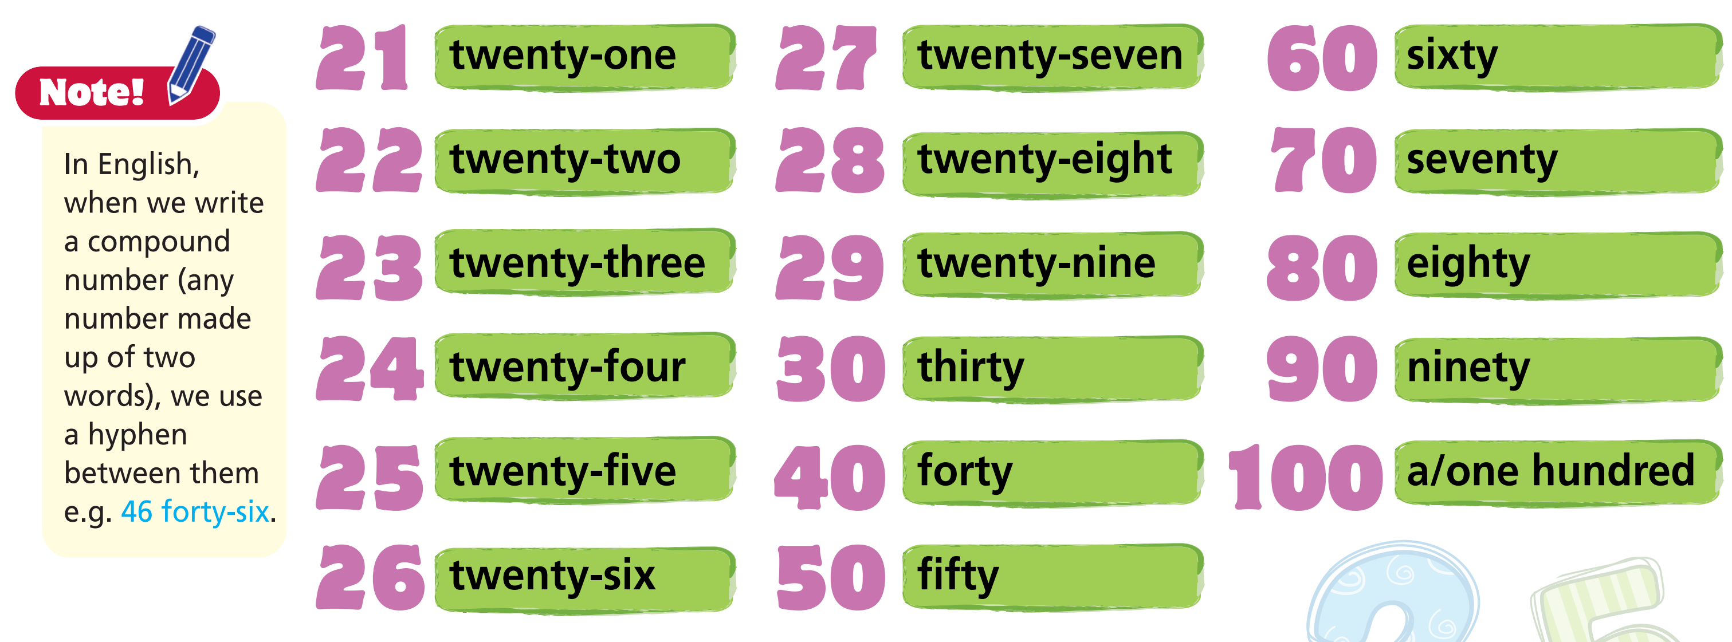
3 Listen and repeat.

Slide 22
Practice

Slide 23

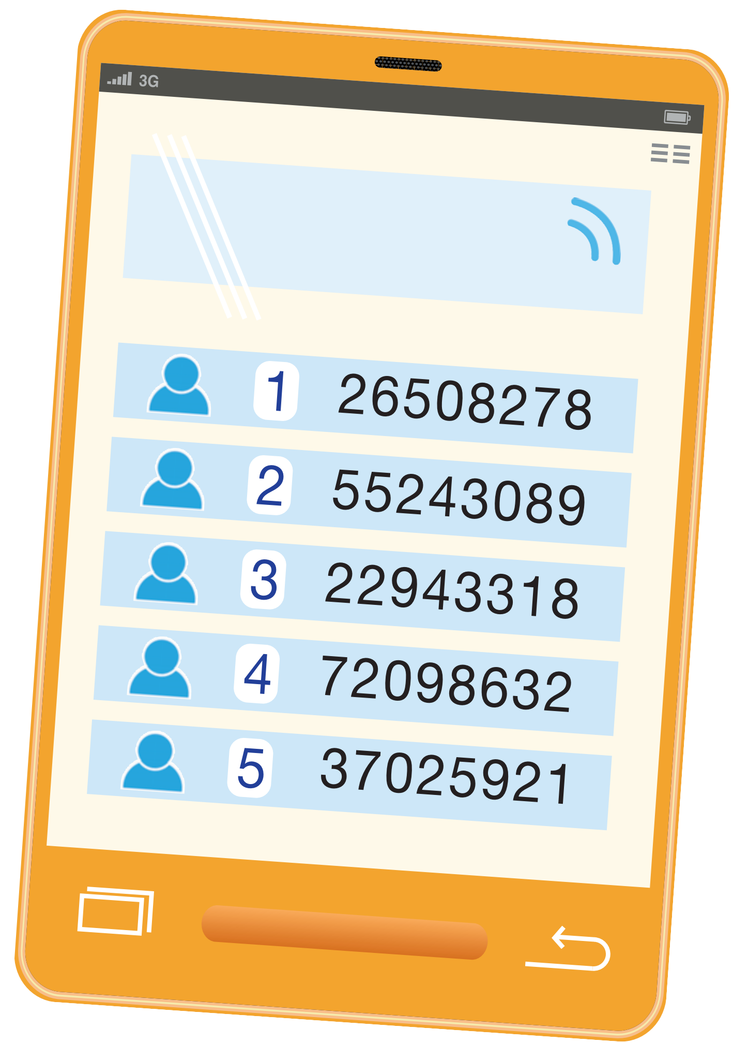

2 Ask and answer as in the example.
Example
1 A: What’s your telephone number?
B: It’s two-six-five-oh-eight-two-seven-eight.
In English, when we use 0 (zero) in telephone numbers, we say oh NOT zero.

Slide 24
4 Listen and circle the number you hear.
1 12 20
2 10 100
3 50 15
4 42 24
5 30 13
6 8 80

Slide 25
Production

Slide 26
Look around the classroom and find how many students/ tables/ chairs/ fans/ boards/ curtains/ TVs there are.

Slide 27
Grammar

Slide 28
Presentation

Slide 29

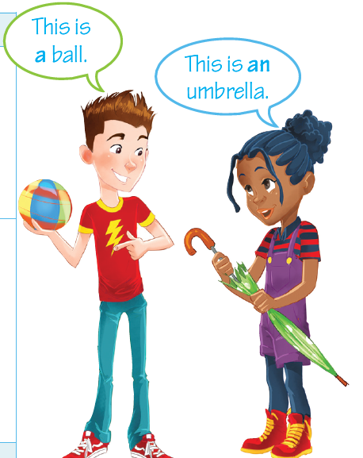
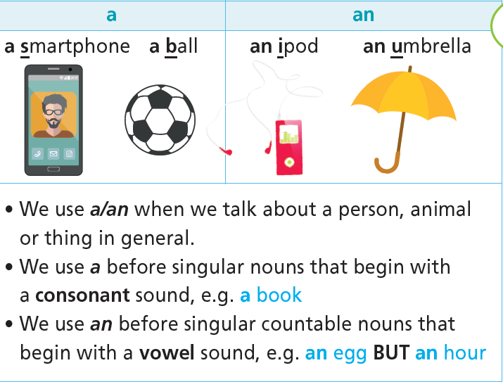
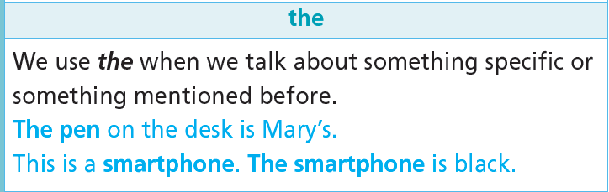
5 Read the theory box.

Slide 30
Practice

Slide 31
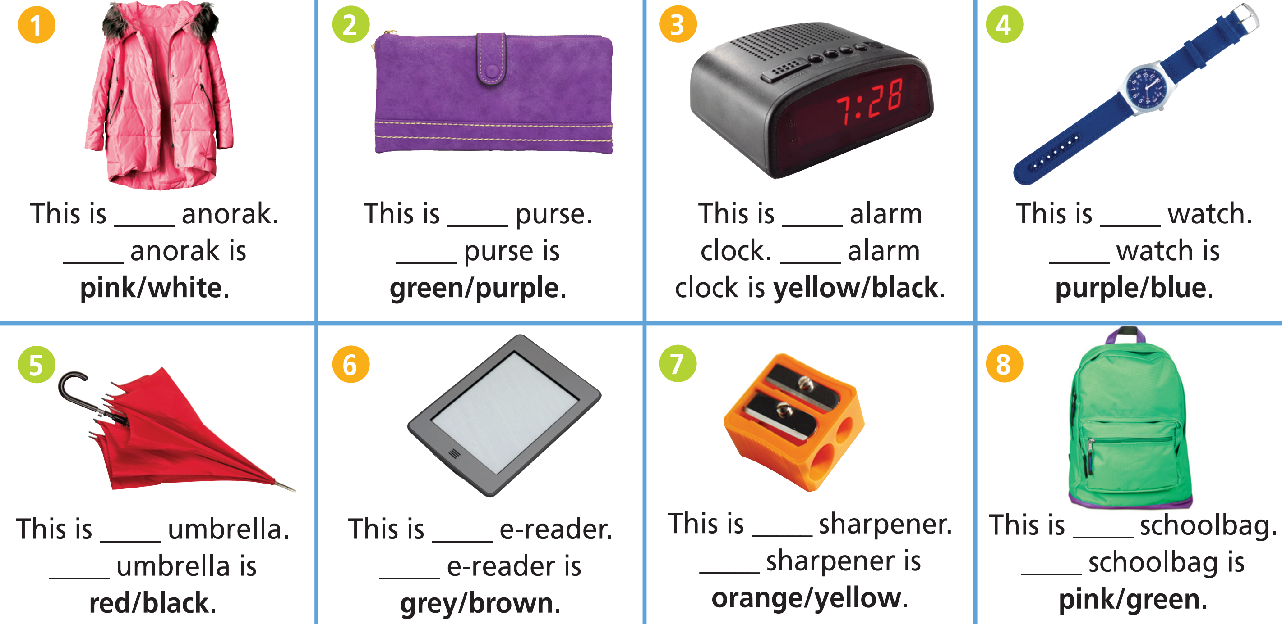
6 Fill in the gaps with a/an or the, then circle the correct colour. Which of the words in bold contain blended consonants?
an
a
an
a
The
The
The
The
an
an
a
a
The
The
The
The

Slide 32
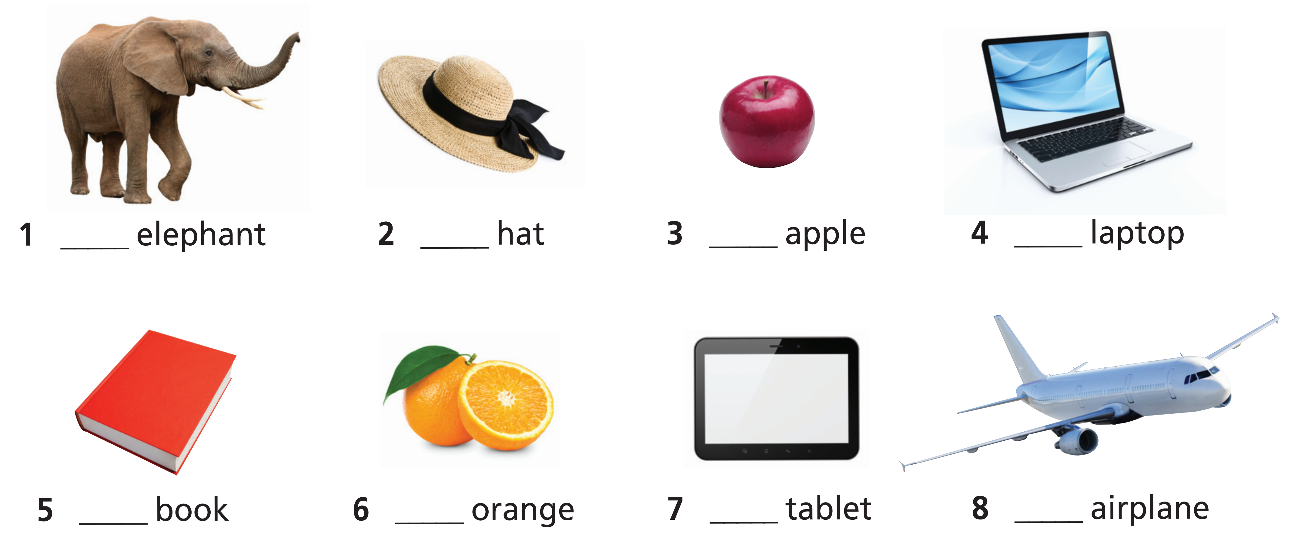
Further practice
Fill in the gaps with a or an.
An
A
An
A
A
An
A
An

Slide 33
Production

Slide 34
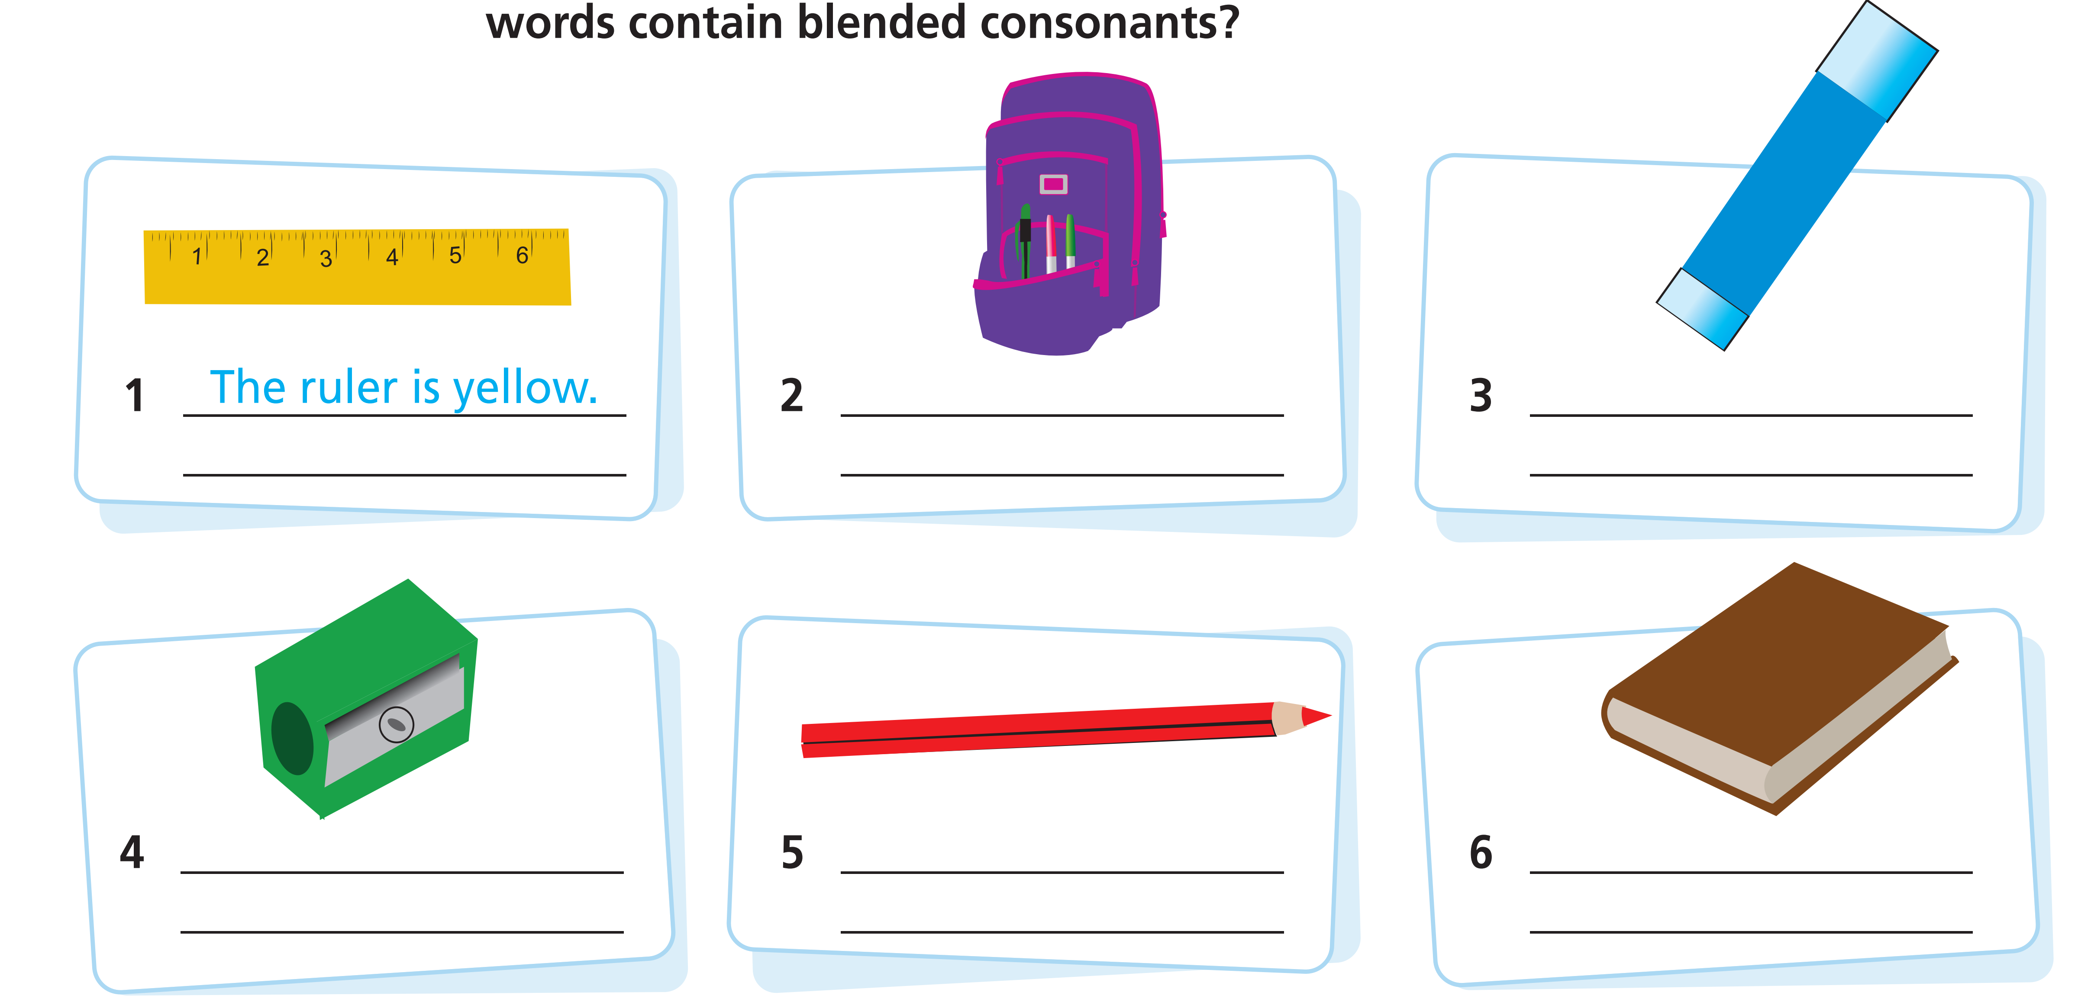
Look at the pictures and write sentences as in the example.
The schoolbag
is purple.
The glue is blue.
The sharpener
is green.
The pencil is red.
The book is brown.
Notes:
The pencil is red.

Slide 35

CONSOLIDATION

Slide 36
Write a paragraph (40-60 words) about what you have got in your schoolbag.

Slide 37

WRAP-UP

Slide 38
Today’s lesson
Vocabularies
Numbers
Grammar
Have got (interrogative)
Possessive case
A/An/The

Slide 39
Homework
Practise the vocabularies and grammar and make sentences using them.
Do the exercises in TA 6 Right on WB (pp. 8, 9, 10).
Do the exercises in TA 6 Right on Notebook (p. 9).
Prepare the next lesson (pp. 16, 17 SB)

Slide 40
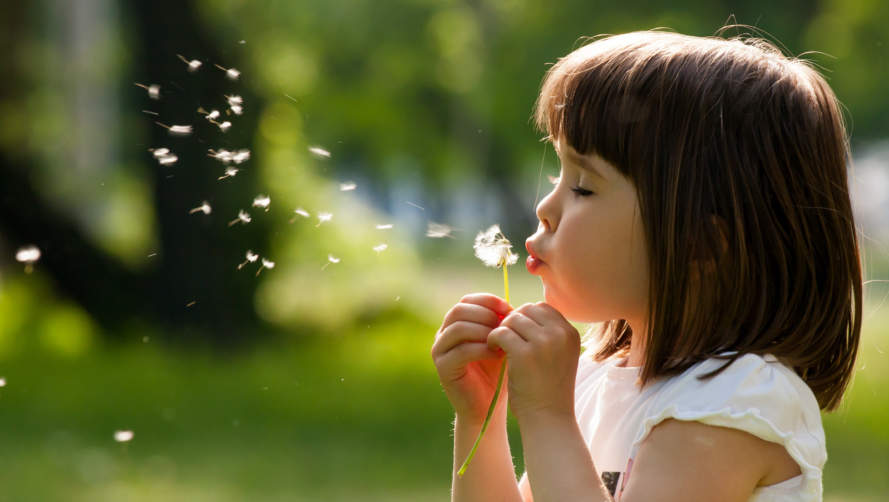
Enjoy your day!

