Slide 1


Slide 2
Unit
10
The ecosystem
Unit
FAMILY LIFE
LESSON 5
LISTENING
Human impact on ecosystems

Slide 3
LESSON 5
LISTENING
WARM-UP
Game: Food chain
PRE-LISTENING
Vocabulary
- Task 2. Listen to a talk and choose the correct answers A, B or C.
- Task 3. Listen to the talk again and decide the statements are True or False.
WHILE-LISTENING
POST-LISTENING
Discussion: What can humans do to protect and restore the earth’s ecosystems?
Wrap-up
Homework
CONSOLIDATION

Slide 4
WARM-UP
FOOD CHAIN
- Ss work in groups.
- Put the animals in the correct positions in the food chain.
- Stick the animals on their paper and put the paper on the board.

Slide 5






WARM-UP
2
3
1
4
5

Slide 6
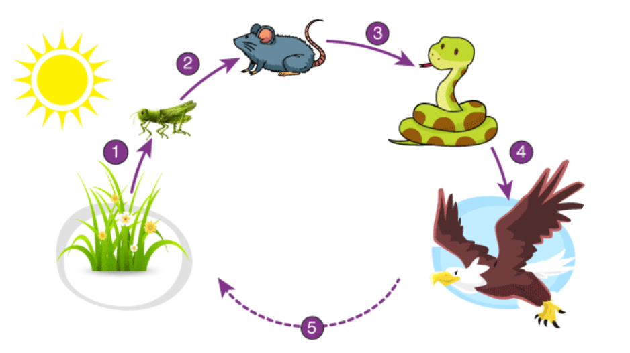
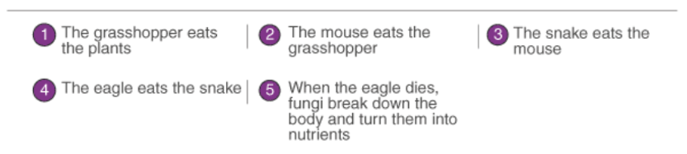
WARM-UP
KEY

Slide 7
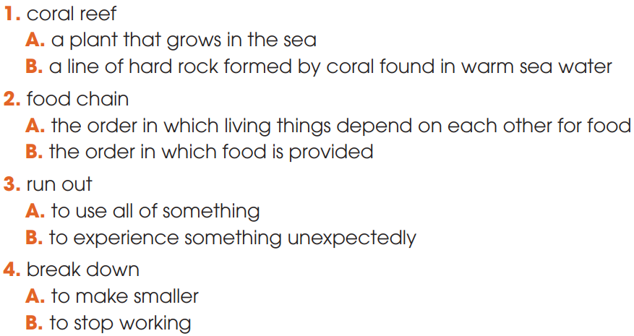
PRE-LISTENING
1
Choose the correct meaning of these words

Slide 8
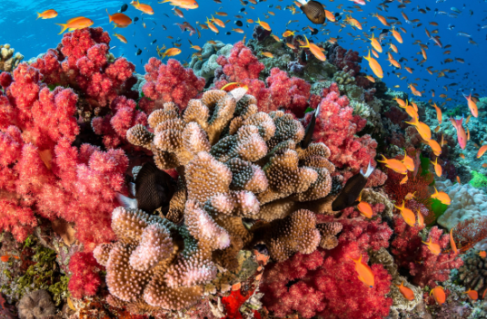

PRE-LISTENING
coral reef (n)
/ˈkɒrəl riːf/
a hard substance that is red, pink or white in colour, and that forms on the bottom of the sea from the bones of very small creatures

Slide 9

PRE-LISTENING
expert (n)
/ˈekspɜːt/
a person with special knowledge, skill or training in something

Slide 10
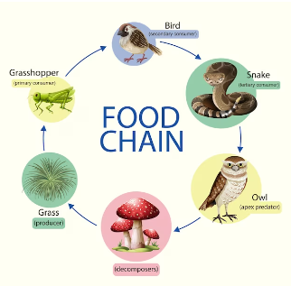
PRE-LISTENING
food chain (n)
/ˈfuːd tʃeɪn/
a series of living creatures in which each type of creature feeds on the one below it in the series

Slide 11
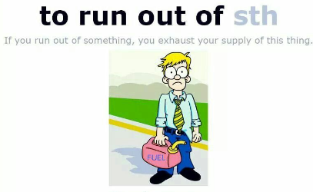
PRE-LISTENING
run out of (phr.v)
to use up or finish a supply of something

Slide 12

PRE-LISTENING
restore (v)
/rɪˈstɔː(r)/
to bring back a situation or feeling that existed before

Slide 13
PRE-LISTENING
Form | Pronunciation | Meaning
1. coral reef (n) | /ˈkɒrəl riːf/ | a hard substance that is red, pink or white in colour, and that forms on the bottom of the sea from the bones of very small creatures.
2. expert (n) | /ˈekspɜːt/ | a person with special knowledge, skill or training in something
3. food chain (n) | /ˈfuːd tʃeɪn/ | a series of living creatures in which each type of creature feeds on the one below it in the series
4. run out of (phrasal verb) |  | to use up or finish a supply of something
5. restore (v) | /rɪˈstɔː(r)/ | ​ to bring back a situation or feeling that existed before

Slide 14
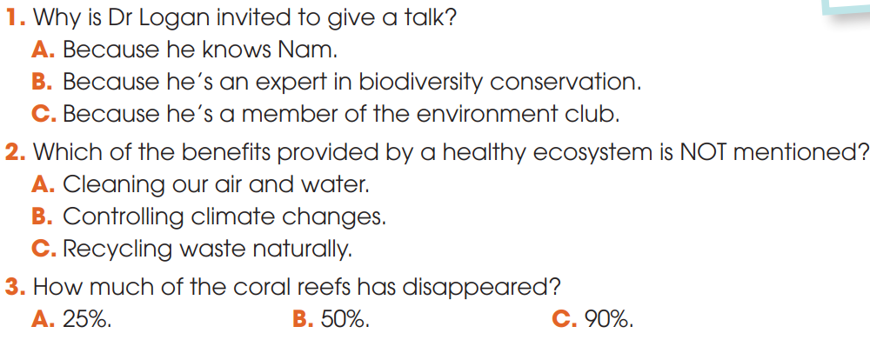
WHILE-LISTENING
2
Listen to a talk and choose the correct answers A, B or C.

Slide 15
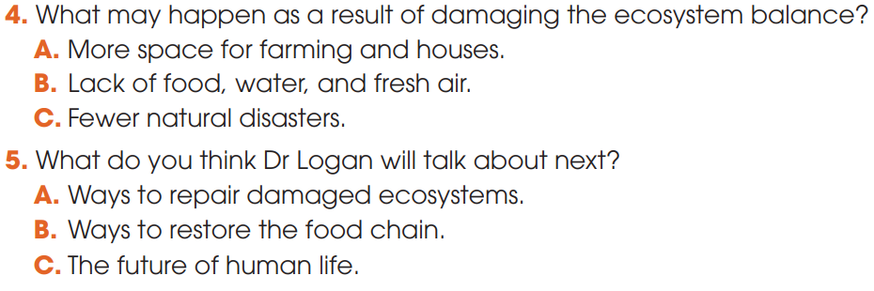
WHILE-LISTENING
2
Listen to a talk and choose the correct answers A, B or C.

Slide 16
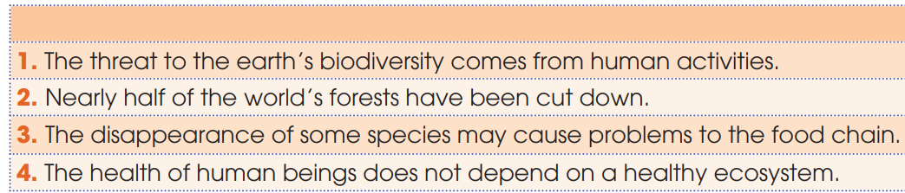

WHILE-LISTENING
3
Listen to the talk again and decide the statements are True or False
√
√
√
√

Slide 17

POST-LISTENING
5
Discussion: What can humans do to protect and restore the earth’s ecosystems?
Suggested ideas:
- Try eco-friendly products
- Plant more trees
- Reduce, reuse and recycle materials
- Save water
- Conserve energy
- Buy local, in-season produce and organic food if possible

Slide 18
CONSOLIDATION
1
Wrap-up
What have you learnt today?
Human impacts on ecosystems;
Listening for main ideas and specific information.

Slide 19
CONSOLIDATION
2
Homework
Do exercises in the workbook.
Prepare for Lesson 6 - Unit 10.

Slide 20

Website: hoclieu.vn
Fanpage: facebook.com/sachmem.vn/

