Slide 2




Unit
6
VIETNAMESE LIFESTYLE:
THEN AND NOW
LESSON 2: A CLOSER LOOK 1

Slide 3

OBJECTIVES
By the end of the lesson, students will be able to:
Use the lexical items related to the topic VIETNAMESE LIFESTYLE: THEN AND NOW;
Pronounce the cluster /fl/ and /fr/ in words and sentences correctly.

Slide 4
LESSON 2: A CLOSER LOOK 1
LESSON 2: A CLOSER LOOK 1
WARM-UP
Flashback
Vocabulary
Task 1: Match the verbs or phrasal verbs with their meanings.
Task 2: Work in pairs. Discuss and fill each blank with an adjective from the box.
Task 3: Circle the correct answer A, B, C, or D to complete each sentence.
VOCABULARY
PRONUNCIATION
Task 4: Listen and tick (√) the words you hear. Then listen again and repeat.
Task 5: Listen and repeat the sentences. Pay attention the underlined words.
CONSOLIDATION
Wrap-up
Homework

Slide 5
WARM-UP
- Work in teams.
- Each team has a list of Vietnamese lifestyle activity from either the past or present.
- Take turns to act out the lifestyle activity they were given. The other team must try to guess the activity.
FLASHBACK
- The first team to guess correctly the activity.
- The team with the most points at the end of the game wins.

Slide 6
WARM-UP
Past: playing folk games, wearing ao dai, riding a cyclo, eating pho, living in a traditional village.
LIST
Present: using modern technology, living in a modern apartment, eating fast food, shopping at a mall, watching movies at a cinema.

Slide 7


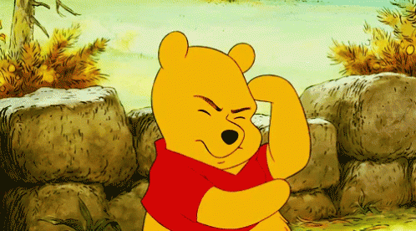
VOCABULARY
to write something down or remember it carefully
take note
/teɪk nəʊt/
ghi chép

Slide 8

VOCABULARY
to learn something so that you remember it exactly
memorise (v)
/ˈmeməraɪz/
ghi nhớ

Slide 9
VOCABULARY
to follow someone or something
pursue (v)
/pəˈsjuː/
theo đuổi

Slide 10
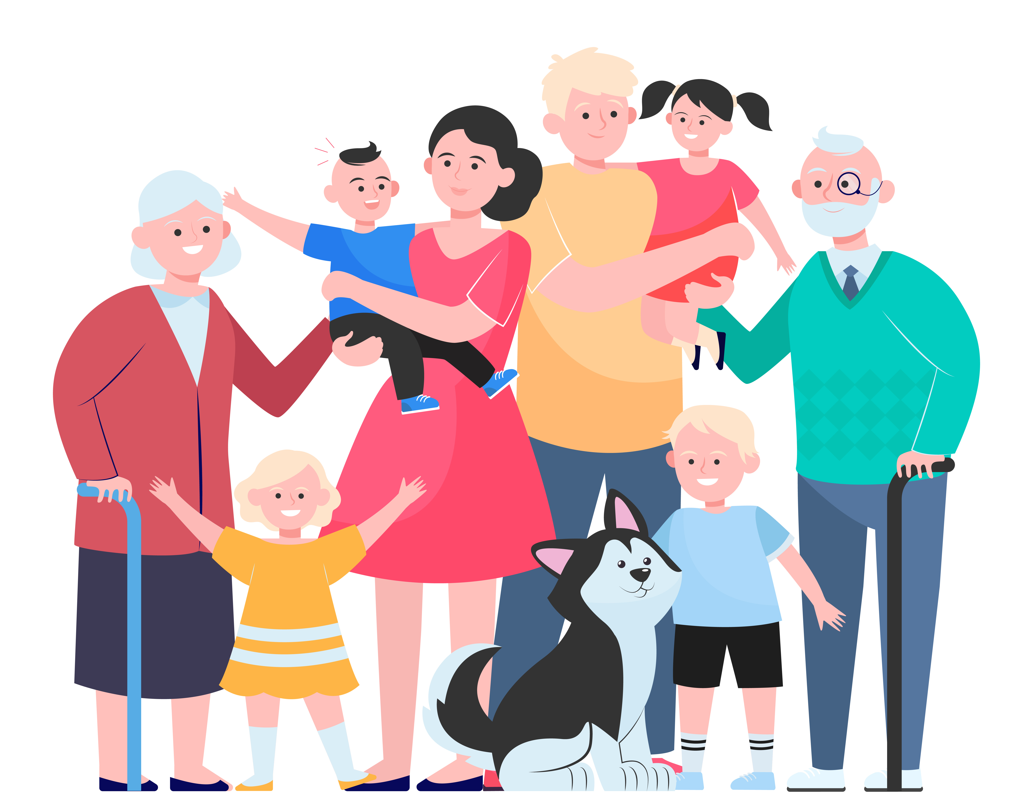
VOCABULARY
based on the principles of democracy.
democratic (adj)
/ˌdeməˈkrætɪk/
Ex: We must accept the results of a democratic election (= an election in which all people can vote).
thuộc dân chủ

Slide 11
VOCABULARY
a family that includes many generations.
extended (adj)
/ɪkˈstendɪd/
nhiều thế hệ (trong 1 gia đình)
Ex: We must accept the results of a democratic election (= an election in which all people can vote).

Slide 12

VOCABULARY
being close to family members and support them in whatever they do.
family-oriented (adj)
/ˈfæməli ˈɔrientɪd/
hướng về, coi trọng gia đình

Slide 13
VOCABULARY
New words | Pronunciation | Meaning
1. take note | /teɪk nəʊt/ | ghi chép
2. memorise (v) | /ˈmeməraɪz/ | ghi nhớ
3. pursue (v) | /pəˈsjuː/ | theo đuổi
4. democratic (adj) | /ˌdeməˈkrætɪk/ | thuộc dân chủ
5. extended (adj) | /ɪkˈstendɪd/ | nhiều thế hệ (trong 1 gia đình)
6. family-oriented (adj) | /ˈfæməli ˈɔrientɪd/ | hướng về, coi trọng gia đình.
A | B
1. take notes | a. learn something carefully so that you can remember it exactly. | 1.
2. depend on | b. take the position of something / somebody | 2.
3. memorise | c. write down some key information when listening to a talk, a lecture. | 3.
4. pursue | d.rely on something /somebody | 4.
5. replace | e. try to achieve something over a period of time | 5.

Slide 14
VOCABULARY
1
Match the verbs or phrasal verbs with their meanings.
A | B
1. take notes | a. learn something carefully so that you can remember it exactly. | 1.
2. depend on | b. take the position of something / somebody | 2.
3. memorise | c. write down some key information when listening to a talk, a lecture. | 3.
4. pursue | d.rely on something /somebody | 4.
5. replace | e. try to achieve something over a period of time | 5.
1. Four generations live in my house: my great grandparents, my grandparents, my parents, and me.
It’s a(n) ____________family.
c
d
a
2. In our group, everybody has equal rights to speak and work.
We have a(n)____________relationship
e
b

Slide 15
PRACTICE
2
Work in pairs. Discuss and fill each blank with an adjective from the box.
democratic
personal
various
extended
family-oriented
3. Children in the past played a lot of traditional outdoor games such as hide-and-seek, tug of war, and marbles.
There were ____________outdoor games for children.
1. Four generations live in my house: my great grandparents, my grandparents, my parents, and me.
It’s a(n) ____________family.
4. I don’t make public my telephone number, home address, or birthday
They are my ____________ information.
2. In our group, everybody has equal rights to speak and work.
We have a(n)____________relationship.

Slide 16
PRACTICE
2
Work in pairs. Discuss and fill each blank with an adjective from the box.
democratic
personal
various
extended
family-oriented
1. Four generations live in my house: my great grandparents, my grandparents, my parents, and me.
It’s a(n) ____________family.
3. Children in the past played a lot of traditional outdoor games such as hide-and-seek, tug of war, and marbles.
There were ____________outdoor games for children.
5. He values his family and spends a lot of time with them.
He’s a(n)________________ person
2. In our group, everybody has equal rights to speak and work.
We have a(n)____________relationship
4. I don’t make public my telephone number, home address, or birthday.
They are my ____________ information.

Slide 17
PRACTICE
2
Work in pairs. Discuss and fill each blank with an adjective from the box.
democratic
personal
various
family-oriented
democratic
personal
various
extended
5. He values his family and spends a lot of time with them.
He’s a(n)________________ person.
3. Children in the past played a lot of traditional outdoor games such as hide-and-seek, tug of war, and marbles.
There were ____________outdoor games for children.
4. I don’t make public my telephone number, home address, or birthday
They are my ____________ information.

Slide 18
PRACTICE
3
Circle the correct answer A, B, C, or D to complete each sentence.
1. Most of the events at the fair are ______, i.e. they are designed for the family.
A. family-oriented
C. democratic
B. exciting
D. various
2. In the past, girls had little opportunity to ______ their interests.
A. know
C. pursue
B. replace
D. promise

Slide 19
PRACTICE
3
Circle the correct answer A, B, C, or D to complete each sentence.
3. Hi-tech appliances used for housework have ______ our old-fashioned tools.
A. made
C. stopped
B. replaced
D. given up
4. The relationship between parents and children is now more ______ than in the past.
A. independent
C. democratic
B. private
D. extended

Slide 20
PRACTICE
3
Circle the correct answer A, B, C, or D to complete each sentence.
5. Protect your personal ______ online by using strong and unique passwords.
A. taste
C. opinions
B. experience
D. privacy

Slide 21
EXTRA ACTITIVTY
Use the words in brackets in their correct forms to complete the sentences.
memorise
1. How could you ____________ so much information after listening to the news just once? (memory)
democratic
2. I highly appreciate the _____________ teacher-student relation in our class. We feel free to discuss things with our teachers. (democracy)
extended
3. I prefer to live in an ___________ family where I can live with my grandparents, too. (extend)
Notes:
wish → wish
know → knowledge
decide → decision
damage → damage

Slide 22
EXTRA ACTITIVTY
Use the words in brackets in their correct forms to complete the sentences.
pursue
4. My parents let me ________ my passion for acting even though they do not like it. (pursuing)
replaced
5. Emails have __________ letters by post for tens of years. (replacement)
Notes:
wish → wish
know → knowledge
decide → decision
damage → damage

Slide 23
LESSON 2: A CLOSER LOOK 1
LESSON 2: A CLOSER LOOK 1
WARM-UP
Flashback
Vocabulary
Task 1: Match the verbs or phrasal verbs with their meanings.
Task 2: Work in pairs. Discuss and fill each blank with an adjective from the box.
Task 3: Circle the correct answer A, B, C, or D to complete each sentence.
VOCABULARY
PRONUNCIATION
Task 4: Listen and tick (√) the words you hear. Then listen again and repeat.
Task 5: Listen and repeat the sentences. Pay attention the underlined words.

Slide 24
PRONUNCIATION
Listen and repeat:
Review the cluster /fl/ and /fr/.
/fl/
/fr/

Slide 25
PRONUNCIATION
4
Listen and tick (√) the words you hear. Then listen again and repeat.
1. 2. 3. 4. 5. 6. | a. fruit a. frame a. free a. fright a. fresh a. frog | b. flute b. flame b. flea b. flight b. flesh b. flog
√
√
√
√
√
√
1. The photos of their fight for freedom are on the second floor.
2. Who suffers most from generation conflicts?
3. The man is reflecting on his frightening trip.
4. How does the past influence your friends?
5. When I was small, I caught the flu frequently.

Slide 26
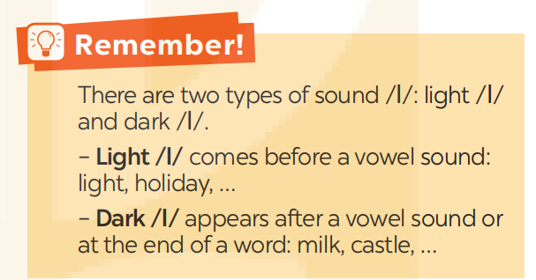
PRONUNCIATION
5
Listen and repeat the sentences. Pay attention the underlined words.
1. The photos of their fight for freedom are on the second floor.
2. Who suffers most from generation conflicts?
3. The man is reflecting on his frightening trip.
4. How does the past influence your friends?
5. When I was small, I caught the flu frequently.

Slide 27
LESSON 2: A CLOSER LOOK 1
LESSON 2: A CLOSER LOOK 1
WARM-UP
Flashback
Vocabulary
Task 1: Match the verbs or phrasal verbs with their meanings.
Task 2: Work in pairs. Discuss and fill each blank with an adjective from the box.
Task 3: Circle the correct answer A, B, C, or D to complete each sentence.
VOCABULARY
PRONUNCIATION
Task 4: Listen and tick (√) the words you hear. Then listen again and repeat.
Task 5: Listen and repeat the sentences. Pay attention the underlined words.
CONSOLIDATION
Wrap-up
Homework

Slide 28

CONSOLIDATION
1
Wrap-up
What have we learnt in this lesson?
Use the lexical items related to the topic VIETNAMESE LIFESTYLE: THEN AND NOW;
Pronounce the cluster /fl/ and /fr/ in words and sentences correctly.

Slide 29

CONSOLIDATION
2
Homework
- Do exercises in the workbook.
- Find 3 more words that have the cluster /fl/ and /fr/.

Slide 30
Website: hoclieu.vn
Fanpage: facebook.com/www.tienganhglobalsuccess.vn/

