Slide 1

UNIT 7: INVENTIONS
Lesson 1.1 – Vocabulary & Reading
Page 56

Slide 2



Lesson 1.1
LESSON OUTLINE
Consolidation

Slide 3
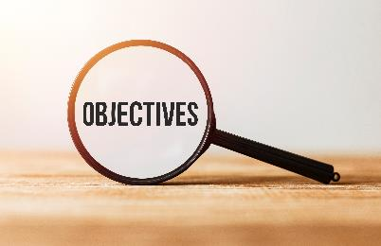
By the end of this lesson,
students will be able to …
learn vocabulary for inventions.
practice reading for specific information.
ask and answer about Science Special's Top 100 inventions.

Slide 4
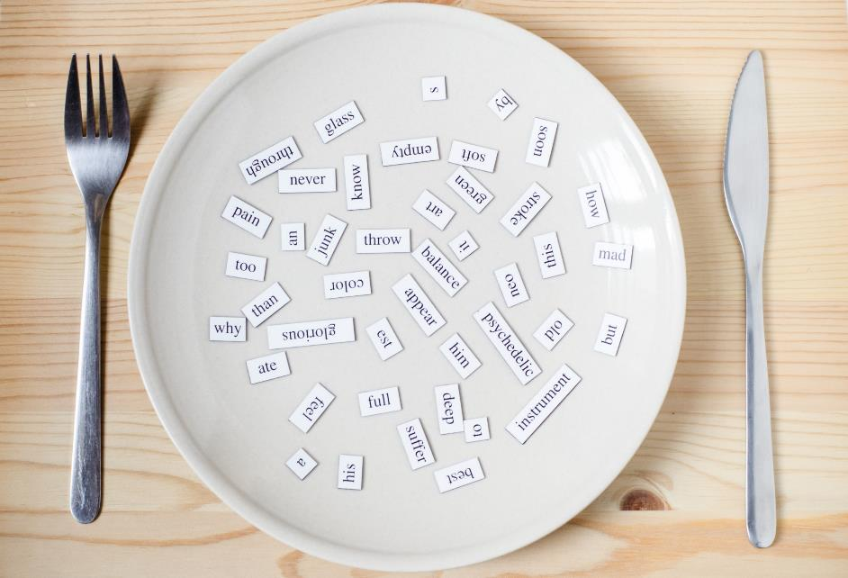
New words
telescope
ballpoint pen
microscope
Band-Aid
rocket
thermometer

Slide 5
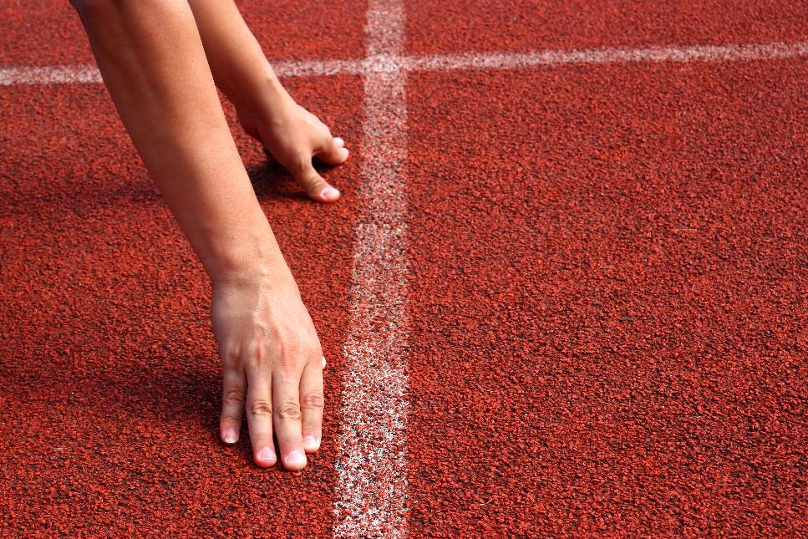


Slide 6

Work in pairs.
What can you see in this classroom?
I can see lights, fans, a TV, a laptop, a smart phone, tables, chairs, etc.
What do you think is the most modern device?
I think …

Slide 7



Slide 8

Listen and repeat. Click each phrase to hear the sound.
telescope (n) /ˈtelɪskoʊp / kính viễn vọng
ballpoint pen (n) / ˈbɔːlpɔɪnt pen/ bút bi
microscope (n) / ˈmaɪkrəskoʊp / kính hiển vi
Band-Aid (n) / ˈbænd eɪd / băng cá nhân
rocket (n) / ˈrɑːkɪt / tên lửa
thermometer (n) / θərˈmɑːmɪtər / nhiệt kế
Notes:
GV click vào từng cụm nghe âm thanh

Slide 9

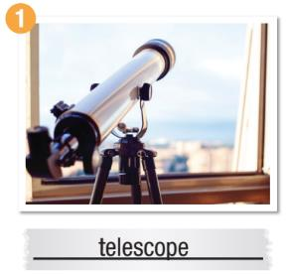
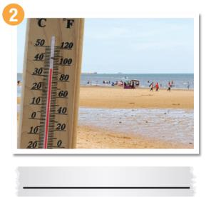
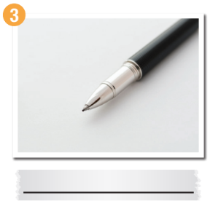
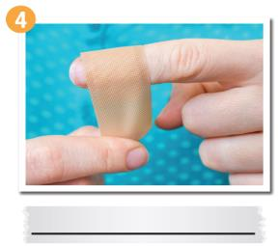
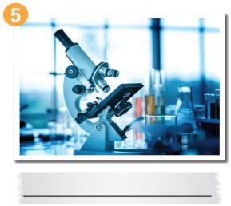
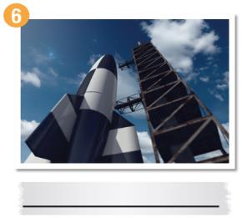
a. Look at the pictures and the descriptions. Write the correct word on the line.

Slide 10
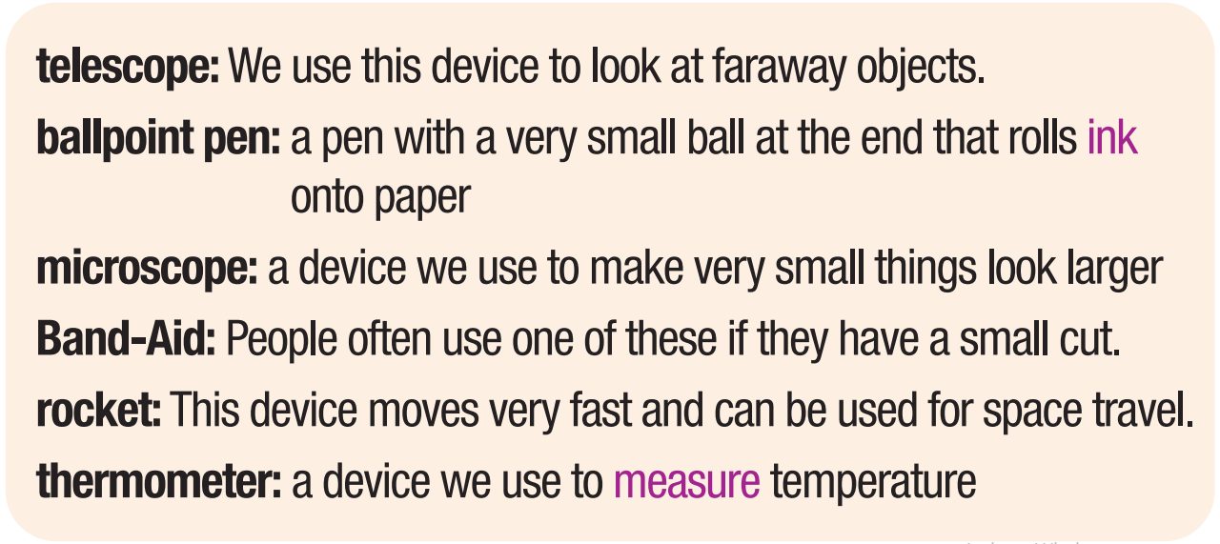
Descriptions

Slide 11
Listen and check your answers.
thermometer
ballpoint pen
Band-Aid
microscope
rocket

Slide 12
Extra Practice
WB, page 38
b. Fill in the blanks using the words from Task a.
thermometer
1. You don't look very well. Where's the __________________? Let's check your temperature.
2. Can you please give me the __________________ over there? I need to write this down quickly.
3. She likes to sit on the rooftop and use her __________________ to look at the stars.
4. Some creatures are so small that you need a __________________ to see them.
5. Do you have a __________________? I just cut myself.
6. The _______________ is scheduled to lift off on September 12th.
ballpoint pen
telescope
microscope
Band-Aid
rocket
Notes:
Taken from TA 10 i-Learn Smart World WB, page 2

Slide 13

Work in pairs.
Say which of the inventions in Task a. you have used before.
I've used a microscope in biology class.
I’ve used a telescope to see the stars.

Slide 14



Slide 15
Underline the key words/phrases.
Pre-Reading
What do you think is the greatest invention ever?
We're continuing our countdown of the 100 greatest inventions of all time. This week we reveal inventions 25 to 22.
25 Before the microscope was invented, people could not see very small things. The microscope, which was invented around 1590, was first made by a Dutch scientist called Zacharias Janssen. Objects looked three to nine times bigger under this microscope.

Slide 16
Underline the key words/phrases.
Pre-Reading
24 Daniel Fahrenheit, who was a Dutch scientist, invented the mercury thermometer in 1714. He also developed the Fahrenheit scale to use on his thermometer. That temperature scale, which is still
used in some countries today, is named after him.

Slide 17
Underline the key words/phrases.
Pre-Reading
23 The light bulb, which was invented in 1879, was first made by Thomas Edison and his team. They tried more than 3,000 designs before introducing their electric light to the world. Edison, who also created many other inventions, is remembered as America's greatest inventor.

Slide 18
Pre-Reading
Underline the key words/phrases.
22 Robert Goddard, who was an American physicist, invented the liquid-fueled rocket in 1926. Its first ﬂight, which happened on March 16th, 1926, marked the beginning of the space age.
Which of these inventions do you think is the most important?
Email us at sciencesm@science.edu and let us know. Make sure you continue to read the Science Special's Top 100 inventions next week when we countdown inventions 21 to 16.

Slide 19
While-Reading
Skim the article. Answer the question “How many countries did the scientists come from?
→ 2 countries

Slide 20
Read the questions.
Scan the article and answer the questions.
1. When was the microscope invented?
The microscope was invented in 1590.
2. What did Daniel Fahrenheit create for his thermometer?
Daniel Fahrenheit created the Fahrenheit scale.

Slide 21
Read the questions.
Scan the article and answer the questions.
3. Who do people think is America's best inventor?
Thomas Edison
4. What did Robert Goddard study?
Robert Goddard studied physics.

Slide 22

Post-Reading
Work in pairs.
Which of these inventions
- do you like best? Why?
- do you think is the most important? Why?

Slide 23

Consolidation

Slide 24
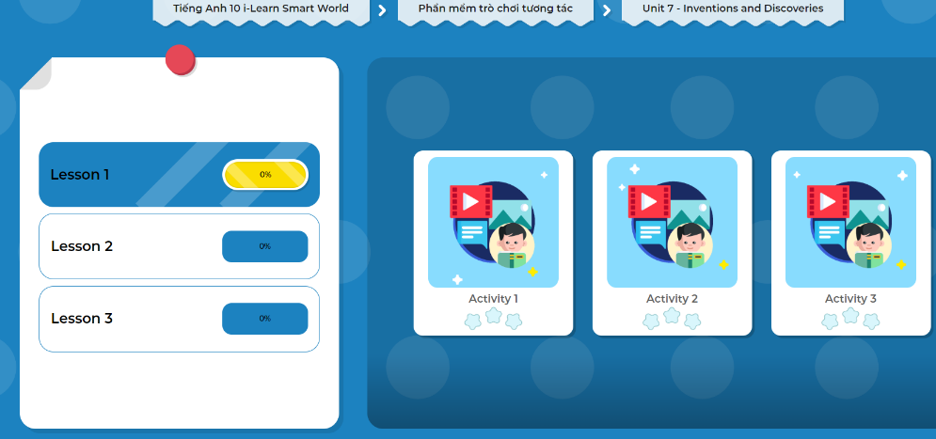
Extra Practice
DHA on Eduhome
Let’s Play!
Click here to play the games.

Slide 25
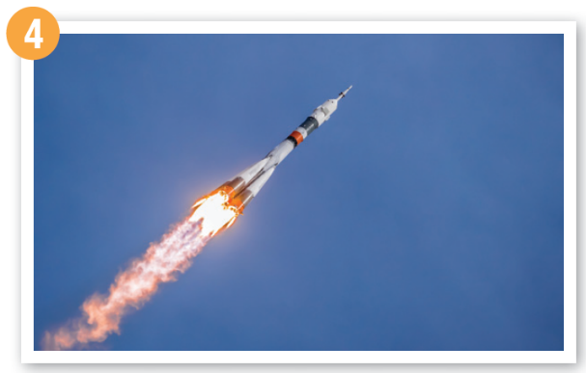
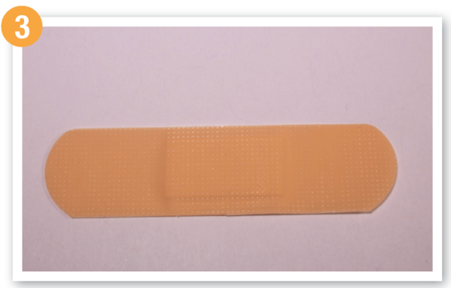
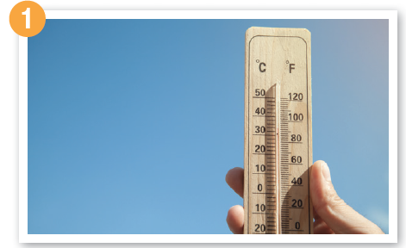
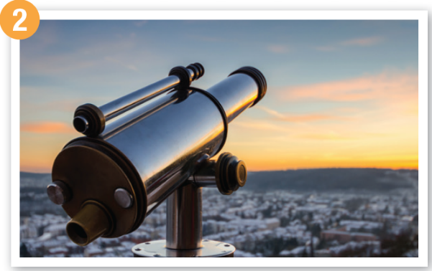
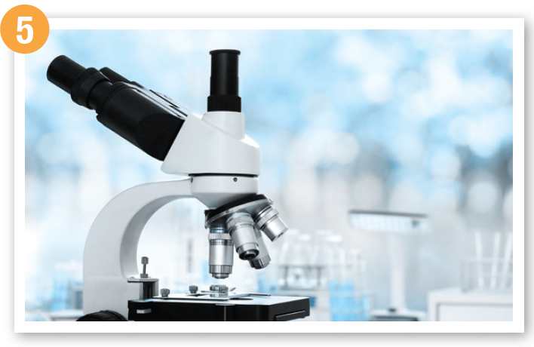
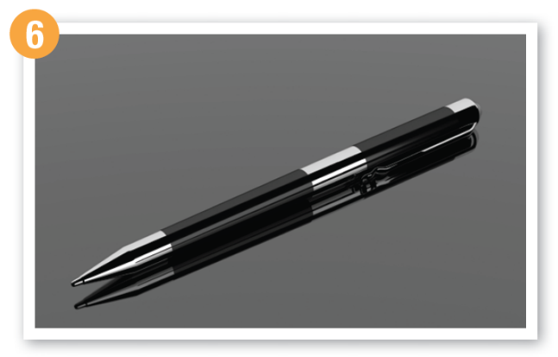
What is it?
What is it used for?

Slide 26

WRAP-UP

Slide 27
Today’s lesson
Vocabulary: Inventions
Reading: for key information
Speaking: asking and answering about
inventions

Slide 28
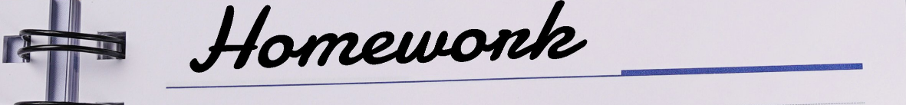
Learn by heart vocabularies and make sentences using them.
Do the exercises in WB on page 38 (Reading).
Do the exercises in Tiếng Anh 10 i-Learn Smart World Notebook on page 38.
Prepare the next lesson - Grammar on page 57 in SB.
Play the consolidation games in Tiếng Anh 10 i-Learn Smart World DHA App on www.eduhome.com.vn

