Slide 1


Slide 2

1
Unit
FAMILY LIFE
REVIEW 2
LESSON 1
LANGUAGE

Slide 3

Unit
1
1
FAMILY LIFE
Family Life
Unit
OBJECTIVES
1. Knowledge
Review the language they have learnt in Unit 4-5.
2. Core competence
- Develop critical thinking skill;
- Be collaborative and supportive in pair work and team work;
- Actively join in class activities.
3. Personal qualities
- Develop self-study skills

Slide 4
LESSON 1
LANGUAGE
Unit
GETTING STARTED
WARM-UP
Miming game
PRONUNCIATION
Activity 1: Escape the maze by connecting all the works with stress on the first syllable
Activity 2: Pair the cards
VOCABULARY
Activity 1: Find the missing letters. Complete the sentences using the pictures.
Activity 2: Complete the sentences with the words given.
GRAMMAR
Activity 1: Read the text and circle the correct answers.
Activity 2: Recall the information.
CONSOLIDATION
Wrap-up
Home work

Slide 5
LESSON 1
LANGUAGE
Unit
GETTING STARTED
WARM-UP
Miming game

Slide 6
WARM-UP
Game rules
- 2 teams. Each team send a member in front.
- Listen to the word whispered by the teacher.
The student draws or mimes the word.
The class make guesses of the answers.
The 1st student to get the correct answer will gain a point for their team.

Slide 7
LESSON 1
LANGUAGE
Unit
GETTING STARTED
WARM-UP
Miming game
PRONUNCIATION
Activity 1: Escape the maze by connecting all the works with stress on the first syllable
Activity 2: Pair the cards

Slide 8

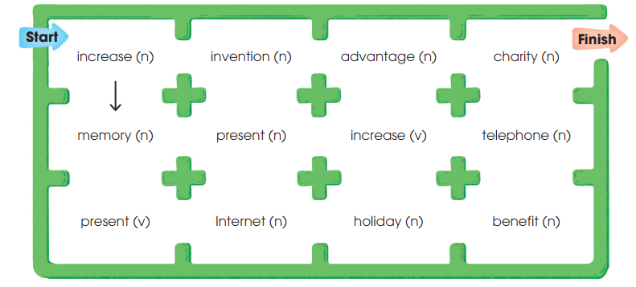
PRONUNCIATION
1
Escape the maze by connecting all words with the stress on the first syllable. Follow the examples and then listen to check your answers. Practise saying the words. (p.62)

Slide 9
PRONUNCIATION
2
Pair the cards.
Rules
- Work in pairs.
- Choose 10 words and copy them on your cards.
- Shuffle the cards and spread them in front of you.
- Take turns to open any two cards. If the stress pattern of the words on the cards match, read the words and keep both cards.
- If the stress patterns don’t match or you can’t pronounce correctly, put them face down in the same position.
- The winner is the player with most cards

Slide 10
PRONUNCIATION
2
Pair the cards.
importance
computer
habitat
tropical
museum
attendance
diagram
photograph
forgetful
encourage
formulate
attitude
determine
examine
fortunate
fluency
dependent
acquaintance
enterprise
activate

Slide 11
LESSON 1
LANGUAGE
Unit
GETTING STARTED
WARM-UP
Miming game
PRONUNCIATION
Activity 1: Escape the maze by connecting all the works with stress on the first syllable
Activity 2: Pair the cards
VOCABULARY
Activity 1: Find the missing letters. Complete the sentences using the pictures.
Activity 2: Complete the sentences with the words given.

Slide 12
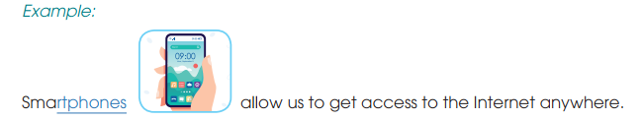
VOCABULARY
1
What are the missing letters? Complete the sentences using the pictures to help you. (p.62)

Slide 13
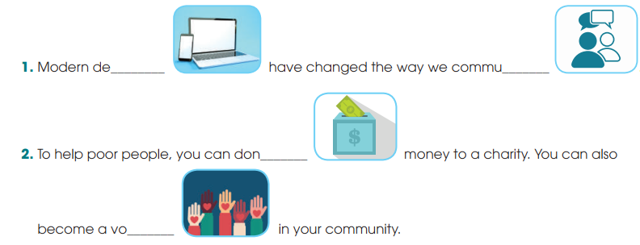
VOCABULARY
1
What are the missing letters? Complete the sentences using the pictures to help you. (p.62)
vices
nicate
ate
lunteer

Slide 14
VOCABULARY
2
Complete the sentences using these words. There are some extra ones. (p.63)
useful
useless
interested
interesting
careful
careless
interesting / useful
Many ________________ inventions in the world are the results of hard work and ____________ experiments.
Things such as old clothes or toys seem ____________, but you can donate them to charity. Some poor people may be ___________ in them.
careful
useless
interested

Slide 15
LESSON 1
LANGUAGE
Unit
GETTING STARTED
WARM-UP
Miming game
PRONUNCIATION
Activity 1: Escape the maze by connecting all the works with stress on the first syllable
Activity 2: Pair the cards
VOCABULARY
Activity 1: Find the missing letters. Complete the sentences using the pictures.
Activity 2: Complete the sentences with the words given.
GRAMMAR
Activity 1: Read the text and circle the correct answers.
Activity 2: Recall the information.

Slide 16
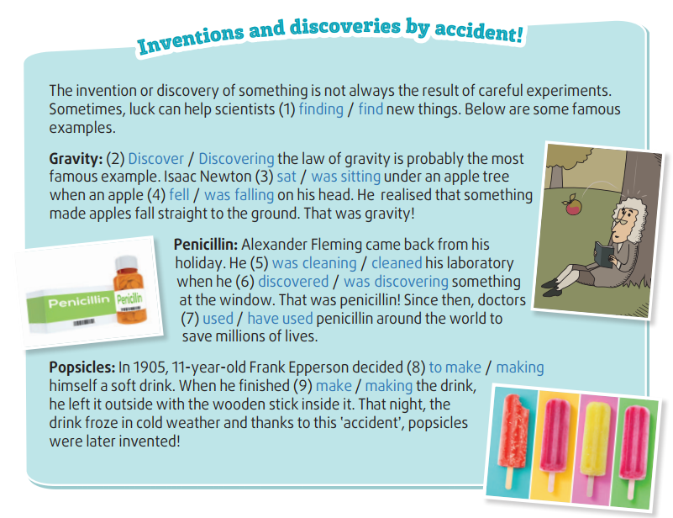
GRAMMAR
1
Read the text and circle the correct answers. (p.63)

Slide 17
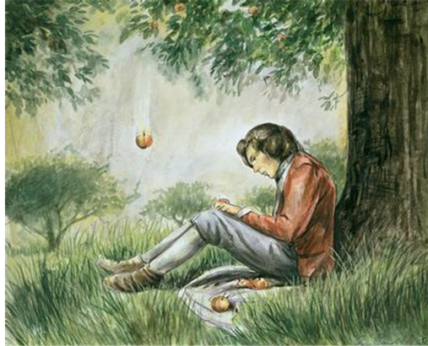
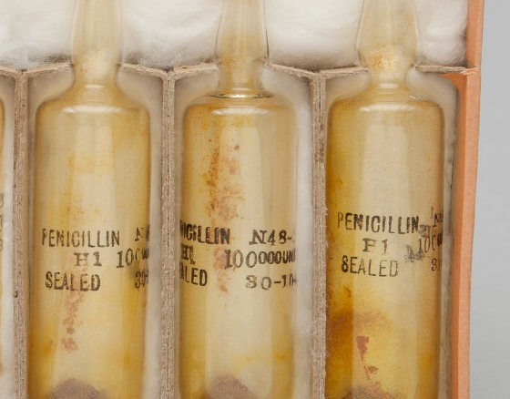
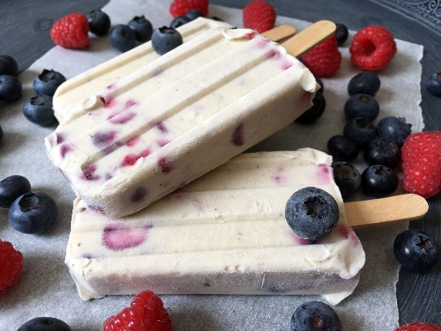
GRAMMAR
2
Recall the information
- Work in groups of three.
- Each student in the group chooses a different invention from the text and pretend you are the person who has invented or discovered the thing.
- Each student should try to explain how you did it using the information from the text.
E.g. I’m Isaak Newton and I discovered the law of gravity. I was sitting under the apple tree when an apple fell on my head. I realized that something made apples fall straight to the ground. That’s how I discovered gravity.

Slide 18
LESSON 1
LANGUAGE
Unit
GETTING STARTED
WARM-UP
Miming game
PRONUNCIATION
Activity 1: Escape the maze by connecting all the works with stress on the first syllable
Activity 2: Pair the cards
VOCABULARY
Activity 1: Find the missing letters. Complete the sentences using the pictures.
Activity 2: Complete the sentences with the words given.
GRAMMAR
Activity 1: Read the text and circle the correct answers.
Activity 2: Recall the information.
CONSOLIDATION
Wrap-up
Home work

Slide 19
CONSOLIDATION
1
Wrap-up
1. Knowledge
Review the language they have learnt in Unit 4-5.
2. Core competence
- Develop critical thinking skill;
- Be collaborative and supportive in pair work and team work;
- Actively join in class activities.
3. Personal qualities
- Develop self-study skills

Slide 20
CONSOLIDATION
2
Homework
Do exercises in the workbook
Prepare for the next lesson:
REVIEW 2 – Lesson 2: Skills.

Slide 21


