Slide 2
Unit 6
Artificial Intelligence
LESSON 7
COMMUNICATION & CULTURE / CLIL

Slide 3
LESSON 7
COMMUNICATION & CULTURE / CLIL
WARM-UP
Watch a video
- Task 1: Listen and complete the conversations. Then practice in pairs.
- Task 2: Work in pairs. Use the models in Task 1 to make similar conversations.
EVERYDAY ENGLISH
CLIL
- Task 1: Read the text and complete the timeline showing the evolution of robots.
- Task 2: Work in groups. Discuss the questions.
CONSOLIDATION
- Wrap-up
- Homework

Slide 4
WARM-UP
Watch a video
- Before playing the video, teacher asks Ss to watch carefully and try to remember as many details as possible. Ss can take notes if they want.
- Teacher shows the question, Ss raise their hands to grab the chance to answer.
- Teacher leads in the lesson.

Slide 5
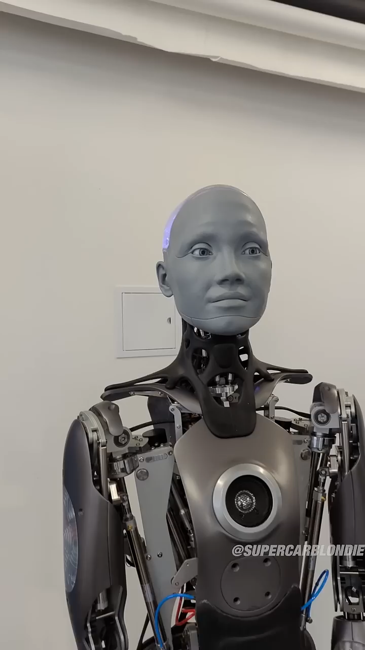
WARM-UP
WARM-UP
Watch the video and answer the question.
What’s your impression on Ameca – the robot?

Slide 6
EVERYDAY ENGLISH
1
Listen and complete the conversations with the expressions in the box. Then practise them in pairs.
C. Hey
1
Nam: (1) _________, Nick!
Nick: Yes, Nam.
Nam: (2) __________________ if I ask you a few questions about our project
on robots?
Nick: Not at all. Go ahead.
Speaker: (3) ____________________________, please? Today, I’m going to talk about some applications of AI in education.
Phong: (4) ________________________, but could you please explain the topic of your talk?
Speaker: Sure, we’re going to find out how AI can support teachers and students. Phong: I understand now. Thanks.
B. Do you mind
D. May I have your attention
2
A. I’m sorry for interrupting

Slide 7
EVERYDAY ENGLISH
Useful expressions
Getting attention
• May I have your attention, please?
• Could I ask you a question?
• Can I have a few seconds/a moment of your time?
• Look!/Listen!/Watch!
• Excuse me!
• Sorry to bother you.
• Hey!
Interrupting
• I'm sorry for interrupting/to interrupt, but I don't quite understand ...
• Sorry for the interruption, but could you(repeat) ...
• This will only take a minute.
• Would you mind (telling me) ...
• I apologise for the interruption, but I have an important question about ...
• Pardon me/Excuse me, I have …
• Hold on!
• Just a second.

Slide 8

EVERYDAY ENGLISH
2
Work in pairs. Use the models in Task 1 to make similar conversations for these situations. One of you is A, the other is B.
1. A is at a museum or robot exhibition where he/she can see B in the crowd, A wants to get B’s attention.
2. A is a scientist giving a talk on the use of AI at home. B is in the audience, and he/she wants to interrupt the scientist to ask a question.

Slide 9
EVERYDAY ENGLISH
2
Work in pairs. Use the models in Task 1 to make similar conversations for these situations. One of you is A, the other is B.
a.
Student A: Hey, Long. Are you also attending the exhibition: Robots in 21st century ?
Student B: Hi, Mai. Yes, I have just arrived.
Student A: Sorry to bother you. Do you want to join me in a VR trip?
Student B: Definitely.
b.
Student A: …So I have talked about the use if AI in education. Now, let’s move to the application of AI in workplace.
Student B: Excuse me, Dr Peter. Would you mind telling me more about the challenges of using AI chatbots in classroom?
Student A: That’s a good question. Well,….

Slide 10
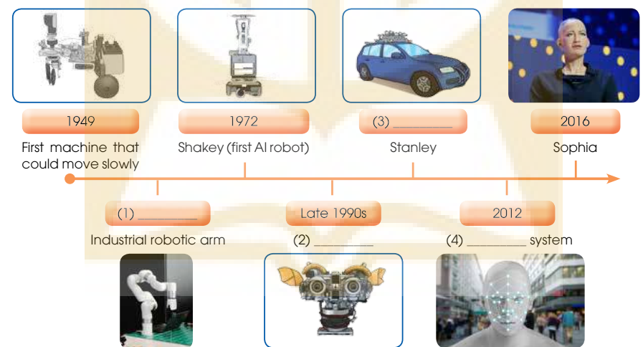
CLIL
1
Read the text and complete the timeline showing the evolution of robots
2005
1959
Kismet
Visual -recognition

Slide 11

CLIL
2
Work in groups. Discuss the questions.
What types of AI are widely used in Viet Nam? How do you think robots and AI will develop in Viet Nam in the future?

Slide 12
CONSOLIDATION
1
Wrap-up
What have you learnt today?
Gain knowledge about the evolution of robots;
Review expressions for getting attention and interrupting.
Talk about future of AI in Vietnam.

Slide 13
CONSOLIDATION
2
Homework
- Do exercises in the workbook.
- Prepare for the next lesson – Looking back and Project.

Slide 14
Website: hoclieu.vn
Fanpage: facebook.com/www.tienganhglobalsuccess.vn

