Slide 1

Unit 7: Toys
Lesson 1.3
Page 98

Slide 2
Lesson Outline
Warm-up
Practice
Speaking
Consolidation
Wrap-up

Slide 3
Objectives
By the end of this lesson, students will be able to…
Vocabulary: Review and practice the vocabularies learnt earlier in the lesson.
Structure: Practice structures:
What can you see? - I can see...

Slide 4

WARM UP

Slide 5


BRICK WALL GAME
PLAY
BRICK WALL GAME
Notes:
Ms Huyền Phạm - 0936.082.789 – YOUTUBE: MsPham. Facebook: Dạy và học cùng công nghệ.

Slide 6
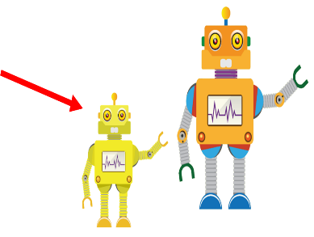
What can you see?
I can see a small robot.
I can see a small doll.
I can see a small car.
Next
PLAY
Notes:
Ms Huyền Phạm - 0936.082.789 – YOUTUBE: MsPham. Facebook: Dạy và học cùng công nghệ.

Slide 7
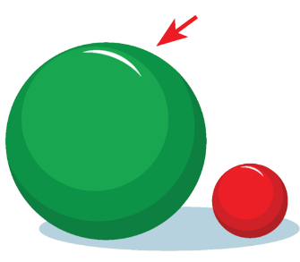
What can you see?
I can see a big doll.
I can see a big ball.
I can see a big car.
Next
PLAY
Notes:
Ms Huyền Phạm - 0936.082.789 – YOUTUBE: MsPham. Facebook: Dạy và học cùng công nghệ.

Slide 8
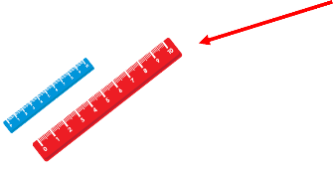
What can you see?
I can see a small doll.
I can see a small ruler.
I can see a big ruler.
Next
PLAY
Notes:
Ms Huyền Phạm - 0936.082.789 – YOUTUBE: MsPham. Facebook: Dạy và học cùng công nghệ.

Slide 9

What can you see?
I can see a big doll.
I can see a big ball.
I can see a big car.
Next
PLAY
Notes:
Ms Huyền Phạm - 0936.082.789 – YOUTUBE: MsPham. Facebook: Dạy và học cùng công nghệ.

Slide 10
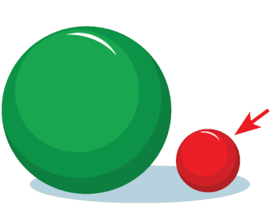
What can you see?
I can see a small ball.
I can see a small doll.
I can see a small car.
Next
PLAY
Notes:
Ms Huyền Phạm - 0936.082.789 – YOUTUBE: MsPham. Facebook: Dạy và học cùng công nghệ.

Slide 11
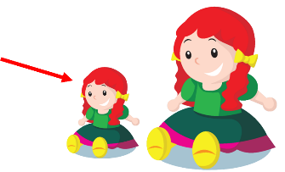
What can you see?
I can see a big doll.
I can see a small ball.
I can see a small doll.
Next
PLAY
Notes:
Ms Huyền Phạm - 0936.082.789 – YOUTUBE: MsPham. Facebook: Dạy và học cùng công nghệ.

Slide 12

It’s time to learn …

Slide 13

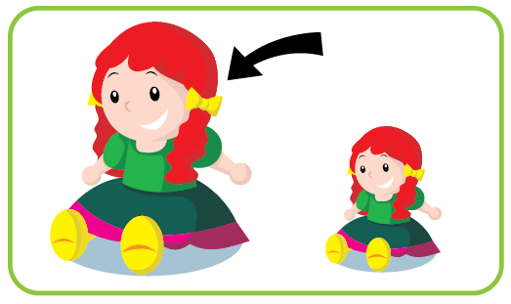
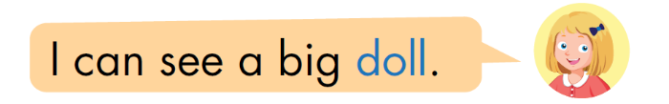
Pre-Speaking
Look and write
Notes:
Click textbox: pre-speaking to hear the sound

Slide 14

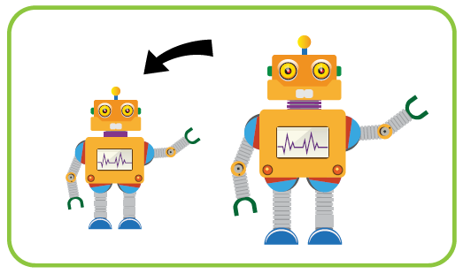

Pre-Speaking
Look and write
What can you see?
I can see a____________.
small robot
Notes:
Click textbox: pre-speaking to hear the sound

Slide 15
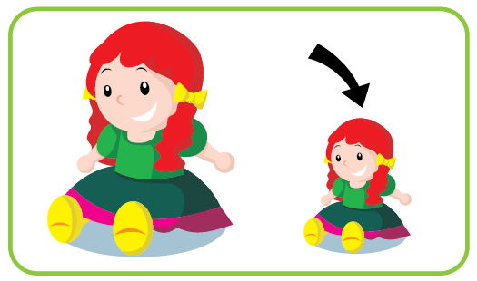
Pre-Speaking
Look and write
What can _____________?
you see
_____________________.
I can see a small doll
Notes:
Click textbox: pre-speaking to hear the sound

Slide 16
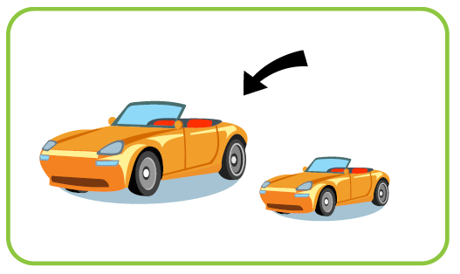
Pre-Speaking
Look and write
_____________________
What can you see?
_____________________.
I can see a big car
Notes:
Click textbox: pre-speaking to hear the sound

Slide 17
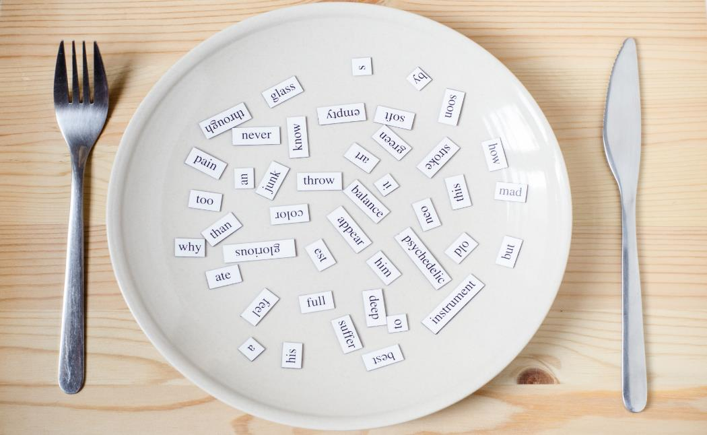
Structures
What can you see?
I can see a big doll.
What can you see?
I can see a small robot.

Slide 18
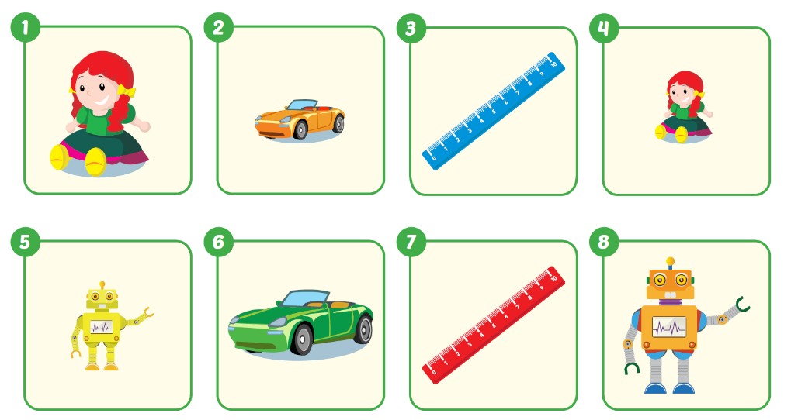
a blue ruler
Show me______________.
Notes:
Click vô tủ lạnh sẽ ra đáp án

Slide 19
a small car
Show me______________.
Notes:
Click vô tủ lạnh sẽ ra đáp án

Slide 20
a small robot
Show me______________.
Notes:
Click vô tủ lạnh sẽ ra đáp án

Slide 21
a red ruler
Show me______________.
Notes:
Click vô tủ lạnh sẽ ra đáp án

Slide 22

Practice

Slide 23

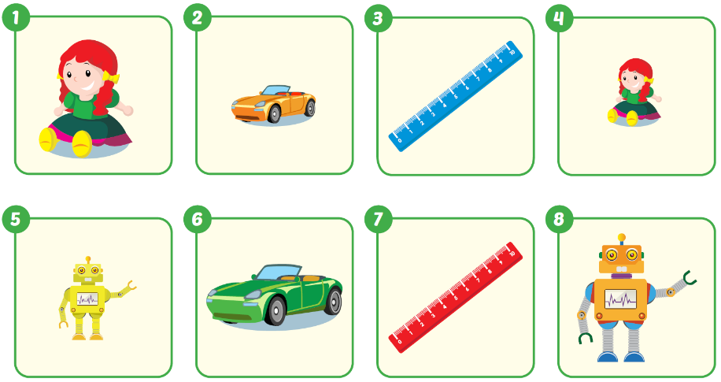

Slide 24
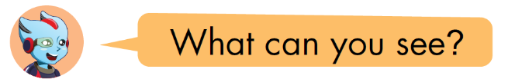
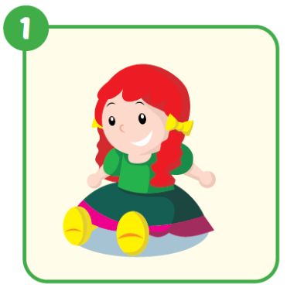

I can see a big doll.

Slide 25
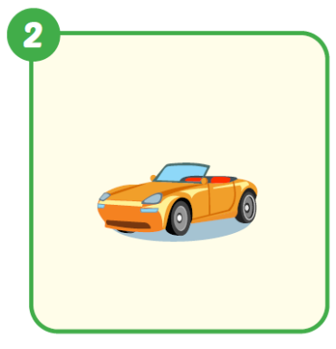
I can see a small car.

Slide 26
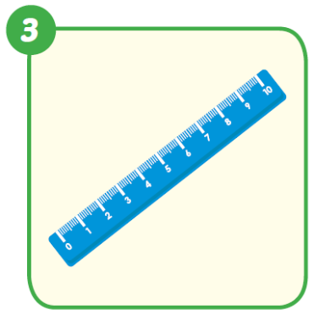
I can see a blue ruler.

Slide 27
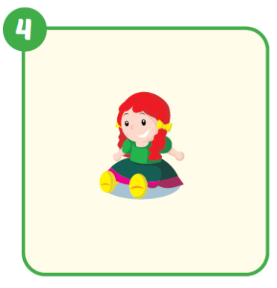
I can see a small doll.

Slide 28
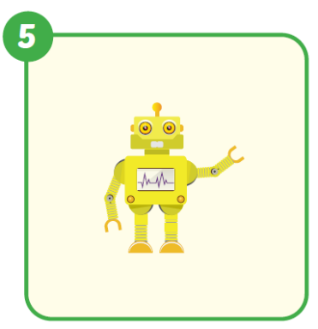
I can see a small robot.

Slide 29
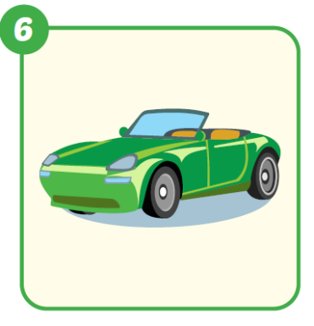
I can see a big car.

Slide 30
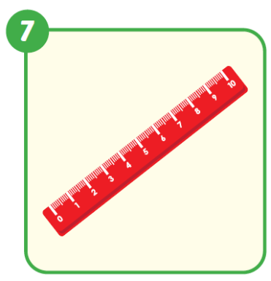
I can see a red ruler.

Slide 31
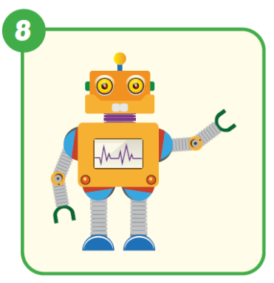
I can see a big robot.

Slide 32
Post speaking
Game: Draw it.

Slide 33


Post speaking
My birthday presents

Slide 34

a small robot.
I can see
Click here to guess what’s in the box.

Slide 35
I can see
a small doll.
Click here to guess what’s in the box

Slide 36
I can see
a big car.
Click here to guess what’s in the box

Slide 37

I can see
a big ball.
Click here to guess what’s in the box

Slide 38

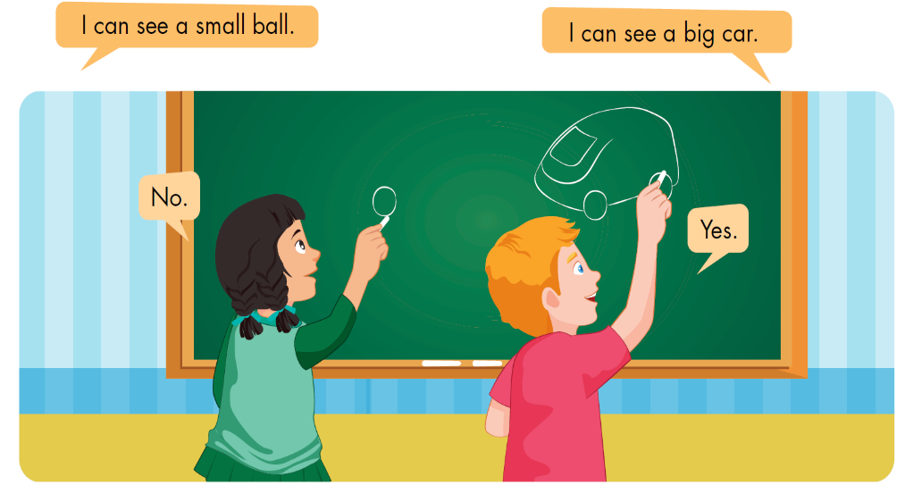
Post speaking
Notes:
Sau khi HS trả lời, click chuột 1 cái để hình biến mất, nếu học sinh trả lời đúng click vô hình món quà để khích lệ

Slide 39

CONSOLIDATION

Slide 40
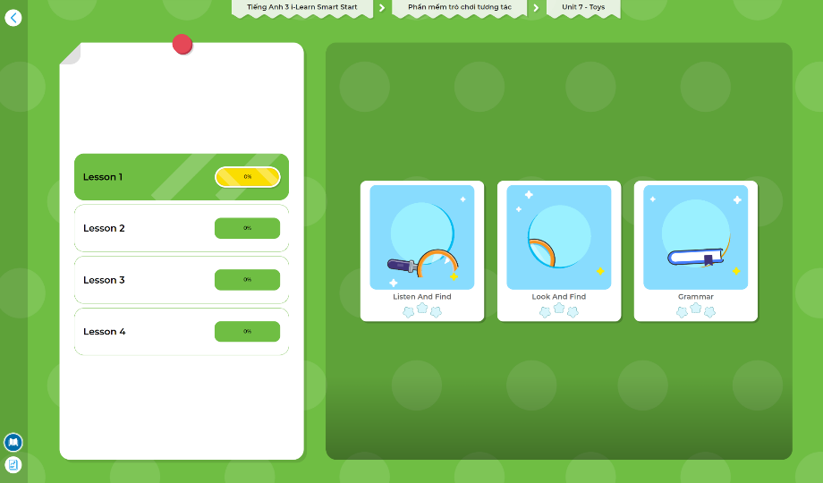
Extra Practice
DHA App
LET’S PLAY!
Click here to play the games

Slide 41

WRAP-UP

Slide 42
Today’s lesson
Structures/ Sentence patterns
What can you see?
I can see....

Slide 43
Homework
Practice the vocabularies and structure; and make sentences using them.
Do the exercises in Tiếng Anh 3 i-Learn Smart Start WB (page 69)
Do the exercises in Tiếng Anh 3 i-Learn Smart Start Notebook (page 46)
Prepare the next lesson (page 99 SB)
Play the consolidation games in Tiếng Anh 3 i-Learn Smart Start DHA App on www.eduhome.com.vn

Slide 44

Enjoy your day!

