Slide 2
Unit 6
Artificial Intelligence
LESSON 8
LOOKING BACK AND PROJECT

Slide 3
LESSON 8
LOOKING BACK AND PROJECT
WARM-UP
Game: Lucky number
- Pronunciation
- Vocabulary
- Grammar
LOOKING BACK
PROJECT
Project: AI in our lives
CONSOLIDATION
- Wrap-up
- Homework

Slide 4
WARM-UP
Game: Lucky number
- Ss work in 2 teams.
- There are 7 numbers, 1 of which are lucky ones.
- If Ss choose a lucky number, they get one point without answering the question.
- If they choose the other numbers, Ss have to rearrange the letters in the word to make a correct one.
- One point for a correct answer.
- The group with the most points is the winner.

Slide 5
WARM-UP
WARM-UP
Answer the question in each puzzle.
1
2
3
4
5
6
7

Slide 6
WARM-UP
WARM-UP
Number 1
O/H/C/B/A/T/S/T
CHATBOTS
BACK

Slide 7
WARM-UP
WARM-UP
Number 2
A/I/P/R/S/E/O/E/N/L/S
PERSONALISE
BACK

Slide 8
WARM-UP
WARM-UP
Number 3
F/P/O/T/O/R/O/I/L
PORTFOLIO
BACK

Slide 9
WARM-UP
WARM-UP
Number 4
U/V/R/I/T/L/A
VIRTUAL
BACK

Slide 10
WARM-UP
WARM-UP
Number 5
L/M/A/P/T/O/F/R
PLATFORM
BACK

Slide 11
WARM-UP
WARM-UP
Question 6
R/T/O/B/I/C/O
ROBOTIC
BACK

Slide 12

WARM-UP
WARM-UP
Question 7
BACK

Slide 13
LOOKING BACK
LOOKING BACK
Listen and underline the homophone of the word in bold in each sentence. Then practise saying the sentences in pairs.
1. People are not allowed to talk aloud in the library.
2. Students felt very bored when their teacher kept writing on the board.
3. Where can I buy some new clothes to wear to the party?
4. Robots don’t know how to say ‛No’.

Slide 14
LOOKING BACK
Complete the sentences using the correct forms of the words in the box.
activate artificial intelligence application virtual
1. In the future, we might see more __________________ of AI in every aspect of life.
2. Websites use __________________ to learn about users’ shopping preferences and recommend products
or services.
3. It is quite simple to _________________ this robot and ask it to perform some tasks.
4. Computer software is used by travel agents to create ____________ tours of popular destinations.
applications
artificial intelligence
activate
virtual

Slide 15
LOOKING BACK
Choose the option A, B, C, or D that is closest in meaning to each of the given sentences.
1. I am going to have my broken laptop fixed by the computer shop.
A. I am going to ask the computer shop to fix my broken laptop.
B. I am going to learn how to fix my broken laptop at the computer shop.
C. I am going to fix my laptop with the computer shop.
D. Someone advised me to fix my broken laptop at the computer shop

Slide 16
LOOKING BACK
Choose the option A, B, C, or D that is closest in meaning to each of the given sentences.
2. When we were away, our home robot walked and fed our pets.
A. We had our pets walk and feed our home robots when we were away.
B. We bought a robot when we were away, which could walk and feed our pets.
C. We had our home robot walk and feed our pets when we were away.
D. Our pets walked and ate with our home robot when we were away.

Slide 17
LOOKING BACK
Choose the option A, B, C, or D that is closest in meaning to each of the given sentences.
3. A mechanic installed a smart lock on her front door yesterday.
A. A mechanic had her install a smart lock on her front door yesterday.
B. A mechanic had a smart lock installed on her front door yesterday.
C. She and a mechanic installed a smart lock on her front door yesterday.
D. She got a mechanic to install a smart lock on her front door yesterday

Slide 18
LOOKING BACK
Choose the option A, B, C, or D that is closest in meaning to each of the given sentences.
4. We often use an app called Essy to check our essays.
A. An app called Essy often has us check our essays.
B. We often get our essays checked by an app called Essy.
C. An app called Essy often has our essay checked for us.
D. We often have an app called Essy checked by our essays

Slide 19
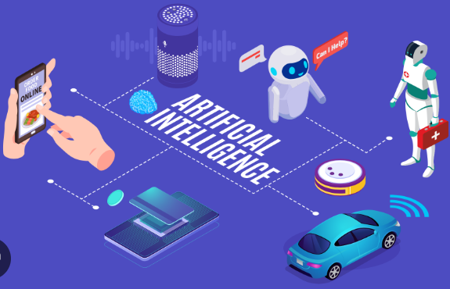
PROJECT
Our class is organising a Technology Fair. The theme is ‘AI in our daily lives’. Work in groups. Think of a way of using ai in your daily life. This can be an existing or a new application. use these questions as cues.
• What is the AI application? (If it’s a new application, give it a name.)
• What is its purpose?
• How does it work?
• How will it improve your life?
Present your idea to the class in the form of an
oral presentation, a poster, or a leaflet.

Slide 20
CONSOLIDATION
1
Wrap-up
What have you learnt today?
- Review the vocabulary and grammar of Unit 6;
- Apply vocabulary and grammar into practice through a project.

Slide 21
CONSOLIDATION
2
Homework
- Do exercises in the workbook.
- Prepare for the next lesson – Unit 7.

Slide 22
Website: hoclieu.vn
Fanpage: facebook.com/www.tienganhglobalsuccess.vn

