Slide 2


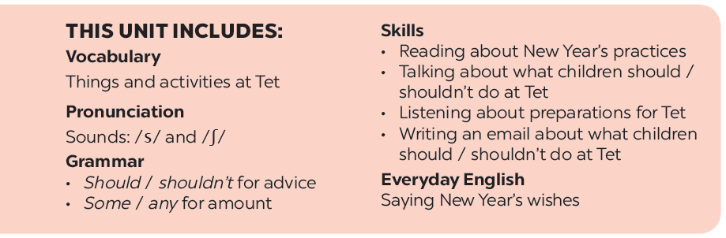

Slide 3







Grammar
Should / shouldn’t for advice
Some / any for amount
Look at the signs at the library and complete the sentences with should or shouldn’t.
Complete the sentences with some or any.
Tick () the activities children should do at Tet and cross (×) the ones they shouldn’t.
Work in pairs. Look at the fridge. Make sentences with the words / phrases provided, using some or any.
Work in pairs. Look at the activities in 2. Take turns to say what you think children should / shouldn’t do.

Slide 4
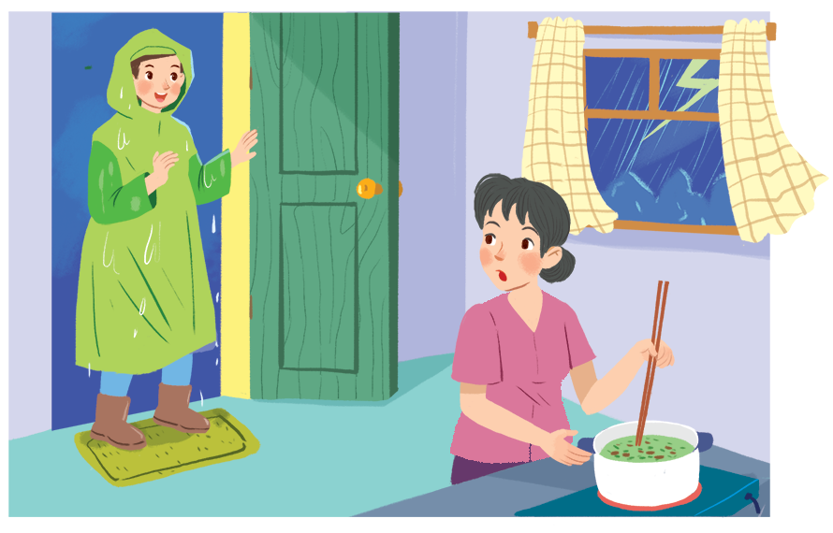
Grammar
Should / shouldn’t for advice
Nam, you shouldn't come in with your raincoat on.

Slide 5


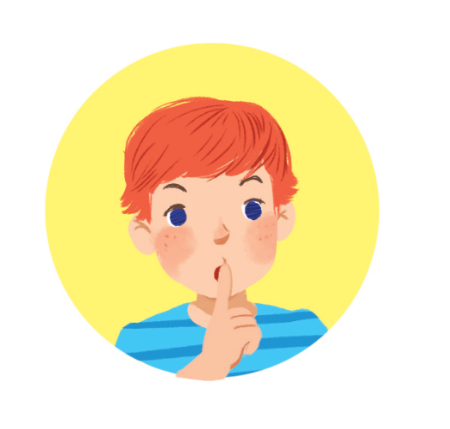

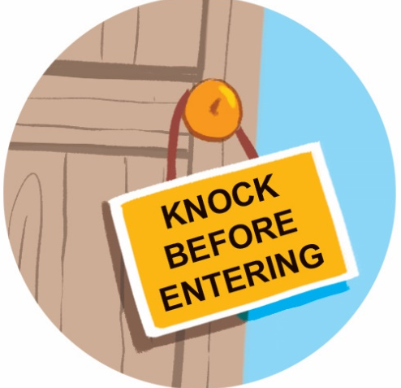
Look at the signs at the library and complete the sentences with should or shouldn’t.

Slide 6

should
1.
You keep quiet.

Slide 7

2.
You
shouldn’t eat or drink.
eat or drink.

Slide 8
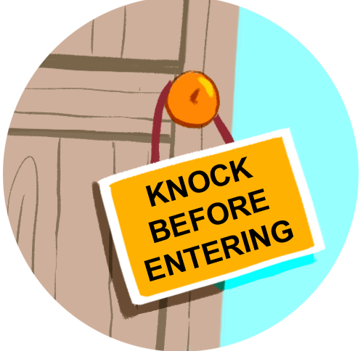
should
3.
You knock before you enter.

Slide 9
shouldn’t run.
4.
You
run.

Slide 10

Grammar
Should / shouldn’t for advice
We use should for things that are good to do.
We use shouldn’t for things that are not good to do.

Slide 11

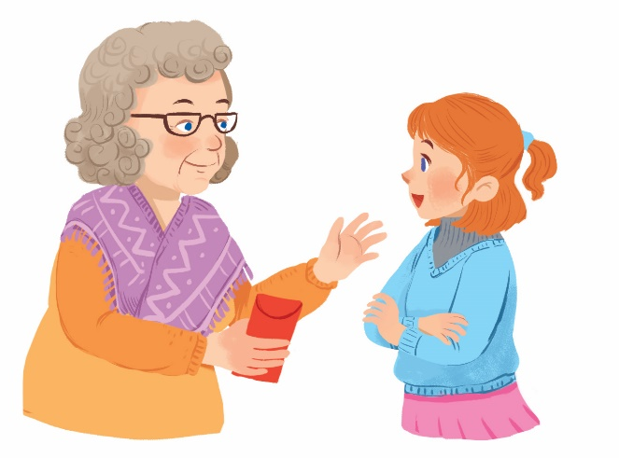
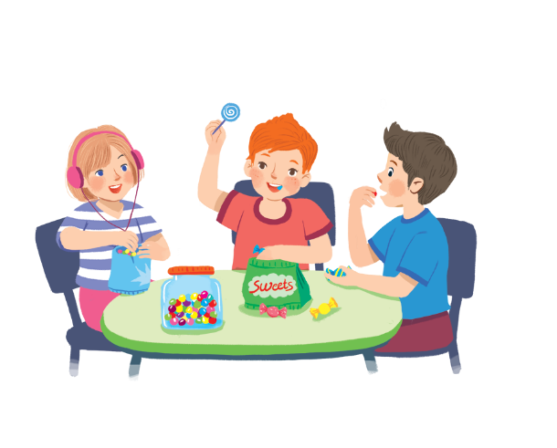
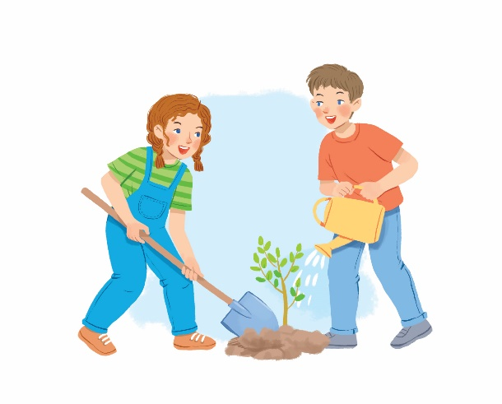
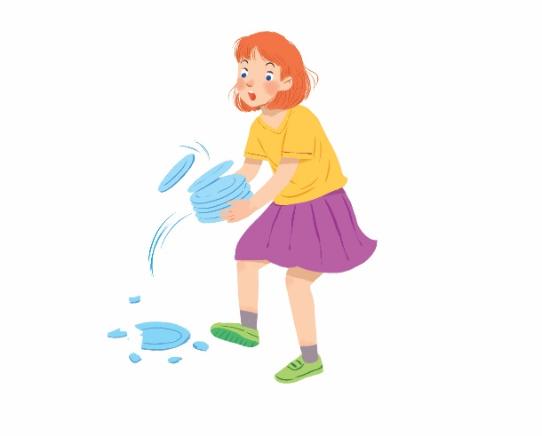
Tick () the activities children should do at Tet and cross (×) the ones they shouldn’t.
Thank you.


1.
behave well
2.
eat lots of sweets


3.
plant trees
4.
break things

Slide 12
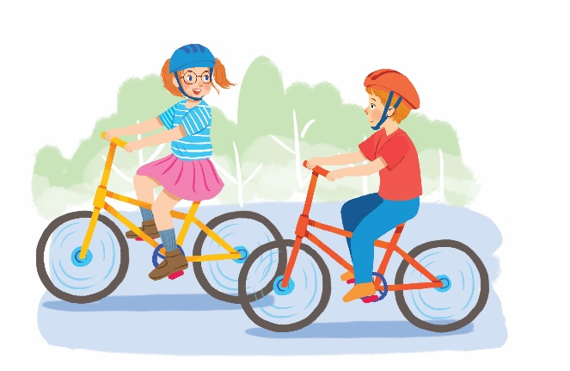
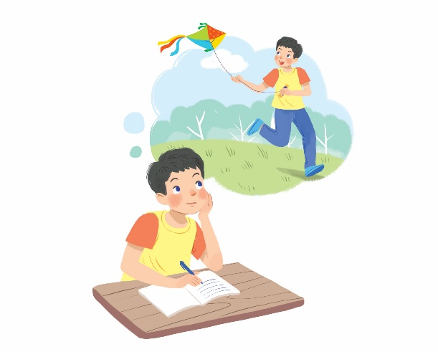
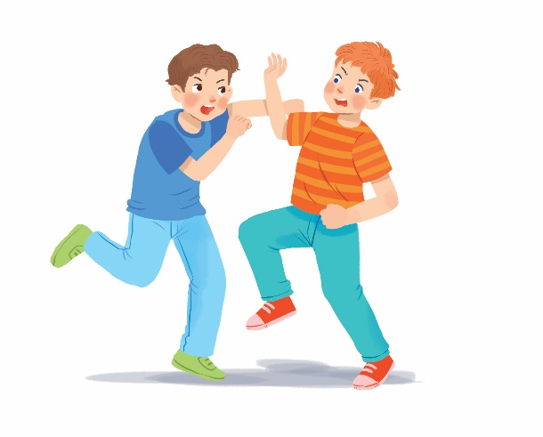
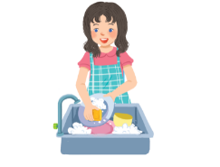
Tick () the activities children should do at Tet and cross (×) the ones they shouldn’t.


5.
go out with friends
6.
make a wish


7.
fight
8.
help with housework

Slide 13

Work in pairs. Look at the activities in 2. Take turns to say what you think children should / shouldn’t do.
Example:
Children should behave well.
Children shouldn’t eat lots of sweets.

Slide 14
Grammar
Some / any for amount
Some
any
(+) My mother bought some fruits.
(+) I need some milk for the cake.
(-) I can’t answer any questions.
(?) Do you have any sugar?

Slide 15
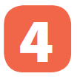
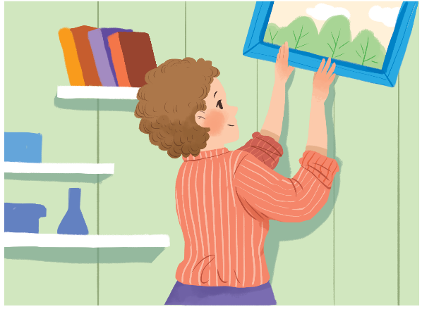
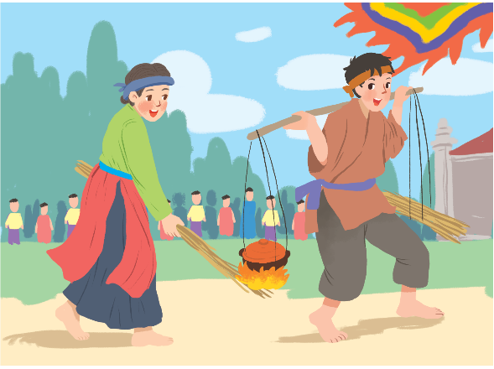
Complete the sentences with some or any.
1.
What do you need to decorate your room?
I need colour paper and pictures.
some
some
any
2.
Do you have free time for spotrs?
Yes, I do.
Are there interesting activities here during Tet?
Yes, there are traditional games like human chess, running and cooking.
3.
any
some

Slide 16

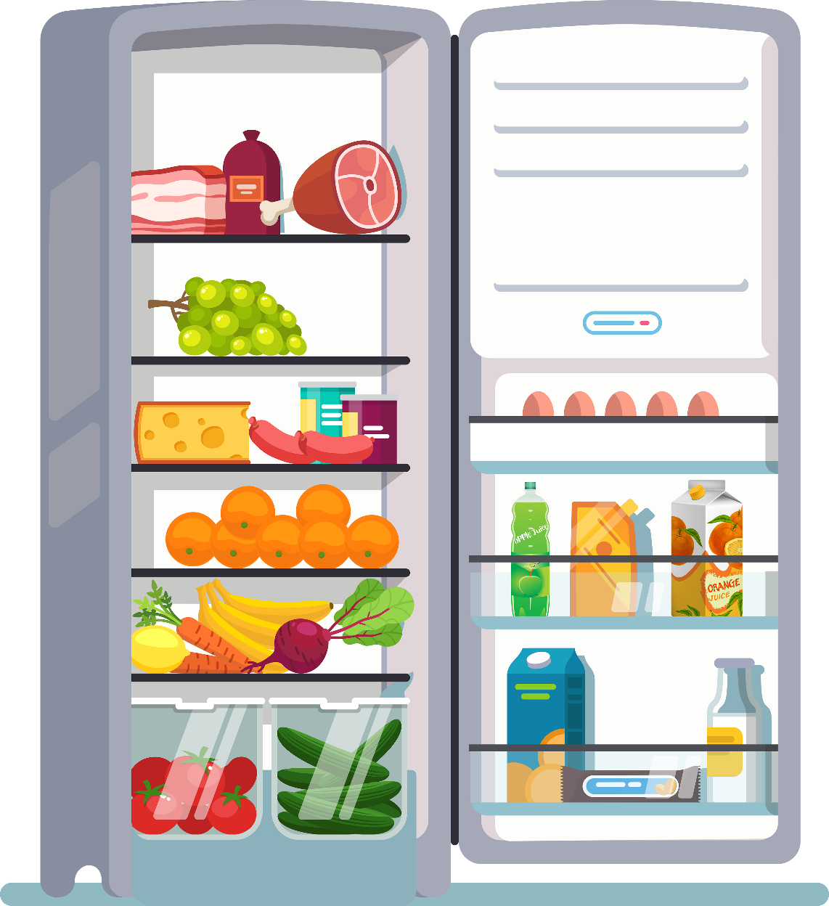
Work in pairs. Look at the fridge. Make sentences with the words / phrases provided, using some or any.
Example:
ice cream
There is not any ice cream.
cucumbers
There are some cucumbers.

Slide 17
1.
eggs
There are some eggs (in the fridge).
2.
fruit juice
There is some fruit juice.
3.
apples
There aren’t any apples.
4.
bread
There isn’t any bread.
5.
bananas
There are some bananas.
6.
cheese
There is some cheese.

Slide 18






Website: hoclieu.vn
Fanpage: facebook.com/www.tienganhglobalsuccess.vn/

