Slide 1






A B C D E F G H I J K L M N O P Q R S T U V W X Y Z
The English Language Presents
English Game
A B C D E F G H I J K L M N O P Q R S T U V W X Y Z

Slide 2


x
J
B
O
N
D
0
0
7
∙
∙
∙
∙
∙
∙
∙
∙
∙
∙
∙
Login:
∙
Password:

Slide 3

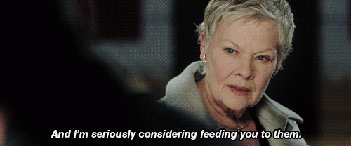
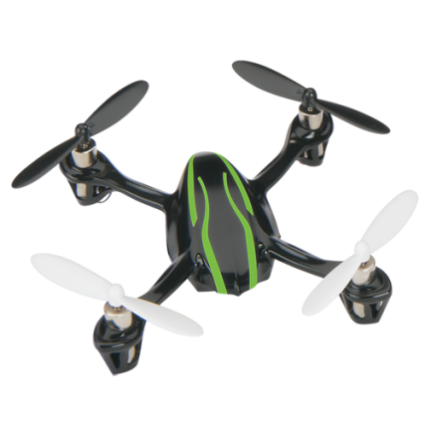
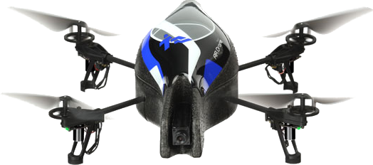
007,
Enemy spy drones are attempting to
steal our secrets. Destroy them all.
M
Watch out for bombs, disarm them if you can. Use your gadgets, and steal some enemy secrets.

Slide 4




A
B
C
D
E
F
1
2
3
4

Slide 5



x
0
3
5
6
8
9
2
4
7
1
0
3
5
6
8
9
2
4
7
1
0
3
5
6
8
9
2
4
7
0
1
3
5
6
8
9
2
4
7
1
0
3
5
6
8
9
2
4
7
1
0
3
5
6
8
9
2
4
7
1
0
3
5
6
8
9
2
4
7
1
0
3
5
6
8
9
2
4
7
1
0
3
5
6
8
9
2
4
7
0
1
3
5
6
8
9
2
4
7
1
0
3
5
6
8
9
2
4
7
1
0
3
5
6
8
9
2
4
7
1
Notes:
Click the rectangles to cycle the numbers on the scoreboard.

Slide 6

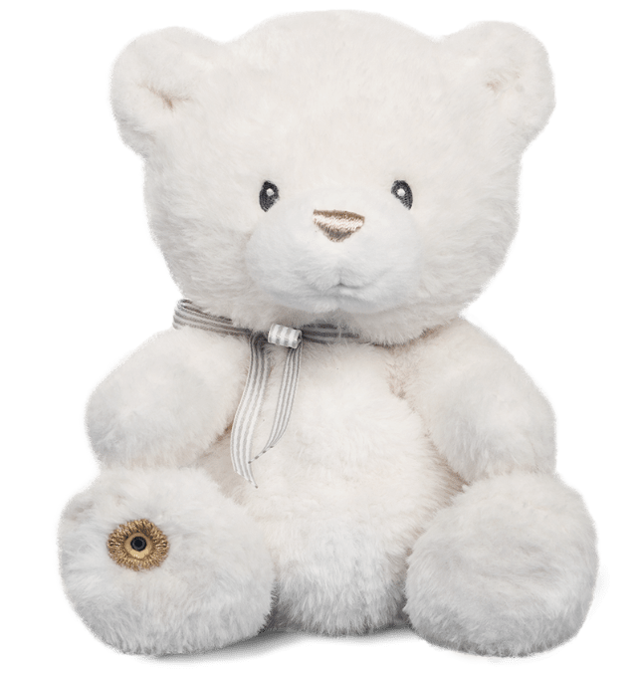

How does it feel? It’s _ _ _ and _ _ _.
It’s soft and thick.
Notes:
The red gun barrel takes you back to question selection in the case of a wrong answer. The green one advances to the score.

Slide 7
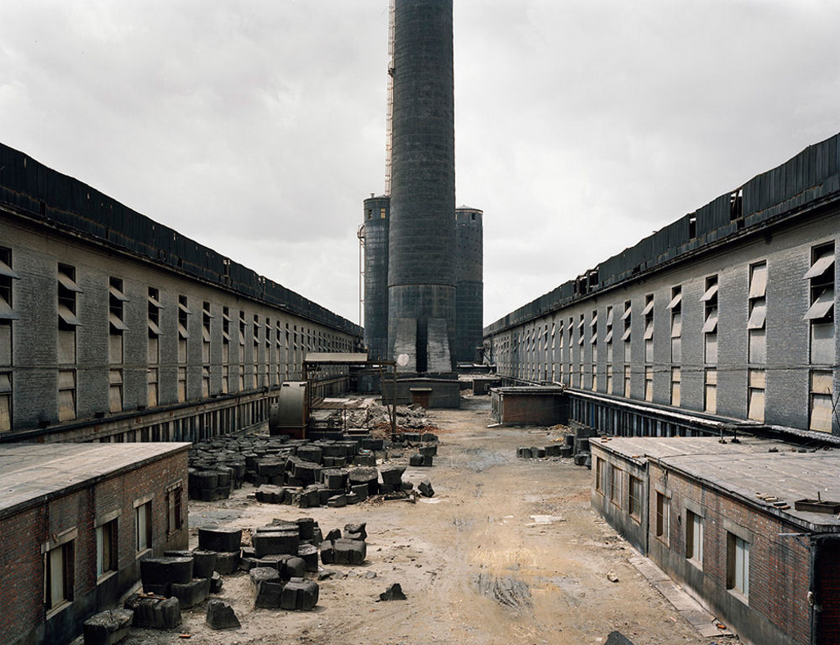

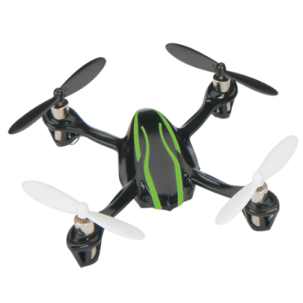
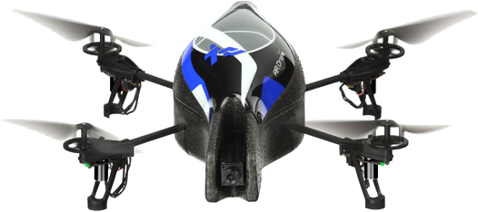
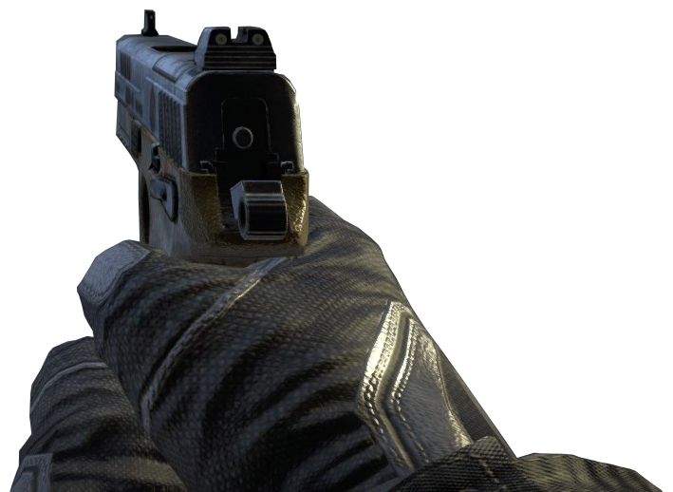

Slide 8

How does it feel? It’s _ _ _ and _ _ _.
It’s hard and thick.
Notes:
The red gun barrel takes you back to question selection in the case of a wrong answer. The green one advances to the score.

Slide 9
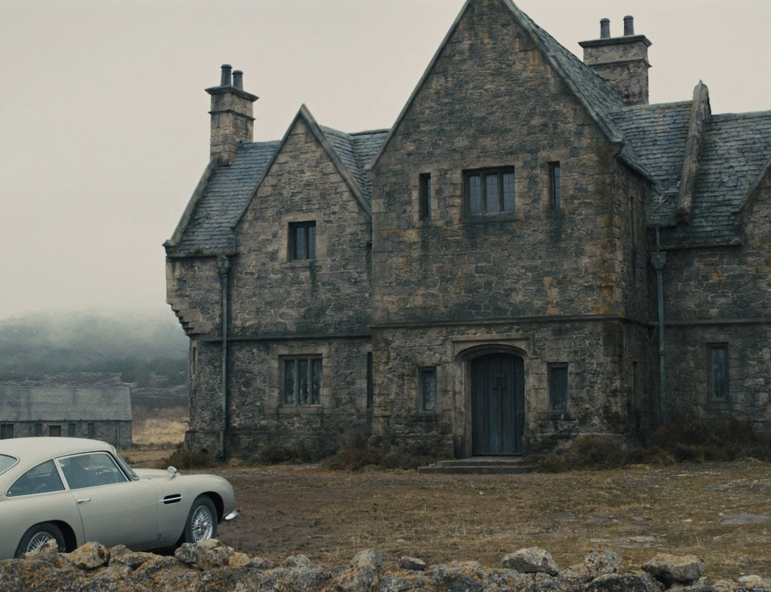

Slide 10

How does it feel? It’s _ _ _ and _ _ _.
It’s soft and thin.
Notes:
The red gun barrel takes you back to question selection in the case of a wrong answer. The green one advances to the score.

Slide 11
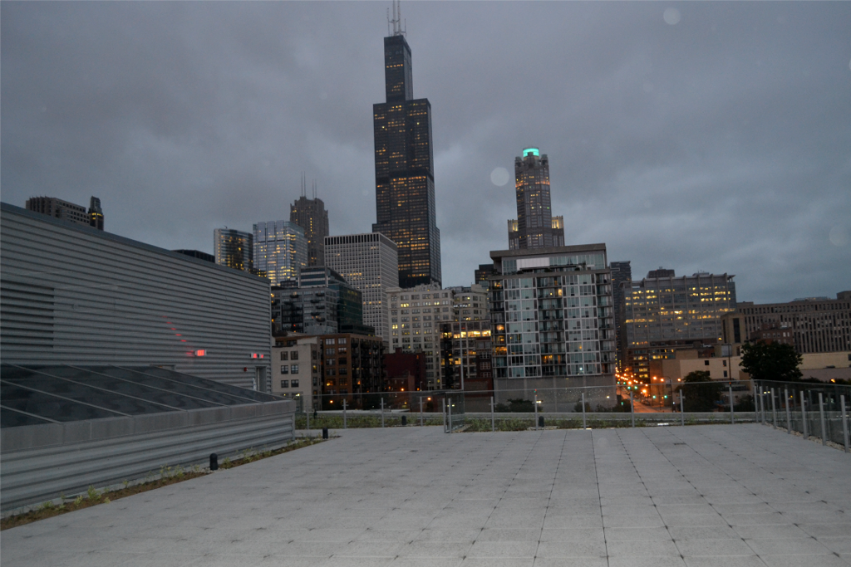


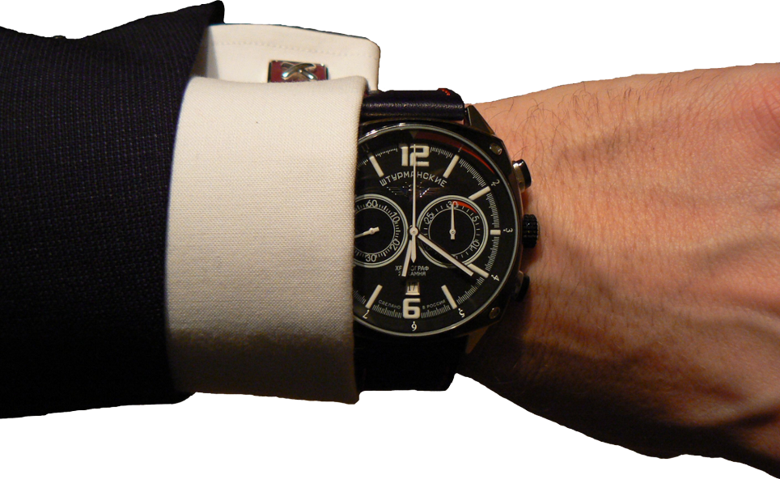

Slide 12
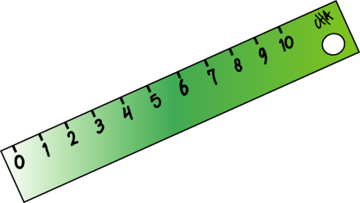
How does it feel? It’s _ _ _ and _ _ _.
It’s thin and hard
Notes:
The red gun barrel takes you back to question selection in the case of a wrong answer. The green one advances to the score.

Slide 13
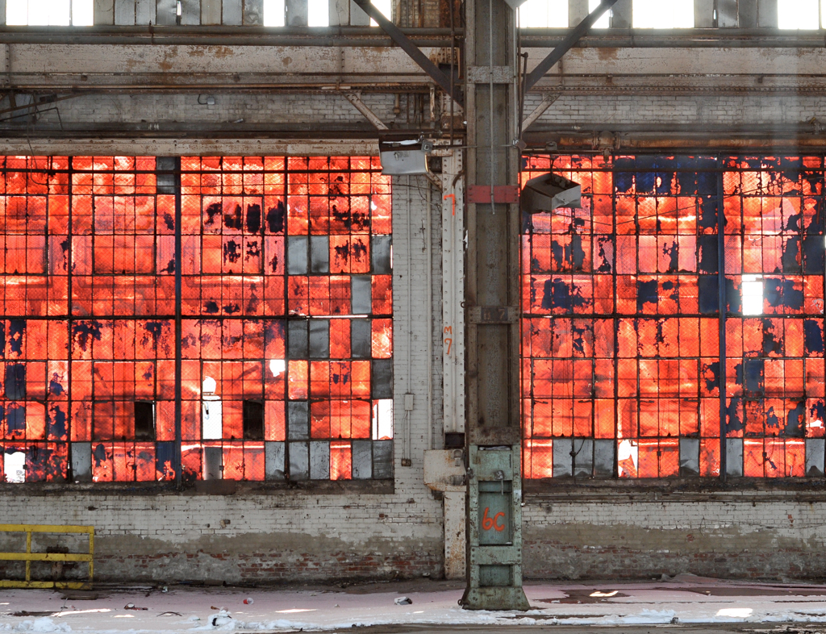



Slide 14

How does it feel? It’s
It’s hot
Notes:
The red gun barrel takes you back to question selection in the case of a wrong answer. The green one advances to the score.

Slide 15
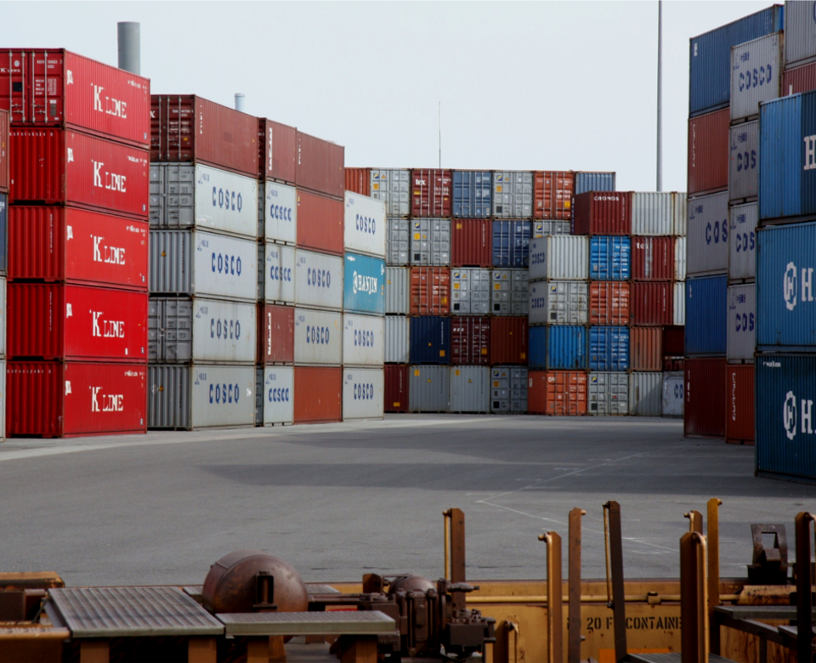

Slide 16

How does it feel? It’s
It’s cold
Notes:
The red gun barrel takes you back to question selection in the case of a wrong answer. The green one advances to the score.

Slide 17
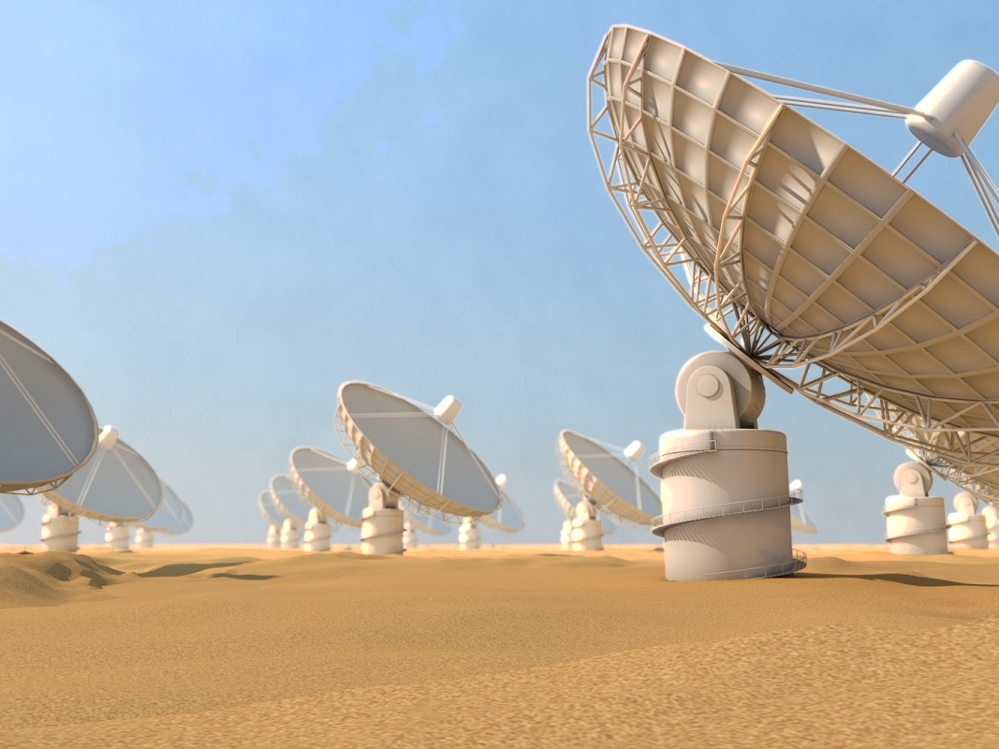

Slide 18
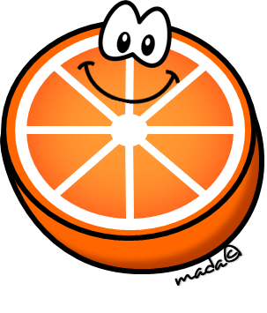
It’s round. It’s sweet and sour.
What is it?
Is it an orange?
Notes:
The red gun barrel takes you back to question selection in the case of a wrong answer. The green one advances to the score.

Slide 20

It’s long. It’s sweet. It’s yellow.
What is it?
Is it a banana?
Notes:
The red gun barrel takes you back to question selection in the case of a wrong answer. The green one advances to the score.

Slide 21
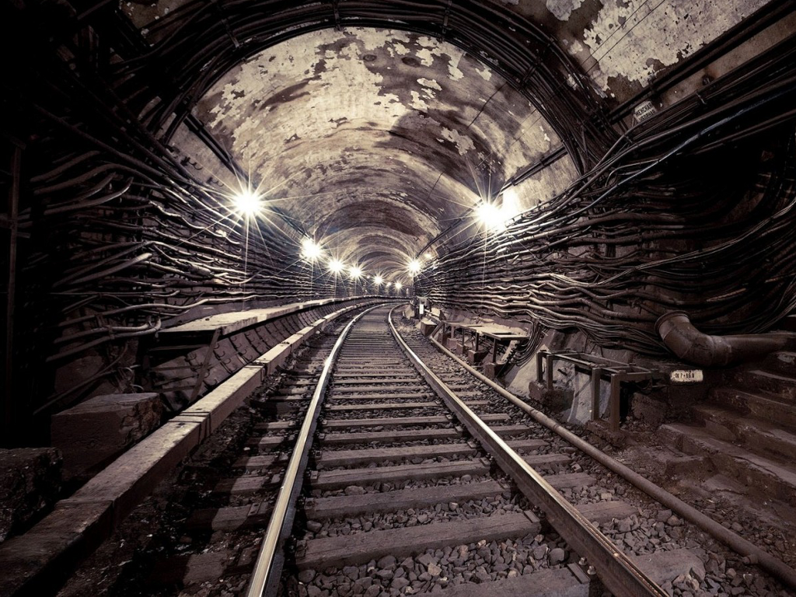

Slide 22

It’s small. It’s sweet. It’s red.
What is it?
Is it a strawberry?
Notes:
The red gun barrel takes you back to question selection in the case of a wrong answer. The green one advances to the score.

Slide 23
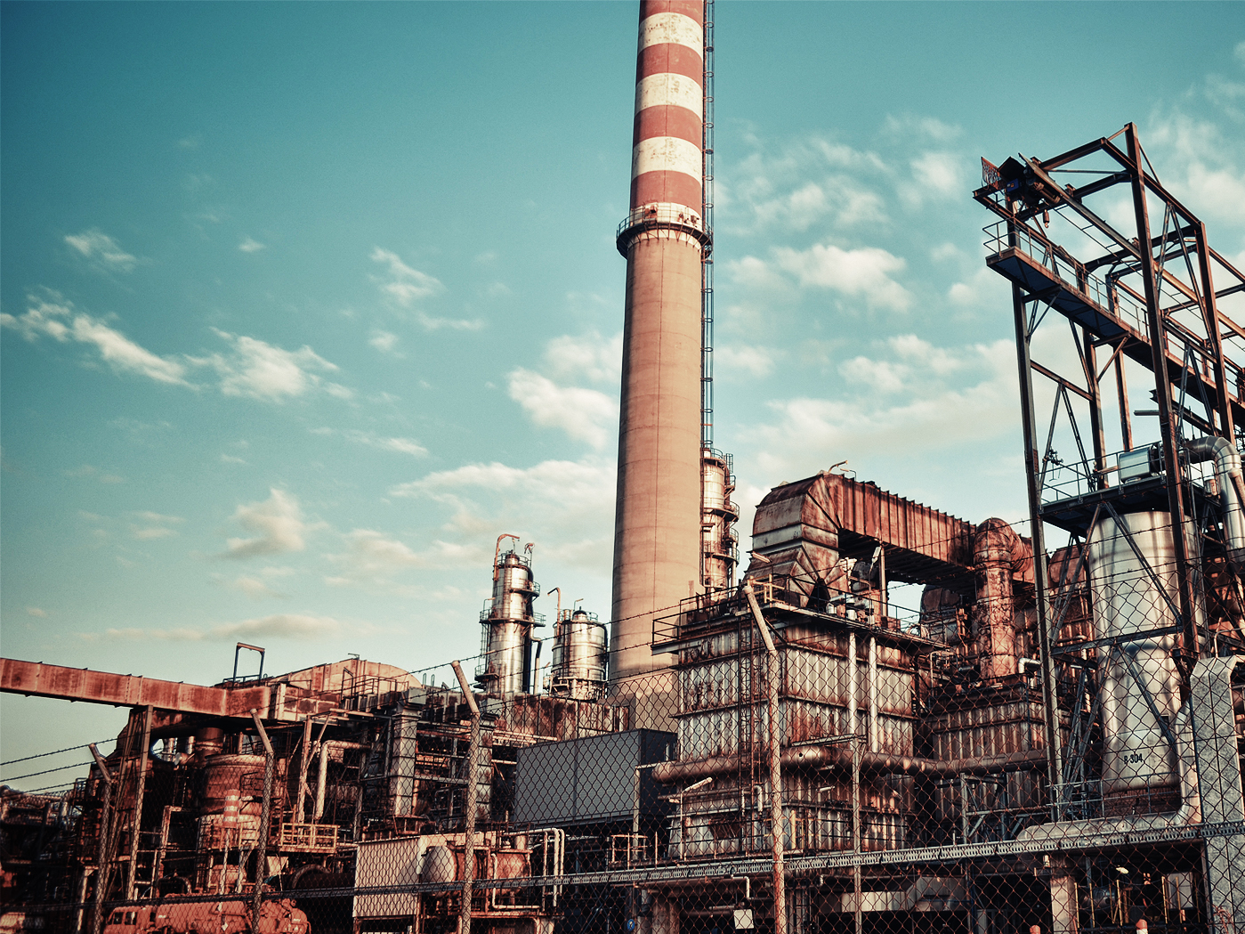

Slide 24

It’s round. It’s sour. It’s yellow
What is it?
Is it a lemon?
Notes:
The red gun barrel takes you back to question selection in the case of a wrong answer. The green one advances to the score.

Slide 25

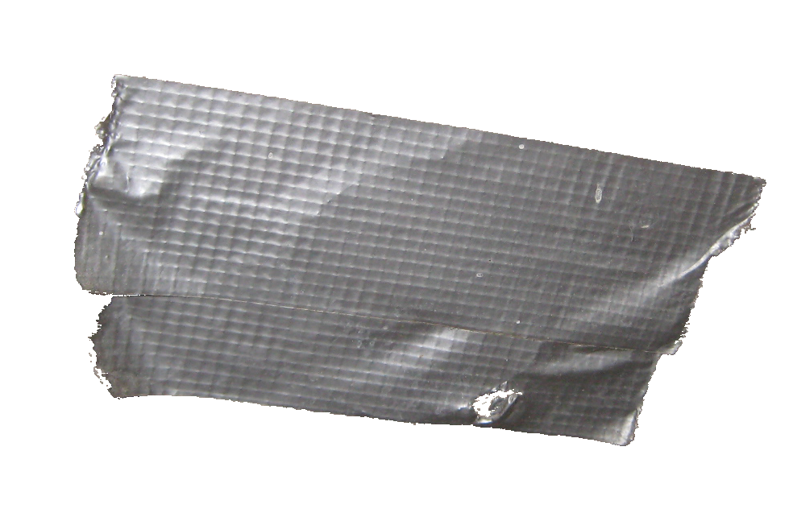
10
6
7
5
2
4
8
3
9
1
0
Notes:
Red/Blue = Boom (Lose Points) Yellow = +10 points

Slide 26
DISARMED
+10 POINTS
Notes:
Red=Disarm, Blue/Yellow=Boom

Slide 27
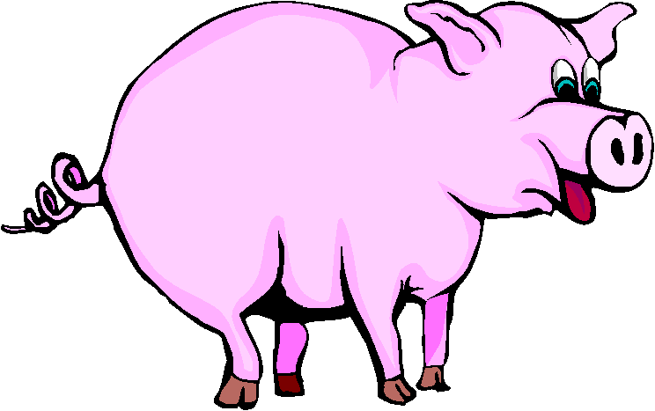
What’s that shadow?
It’s a pig
Notes:
The red gun barrel takes you back to question selection in the case of a wrong answer. The green one advances to the score.

Slide 28
10
6
7
5
2
4
8
3
9
1
0
Notes:
Blue/Yellow = Boom (Lose Points) Red= +10 points

Slide 29
DISARMED
+10 POINTS
Notes:
Red=Disarm, Blue/Yellow=Boom

Slide 30

What’s that shadow?
It’s a mouse.
Notes:
The red gun barrel takes you back to question selection in the case of a wrong answer. The green one advances to the score.

Slide 31
10
6
7
5
2
4
8
3
9
1
0
Notes:
Red=Disarm, Blue/Yellow=Boom

Slide 32
DISARMED
+10 POINTS
Notes:
Red/Yellow = Boom (Lose Points) Blue = +10 points

Slide 33

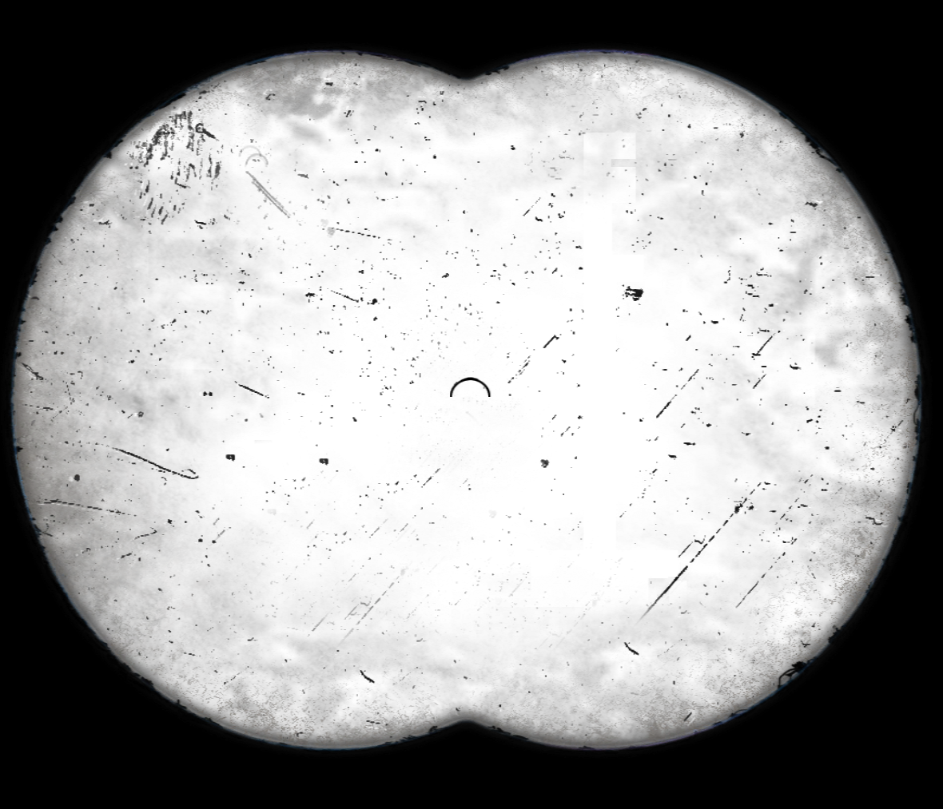


5
4
3
2
1
Notes:
Hidden picture: Paste the picture you want to use on top of the slide. Something large will work the best. Right click it and move it to the back layer. When this slide comes up the first click will make the blocks begin to disappear along with activating the score meter on the right. Once a student gets the answer a second click will reveal the whole image and stop the point meter. The whole thing is set to complete within 20 seconds.

Slide 34
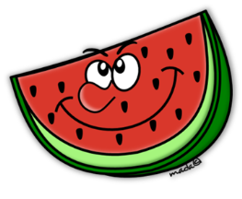
5
4
3
2
1
Notes:
Hidden picture: Paste the picture you want to use on top of the slide. Something large will work the best. Right click it and move it to the back layer. When this slide comes up the first click will make the blocks begin to disappear along with activating the score meter on the right. Once a student gets the answer a second click will reveal the whole image and stop the point meter. The whole thing is set to complete within 20 seconds.

Slide 35
5
4
3
2
1
Notes:
Hidden picture: Paste the picture you want to use on top of the slide. Something large will work the best. Right click it and move it to the back layer. When this slide comes up the first click will make the blocks begin to disappear along with activating the score meter on the right. Once a student gets the answer a second click will reveal the whole image and stop the point meter. The whole thing is set to complete within 20 seconds.

Slide 36

5
4
3
2
1
Notes:
Hidden picture: Paste the picture you want to use on top of the slide. Something large will work the best. Right click it and move it to the back layer. When this slide comes up the first click will make the blocks begin to disappear along with activating the score meter on the right. Once a student gets the answer a second click will reveal the whole image and stop the point meter. The whole thing is set to complete within 20 seconds.

Slide 37
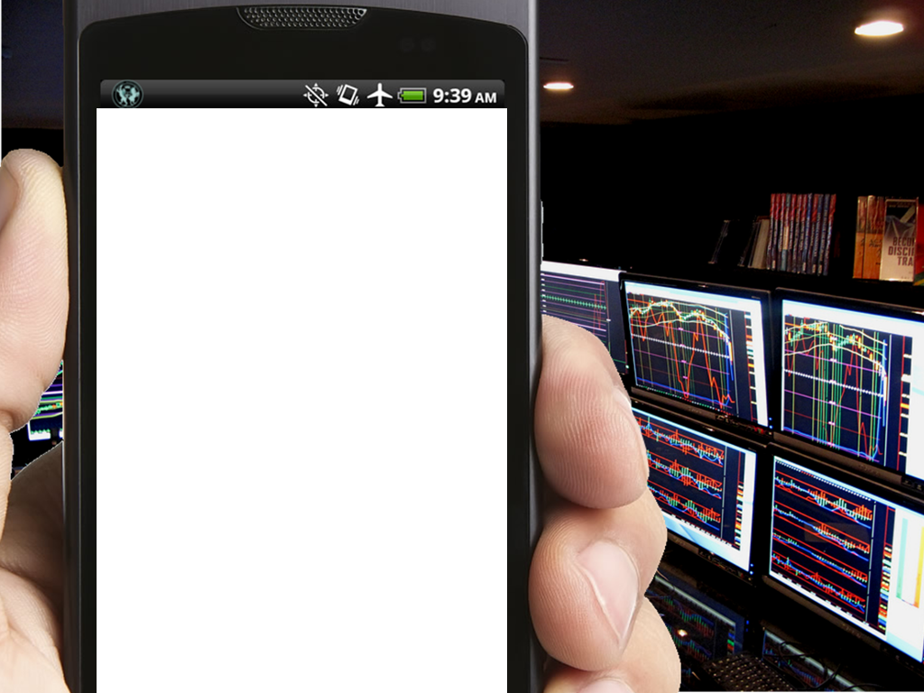

morning
the
in
rises
Do not erase this box. It helps the slide function.
sun
The
Use your Spy Phone to hack into the computers.
5
4
3
2
1
Initiate Hack
Access Granted
The sun rises in the morning.
Notes:
Fill in the words for a scrambled sentence where the one-eight place holders are above the phone. Delete any that are unused. Click once to bring up the phone. There is a 30 second timer, the arrow will go back to 5 after that but they should only get 1 point if they take too long. The second click brings up the answer and stops the point marker.

Slide 38
evening
the
in
down
goes
Do not erase this box. It helps the slide function.
sun
The
Use your Spy Phone to hack into the computers.
5
4
3
2
1
Initiate Hack
Access Granted
The sun goes down in the evening.
Notes:
Fill in the words for a scrambled sentence where the one-eight place holders are above the phone. Delete any that are unused. Click once to bring up the phone. There is a 30 second timer, the arrow will go back to 5 after that but they should only get 1 point if they take too long. The second click brings up the answer and stops the point marker.

Slide 39
the
sky
in
high
is
Do not erase this box. It helps the slide function.
moon
The
Use your Spy Phone to hack into the computers.
5
4
3
2
1
Initiate Hack
Access Granted
The moon is high in the sky.
Notes:
Fill in the words for a scrambled sentence where the one-eight place holders are above the phone. Delete any that are unused. Click once to bring up the phone. There is a 30 second timer, the arrow will go back to 5 after that but they should only get 1 point if they take too long. The second click brings up the answer and stops the point marker.

Slide 40
sky
In the
high
is
sun
the
Do not erase this box. It helps the slide function.
noon,
At
Use your Spy Phone to hack into the computers.
5
4
3
2
1
Initiate Hack
Access Granted
At noon, the sun is high in the sky.
Notes:
Fill in the words for a scrambled sentence where the one-eight place holders are above the phone. Delete any that are unused. Click once to bring up the phone. There is a 30 second timer, the arrow will go back to 5 after that but they should only get 1 point if they take too long. The second click brings up the answer and stops the point marker.

Slide 41

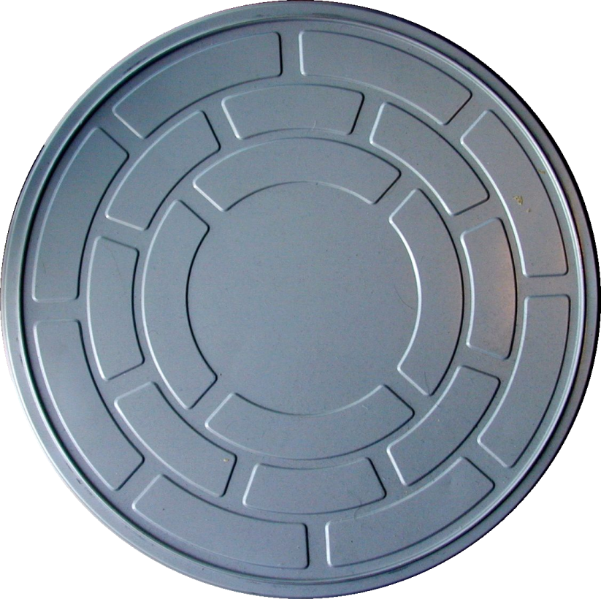

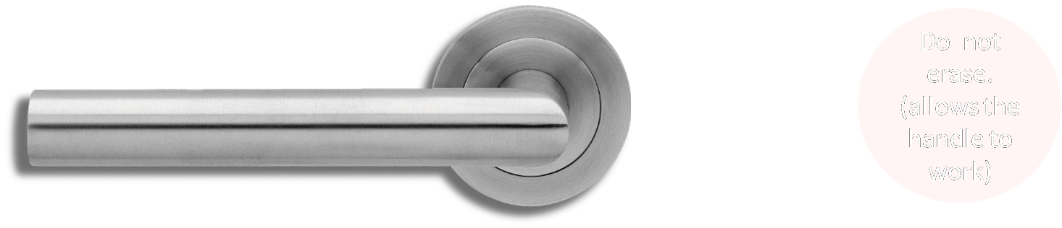
How does it feel?
How does it taste?
What is it?
It’s thin
It’s sweet
It’s a strawberry
X
O
O
It’s hard
It’s sour
It’s a grape
X
X
X
It’s soft
It’s hot
It’s a watermelon.
O
X
X
Notes:
Zoom out to see all the question/answer place holders. Fill them in according to the green O’s and Red X’s. If you get any wrong answer you fail the challenge, hit the red marker in the bottom left, if you get all 3 correct you get to steal that amount of points from the other teams (all from one team or split between several teams)

Slide 42
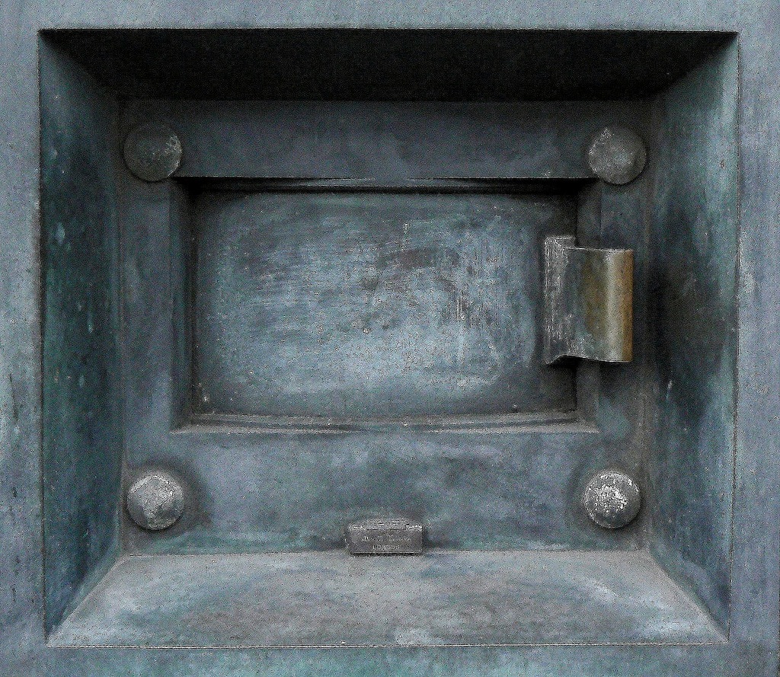

Steal 5 points
Notes:
Steal this amount of points from the other teams (all from one team or split between several teams)

Slide 43
How does it feel?
How does it taste?
What is it?
It’s hard
It’s sour
It’s a banana
X
O
X
It’s hot
It’s sweet
It’s a lemon
X
X
O
It’s soft
It’s sweet and sour
It’s a mango
O
X
X
Notes:
Zoom out to see all the question/answer place holders. Fill them in according to the green O’s and Red X’s. If you get any wrong answer you fail the challenge, hit the red marker in the bottom left, if you get all 3 correct you get to steal that amount of points from the other teams (all from one team or split between several teams)

Slide 44
Steal 10 points
Notes:
Steal this amount of points from the other teams (all from one team or split between several teams)

Slide 45
How does it taste?
How does it feel?
What are they?
They’re sweet
They’re hard
It’s a grape.
O
X
X
They’re sour
They’re hot
It’s grapes
X
X
X
They’re sweet and sour
They’re soft
They are grapes
X
O
O
Notes:
Zoom out to see all the question/answer place holders. Fill them in according to the green O’s and Red X’s. If you get any wrong answer you fail the challenge, hit the red marker in the bottom left, if you get all 3 correct you get to steal that amount of points from the other teams (all from one team or split between several teams)

Slide 46
Steal 5 points
Notes:
Steal this amount of points from the other teams (all from one team or split between several teams)

Slide 47

How does it taste?
How does it feel?
What is it?
It’s sweet and cold
It’s hot
It’s strawberry juice
X
O
X
It’s bitter and hot
It’s thick
It’s coffee
O
X
O
It’s sour and cold
It’s thin
It’s grape juice
X
X
X
Notes:
Zoom out to see all the question/answer place holders. Fill them in according to the green O’s and Red X’s. If you get any wrong answer you fail the challenge, hit the red marker in the bottom left, if you get all 3 correct you get to steal that amount of points from the other teams (all from one team or split between several teams)

Slide 48
Steal 10 points
Notes:
Steal this amount of points from the other teams (all from one team or split between several teams)

Slide 49

SƯU TẦM: ĐOÀN VĂN DOANH, NAM TRỰC, NAM ĐỊNH
LINK NHÓM DÀNH CHO GV BỘ MÔN VẬT LÝ TRAO ĐỔI TÀI LIỆU VÀ CHUYÊN MÔN CT 2018
https://www.facebook.com/groups/299257004355186

