Slide 1





Slide 4
Notes:
show pupils the picture and ask them questiions related like what subject is it? is it art? What’s your favourite subject? Why do you like art? What subject do you have today?

Slide 5
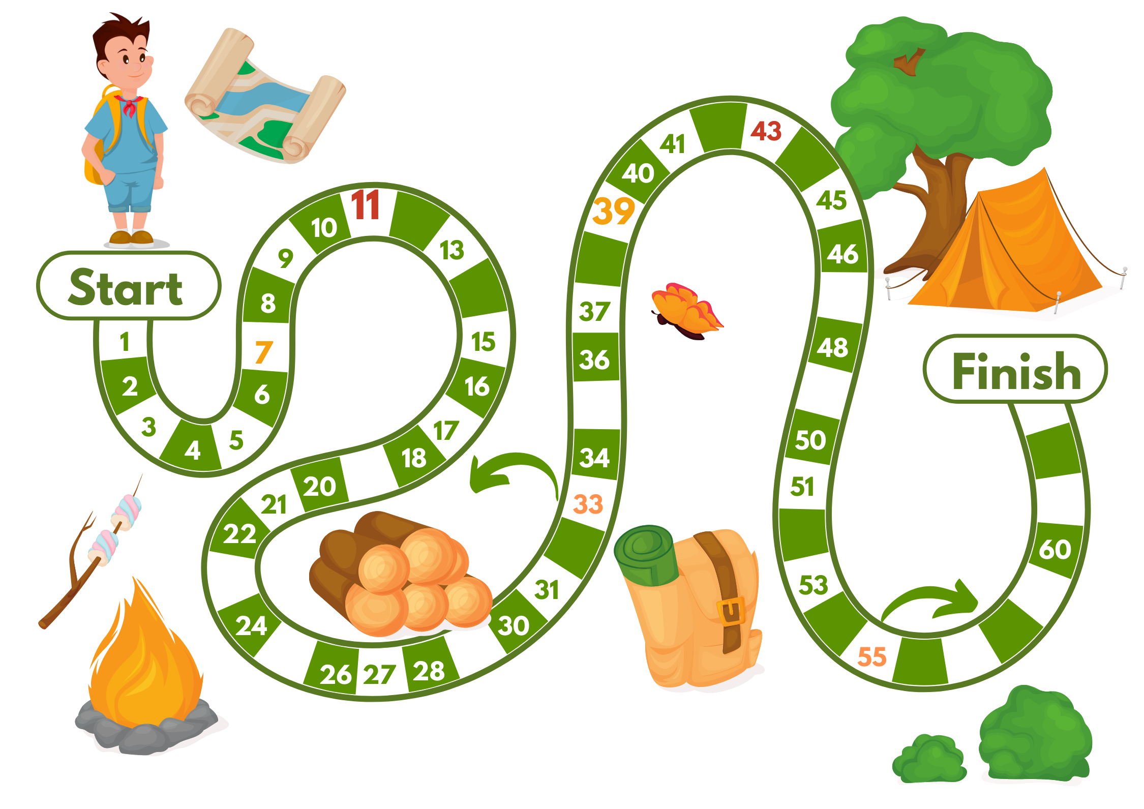
Notes:
camping trip game
roll a dice and add 5
red number: back 5 spaces
orange number: forward 3 spaces
the rest, answer randomly the flashcard opened, questions given by the Teacher, for example, what is it? which subject do you use a ruler/ a crayon?...

Slide 6

Notes:
English
Maths: clues: 2 woves and 2 cats, count- relates to number

Slide 7

Notes:
Vietnamese
Art

Slide 8

Notes:
Music
PE

Slide 9

Notes:
a teacher
runner- PE

Slide 10

Notes:
IT
Maths

Slide 11
My name is Peter. It is Thursday today. I have English, PE, music, art and maths at school. My favourite subject is English. I like it because I want to be an English teacher. I also like music because I want to be a singer, too. I do not like maths because I am not good at it.
Notes:
Read the text

Slide 12
My name is Peter. It is Thursday today. I have English, PE, music, art and maths at school. My favourite subject is English. I like it because I want to be an English teacher. I also like music because I want to be a singer, too. I do not like maths because I am not good at it.
1. His name is Peter
2. He has four subjects at school.
3. His favourite subject is English
4. Music is not his favourite English.
Notes:
Give pupils explanation
1T 2F 3T 4F

Slide 13
My name is………………..
I have…………………and maths today. My favourite subject is……………… I like it because I want to be………………………
What’s your favourite subject?

Slide 14
My name is….
I have………. and maths today.
My favourite subject is….
I like it because I want to be….
What is your favourite subject?

Slide 15
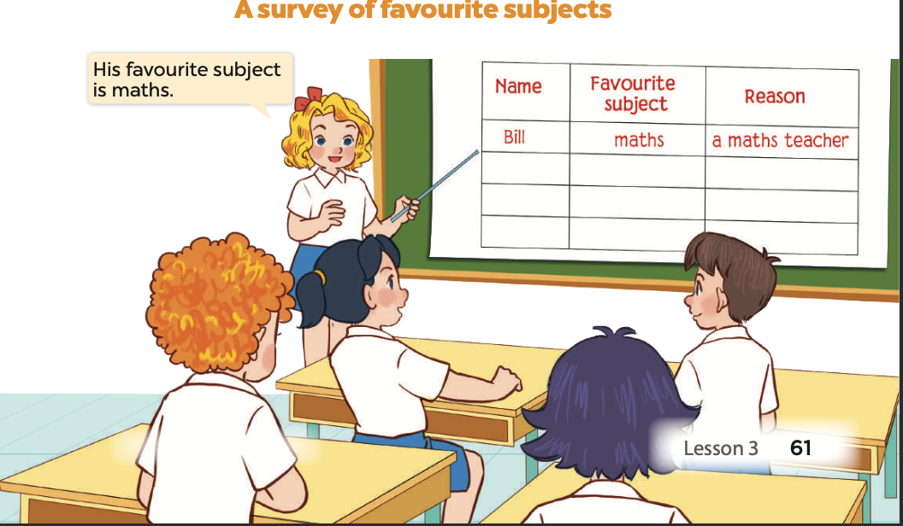

Slide 16
NAME | FAVOURITE SUBJECT | REASON
Bill | maths | a maths teacher

Slide 17
PRESENTATION
Group 1
Group 2
Group 3
Group 4
Notes:
divide pupils into groups, ask them to interview their friends to complete a survery on their favourite subjects, give help if necessary
request each group to present

Slide 18

music
art
maths
English
PE
Notes:
all boxes in the middle of the room
pupils are delivered pieces of paper with 5 colours (purple, green, brown, grass, orange)
all pupls sit with their back toward the boxes.
pupils take turns to put the colour piece of paper into the corresponding colour box.
the piece of paper is their favourite subject at school.
They can put paper pieces into more than one box.
The teacher and the whole class check the number of paper pieces in each box and give a summary.

Slide 19

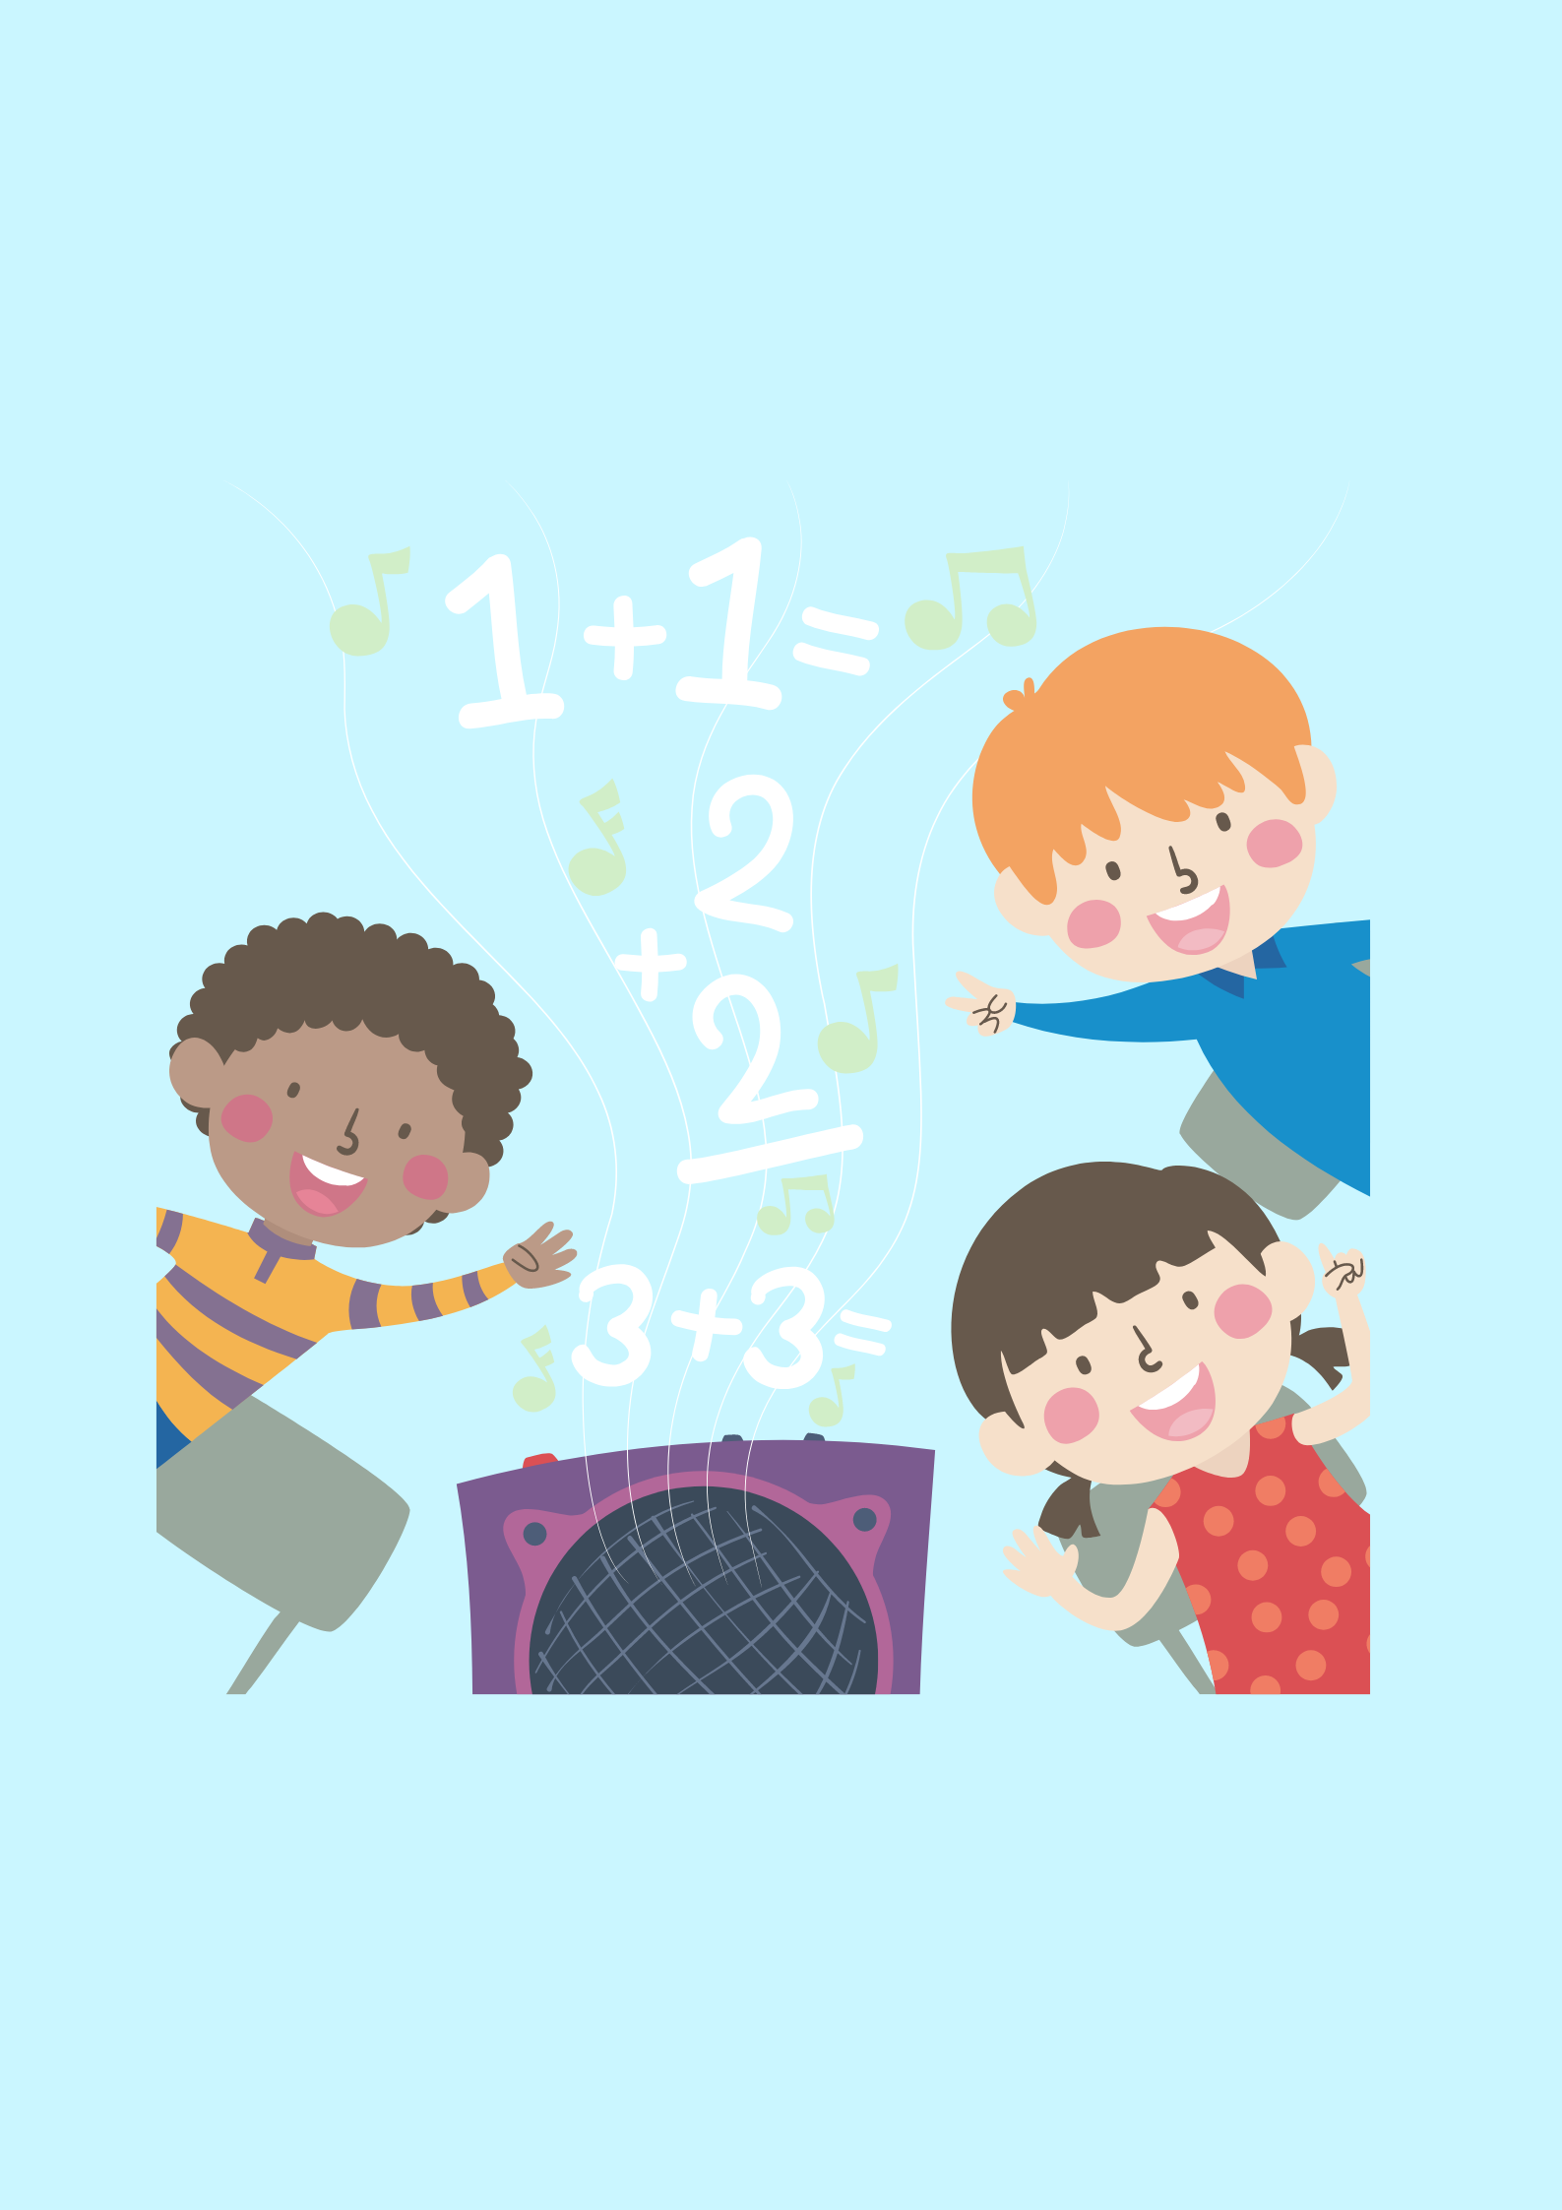
WHAT DO YOU LEARN TODAY?

Slide 20


Slide 21
MATCH THE SUBJECT WITH THE PICTURE TO ANSWER THE QUESTION “ WHAT’S YOUR FAVOURITE SUBJECT?”

Slide 22





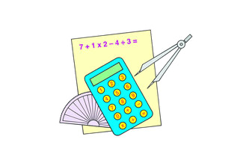

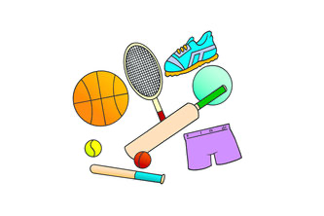
ART
MATHS
MUSIC
ENGLISH
“ WHAT’S YOUR FAVOURITE SUBJECT?”
SCIENCE
IT
PE
ART
Notes:
THIS GAME CAN BE PLAYED IN GROUPS OR TEAMS, FLASH THE CARDS THEN THE WORDS, TIME AND COUNT FOR PUPILS TO MATCH AFTER THE TEACHER SAYS THE SUBJECT IN ORDER,
art- IT science, music, science, maths, drawing, PE
after pupils say, ask Why do you like it?

Slide 23


