Slide 1


English 8
UNIT 9 . NATURAL DISASTERS
PERIOD 77: LOOKING BACK + PROJECT
Welcome to our class

Slide 2
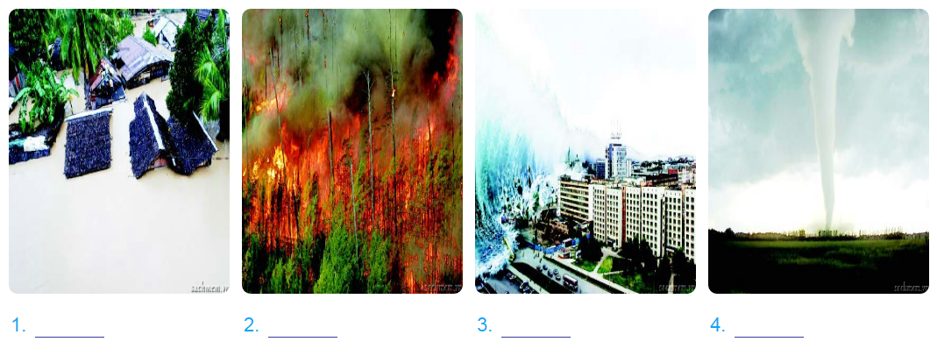
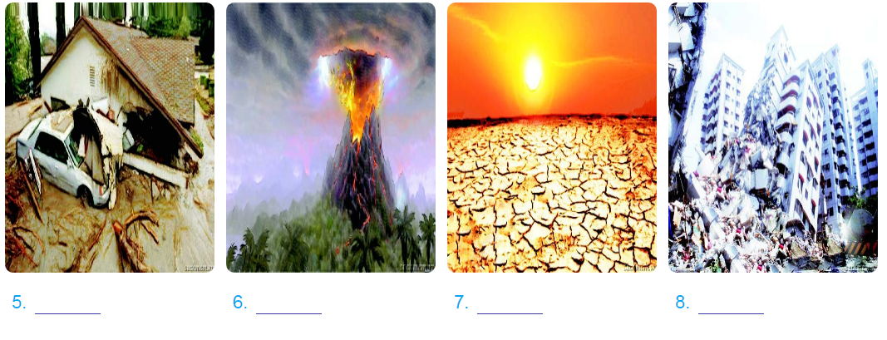
* Warm - up.
flood
forest fire
tsunami
tornado
volcano eruption
mudslide
drought
earthquake

Slide 3
I. New words:
- slide ( v) : trượt, chuyển động, chảy (bùn)
- reservation (n): sự đặt trước (đặt phòng)
- pass (n) : vé tháng, hộ chiếu
- put on (v) : dựng lại (vở kịch)

Slide 4
A. VOCABULARY
1. Match the words (1-6) to their definitions (A-F).

Slide 5
Words | Definitions
A. a violent storm with very strong winds which move in a circle
1. drought
B. a huge wave that can destroy towns near the sea
2. mudslide
C. a long period when there is no rain and not enough water for people, animals and plants
3. ﬂood
D. a large amount of water covering an area that is usually dry
4. tsunami
E. a sudden, violent shaking of the Earth’s surface
5. tornado
F. a large amount of mud sliding down a mountain, often destroying buildings and injuring or killing people below
6.earthquake
C
F
D
B
A
E
1. 2. 3. 4. 5 . 6.

Slide 6
2.Use the words from the box in the correct form to complete the sentences.
scatter
take
evacuate
put out
provide
Emergency workers ___________ the village when the river ﬂooded the area.
2. Rescue workers are still trying to __________ the forest fires.
3. The strong winds forced the climbers to _______ shelter.
4. Many countries have __________ food and other material aid to the hurricane victims.
5. Debris from collapsed buildings was __________ across the whole area.
d
d
ed

Slide 7
B. GRAMMAR
THE PASSIVE VOICE :
Example:
Active:
Rescue workers have freed ten people trapped in collapsed buildings .
S
V
O
Passive:
be
+ PP
(by) + O
S
Ten people trapped in collapsed buildings
have freed
by rescue workers.
been

Slide 8
B. Grammar
3. Decide which of the sentences can be changed to passive voice. Write them down. Explain why two of them cannot.
The tickets will be collected (by Mr Smith).
1. Mr Smith will collect the tickets.
___________________________________________
2. The students put on a play at the end of term.
___________________________________________
3. Jim is always late for work.
___________________________________________
4. Julie took the message.
___________________________________________
5. A local artist painted the picture.
___________________________________________
6. They arrived at the theatre at 8.30 p.m.
___________________________________________

Slide 9
B. Grammar
3. Decide which of the sentences can be changed to passive voice. Write them down. Explain why two of them cannot.
1. Mr Smith will collect the tickets.
2. The students put on a play at the end of term.
3. Jim is always late for work.
→The tickets will be collected (by Mr Smith).
→ A play was put on (by the students) at the end of term.
→The sentence cannot be written in the passive because its main verb is not a transitive verb.

Slide 10
B. Grammar
3. Decide which of the sentences can be changed to passive voice. Write them down. Explain why two of them cannot.
4. Julie took the message.
5. A local artist painted the picture.
6. They arrived at the theatre at 8.30 p.m.
→The message was taken (by Julie).
→ The picture was painted by a local artist.
→The sentence cannot be written in the passive because its main verb arrive is not a transitive verb.

Slide 11
4. Match the two parts to make complete sentences.
1. After our plane had landed, 2. We found out the train had left 3. When we got to the hotel, 4. I had never really travelled 5. The waiter had taken my plate 6. As I stepped onto the bus, | a. we learnt they had lost our reservation. b. until I decided to study abroad. c. before I fnished eating my meal. d. we waited an hour for our luggage. e. I noticed I had left my pass at home. f. ten minutes before we got to the station.
d
f
a
b
c
e
1. 2. 3. 4. 5 . 6.

Slide 12
5a. Imagine five bad things that happened to you yesterday, and write them down.
Example:
- Someone stole my bike.
My sister broke my compute
.............
Suggested answer
- My bike broke down on the way to school.
- I went to school late.

Slide 13
b. Work in groups.
Add time clauses to your sentences as the following examples. Remember to use the past perfect

Slide 14
Past perfect tense:
(+) Positive
S+ had + past pariciple
Ex: I had left when they came.
(-) negative
S + had not( hadn’t) + past participle
Ex: I hadn’t left when they came.
(?) Questions
Had + S +past participle?
→Yes, S + had / No, S + hadn’t
Ex: Had you left when they came ?

Slide 15
b. Work in groups.
Add time clauses to your sentences as the following examples. Remember to use the past perfect
When I woke up yesterday morning,
somebody had stolen my bike.
When I got home yesterday, my sister had broken my computer.

Slide 16
Do you remember the responses? Write them into the correct columns.
Wow !
That’s awful !
Oh no!
That’s great !
How terrible !
That’s shocking!
Oh dear!
That’s relief !
How wonderful !
That’s awesome!
Responding to good news | Responding to bad news

Slide 17
C. COMMUNICATION
6. Read the news headlines. In pairs, use the expressions from the box in GETING STARTED to respond to them.
Six-year-old rescued from forest fire by pet dog | Temporary accommodation set up for volcano victims
Hundreds of homes damaged or destroyed in Haiti by tornado | One million dollars raised for typhoon victims in the Philippines so far
Earthquake survivors found under debris after ten days | Debris finally cleared by rescue teams
Example:
A: It says here that a six-year-old girl was rescued from a forest fire by her pet dog.
B: Wow! That’s amazing!

Slide 18
D. PROJECT
1. These activities aiming to provide aid for victims of natural disasters. Write a phrase to describe each picture.

Slide 19
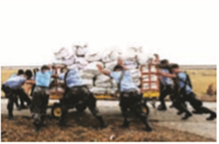
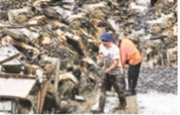
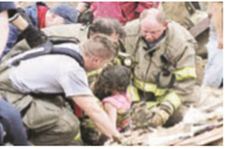
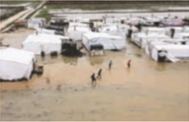
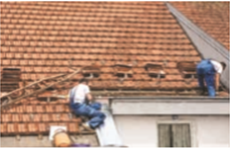
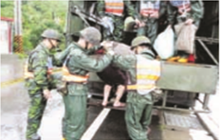
A Helping Hand
providing (food/ medical) supplies
2
3
freeing trapped people
1
clearing up debris
4
setting up temporary accommodation (for the victims of a disaster)
5
evacuating the village/ town ... to a safe place/ area
6
repairing houses/ buildings

Slide 20
2. Work in groups
Imagine you are members of a volunteer team who are going to provide aid for the victims of a natural disaster. Work out a plan for your team.
- Provide food, medical aid supplies.
- Cleaning up debris.

Slide 21
3. Share tour plan with other groups. Vote for the best plan.

Slide 22





Thanks for your attention
Good bye. See you again !

