Slide 1

Unit 6: Entertainment
Lesson 6b: Grammar
(Cont.)
Page 107

Slide 2
Lesson Outline
Warm-up
Grammar
Consolidation
Wrap-up

Slide 3
Objectives
By the end of this lesson, students will be able to…
revise and practise “will” and “be going to”.
learn a new grammar point: Present Continuous.

Slide 4

WARM-UP

Slide 5
Choose the word whose main stress is placed differently from that of the others.
1. A. underwater B. exhibition C. experience D. entertainment
/ˌʌndəˈwɔːtə/ /ˌeksɪˈbɪʃən/ /ɪkˈspɪəriəns/ /entəˈteɪnmənt/
2. A. capsule B. event C. speedboat D. coaster
/ˈkæpsjuːl/ /ɪˈvent/ /ˈspiːdbəʊt/ /ˈkəʊstə/
3. A. equipment B. attraction C. delicious D. classical
/ɪˈkwɪpmənt/ /əˈtrækʃən/ /dɪˈlɪʃəs/ /ˈklæsɪkəl/

Slide 6
4 Complete the sentences. Use the appropriate form of be going to and the verbs in the list.
• visit • chat • play • watch • attend
This weekend ...
1 John _____________________ football. (✗)
2 Steve _____________________ a film at the cinema. (✓)
3 Paula _____________________ her cousins. (✗)
4 Jim and Andy _____________________ to each other online. (✓)
5 Kim and her mum _____________________ a theatre performance. (✗)
isn’t going to play
is going to watch
isn’t going to visit
are going to chat
aren’t going to attend

Slide 7

It’s time to learn …

Slide 8
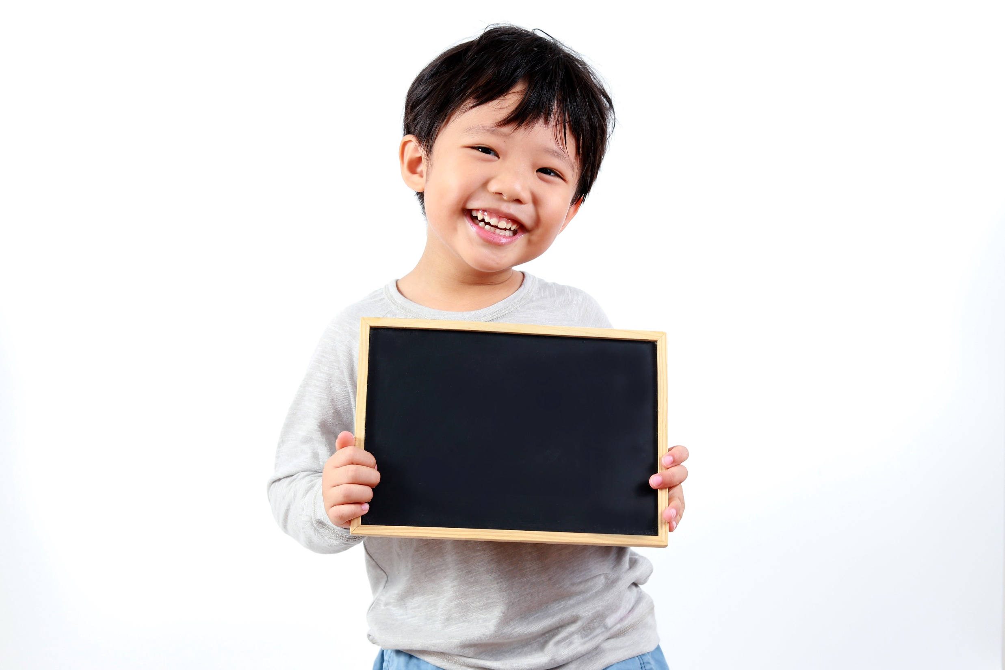
Practice

Slide 9

5 Ask and answer using the prompts and be going to.
First, make the questions.
1 you/travel abroad this summer?
Are you going to travel abroad this summer?
2 you/work on TV when you grow up?
Are you going to work on TV when you grow up?
3 where/you and your family/spend the weekend?
Where are you and your family going to spend the weekend?
4 your parents/attend a performance next Saturday?
Are your parents going to attend a performance next Saturday?
Now, ask and answer the questions with your partners.

Slide 10
6 Put the verbs in brackets in the Future Simple (will) or the be going to form.
on-the-spot decisions
1 A: Have you got this week’s Teen Sports magazine?
B: I’m not sure. I _________________ (have) a look.
2 A: The drama club _________________ (hold) a performance this Sunday.
B: Really? I _________________ (come)!
3 A: There’s a documentary about celebrities on TV tonight.
B: I know. I _________________ (not/watch) it, though.
4 A: Do you think _________________ (Peter/come) to the party?
B: No. He _________________ (spend) the weekend with his uncle.
will have
plan
is going to hold
promise
will come
intention
am not going to watch
Peter will come
prediction based on what we think
is going to spend
intention

Slide 11
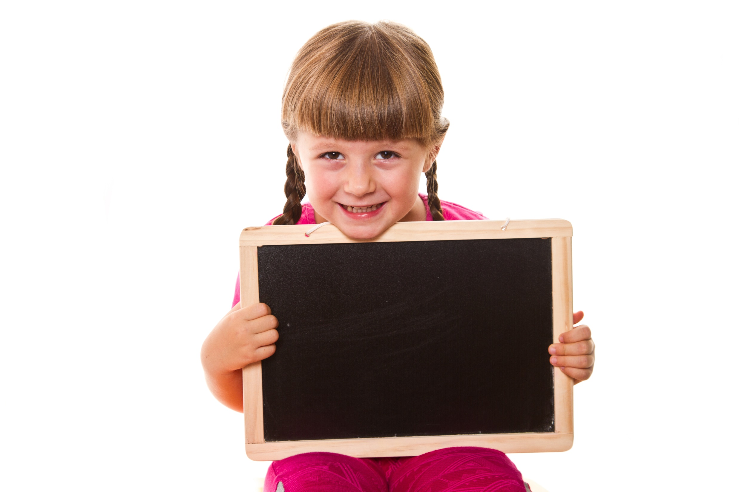
Presentation

Slide 12
Present Continuous
We use the Present Continuous for fixed arrangements in the near future.
e.g. John’s leaving tomorrow. He bought his train ticket yesterday.
Note!
I + am V-ing
He/She/It/Singular nouns + is V-ing
You/We/They/Plural nouns + are V-ing

Slide 13
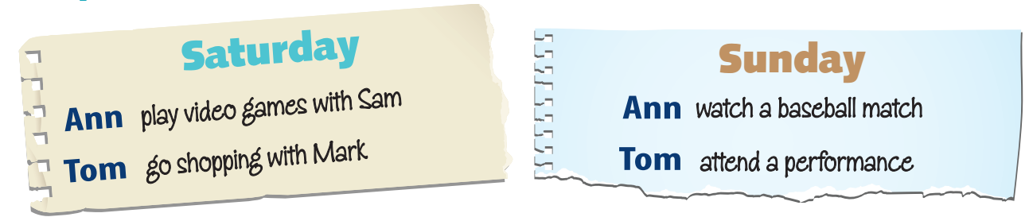
7 Look at the notes. Correct the sentences. Write in your notebook.
Example
1 Ann is watching a basketball match with Sam on Saturday.
=> Ann isn’t watching a basketball match with Sam on Saturday.
=> She’s playing video games with Sam.

Slide 14
7 Look at the notes. Correct the sentences. Write in your notebook.
2 Tom is playing video games on Sunday.
=> Tom isn’t playing video games on Sunday.
=> He’s attending a performance.
3 Tom and Mark are attending a performance on Saturday.
=> Tom and Mark aren’t attending a performance on Saturday.
=> They’re going shopping.

Slide 15
7 Look at the notes. Correct the sentences. Write in your notebook.
4 Ann and Sam are going shopping on Saturday.
=> Ann and Sam aren’t going shopping on Saturday.
=>They’re playing video games.
5 Ann is attending a performance on Sunday.
=> Ann is not attending a performance on Sunday.
=> She’s watching a baseball match.

Slide 16
Further practice
Complete the sentences. Use verbs from the list in the Present Continuous.
• fly • visit • spend • go • play • not/plan
A
are flying
We 1) __________________ to France at the weekend.
Really? Where are you going?
We 2) _______________________ two weeks in Paris.
Wow! 3) ____________ you ______________ anywhere special while you’re there?
Yes. After we arrive, we 4) _____________ the Eiffel Tower.
That sounds great! Are you going to see a football game at the Stade de France?
There is a game on this Sunday, but we 5) ______________________ to watch it. We 6) __________________ tennis on that day.
Well, I hope you have an amazing time.
Thanks!
B
A
are spending
B
Are
going
A
are visiting
B
A
aren’t planning
are playing
B
A

Slide 17

Production

Slide 18

8 Tell your partner about what you are/aren’t doing this evening and what you are/aren’t going to do this weekend.
Sample
I’m doing my homework tonight. I’m not going out with my friends. This weekend, I’m going to go to the cinema with my brother. I’m not going to go to the beach.

Slide 19

CONSOLIDATION

Slide 20
Write a paragraph (50-60 words) about your coming holiday.
Use the Future Simple, “be going to” and the Present Continuous.

Slide 21

WRAP-UP

Slide 22
Today’s lesson
Grammar
- Future Simple
- be going to
- Present Continuous

Slide 23
Homework
Practise the grammar point and make sentences using them.
Do the exercises in TA 6 Right on WB (p. 55).
Complete the grammar notes in TA 6 Right on Notebook (p. 56).
Prepare the next lesson (p. 108 SB).

Slide 24
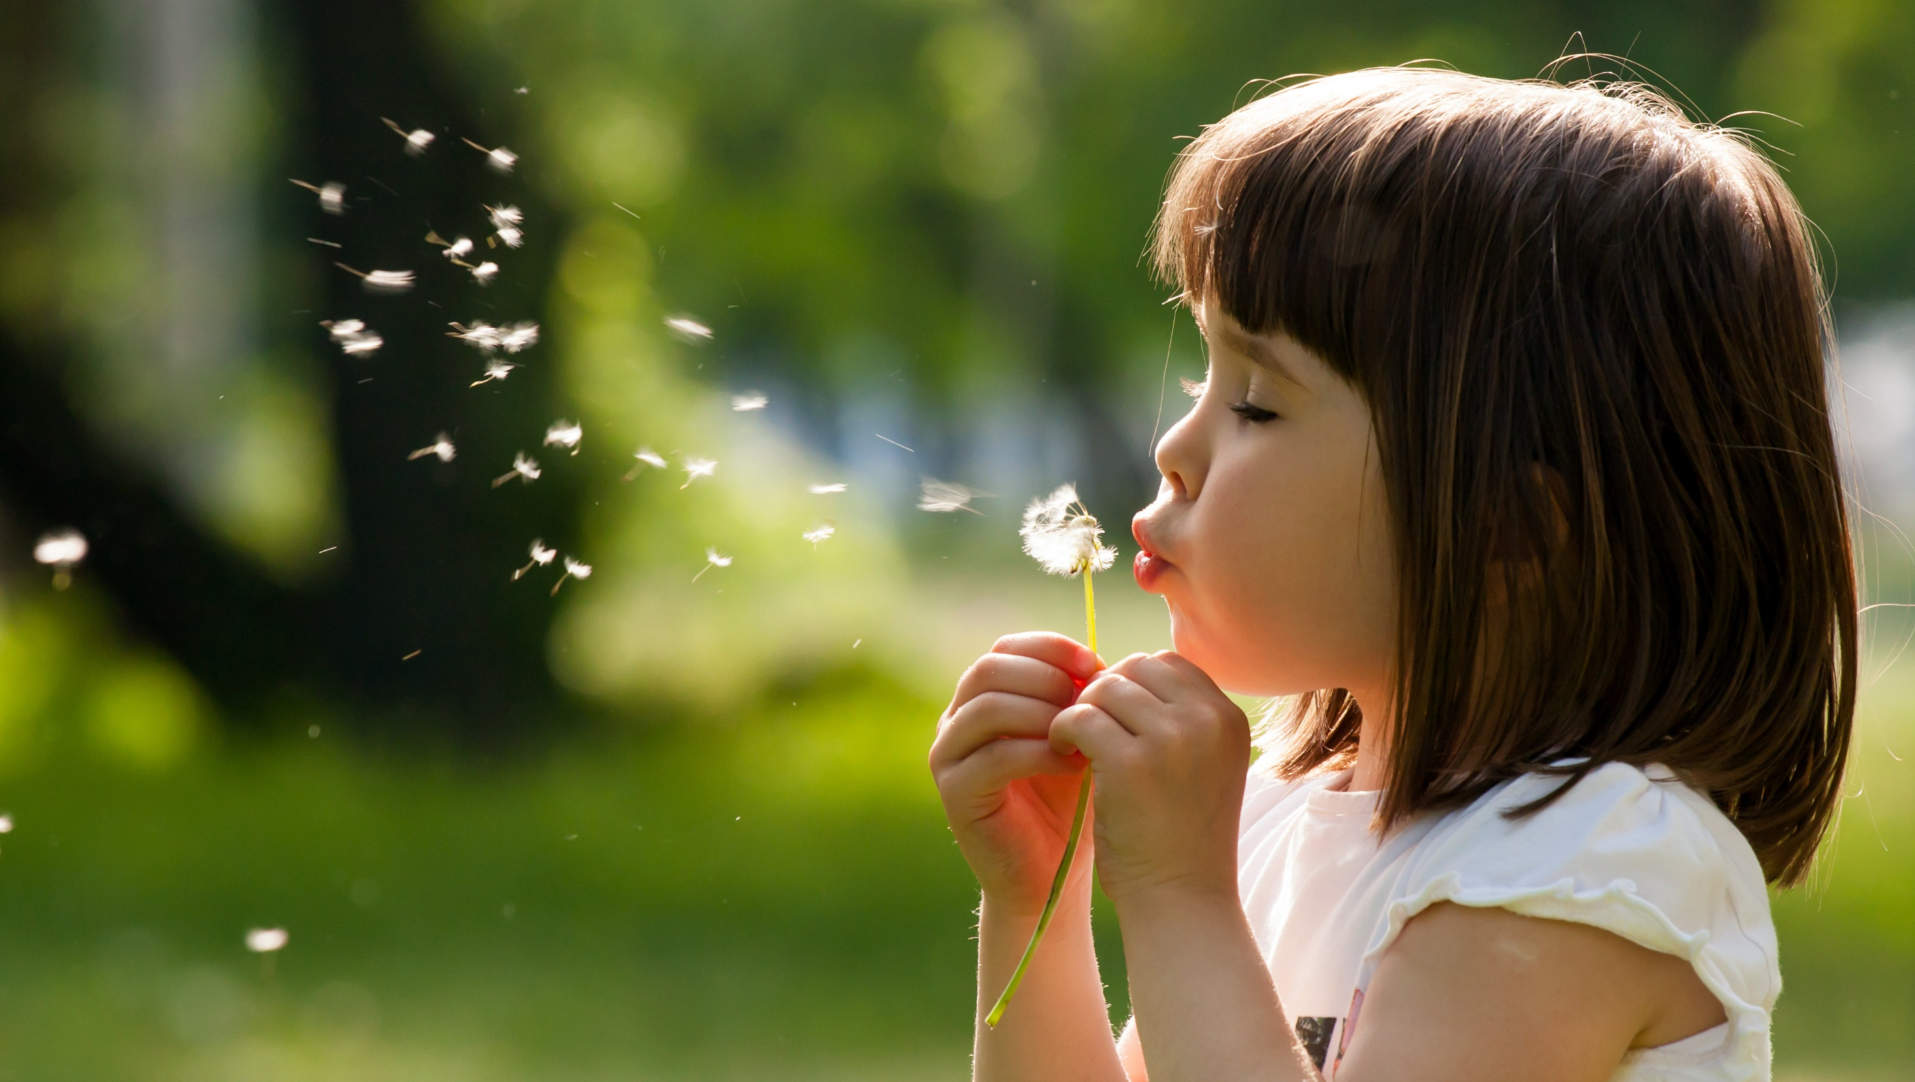
Enjoy your day!

