Slide 1


Slide 2

Unit
4
Asean and Viet Nam
Unit
FAMILY LIFE
LESSON 3
READING
ASEAN news

Slide 3
LESSON 3
READING
WARM-UP
Labelling
PRE-READING
Task 1: Discuss the questions.
Task 2: Read the news items and choose the most suitable headline for each one.
Task 3: Match the highlighted words with their meanings.
Task 4: Answer the question.
WHILE-READING
POST-READING
Task 5: Discussion
CONSOLIDATION
Wrap-up
Homework

Slide 4
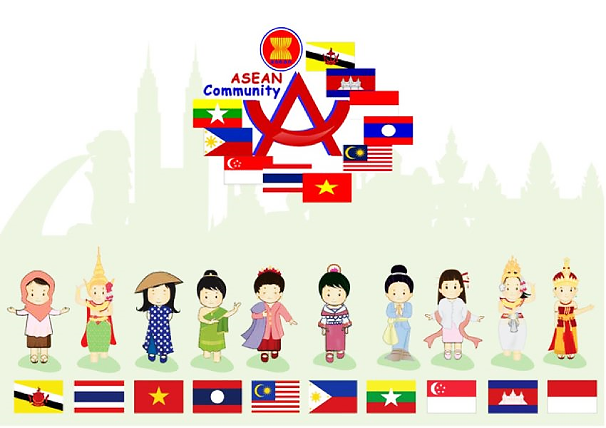
WARM-UP
Labelling game

Slide 5
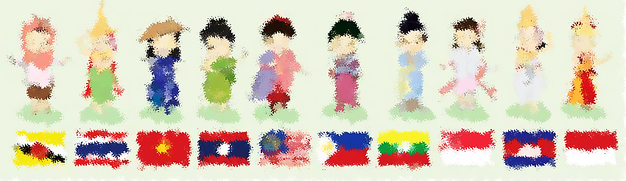
WARM-UP
Students work in 4 groups
There are some news headlines and some categories: Sport, Laws, Education, etc…
Raise your hands to get turn and put the headlines in the correct category.

Slide 6

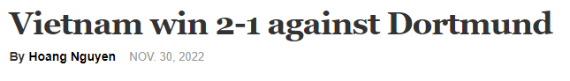
Put the news headlines in the correct category
1
Economy
Food
Politics
Sport

Slide 7
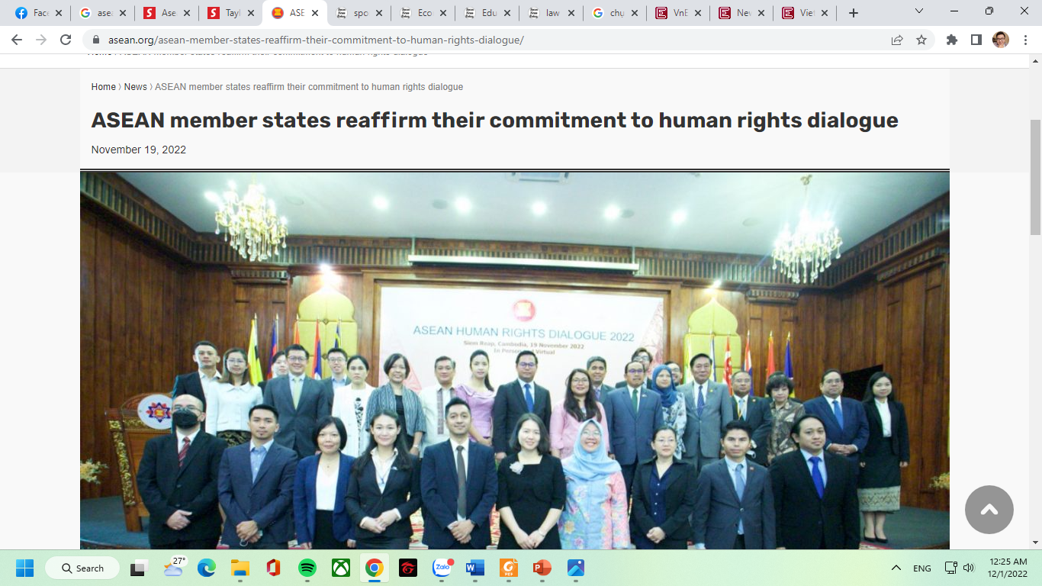
Put the news headlines in the correct category
2
Economy
Food
Law
Sport

Slide 8
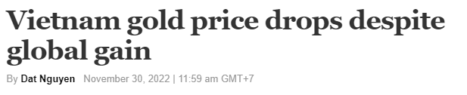
Put the news headlines in the correct category
3
Economy
Food
Politics
Sport

Slide 9
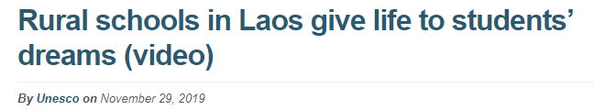
Put the news headlines in the correct category
4
Economy
Education
Politics
Sport

Slide 10
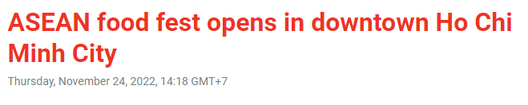
Put the news headlines in the correct category
5
Economy
Food
Politics
Sport

Slide 11
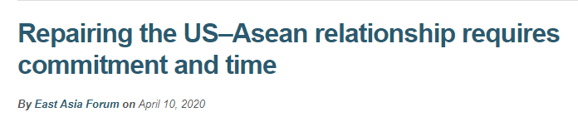
Put the news headlines in the correct category
6
Economy
Education
Politics
Laws

Slide 12

PRE-READING
1
Work in pairs. Discuss the following questions.

Slide 13


PRE-READING
relation (n)
/rɪˈleɪʃən/
the connection between people, groups, organizations, or countries

Slide 14

PRE-READING
eye-opening (adj)
/ˈaɪˌəʊpənɪŋ/
surprising, and teaching you new facts about life, people, etc.

Slide 15

PRE-READING
represent (v)
/ˌreprɪˈzent/
to speak, act, or be present officially for another person or people

Slide 16

PRE-READING
live stream (n)
/ˈlaɪvstriːm/
a broadcast of the video and sound of an event over the internet as it happens

Slide 17
Form | Pronunciation | Meaning
1. relation (n) | /rɪˈleɪʃən/ | the connection between people, groups, organizations, or countries
2. eye-opening (adj) | /ˈaɪˌəʊpənɪŋ/ | surprising, and teaching you new facts about life, people, etc.
3. represent (v) | /ˌreprɪˈzent/ | to speak, act, or be present officially for another person or people
4. live stream (n) | /ˈlaɪvstriːm/ | a broadcast of the video and sound of an event over the internet as it happens

Slide 18
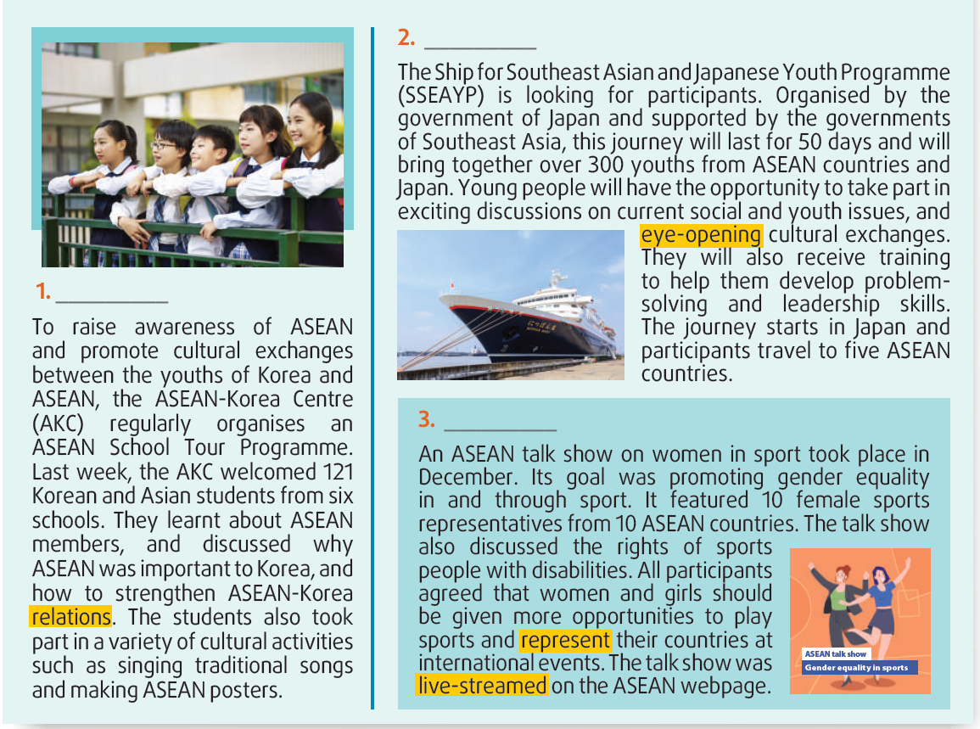

WHILE-READING
2
Read the news items and choose the most suitable headline for each one.
A
D
C
Answer key:
1. D 2. A 3. C

Slide 19
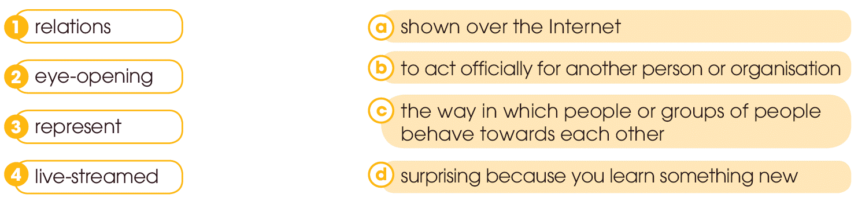
WHILE-READING
3
Read the news items again and match the highlighted words with their meanings.

Slide 20
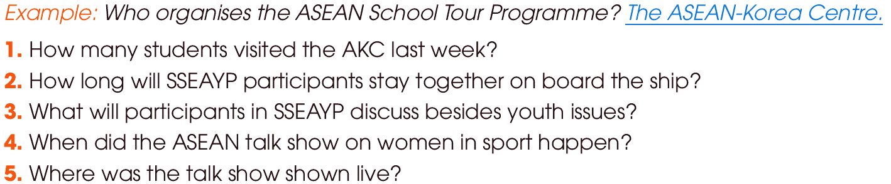
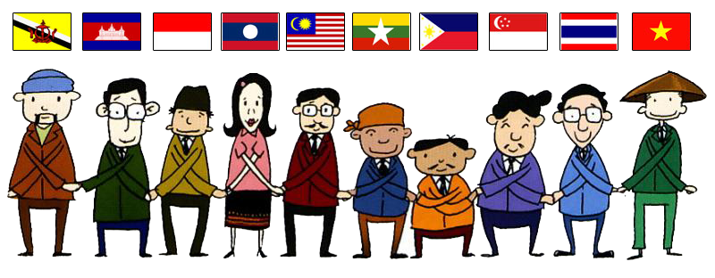
WHILE-READING
4
Read the news items again and answer each question below with no more than FOUR words and/or a number.
1. 121 (students)
2. 50 days
3. current social issues
4. (in) December
5. (on) the ASEAN webpage
ANSWER KEY

Slide 21

POST-READING
5
Work in groups. Discuss the following questions.

Slide 22
CONSOLIDATION
1
Wrap-up
What have you learnt today?
Read for main ideas and specific information in news items about ASEAN countries.
New vocabularies

Slide 23

CONSOLIDATION
2
Homework
Do exercises in the workbook.
Prepare for Lesson 4 - Unit 4.

Slide 24

Website: hoclieu.vn
Fanpage: facebook.com/www.tienganhglobalsuccess.vn

