Slide 1


Slide 2

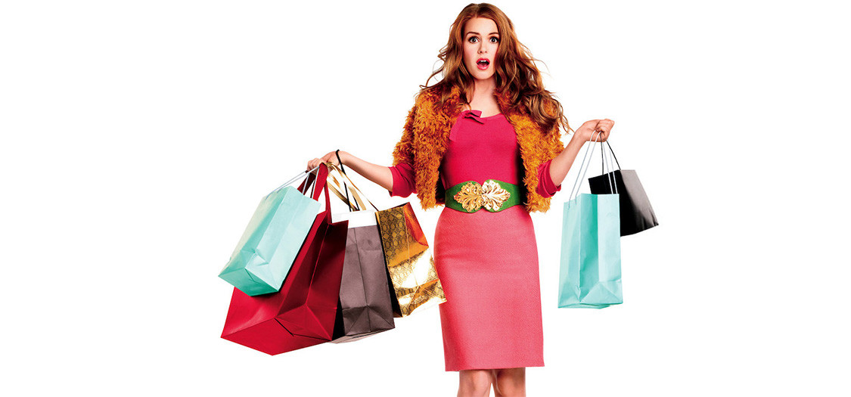
Unit
8
SHOPPING
LESSON 2: A closer look 1
1

Slide 3
LESSON 2: A CLOSER LOOK 1
WARM-UP
Video watching
Vocabulary
Task 1: Write the words and phrases under the correct pictures.
Task 2: Match the shopping places with their characteristics.
Task 3: Complete the sentences with the words and phrases from the box.
VOCABULARY
PRONUNCIATION
Task 4: Listen and repeat the words. Pay attention to the sounds /sp/ and /st/.
Task 5: Listen and repeat the sentences. Pay attention to the underlined words.
PRODUCTION
Game: Whispering
CONSOLIDATION
Wrap-up
Homework

Slide 4
CLIP WATCHING
WARM-UP
Do you know the film? What’s its name?
It’s Confessions of a Shopaholic.
What is it about?
It’s about a girl who is addicted to shopping.
SHOPAHOLIC
Notes:
Link video: https://www.youtube.com/watch?v=d-jE5WJ7J28

Slide 5


PRESENTATION
shopaholic (n)
/ˌʃɒpəˈhɒlɪk/
người nghiện mua sắm

Slide 6

PRESENTATION
on sale
/ɒn seɪl/
đang (được bán) hạ giá

Slide 7

PRESENTATION
discount shop (n)
/ˈdɪskaʊnt ʃɒp/
cửa hàng hạ giá

Slide 8
VOCABULARY
PRESENTATION
New words | Pronunciation | Meaning
1. shopaholic (n) | /ˌʃɒpəˈhɒlɪk/ | người nghiện mua sắm
2. on sale | /ɒn seɪl/ | đang (được bán) hạ giá
3. discount shop(n) | /ˈdɪskaʊnt ʃɒp/ | cửa hàng hạ giá

Slide 9

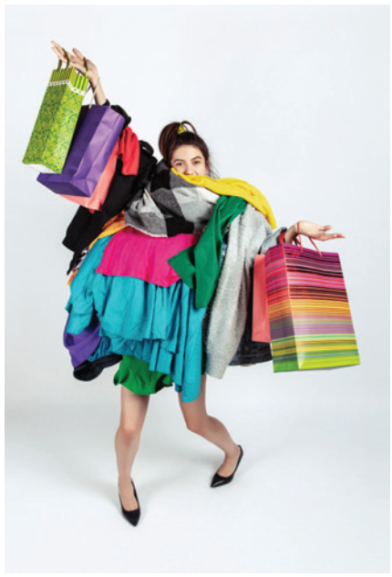
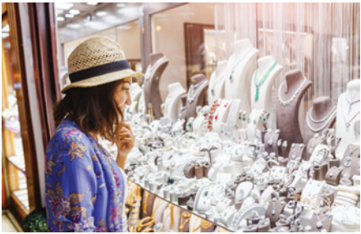


VOCABULARY
1
Write the words and phrases under the correct pictures
shopaholic
browsing
price tag
Internet access
on sale
1. _____________
4. _____________
2. _____________
5. _____________
3. _____________

Slide 10
VOCABULARY
2
Match the shopping places with their characteristics.
1. a speciality shop |  | a. It offers lower prices on all products.
2. a discount shop |  | b. It uses the Internet to sell goods and services.
3. a supermarket |  | c. It is often outdoor and offers a wide range of goods. Buyers can bargain.
4. an online shop |  | d. It is a large indoor shopping place with mixed prices for all the items offered.
5. an open-air market |  | e. It offers one or two specific kinds of goods.

Slide 11
VOCABULARY
3
Complete the sentences with the words and phrases from the box.
shopaholic
bargain
speciality shops
browsing
range of products
1. There are many _____________ in a shopping centre.
2. I spent the whole morning just ________online for clothes, but I didn’t buy anything.
3. Alice doesn’t know how to _______, so she paid too much for her
T-shirt.
4. Both online and offline supermarkets offer a wide ______________.
5. She’s a __________. She spends too much time and money shopping.

Slide 12
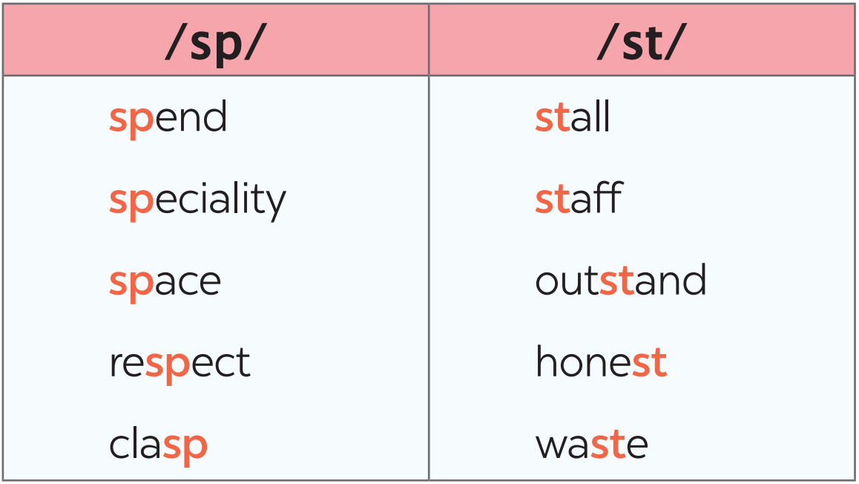
PRONUNCIATION
4
Listen and repeat the words. Pay attention to the sounds /sp/ and /st/.

Slide 13
PRONUNCIATION
5
Listen and repeat the sentences. Pay attention to the underlined words.
1. There is a three-storey sports centre in my neighbourhood.
2. The assistant at her shop always gives us special attention.
3. The shop owner treats his customers with a lot of respect.
4. The food at that restaurant is too spicy for me.
5. Tom spent half of his savings in that music store.

Slide 14
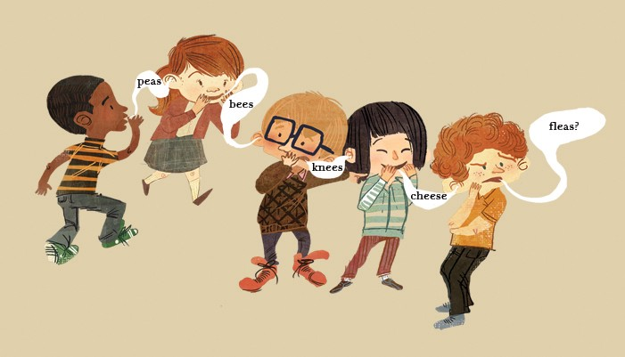
PRODUCTION
5
GAME: WHISPERING
RULE:
- Work in 2 teams
Players stand in a line.
The teacher whispers a word to the Ss standing at the 1st row. Ss whisper from one person to the next until the end of the line. The last person in the line repeats the words.
The team with more correct words will win.

Slide 15

CONSOLIDATION
1
Wrap-up
What have we learnt in this lesson?
Shopping places and their characteristics.
2 sounds /sp/ and /st/

Slide 16

CONSOLIDATION
2
Homework
Name a list of shopping places
Find 5 more words with the sounds /st/ and /sp/
Do the exercises in the Workbook

Slide 17

Website: hoclieu.vn
Fanpage: facebook.com/tienganhglobalsuccess.vn/

