Slide 1

Unit 3: All about food
Lesson 3a: Vocab Expansion
Page 55

Slide 2
Lesson Outline
Warm-up
Vocabulary
Speaking
Writing
Consolidation
Wrap-up

Slide 3
Objectives
By the end of this lesson, students will be able to…
learn more vocabulary about food.
write a short text about their favourite dish.

Slide 4

WARM-UP

Slide 5
Choose the words whose main stress is placed differently from the others.
A. recipe B. cereal C. animal D. magazine
/ˈresɪpi/ /ˈsɪəriəl/ /ˈænɪməl/ /mæɡəˈziːn/
2. A. popular B. unhealthy C. difficult D. excellent
/ˈpɒpjələ/ /ʌnˈhelθi/ /ˈdɪfɪkəlt/ /ˈeksələnt/
3. A. tomato B. cucumber C. strawberry D. vegetable
/təˈmɑːtəʊ/ /ˈkjuːkʌmbə/ /ˈstrɔːbəri/ /ˈvedʒtəbəl/

Slide 6

It’s time to learn …

Slide 7

Vocabulary

Slide 8
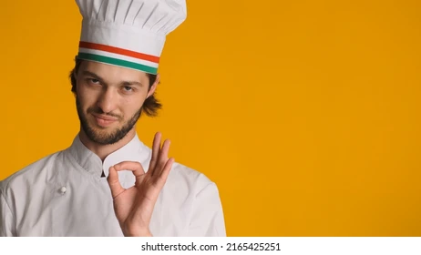
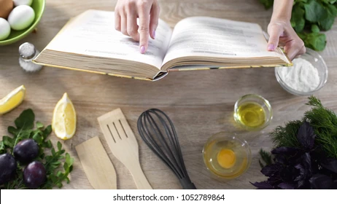
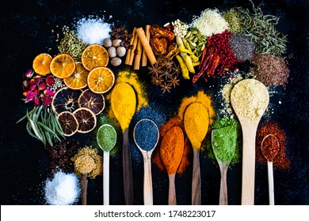
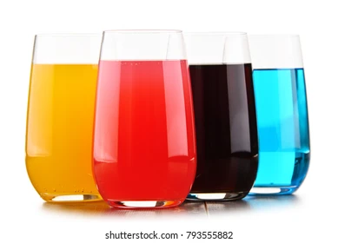
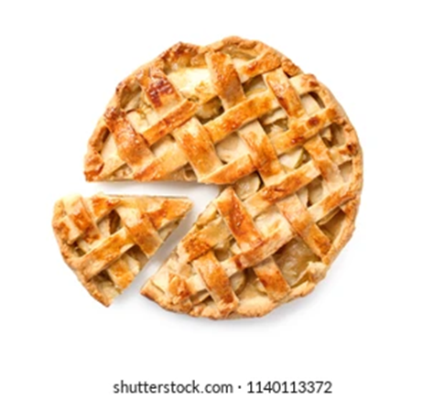
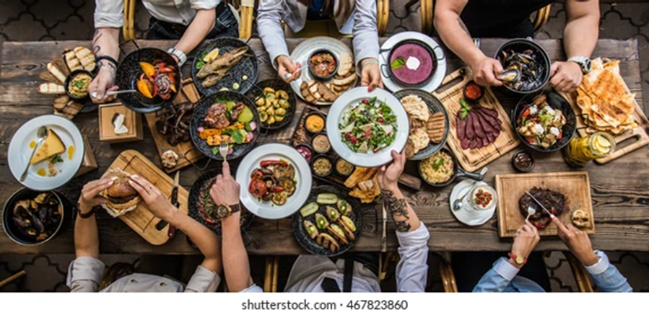
Label the pictures with the following words: flavour, pie, meal, chef, drinks, recipe.
chef
recipe
flavour
drinks
pie
meal

Slide 9
3. Complete the sentences with flavour, pies, meal, chef, drinks or recipe.
1 I always use my grandma’s __________ when I make lemon cake.
2 Chocolate is my favourite ___________ of ice cream.
3 My mum makes excellent apple _________ .
4 Jamie Oliver is a famous __________ ; his dishes are excellent.
5 I don’t like sugary ___________ . They are unhealthy.
6 Fish and chips is a British ____________ .
recipe
flavour
pie
chef
drinks
meal

Slide 10
Match the adjectives in A to their opposites in B.
A
good
hot
tall
fast
late
short
B
short
early
long
cold
bad
slow

Slide 11
4. Match the highlighted words in the texts to their opposites below.
healthy, difficult, happy, special
1 easy >< __________________
2 ordinary >< __________________
3 unhealthy >< ___________________
4 sad >< ___________________
difficult
special
healthy
happy

Slide 12
Complete the sentences with the adjectives in exercise 4.
1 Today is mom’s birthday. Let’s cook something …………………….
2 Can you help me? This math puzzle is ……………………..
3 I’m very …………………….. with the new bike.
4 Don’t drink coca cola too much. It’s not ………………………………..
special
difficult
happy
healthy

Slide 13
Speaking

Slide 14
Complete the sentences with Jamie, Gordon, Lorraine.
Lorraine
……………………………. writes books about healthy eating.
Jamie
…………………………… enjoys healthy food like bread and pasta and dislike unhealthy sugary drinks.
Gordon
…………………………… is famous for difficult dishes, but he prefers eating simple food at home like fish with vegetables.

Slide 15
Pair work
5. Which chef do you like the most? Why?
I like Jamie Oliver the most because he makes cooking look fun.

Slide 16
Writing

Slide 17
Pair work
Ask and answer about your favorite dish.
What’s your favorite dish?
What do you need to cook it?
Where is it popular?
Why do you like it?

Slide 18
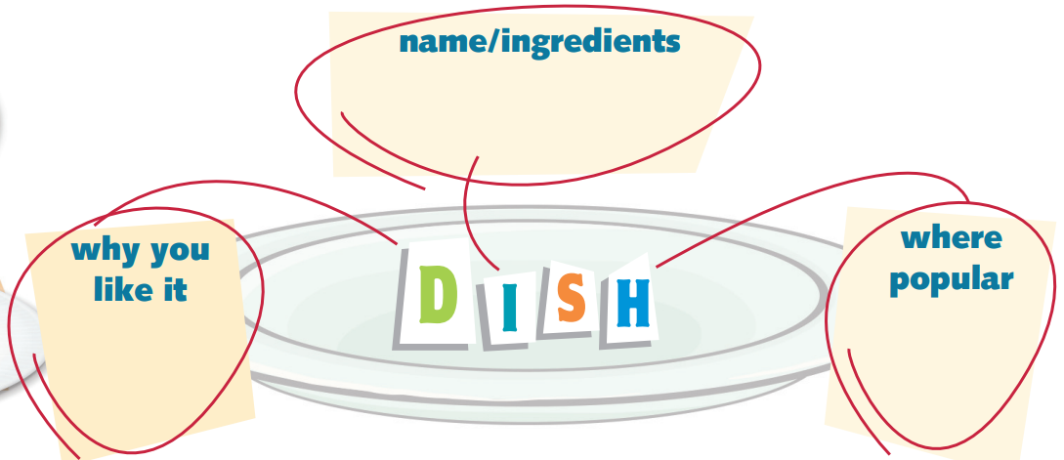
6 a) Think of your favourite dish. Copy and complete the spidergram in your notebook.
Arroz de Tamboril; rice, fish, tomatoes, peppers and onions
simple and
delicious
in Portugal

Slide 19
b) Use your notes in Exercise 6a to complete a short text about your favourite dish for a cookery magazine (about 50 words).
Special Dishes
___________________________ is a dish with _______________________________________________ .
It’s a popular dish in _______________________________ .
I like it because it’s _________________________________ .
Arroz de Tamboril
rice, fish, tomatoes, peppers and onions
Portugal
simple and delicious

Slide 20

CONSOLIDATION

Slide 21
Write a short text (about 50 words) about your friend’s favorite dish, using the vocabulary you have studied today and the information your friend told you.

Slide 22

WRAP-UP

Slide 23
Today’s lesson
Vocabularies
meal
pie
chef
drink
flavour
recipe
Speaking
Talk about your favourite chef
Writing
Write a short text about your favourite dish

Slide 24
Homework
Practise the vocabularies and make sentences using them.
Do the exercises in TA 6 Right on Notebook (pp. 28 & 29)
Do the exercise in TA 6 Right on WB (p. 28)
Prepare the next lesson (p. 56 SB)

Slide 25
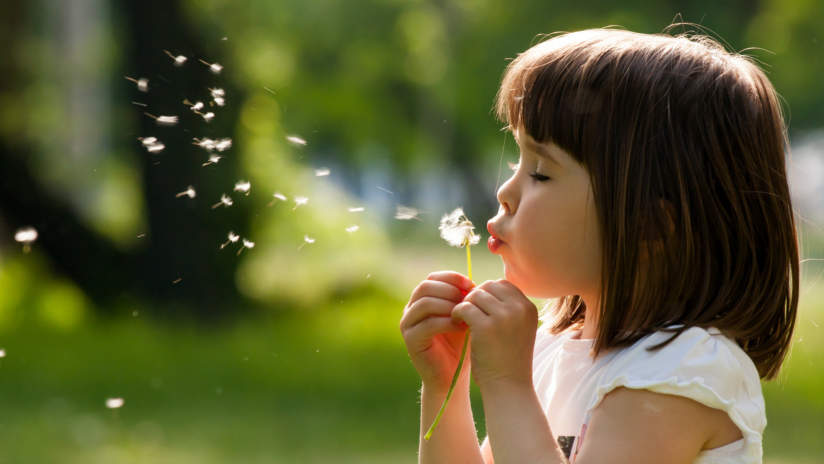
Enjoy your day!

