Slide 1

Unit 7: Transportation
Lesson 3.2: Writing
Page 59

Slide 2


LESSON OUTLINE
Consolidation

Slide 3

By the end of this lesson, students will be able to…
write an opinion paragraph about a type of transportation.
talk about a kind of transportation for kids.

Slide 4

WARM-UP

Slide 5

Work in pairs.
What are some types of transportation in the place you live?
Which type of transportation is suitable for kids?

Slide 6


It’s writing time….

Slide 7
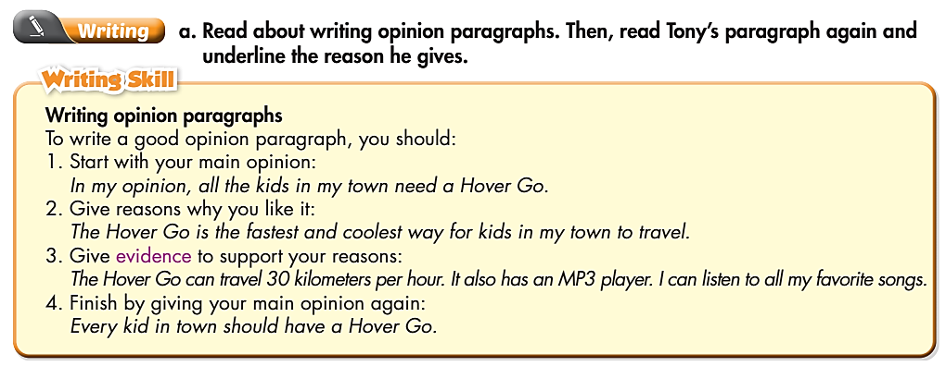
Pre - writing

Slide 8
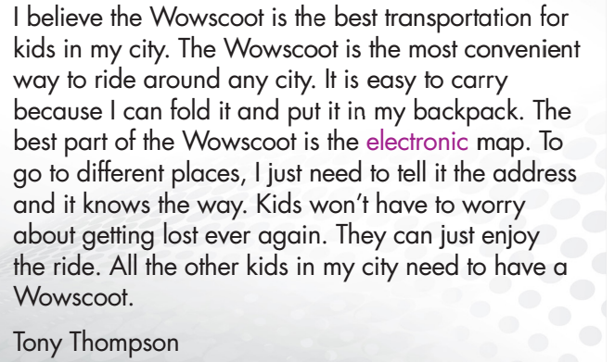
Pre - writing
Read Tony’s paragraph again.
Which sentence does he use to start his main opinion?
Underline the reason he gives.
Underline the evidence he gives.
Which sentence does he use to give his opinion again?

Slide 9
Pre - writing
Read Tony’s paragraph again.
Which sentence does he use to start his main opinion?
In my opinion……..
= I believe…….

Slide 10
Pre - writing
Read Tony’s paragraph again.
2. Underline the reason he gives

Slide 11
Pre - writing
Read Tony’s paragraph again.
3. Underline the evidence he gives.

Slide 12
Pre - writing
Read Tony’s paragraph again.
4. Which sentence does he use to give his opinion again?

Slide 13
How many parts are there in an opinion paragraph?
4 parts.
What are they?
Start with your main opinion.
Give reasons.
Give evidence.
Finish with your main opinion again.

Slide 14
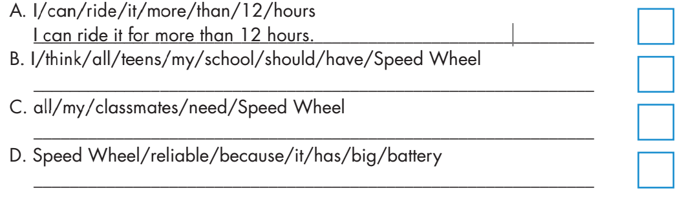
While - writing
b. Write full sentences using the prompts. Then, number the sentences (1-4) to match them with the parts of an opinion paragraph. Use the Skill box to help you.
3
1
I think all the teens in my school should have a Speed Wheel.
4
All of my classmates need a Speed Wheel.
2
The Speed Wheel is reliable because it has a big battery.

Slide 15
Rearrange these sentences to make a paragraph. The first one has been done for you.
a. I think every adult in my city should drive a Moon Car.
1
b. And you don't have to drive it. The computer can take you anywhere you want to go.
4
c. That's why all the adults should have a Moon Car.
7
d. The Moon Car is comfortable, convenient, and fun.
2
e. Children can watch shows or movies, or play video games. Adults can also use the internet to do their work.
6
f. It has six big seats for the whole family. The seats can turn into a bed for a long trip.
3
g. The best part of the Moon Car is the big TV screen.
5

Slide 16

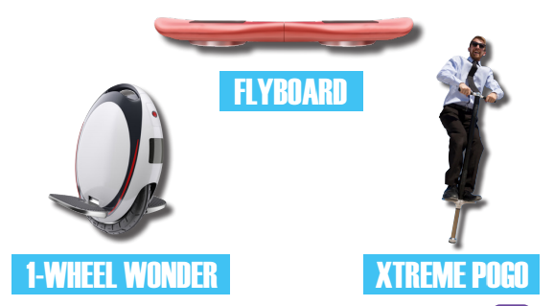
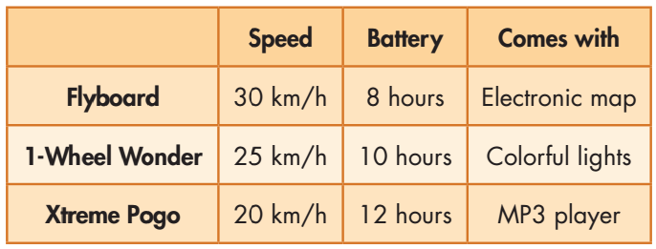
Work in group of 4: Your town is going to buy one type of transportation for all the kids. Look at the pictures. Discuss the different kinds of transportation and choose one for the kids in your town.

Slide 17
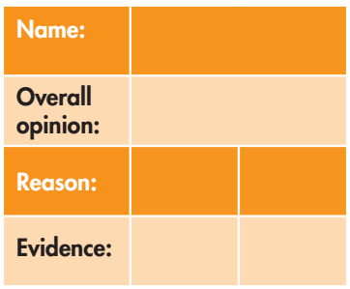
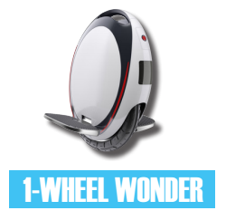
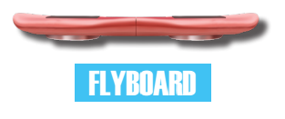

Complete the table with your group. Then present your idea to the whole class.

Slide 18

Hello everyone. My name is….. I’m from group……. Today, our group will talk about one type of transportation for all the kids. We think …….. is good for the kids because …….

Slide 19
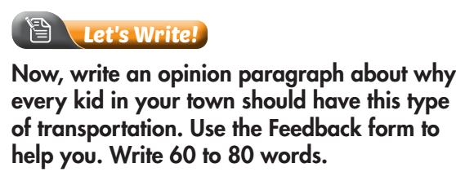

While - writing
Sample answer:
I think every kid in my town should have a Flyboard. The Flyboard is fast and convenient. The Flyboard can travel 30 kilometers per hour. I can go anywhere in a few minutes. The battery lasts for eight hours. I can ride it to school every day and I don’t have to charge it. The Flyboard has an electronic map, so I won’t get lost. That’s why all kids in my town need a Flyboard.

Slide 20
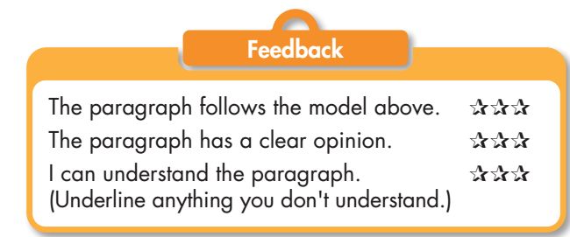

Slide 21

CONSOLIDATION

Slide 22
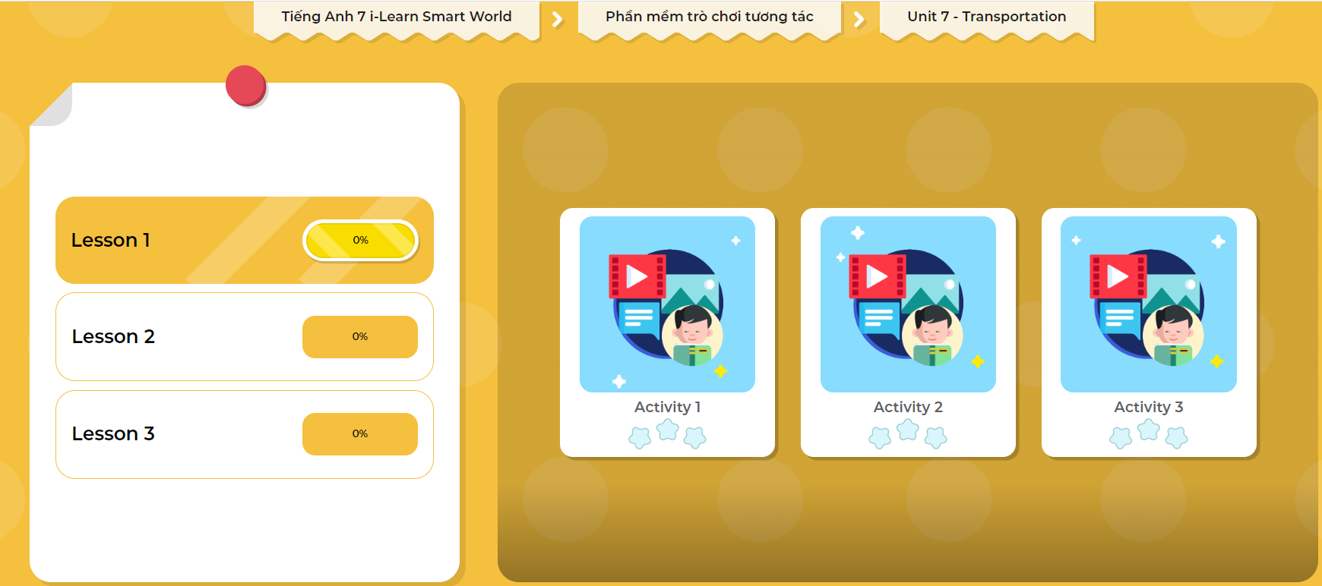
LET’S PLAY!
Click here to play the games

Slide 23

WRAP-UP

Slide 24
Today’s lesson
Writing:
Practice writing an opinion paragraph about kind of transportation.
Speaking:
- Talk about a kind of transportation for kids.

Slide 25
Homework
Do the exercise in Tiếng Anh 7 i-Learn Smart World Workbook on page 43.
Complete the writing notes in Tiếng Anh 7 i-Learn Smart World Notebook on page 47.
Prepare Review Unit 6 (pages 102 & 103 SB).
Play the consolidation games in Tiếng Anh 7 i-Learn Smart World DHA App on www.eduhome.com.vn

Slide 26

Lesson 3
Stay positive and have a nice day!

