Slide 1

Unit 6: Clothes
Lesson 2.1
Page 85

Slide 2
Lesson Outline
Warm-up
Vocabulary
Structure
Consolidation
Wrap-up

Slide 3
Objectives
By the end of this lesson, students will be able to talk about what they are wearing.
Vocabulary: skirt, jacket, jeans, boots, T-shirt.
Structure: - What are you wearing?
- I’m wearing blue jeans/
I’m wearing a red jacket.

Slide 4

WARM UP

Slide 5
Unscramble the letters
dress
d
s
e
r
s
pants
t
p
n
s
a
shorts
h
o
r
s
t
s
socks
c
o
s
k
s
shirt
h
r
i
t
s

Slide 6
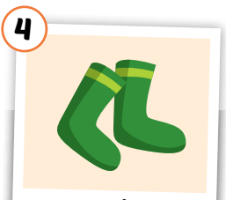
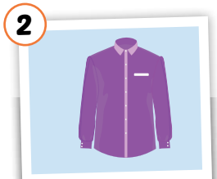
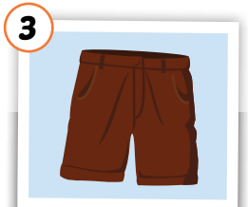
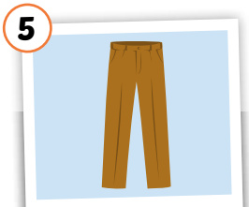
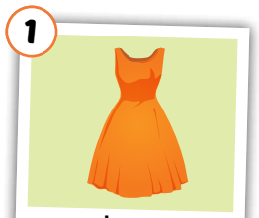

Slide 7
shirt

Slide 8
socks

Slide 9
pants

Slide 10

It’s time to learn …

Slide 11

Vocabulary

Slide 12
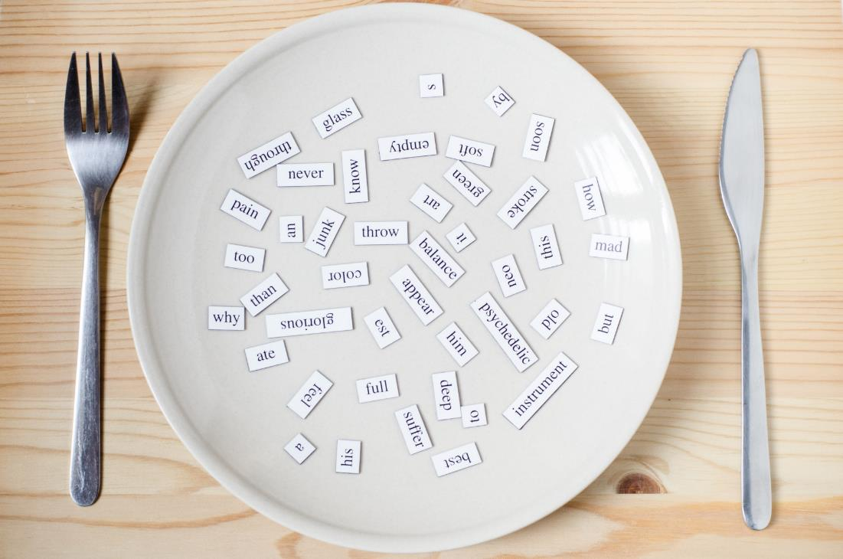
New words
skirt,
jacket,
jeans,
boots,
T-shirt.

Slide 13



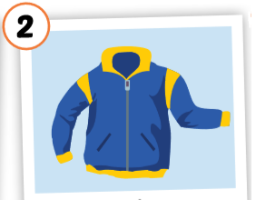
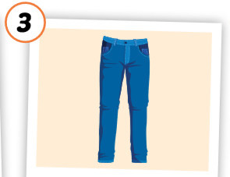
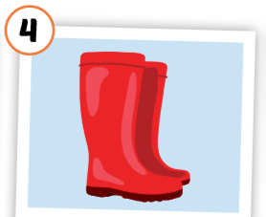
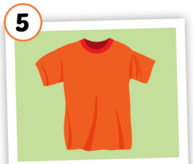
Click each English word to hear the sound.
skirt
jacket
jeans
boots
T-shirt
/skɜːrt/
váy
/ˈdʒækɪt/
áo khoác
/dʒiːnz/
quần jean,
quần bò
/buːts/
đôi ủng
/ˈtiː ʃɜːrt/
áo thun
Notes:
GV giới thiệu từ vựng, CCQ

Slide 14
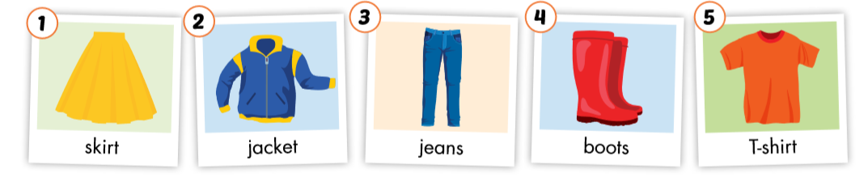

Slide 15

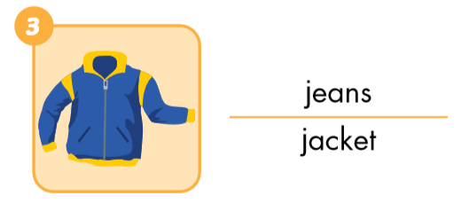
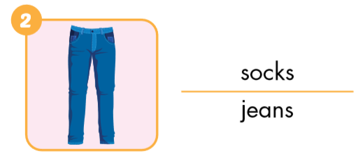
Look and circle.

Slide 16
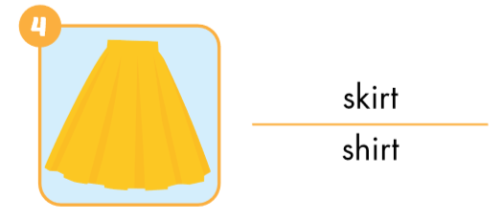
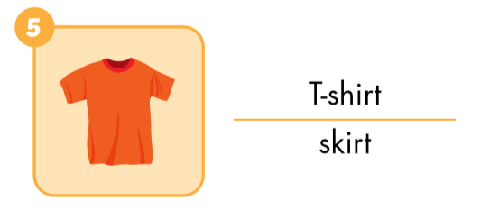
Look and circle.

Slide 17
Put the pictures in the right group.
yellow
blue
red
orange

Slide 18
Put the pictures in the right group.
1. a (pen)
2. some (pens)

Slide 19

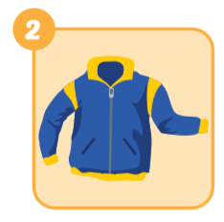
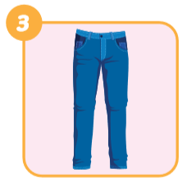
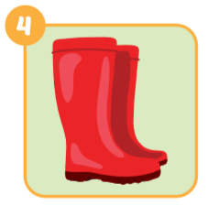
Look and write
skirt
jacket
jeans
boots

Slide 20
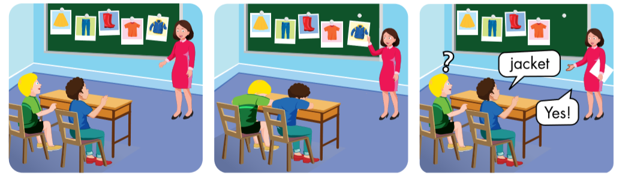

Slide 21


skirt
?

Slide 22

Yes.
jeans
No.

Slide 23

Practice

Slide 24
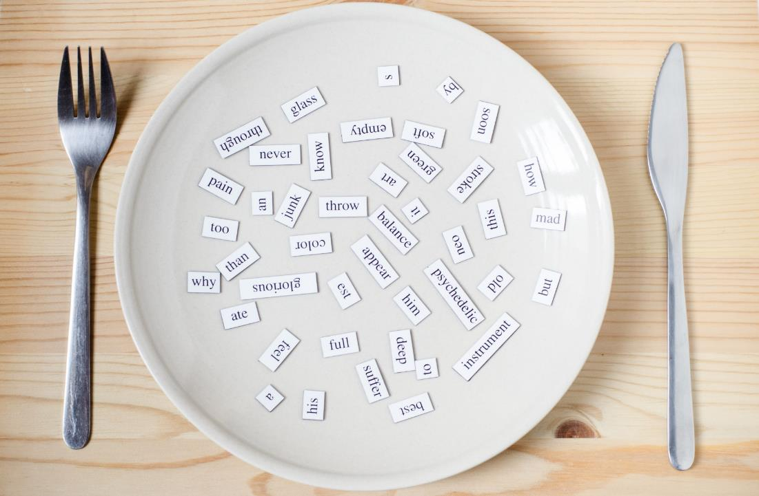
Structures
What are you wearing?
I’m wearing blue jeans.
What are you wearing?
I’m wearing a red jacket.

Slide 25



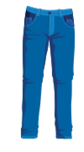

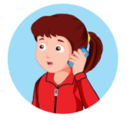


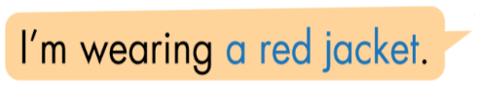
Click the earphone to hear the sound.

Slide 26


What are you wearing?
I’m wearing red boots.

Slide 27


What are you wearing?
I’m wearing a yellow skirt.

Slide 28


What are you wearing?
I’m wearing blue jeans.

Slide 29


What are you wearing?
I’m wearing a orange T-shirt.

Slide 30


What are you wearing?
I’m wearing a blue jacket.

Slide 31

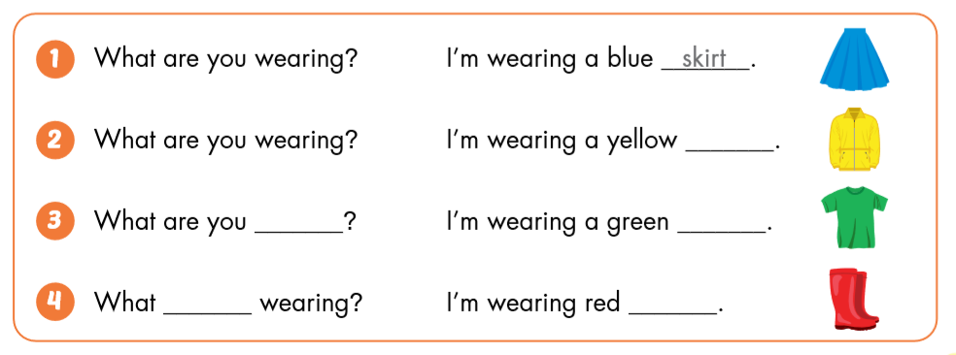
skirt.
jacket.
wearing?
T- shirt.
are you
wearing?
boots.

Slide 32

CONSOLIDATION

Slide 33





T-shirt
boots
jacket
jeans
skirt

Slide 34

WRAP-UP

Slide 35
Today’s lesson
Vocabularies
dress
shirt
shorts
socks
pants
Structures/ Sentence patterns
What do you want?
I want a dress.
What do you want?
I want some shorts.

Slide 36
Homework
Practice the vocabularies and structure; and make sentences using them.
Do the exercises in Tiếng Anh 3 i-Learn Smart Start Workbook (page 60)
Prepare the next lesson (page 86 SB)
Play the consolidation games in Tiếng Anh 3 i-Learn Smart Start DHA App on www.eduhome.com.vn
Do the exercise in Tiếng Anh 3 i-Learn Smart Start Notebook (page 41)

Slide 37

Enjoy your day!

