Slide 1


Slide 2

Unit
3
1
Unit
FAMILY LIFE
MUSIC
LESSON 6
WRITING
Writing a blog about an experience

Slide 3

Unit
1
1
FAMILY LIFE
Family Life
Unit
OBJECTIVES
Use lexical items related to the topic Music;
Write a blog about experiences at a music event.

Slide 4
LESSON 1
GETTING STARTED
Unit
GETTING STARTED
Game: Guess the mystery words.
WARM-UP
* Vocabulary
Task 1: Read Ann’s blog and complete the notes.
Task 2: Put the words and phrases into the appropriate columns.
PRE-WRITING
WHILE-WRITING
Task 3: Imagine you went to a music event. Write a blog (about 120 words) to share your experience.
POST-WRITING
Peer correction
Class correction
CONSOLIDATION
Wrap-up
Homework

Slide 5
WARM-UP
Game: Guess the mystery words
RULES:
2 teams
Look at the pairs of pictures and guess the mystery words.
Each earliest correct answer gets one point.

Slide 6


WARM-UP
Game: Guess the mystery words.
For example:
queen bee

Slide 7


WARM-UP
Game: Guess the mystery words.
For example:
waterfall

Slide 8

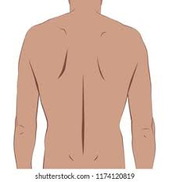
WARM-UP
Game: Guess the mystery words.
come back

Slide 9


WARM-UP
Game: Guess the mystery words.
music event

Slide 10

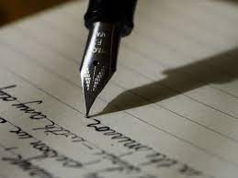
WARM-UP
Game: Guess the mystery words.
blog writing

Slide 11


WARM-UP
Game: Guess the mystery words.
music website

Slide 12

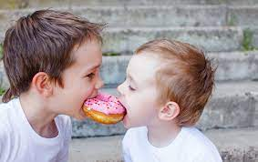
WARM-UP
Game: Guess the mystery words.
experience sharing

Slide 13
LESSON 1
GETTING STARTED
Unit
GETTING STARTED
Game: Guess the mystery words.
WARM-UP
* Vocabulary
Task 1: Read Ann’s blog and complete the notes.
Task 2: Put the words and phrases into the appropriate columns.
PRE-WRITING

Slide 14
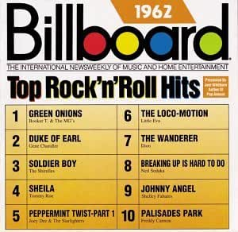

VOCABULARY
hit (n)
/hɪt/
a song that is very popular

Slide 15

VOCABULARY
take place (phr.v)
/teɪk pleɪs/
happen, especially after previously being arranged or planned
The music festival will take place on February 5th.

Slide 16
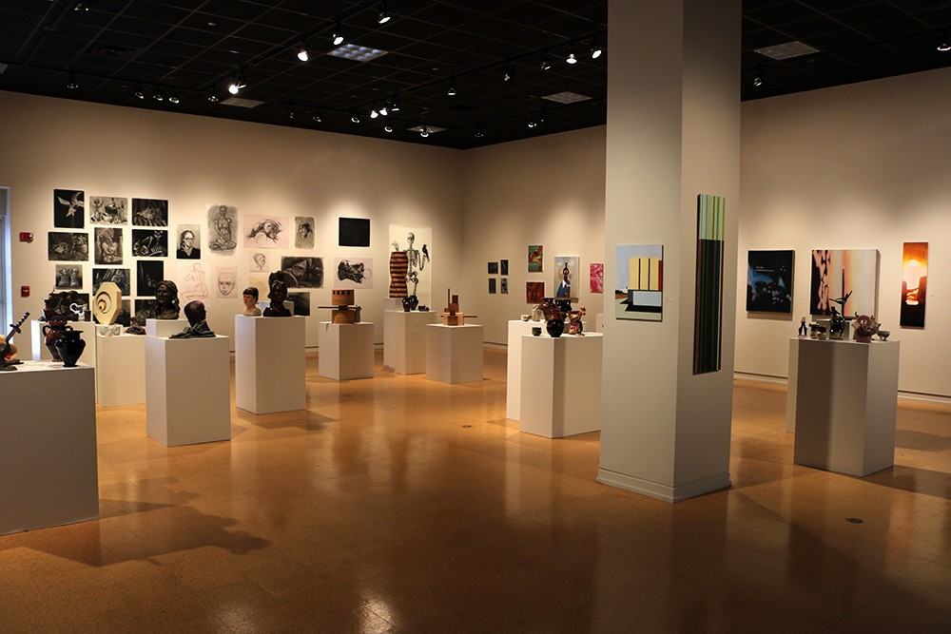
VOCABULARY
art exhibition (n)
/ɑːt ˌeksɪˈbɪʃn/
a collection of works of art, that are shown to the public

Slide 17

PRE-WRITING
1
Ann has just come back from a music event and shared her experience on a music website. Read her blog and complete the notes below.
Ann’s notes
● Event:
● When:
● Where:
● Who with:
● Atmosphere:
● What we did:
• How we felt:
International Youth Music Festival

Slide 18
PRE-WRITING
1
Ann has just come back from a music event and shared her experience on a music website. Read her blog and complete the notes below.
Ann’s notes
● Event:
● When:
● Where:
● Who with:
● Atmosphere:
International Youth Music Festival
last Saturday
in a big country park
some friends
party

Slide 19
PRE-WRITING
1
Ann has just come back from a music event and shared her experience on a music website. Read her blog and complete the notes below.
Ann’s notes
What we did:
How we felt:
- saw favourite idols perform live on stage and listened to their greatest hits
- tasted yummy food from different countries
- made new friends
excited

Slide 20
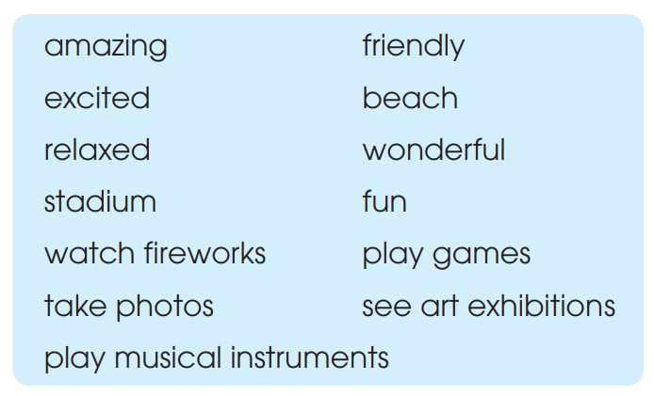
PRE-WRITING
2
Work in groups. Put the words and phrases in the box below into the appropriate columns. Some words and phrases can go into more than one column.

Slide 21
PRE-WRITING
2
Work in groups. Put the words and phrases in the box below into the appropriate columns. Some words and phrases can go into more than one column.
Location | Atmosphere | Activities | Feeling
beach
stadium
amazing
friendly
relaxed
wonderful
fun
watch fireworks
play games
take photos
see art exhibitions
play musical instruments
amazing
excited
relaxed
wonderful

Slide 22
WHILE-WRITING
Extension: Work in groups. Play the chain game.
* RULES:
- Team members sit in a circle;
- Student 1 starts the game by saying what kind of event they went to;
- The next student adds another detail;
- This continues until someone in the team gets mixed up, repeats information or can’t think of anything to add;
- The winner is the member that continues their chain for the longest time.

Slide 23
WHILE-WRITING
Extension: Work in groups. Play the chain game.
* For example:
+ Student 1: We went to a Pop Music Festival.
+ Student 2: We went to a Pop Music Festival. The event took place in the country park.
+ Student 3: We went to a Pop Music Festival. The event took place in the country park. There were a lot of exciting performances with many famous bands and singers from all over the country.

Slide 24
LESSON 1
GETTING STARTED
Unit
GETTING STARTED
Game: Guess the mystery words.
WARM-UP
* Vocabulary
Task 1: Read Ann’s blog and complete the notes.
Task 2: Put the words and phrases into the appropriate columns.
PRE-WRITING
WHILE-WRITING
Task 3: Imagine you went to a music event. Write a blog (about 120 words) to share your experience.

Slide 25
WHILE-WRITING
PRACTICE
3
Imagine you went to a music event. Write a blog (about 120 words) to share your experience. Use the notes in 1 and words and phrases in 2 to help you.
Make an outline based on Ann’s notes and the words and phrases in 2.
If you have been to a music event, make use of your experiences; if you haven’t, write about an event you know about and imagine you have been to it, or make up an event.

Slide 26
LESSON 1
GETTING STARTED
Unit
GETTING STARTED
Game: Guess the mystery words.
WARM-UP
* Vocabulary
Task 1: Read Ann’s blog and complete the notes.
Task 2: Put the words and phrases into the appropriate columns.
PRE-WRITING
WHILE-WRITING
Task 3: Imagine you went to a music event. Write a blog (about 120 words) to share your experience.
POST-WRITING
Peer correction
Class correction
CONSOLIDATION
Wrap-up
Homework

Slide 27
POST-WRITING
PRACTICE
1
Peer correction
Short form | Full form | Examples
sp | spelling | My mum dose the laundry -> sp
T | tense | I took out the rubbish everyday -> T
 | word order | My brother is a boy responsible.
 | missing word | My mum does most the cooking.
a A | capital letter | My sister and i take turns feeding the cat. -> a A

Slide 28
POST-WRITING
PRACTICE
2
Class correction
Sample answer: My sister and I attended the F5 tour at the National Stadium last night. I could sum up the concert in one word, INCREDIBLE. We found our way up to our seats after having a light meal and stood in a queue at the gate of the stadium for 45 minutes. When the curtain was raised to reveal the F5 band, the entire stadium went absolutely crazy.
I was thrilled by every of their performances. There was so much emotion in many of their songs, and the way they performed was so terrific. This was such a wonderful experience, a night that I’ll never forget. I’m so grateful to have been able to have that experience.

Slide 29
LESSON 1
GETTING STARTED
Unit
GETTING STARTED
Game: Guess the mystery words.
WARM-UP
* Vocabulary
Task 1: Read Ann’s blog and complete the notes.
Task 2: Put the words and phrases into the appropriate columns.
PRE-WRITING
WHILE-WRITING
Task 3: Imagine you went to a music event. Write a blog (about 120 words) to share your experience.
POST-WRITING
Peer correction
Class correction
CONSOLIDATION
Wrap-up
Homework

Slide 30
CONSOLIDATION
1
Wrap-up
Use lexical items related to the topic Music;
Write a blog about experiences at a music event.

Slide 31
CONSOLIDATION
2
Homework
Search the Internet for music blogs, choose one that you like most and post it on your class’ Facebook or Zalo group, the blog which gets the most likes will be rewarded.
Prepare for Communication and Culture lesson

Slide 32

Website: sachmem.vn
Fanpage: facebook.com/sachmem.vn/

