Slide 1
Unit 5: Science and technology
Lesson 3.2 – Speaking & Writing
Page 53

Slide 2
Lesson Outline
Warm-up
Speaking
Writing
Consolidation
Wrap-up

Slide 3
By the end of this lesson, students will be able to…
- talk about buying a new phone.
- write an email to your friend about the smartphone you chose.

Slide 4
WARM UP

Slide 5
Two truths and one lie
Tell two truths and one lie about your phone.
Guess which is a lie.
Your group will get one point for one correct guess.
The group with more points will be the winner

Slide 6
Pre-writing

Slide 7
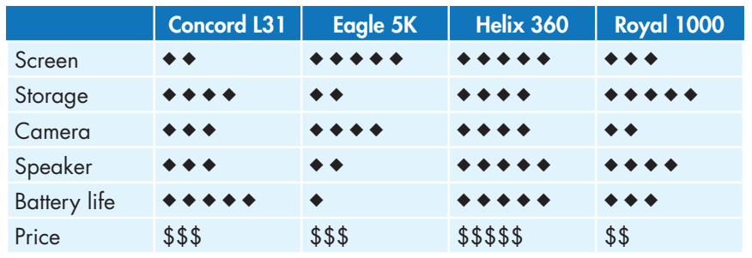
- What do you think about the Concord L31?
- Well, it has long battery life, but the screen isn't good.
- I want a phone for watching movies, so I'll get the…

Slide 8
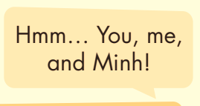
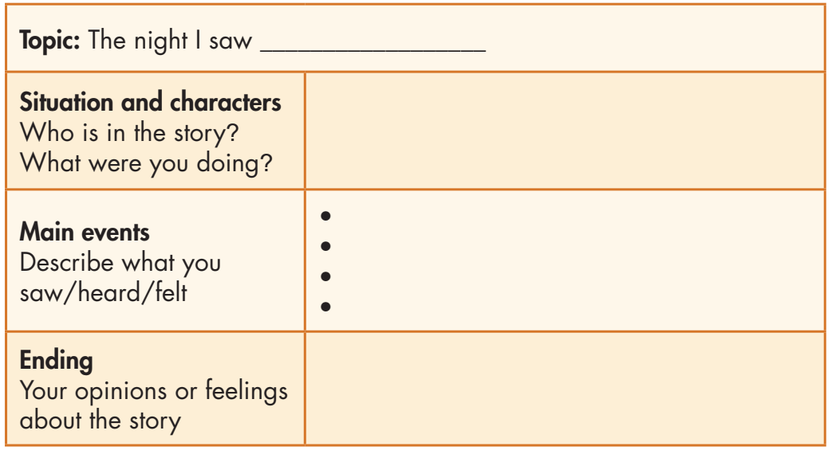
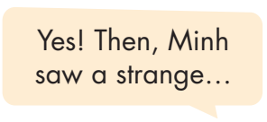
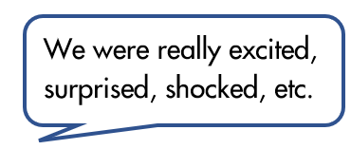
Now, imagine you want to write to a friend about the phone you chose.
In pairs: Choose and talk about two features (good or bad) of each phone. Then, choose one phone to buy and tell your partner which one you want, and why.

Slide 9
While-writing

Slide 10
Now, write a narrative passage to tell the story you planned in Speaking. Use the Writing Skill box and your speaking notes to help you. Write 80 to 100 words.

Slide 11
Can you remember?
What is a structure of a narrative?
How many sections are there in a narrative passage?
What do you write in the topic section?
Do you write about people in the character section?
In which section do you write about what you saw/heard/felt, the main event or the ending section?

Slide 12
Write a narrative passage.
Check your answers with a partner, using the feedback form.

Slide 13
Post-writing

Slide 14
You will have your passages assessed thanks to these criteria:
• narrative structure
• main idea and focus
• sentence fluency
• word choice
• spelling and punctuation

Slide 15
Suggested writing
I'll never forget the night I saw an alien. I was in the car with my mom. We were coming home from swimming class at my local swimming pool. We were driving through a forest when we saw a strange, tall man on the road. He was making a strange noise. He was wearing silver clothes, and he was pointing at the sky. It was really scary. We drove home quickly and called the police. I really believe he was an alien from another planet.

Slide 16
CONSOLIDATION

Slide 17
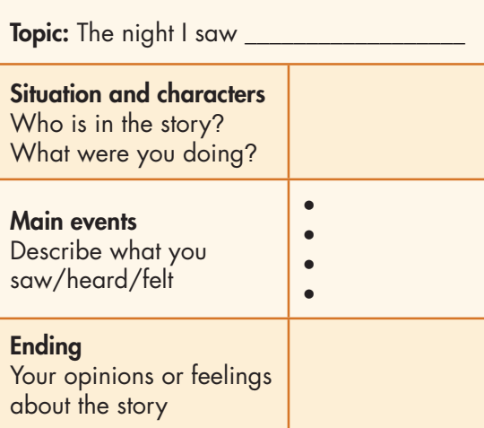
How many parts are there in a narrative passage?

Slide 18
WRAP-UP

Slide 19
Today’s lesson
Speaking: Plan the story about a strange visitor from another planet
Writing: How to write a narrative passage.

Slide 20
Homework
- Review how to write a narrative passage.
- Finish the writing part.
- Do the exercises in WB: Writing (page 37).
- Complete the grammar notes in Tiếng Anh 8 i-Learn Smart World Notebook, page 45.
- Play consolidation games in Tiếng Anh 8 i-Learn Smart World DHA App on www.eduhome.com.vn
- Prepare: Unit 6 – Review – page 98.

Slide 21
Lesson 3
Stay positive and have a nice day!

