Slide 1

Unit 6: Education
Lesson 1.3: Pronunciation & Speaking
Page 46

Slide 2



LESSON OUTLINE
Consolidation

Slide 3

By the end of this lesson, students will be able to…
- practice declining invitations and expressing obligations, using have to.
- practice sound change.

Slide 4

WARM-UP

Slide 5

Work in pairs.
Choose the word whose main stress is placed
differently from the others.
1. A. barbecue B. container C. grocery D.animal
2. A. volunteer B. fantasy C. onion D. vegetable
3. A. teaspoon B. action C. lemon D. bamboo
/ˈbɑ:rbəkju:/
/kənˈteɪnər/
/ˈɡroʊsəri/
/ˈænɪml/
/ˌvɑ:lənˈtɪr/
/ˈfæntəsi/
/ˈʌnjən/
/ˈvedʒtəbl/
/ˈti:spu:n/
/ˈækʃn/
/ˈlemən/
/bæmˈbuː/

Slide 6
Work in pairs.
Choose the word whose underlined part is
pronounced differently from that of the other words.
1. A. vitamin B. medicine C. equipment D. musician
2. A. washes B. arrives C. installs D. opens
3. A. advantage B. behind C. message D. knowledge
/ˈvaɪtəmɪn/
/ˈmedɪsn/
/ɪˈkwɪpmənt/
/mju:ˈzɪʃn/
/wɑːʃiz/
/əˈraɪvz/
/ɪnˈstɑːlz/
/ˈoʊpənz/
/ədˈvæntɪdʒ/
/bɪˈhaɪnd/
/ˈmesɪdʒ/
/ˈnɑːlɪdʒ/

Slide 7
Work in pairs, matching the verbs to the appropriate nouns.
Verbs | Nouns
Finish | video games
Go to | a book report
Play | my project
Take | a presentation
Do | the movies
Write | a test
Give | homework

Slide 8

Work in pairs.
Which activities do you have to do in your class?
I have to write an essay and give a presentation.

Slide 9



Slide 10
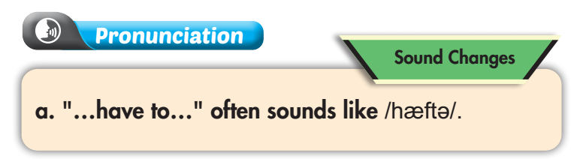
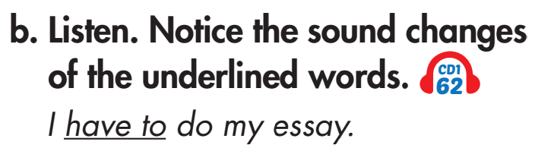

Click on the icon to hear the sound

Slide 11
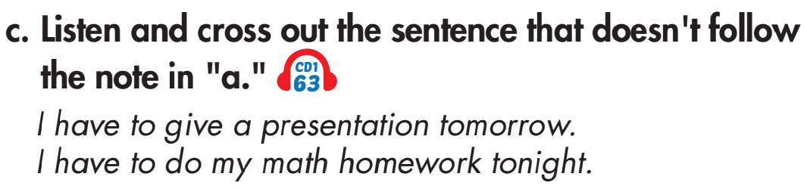
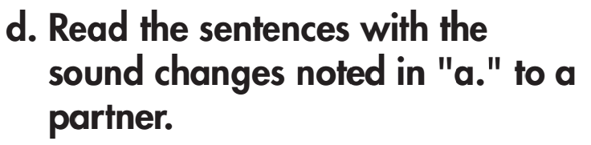
Click on the icon to hear the sound
Wrong. There's no
connected speech.

Slide 12

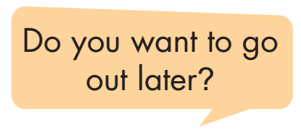
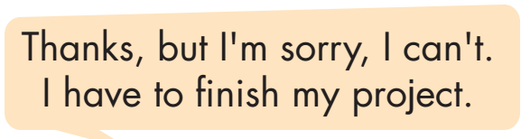

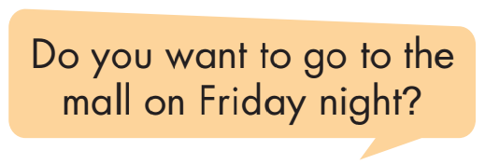
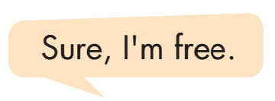

Slide 13
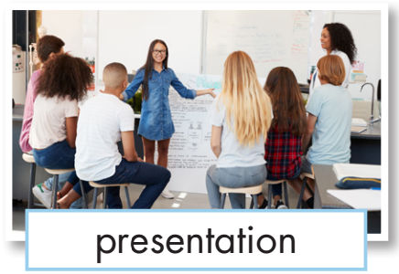
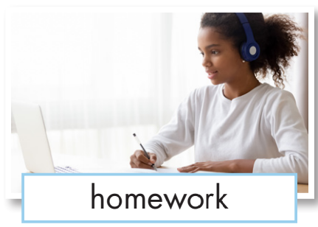

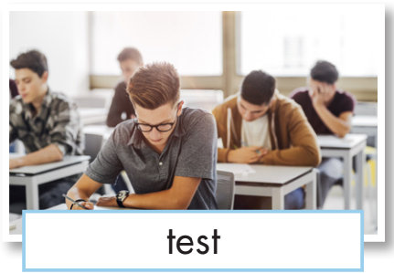

Do the same
Do you want to go out later?
Thanks, but I’m sorry I can’t. I have to………..
Do you want to go to the mall on Friday night?
Sure, I’m free.

Slide 14
Do the same
Do you want to go out later?
Thanks, but I’m sorry I can’t. I have to………..
Do you want to go to the mall on Friday night?
Sure, I’m free.

Slide 15
Do the same
Do you want to go out later?
Thanks, but I’m sorry I can’t. I have to………..
Do you want to go to the mall on Friday night?
Sure, I’m free.

Slide 16
Do the same
Do you want to go out later?
Thanks, but I’m sorry I can’t. I have to………..
Do you want to go to the mall on Friday night?
Sure, I’m free.

Slide 17
Do the same
Do you want to go out later?
Thanks, but I’m sorry I can’t. I have to………..
Do you want to go to the mall on Friday night?
Sure, I’m free.

Slide 18
Do the same
Do you want to go out later?
Thanks, but I’m sorry I can’t. I have to………..
Do you want to go to the mall on Friday night?
Sure, I’m free.

Slide 19

Do you want to ………… on ………..?
Thanks, but I’m sorry I can’t. I have to………..
Do you want to ……….. on ………..?
Sure, I’m free.

Slide 20

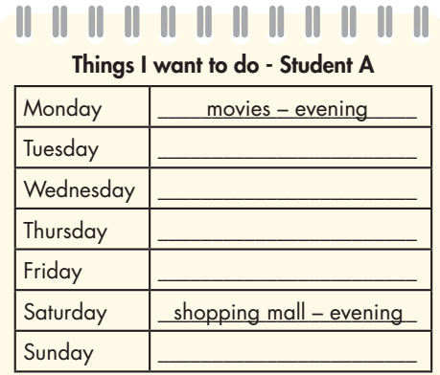
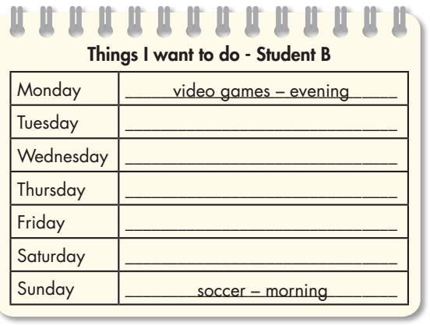
Look at the table. Practice inviting and declining your friend’s invitations. Decide a time to meet.

Slide 21
A: Hey! Do you want to go to the movies on Monday evening?
B: Thanks, but I’m sorry I can’t. I have to finish my project.
A: Do you want to go to the shopping mall on Saturday evening?
B: Sure, I’m free.

Slide 22
B: Hey! Do you want play video games on Monday evening?
A: Thanks, but I’m sorry I can’t. I have to write a book report.
B: Do you want to play soccer on Sunday morning?
A: Sure, I’m free.

Slide 23
Information exchange - work in pairs.
Student A: Write the activities you want to do and invite Student B to join you. Your friend B is too busy with school and decline the invitation (B looks at activity file 4, p.119). Complete the table with what your friend has to do.
Days of week | What I want to do | What my friend (B) has to do
Monday
Tuesday
Wednesday
Thursday
Friday
Saturday
Sunday
Student A

Slide 24
Example
Student A
A: Hey! Do you want go to the movies on Monday evening?
Days of week | What I want to do | What my friend (B) has to do
Monday | Movies -evening | Math homework
Tuesday
Wednesday
Thursday
Friday
Saturday
Sunday | Soccer -morning
B: Thanks, but I’m sorry I can’t. I have to do my Math homework.
A: Do you want to play soccer on Sunday morning?
B: Sure, I’m free.

Slide 25
Swap roles and repeat
Student B: Write the activities you want to do and invite Student A to join you. Your friend A is too busy with school and decline the invitation (A looks at activity file 5, p.120). Complete the table with what your friend has to do.
Days of week | Things I want to do | Things my friend (A)has to do
Monday
Tuesday
Wednesday
Thursday
Friday
Saturday
Sunday
Student B

Slide 26

CONSOLIDATION

Slide 27
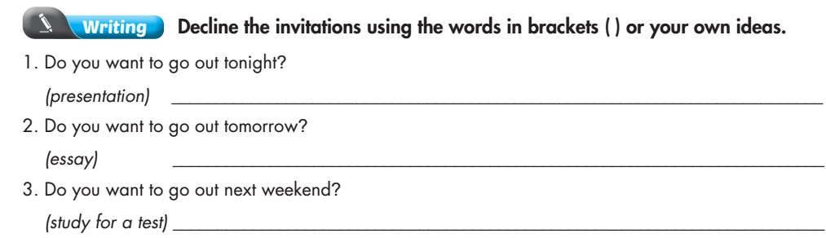
Extra Practice
WB, p. 33

Slide 28

WRAP-UP

Slide 29
Today’s lesson
Speaking:
- Practice declining invitations and expressing obligations, using have to.
- Practice sound change.

Slide 30
Homework
Practice pronouncing have to.
Review the vocabulary and grammar notes in Tiếng Anh 7 i-Learn Smart World Notebook (pages 36 & 37).
Prepare the next lesson (page 46 SB).
Play the consolidation games in Tiếng Anh 7 i-Learn Smart World DHA App on www.eduhome.com.vn.

Slide 31

Lesson 3
Stay positive and have a nice day!

