Slide 1

Unit 10: Cities around the World
Lesson 1.3: Pronunciation & Speaking
Page 80

Slide 2
Lesson Outline
Warm-up
Pronunciation
Practice
Speaking
Consolidation
Wrap-up

Slide 3
Objectives
By the end of this lesson, students will be able to…
- pronounce the sound /ð/ correctly
- use the sound exactly in their speaking
- develop the ability to communicate (about someone’s vacation)

Slide 4

WARM-UP

Slide 5

Work in pairs.
Choose the word whose main stress is placed
differently from the others.
1 A. museum B. cathedral C. gravity D. computer
/mjuːˈziːəm/ /kəˈθiːdrəl/ /ˈɡrævəti/ /kəmˈpjuːtər/
2 A. palace B. statue C. tower D. device
/ˈpæləs/ /ˈstætʃuː/ /ˈtaʊər/ /dɪˈvaɪs/
3 A. polite B. busy C. snowy D. famous
/pəˈlaɪt/ /ˈbɪzi/ /ˈsnoʊi/ /ˈfeɪməs/

Slide 6
Work in pairs.
Choose the word whose underlined part is
pronounced differently from that of the other words.
A. park B. bay C. game D. cave
2. A. beach B. sea C. Earth D. jeans
3. A. gift B. kite C. king D. bridge
/ pɑːrk /
/beɪ/
/ɡeɪm/
/keɪv/
/biːtʃ/
/si:/
/ɜːrθ/
/dʒiːnz/
/ɡɪft/
/kaɪt/
/kɪŋ/
/brɪdʒ/

Slide 7
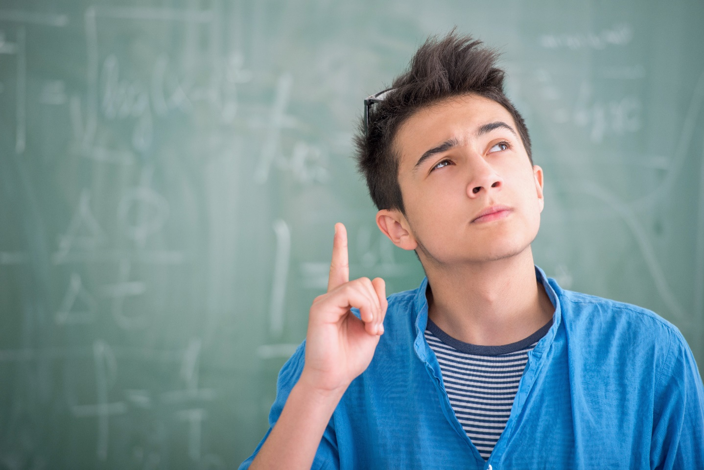
PLAY A GAME
LOOK AT THE PICTURES AND NAME THE PLACES/ LANDMARKS

Slide 8
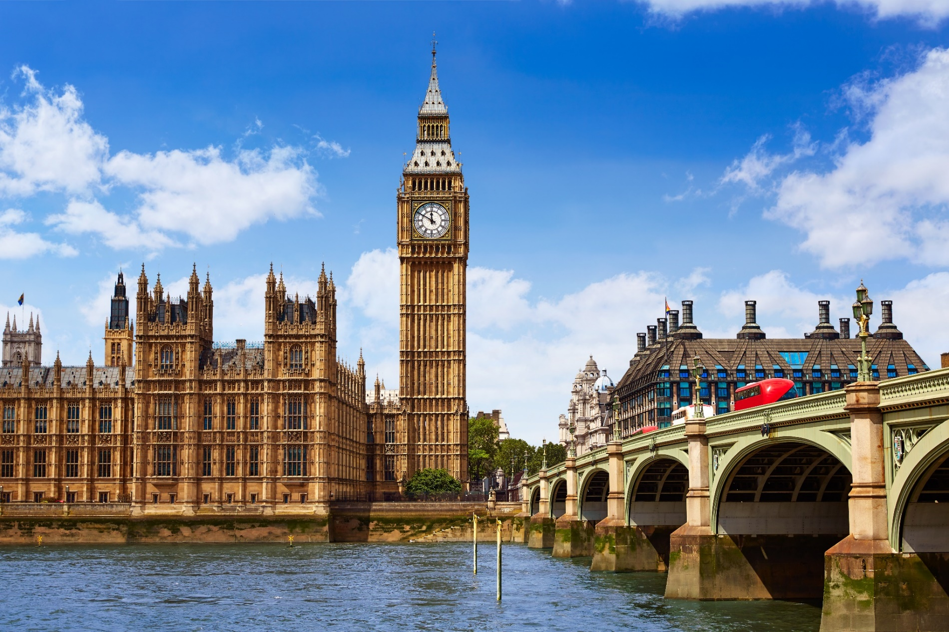
Picture 1
Big Ben (London Clock Tower)

Slide 9
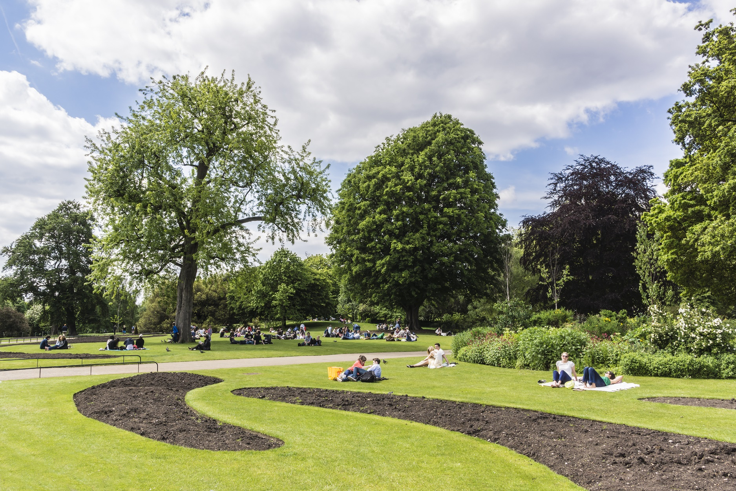
Picture 2
Hyde Park

Slide 10
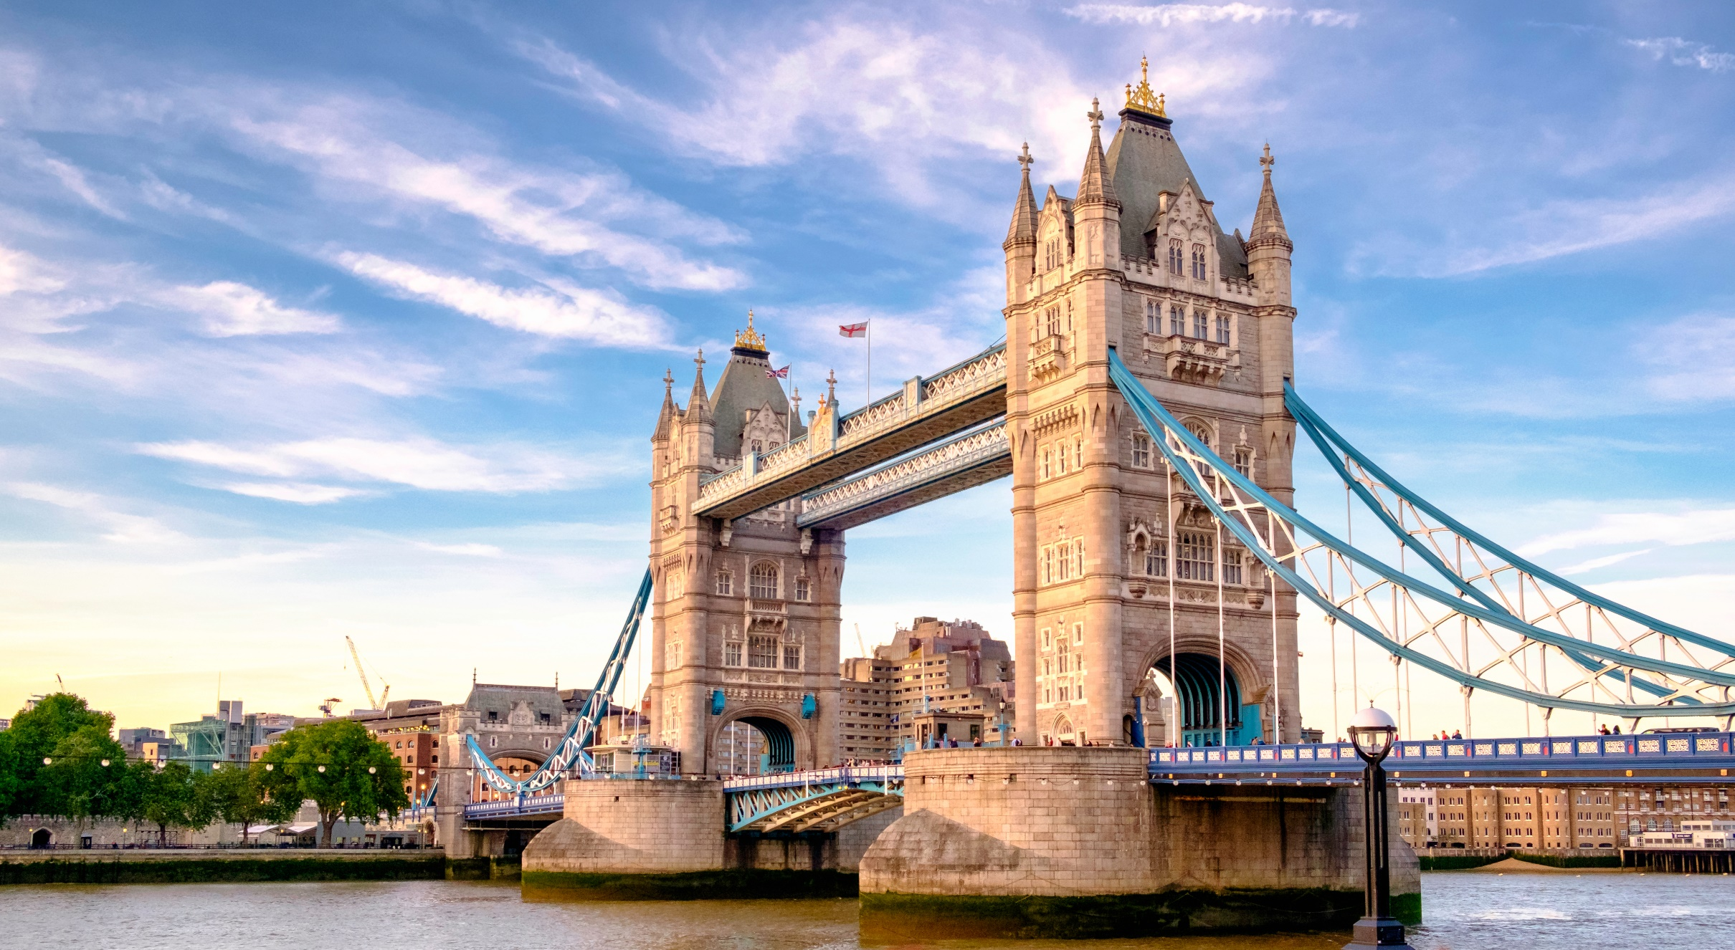
Picture 3
Tower Bridge, London

Slide 11
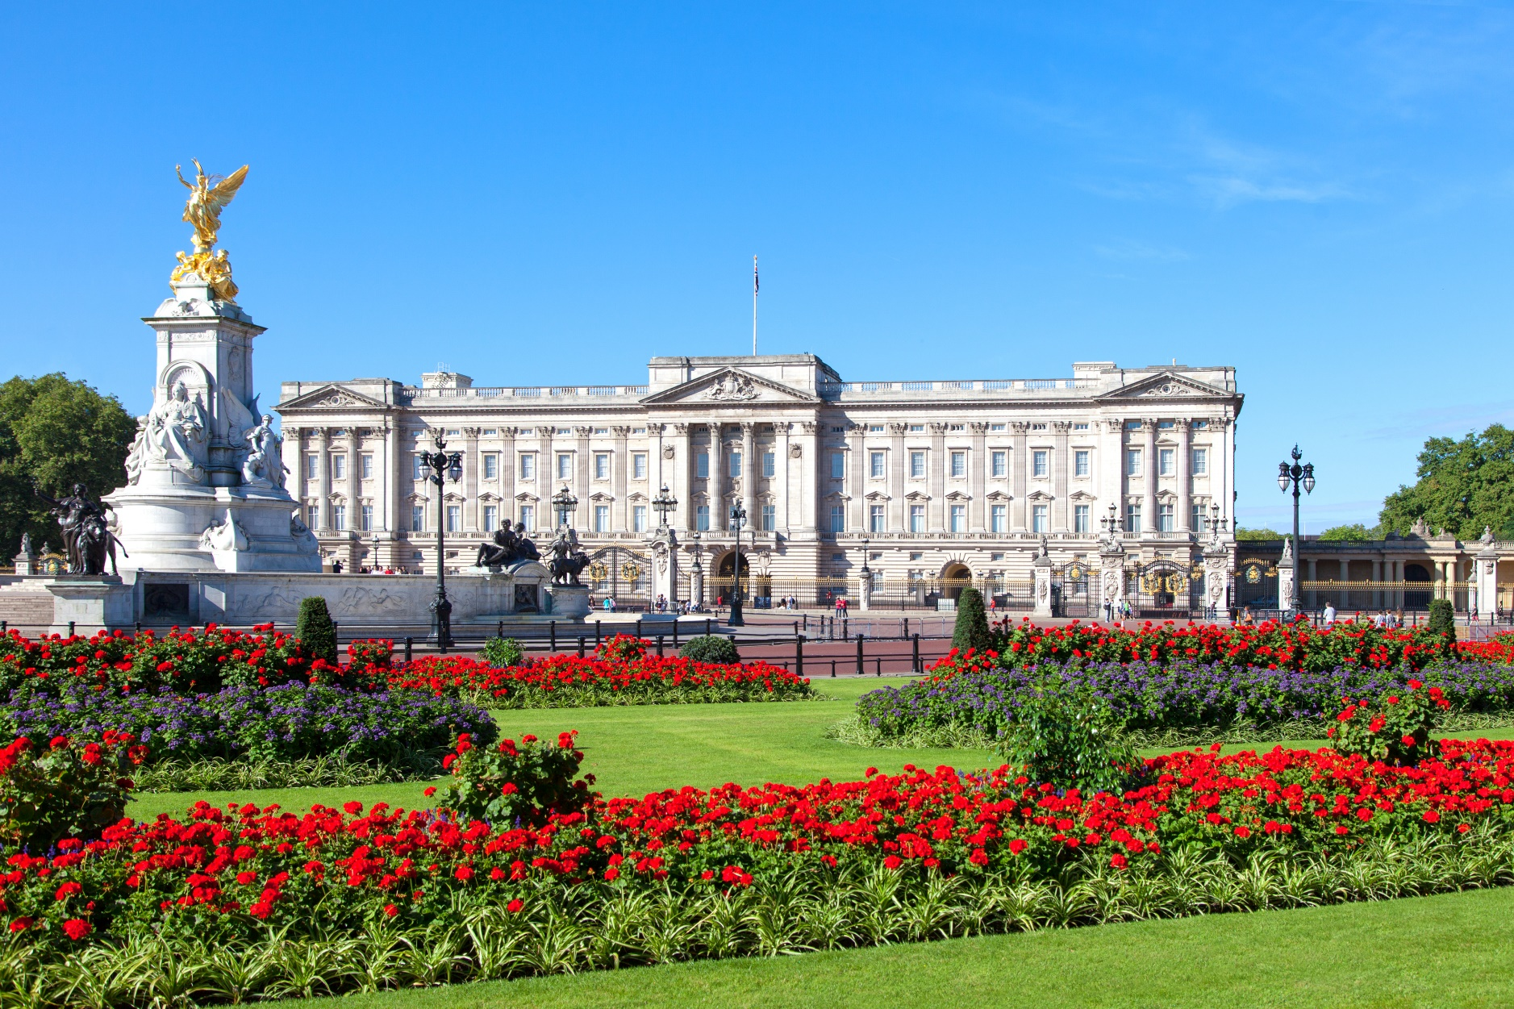
Picture 4
Buckingham Palace

Slide 12
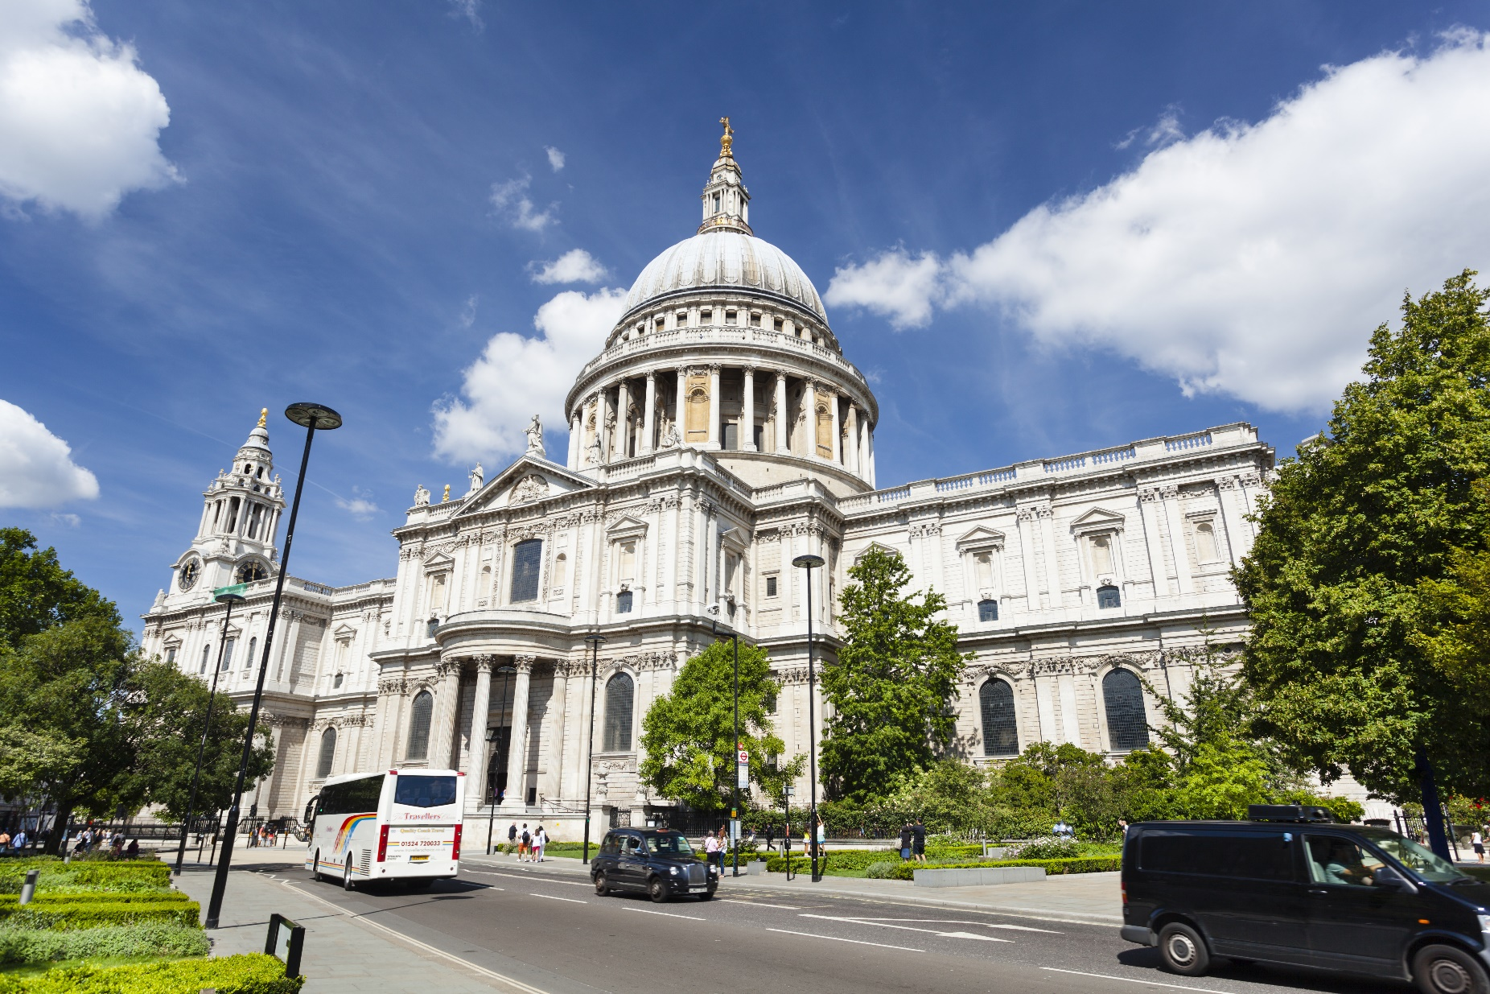
ID: 198849353
Picture 5
St. Paul’s Cathedral

Slide 13
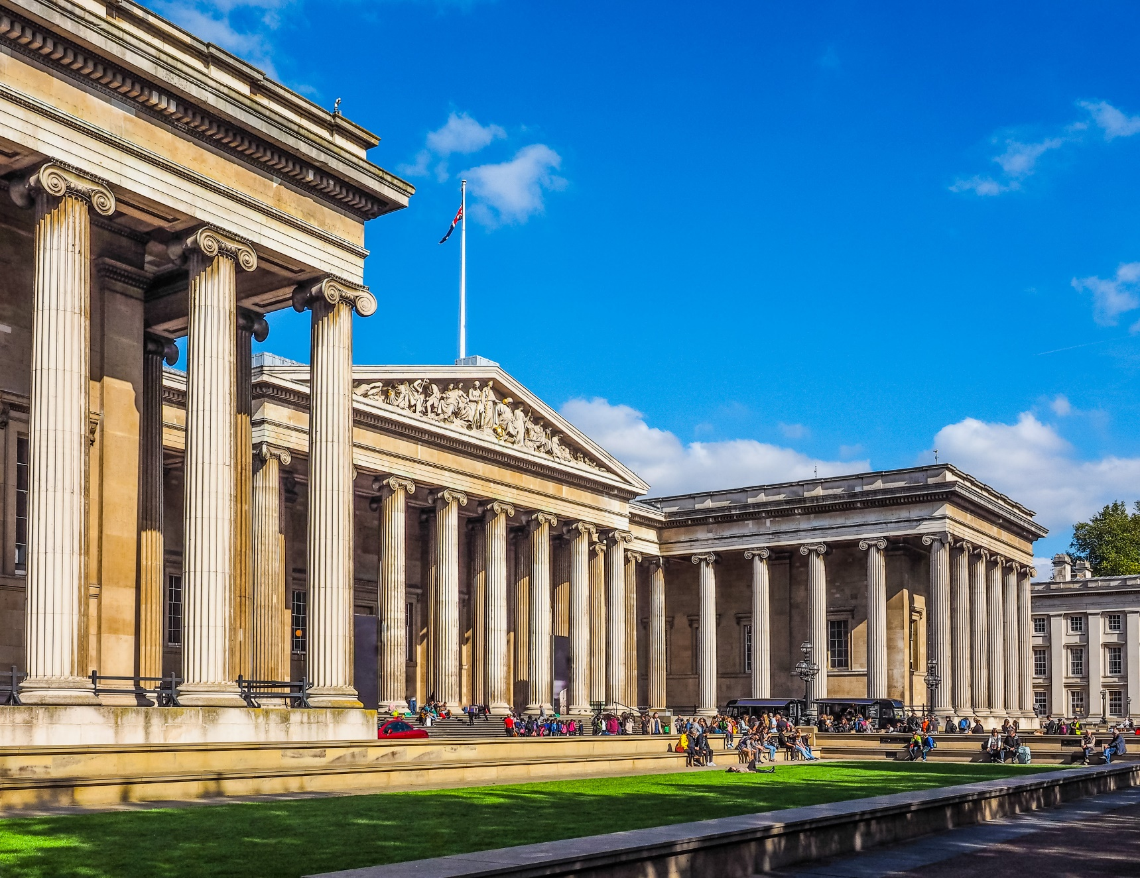
ID: 470203151
Picture 6
The British Museum

Slide 14

Speaking

Slide 15

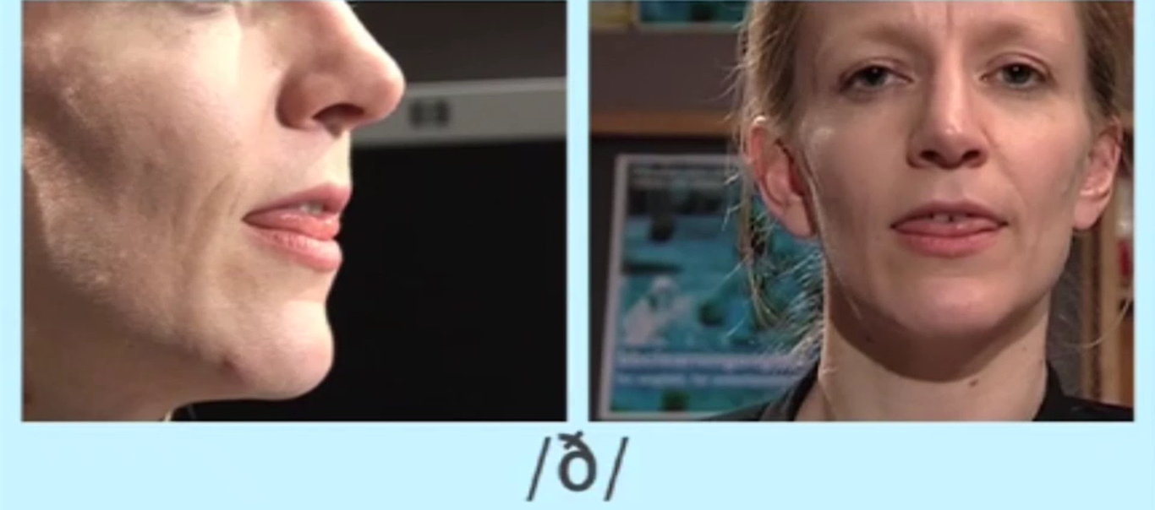
Pre-Speaking
The sound: /ð/
Link to watch the video how to pronounce the sound /ð/ https://www.bbc.co.uk/learningenglish/english/features/pronunciation/voicedconst6

Slide 16

Pre-Speaking
Listen to the words and focus on the underlined letters.
the weather there
/ð/
/ð/
/ð/
Listen and repeat

Slide 17
Pre-Speaking
Find the words with the /ð/ sound
Suggested answers:
that, with, them, then, than, other, within, although, rather, together, mother, father, brother, rather, thus, therefore, …..
Read the words to a partner

Slide 18

Practice the conversation. Swap roles and repeat
Mary: What are you going to do for your vacation?
Tom: I'm going to visit the Sydney Opera House/ Milan Cathedral/ Statue of Liberty.
Mary: What else will you do?
Tom: If I have time, I'll visit the Sydney Harbor Bridge/ Branca Tower/ Central Park.
Mary: What will you do if the weather's cold/ sunny/ rainy?
Tom: If the weather’s cold, I'll visit the Australian Museum/ go to an ice cream store/ watch a Broadway play.

Slide 19
Practice the conversation with your own ideas

Slide 20

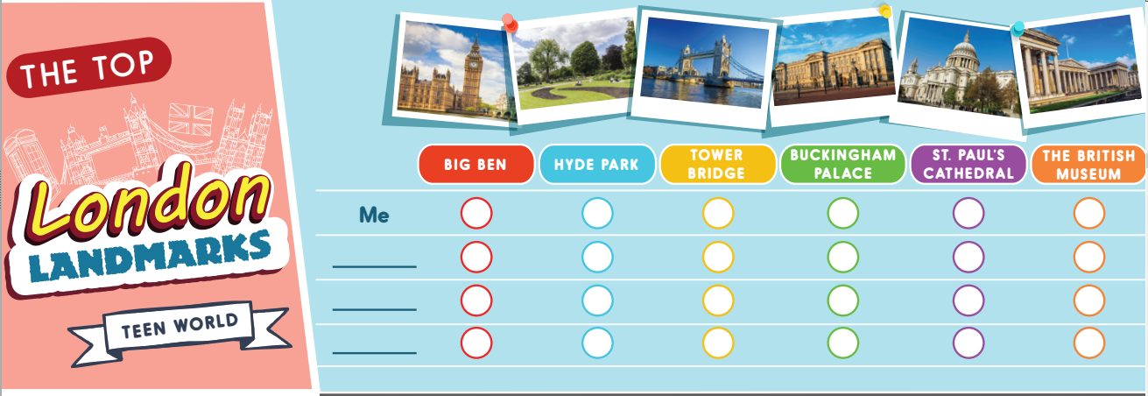
While-Speaking
Famous Landmarks in London
You're going to London for a day and want to visit three places. Tick (✓) three landmarks you would like to go, then ask three friends where they're going to visit.

Slide 21

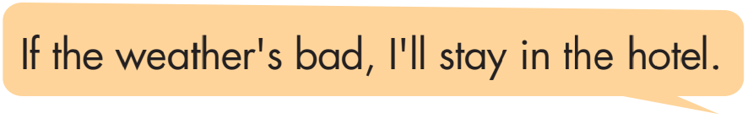
Post-Speaking
What will you do if you have more time or if it rains? Discuss and answer the questions.
If you have more time, what will you do there?
If I have more time, I will buy some souvenirs for my cousins.

Slide 22

CONSOLIDATION

Slide 23
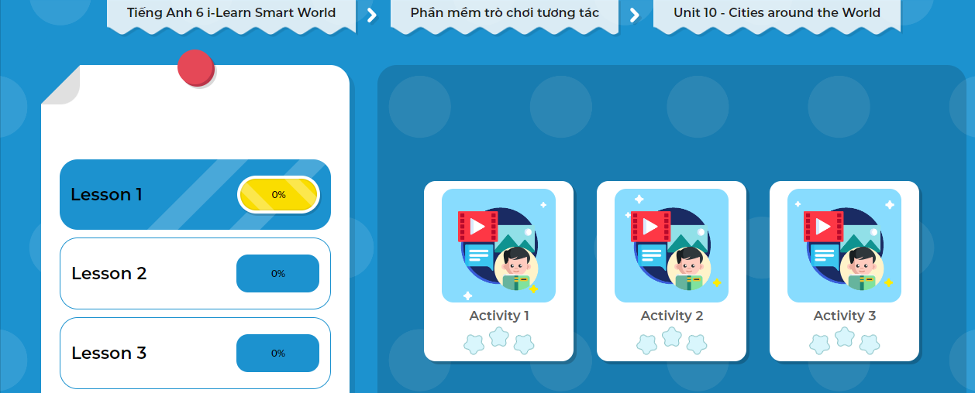
LET’S PLAY!
Click here to play the game!
Notes:
Mở Ứng dụng DHA trên Eduhome. Sách lớp 6, Unit 10, Lesson 1, Activity 3

Slide 24

WRAP-UP

Slide 25
Lesson 3
Today’s lesson
Pronunciation
How to pronounce the sound /ð/
Speaking
Ask and answer about vacation

Slide 26
Homework
Look back on the lesson at home.
Practice asking and answering about a future plan using the First Conditional sentence.
Prepare the next lesson (page 81 SB)
Play the consolidation games in Tiếng Anh 6 i-Learn Smart World DHA App on www.eduhome.com.vn

Slide 27
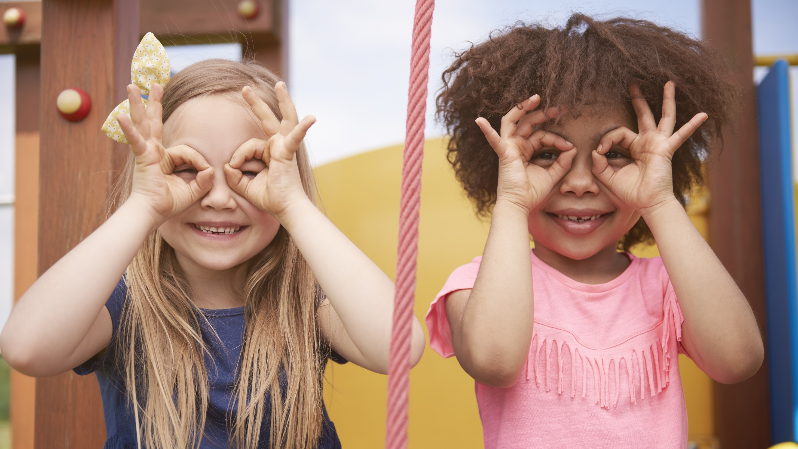
Enjoy your day!

