Slide 2


Unit
2
MY HOUSE
LESSON 5: SKILLS 1
SKILLS
Reading
Speaking
1
1
1

Slide 3
LESSON 5: SKILLS 1
LESSON 1: GETTING STARTED
Shark attack
WARM-UP
* Reading skills: Predicting
* Vocabulary
Task 1: Look at the text and answer the questions.
Task 2: Read again and answer the questions.
Task 3: Circle the things in Tiger Room.
READING
SPEAKING
Task 4: Create a new room for the hotel.
Task 5: Describe your plan.
CONSOLIDATION
Wrap-up
Homework

Slide 4




WARM-UP
C
R
A
Z
Y
A
B
C
D
E
F
G
H
I
J
K
L
M
N
O
P
Q
R
S
MOVE
MOVE
MOVE
MOVE
T
U
V
W
X
Y
Z
MOVE

Slide 5

Unit
MY HOUSE
1
KEY

Slide 6
WARM-UP
C
R
A
Z
Y
A
B
C
D
E
F
G
H
I
J
K
L
M
N
O
P
Q
R
S
T
U
V
W
X
Y
Z

Slide 7


Reading

Slide 8
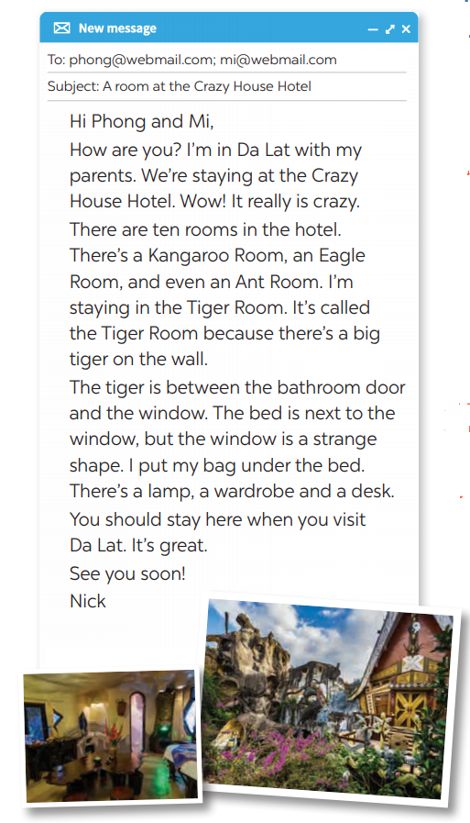
READING
1
Look at the text. Answer the questions.
1. Is it an email or a letter?
→ It is an email.
2. What is the text about?
→ The text is about Nick’s room at the Crazy House Hotel.

Slide 9
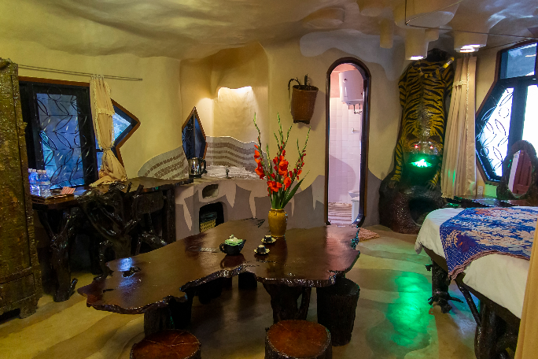

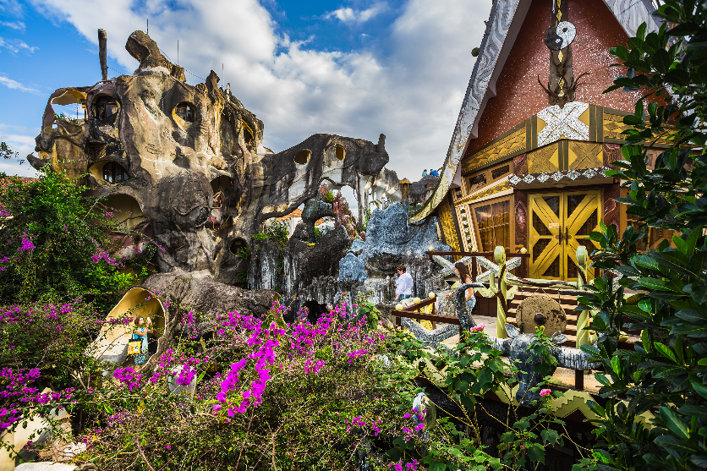
READING
Reading skill: Predicting
Predicting makes reading easy.
Before reading, look at the pictures, design and title.
Decide what the text is about.
Think about what you know about the topic.

Slide 10
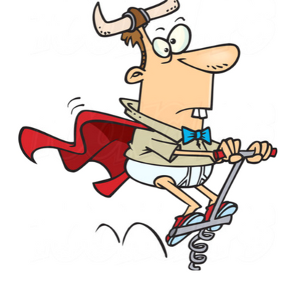

READING
strange (adj)
/streɪndʒ/
kì lạ

Slide 11
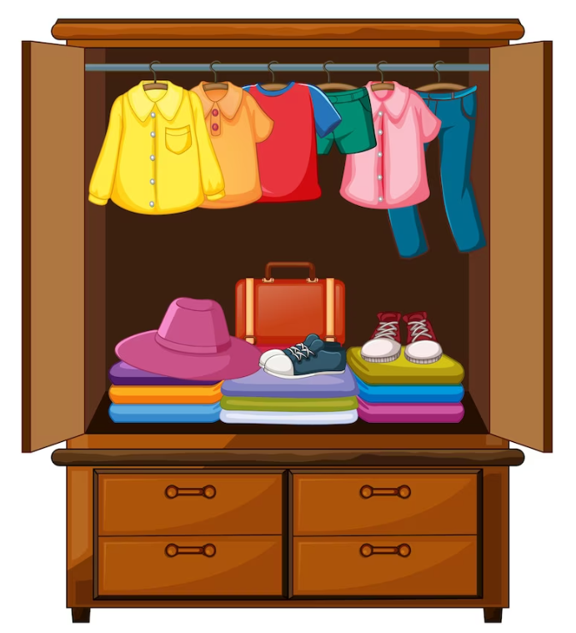
READING
wardrobe (n)
/ˈwɔːdrəʊb/
tủ đựng quần áo

Slide 12
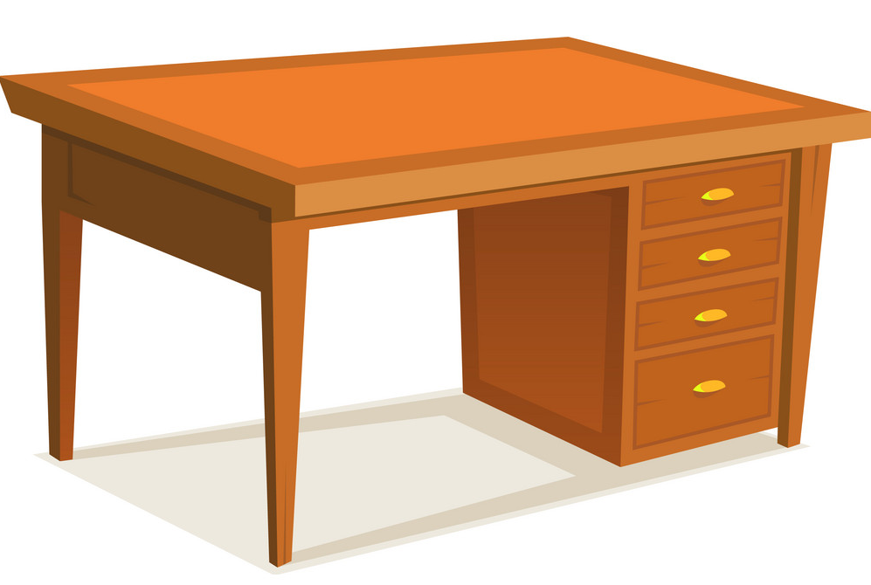
READING
desk (n)
/desk/
bàn học / bàn làm việc

Slide 13
READING
New words | Pronunciation | Meaning
1. strange (adj) | /streɪndʒ/ | kì lạ
2. wardrobe (n) | /ˈwɔːdrəʊb/ | tủ đựng quần áo
3. desk (n) | /desk/ | bàn học / làm việc

Slide 14


READING
2
Read the text again and answer the questions.
To: phong@webmail.com; mi@webmail.com
Subject: A room at the Crazy House Hotel
Hi Phong and Mi,
How are you? I’m in Da Lat with my parents. We’re staying at the Crazy House Hotel. Wow! It really is crazy. There are ten rooms in the hotel.
There’s a Kangaroo Room, an Eagle Room, and even an Ant Room. I’m staying in the Tiger Room. It’s called the Tiger Room because there’s a big tiger on the wall.
The tiger is between the bathroom door and the window. The bed is next to the window, but the window is a strange shape. I put my bag under the bed. There’s a lamp, a wardrobe and a desk.
You should stay here when you visit Da Lat. It’s great.
See you soon!
Nick

Slide 15
READING
2
Read the text again and answer the questions.
1. Who is Nick in Da Lat with?
2. How many rooms are there in the hotel?
He’s in Da Lat with his parents.
There are ten rooms.

Slide 16
READING
2
Read the text again and answer the questions.
3. Why is the room called the Tiger Room?
4. Where is Nick’s bag?
Because there’s a big tiger on the wall.
It’s under the bed.

Slide 17
READING
3
Circle the things in the Tiger Room.
a window | a wardrobe
a cooker | a cupboard
a shelf | a lamp
a desk | a tiger

Slide 18
PRACTICE
Retelling: What to include when describing a room in the hotel.
Reason for the name
Name of the room
Describe
a room
Position of things in the room

Slide 19
Speaking

Slide 20



PRESENTATION
4
Create a new room for the hotel. Draw a plan for the room.

Slide 21
PRESENTATION
5
Show your plan to your partner and describe it.
Example:
This is the shark room. There’s a big shark at the door. There’s a table and a sofa in the middle of the room ...

Slide 22

CONSOLIDATION
1
Wrap-up
What have we learnt in this lesson?
Understand the description of a room at the Crazy House Hotel in Da Lat
Describe one room

Slide 23

CONSOLIDATION
2
Homework
Do exercises in the workbook.
Prepare for the next lesson: Skills 2

Slide 24






Website: hoclieu.vn
Fanpage: facebook.com/www.tienganhglobalsuccess.vn/

