Slide 1


Slide 2

Unit
9
1
Unit
FAMILY LIFE
Protecting the environment
LESSON 5
LISTENING
Saving endangered animals

Slide 3

Unit
1
1
FAMILY LIFE
Family Life
Unit
OBJECTIVES
Listen for specific information in a conversation about ways to protect endangered animals.

Slide 4
LESSON 5
LISTENING
WARM-UP
Game: Ocean rescue
PRE-LISTENING
Task 1: Answer the question.
WHILE-LISTENING
Task 2: True or False.
Task 3: Complete the notes.
POST-LISTENING
Task 4: Work in groups and answer the question.
CONSOLIDATION
Wrap-up
Home work

Slide 5
LESSON 5
LISTENING
WARM-UP
Game: Ocean rescue

Slide 6
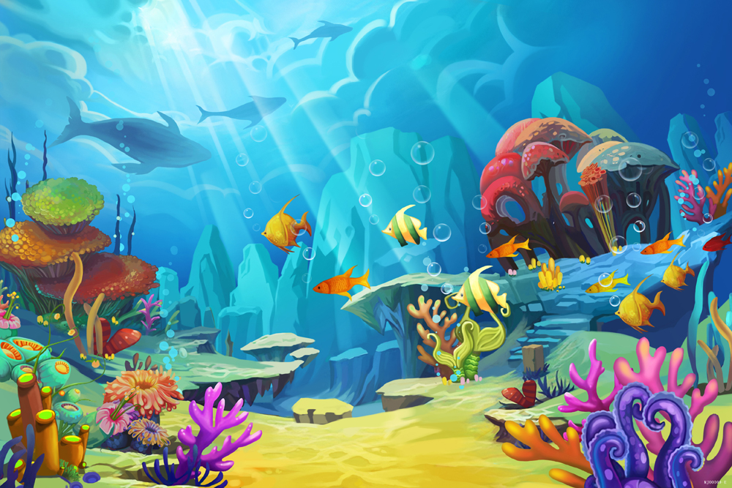


OCEAN RESCUE

Slide 7
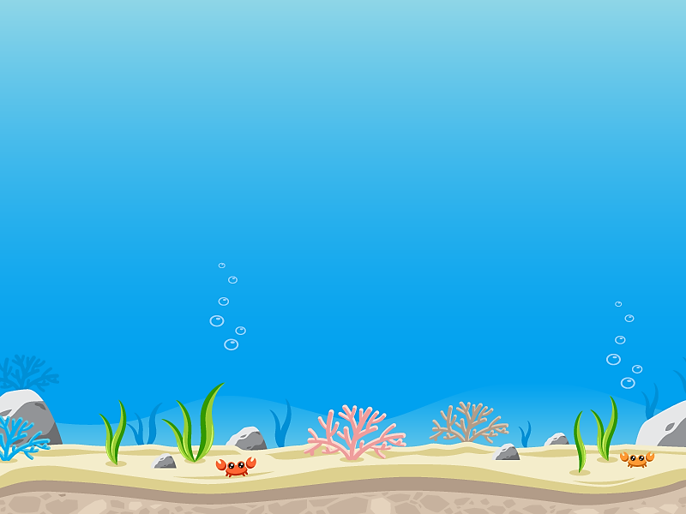







It is a large heavy animal with very thick skin and either one or two horns on its nose.
Start!
A. An elephant
B. A crocodile
C. A hippo
D. A rhino
TIME’S UP

Slide 8



Start!
Rhinos are large animals found
in rivers and lakes in …............
A. America
B. South Africa
C. Europe
D. Australia
TIME’S UP

Slide 9
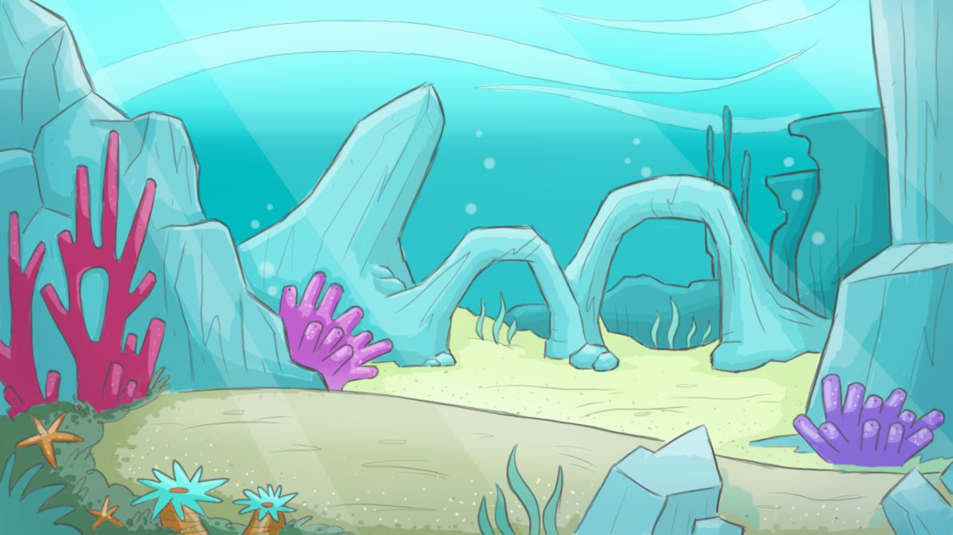
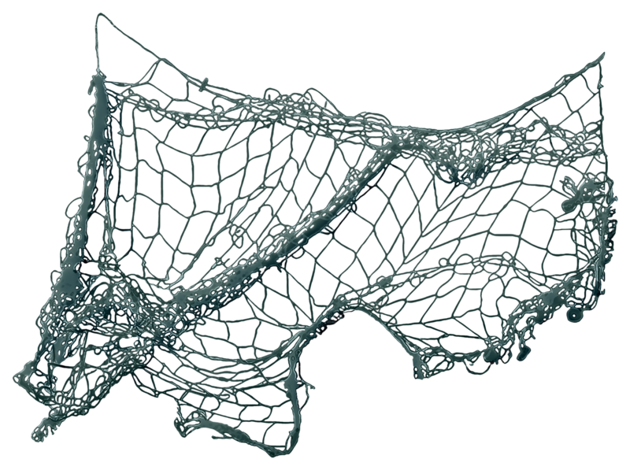


Start!
Rhinos are threatened by
illegal hunting and loss of …............
A. habitat
B. water
C. river
D. ocean
TIME’S UP

Slide 10





Start!
The tiger is the largest living …........., and lives in forest habitats.
A. panda
B. lion
C. cat
D. pangolin
TIME’S UP

Slide 11
Start!
Tigers are endangered animals and there are not more than …......... tigers in the wild now.
A. 35
B. 350
C. 3500
D. 35000
TIME’S UP

Slide 12
LESSON 5
LISTENING
WARM-UP
Game: Ocean rescue
PRE-LISTENING
Task 1: Answer the question.

Slide 13
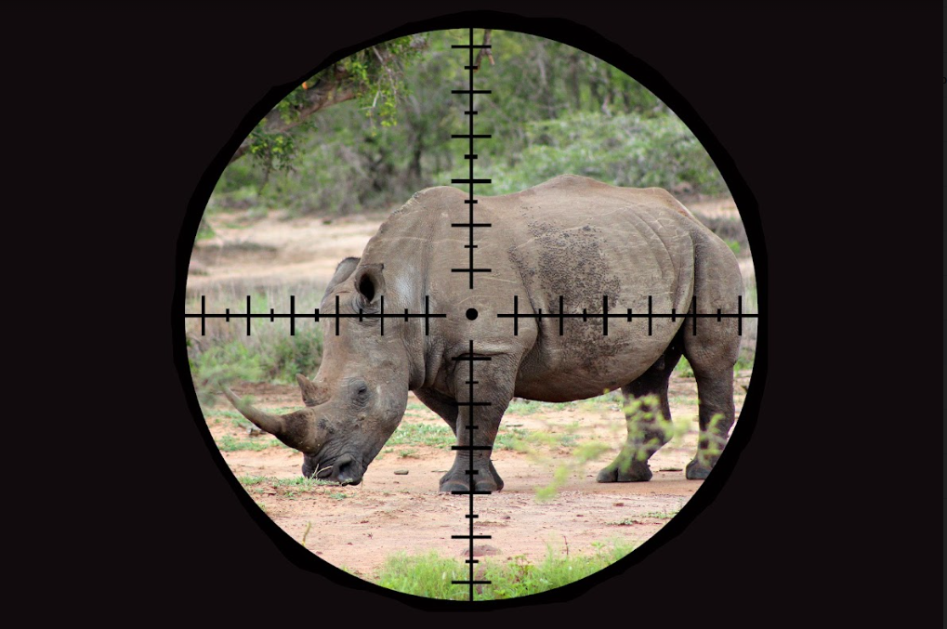
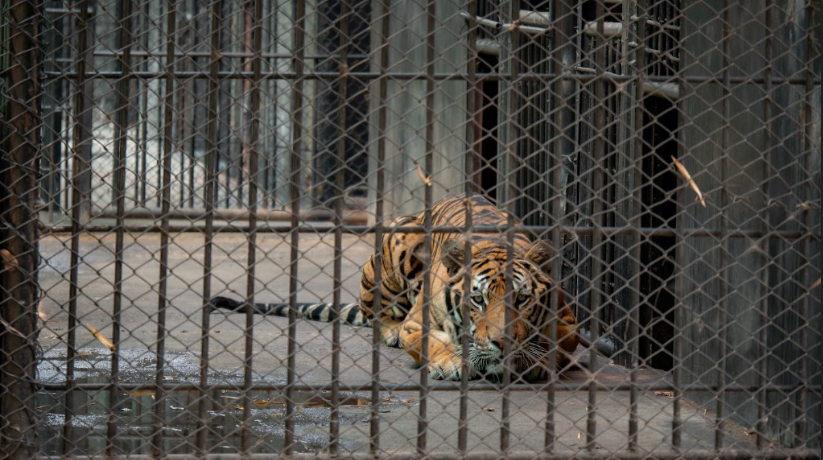
PRE-LISTENING
1
Answer the questions.
What is happening to the animals in the pictures?
The wild tiger is being kept in a cage. /
The wild tiger is being held in captivity.
The rhino is being hunted.

Slide 14
LESSON 5
LISTENING
WARM-UP
Game: Ocean rescue
PRE-LISTENING
Task 1: Answer the question.
WHILE-LISTENING
Task 2: True or False.
Task 3: Complete the notes.

Slide 15

WHILE-LISTENING
2
True or false.
 | T | F
1. Mai will complete her mid-term project in two weeks.
2. Nam believes that people should first be made aware of the importance of the problem.
3. Mai thinks that illegal hunting may not destroy wild animals’ natural habitats.
4. Nam believes that illegal hunting can be prevented by banning wildlife trade.
✓
✓
✓
✓

Slide 16
WHILE-LISTENING
3
Listen to the conversation again and complete the notes. Use ONE word for each gap
Ways to save endangered animals
Helping people understand the (1)……………………………….of the problem. Introducing strict (2)………………………to prevent people from illegal hunting. Banning wildlife (3)…………………………………… Avoiding products made from endangered(4) …………………..parts.
importance
laws
trade
animal

Slide 17
LESSON 5
LISTENING
WARM-UP
Game: Ocean rescue
PRE-LISTENING
Task 1: Answer the question.
WHILE-LISTENING
Task 2: True or False.
Task 3: Complete the notes.
POST-LISTENING
Task 4: Work in groups and answer the question.

Slide 18
POST-LISTENING
4
Work in groups and answer the questions.
Which is the most effective way to save endangered animals? Why?
- Each group prepares a 3-min summary on the most effective way to save endangered animals.
- Take turns presenting the summary of their discussions to the whole class.

Slide 19
LESSON 5
LISTENING
WARM-UP
Game: Ocean rescue
PRE-LISTENING
Task 1: Answer the question.
WHILE-LISTENING
Task 2: True or False.
Task 3: Complete the notes.
POST-LISTENING
Task 4: Work in groups and answer the question.
CONSOLIDATION
Wrap-up
Home work

Slide 20
CONSOLIDATION
1
Wrap-up
Listen for main idea and specific information in a conversation about ways to protect endangered animals.

Slide 21
CONSOLIDATION
2
Homework
Do exercises in the workbook.

Slide 22

Website: hoclieu.vn
Fanpage: facebook.com/tienganhglobalsuccess.vn/

