Slide 1


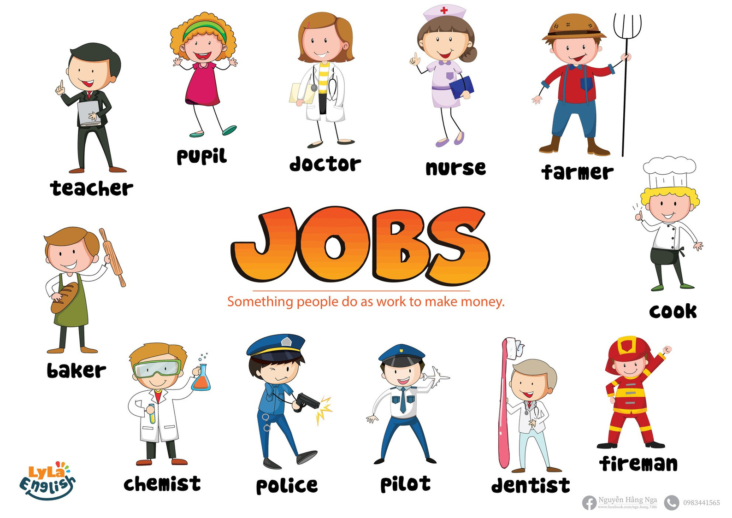


Slide 2



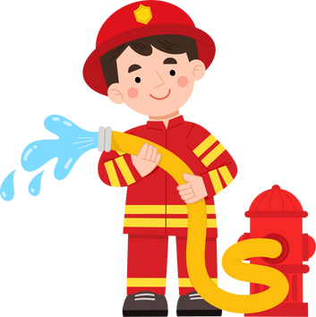


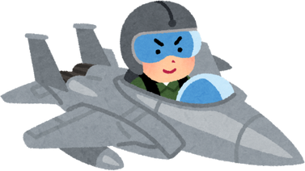
I. Questions
1.Who works at school?
4. Who grows food?
It’s a farmer.
It’s a teacher.
2. Who puts out the fire?
It’s a fireman.
5. What do you want to be when you grow up?
I want to be a.........
3. Who catches the thief?
It’s a police.

Slide 3






II. Vocabulary
teacher: ..........................................................................................
pupil: ............................................................................................
nurse:..............................................................................................
doctor: ............................................................................................

Slide 4


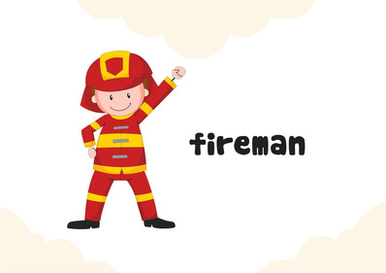
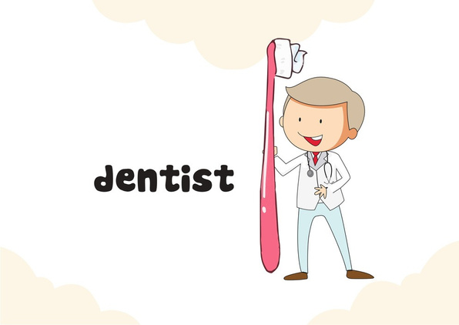
II. Vocabulary
farmer: ..........................................................................................
cook: ..............................................................................................
fire man:.........................................................................................
dentist: ..........................................................................................

Slide 5


II. Vocabulary
pilot: ..........................................................................................
police: ............................................................................................

Slide 6



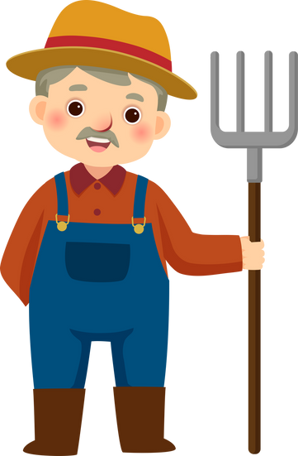
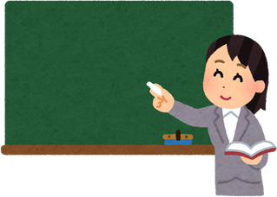
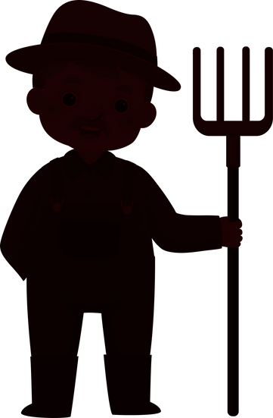



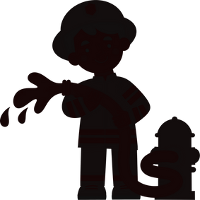
III. Exercise
1. Find the correct shadow

Slide 7



III. Exercise
2. Look and match
Police
nurse
cook
pilot
doctor
farmer

Slide 8
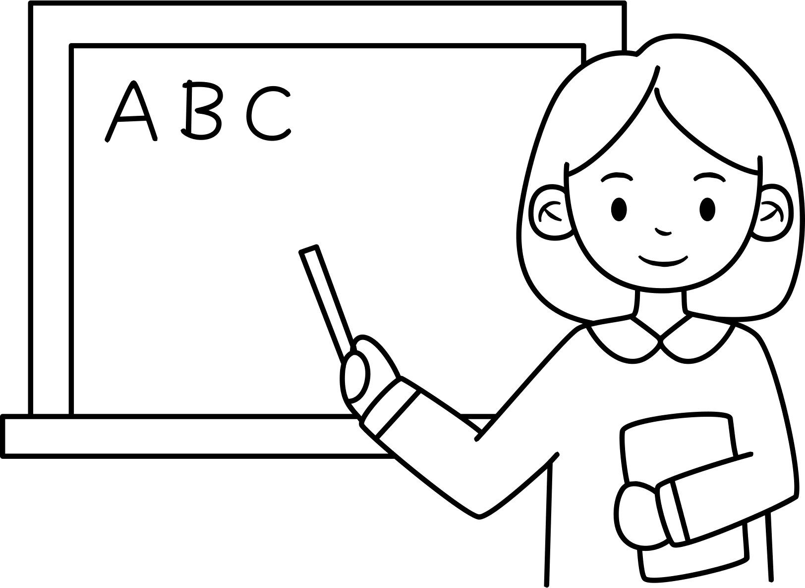
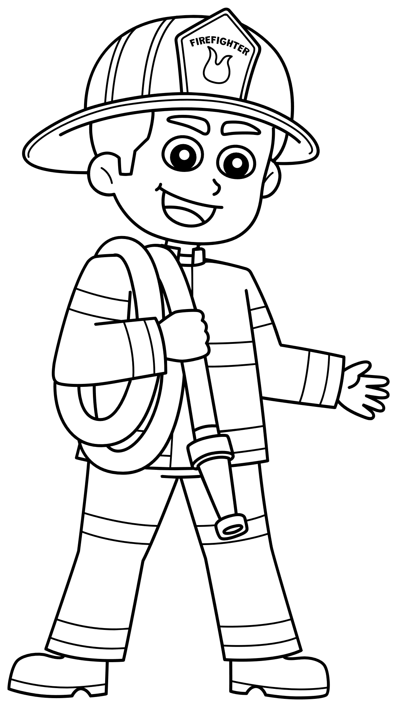
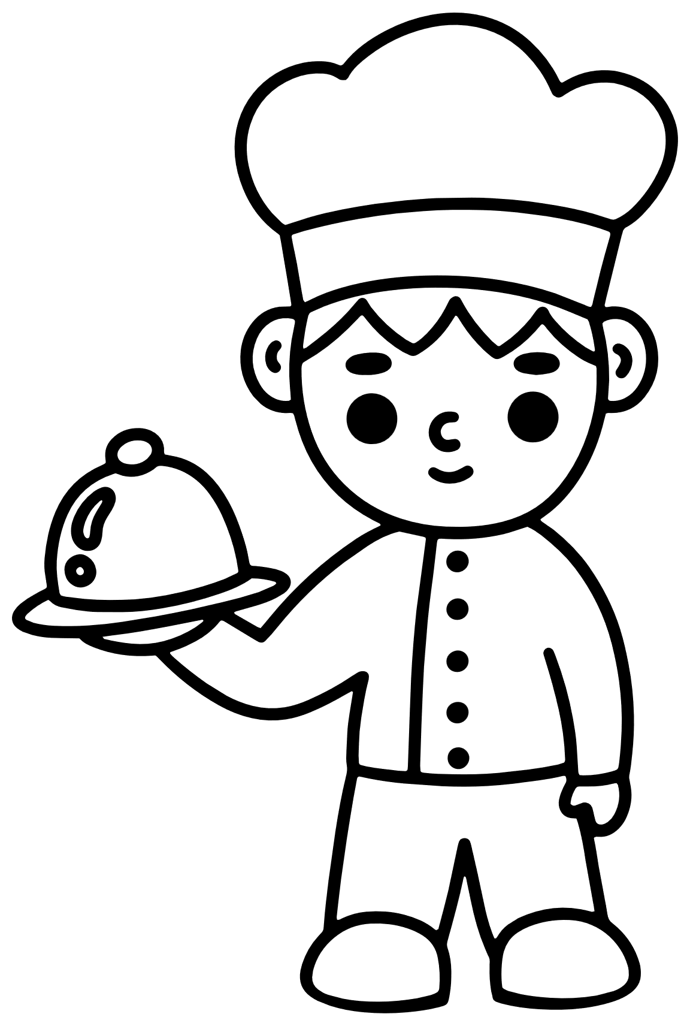
III. Exercise
3. Read and colour.
I’m a teacher.
I’m a fireman.
I’m a cook.

Slide 9





















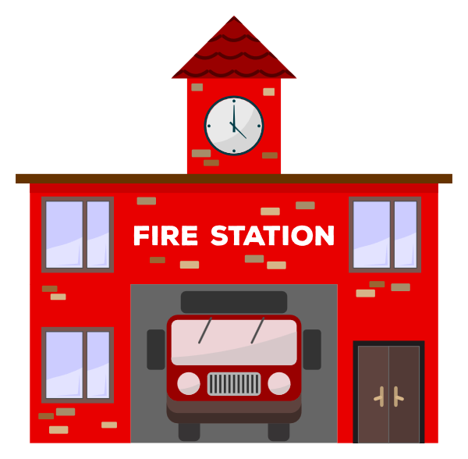
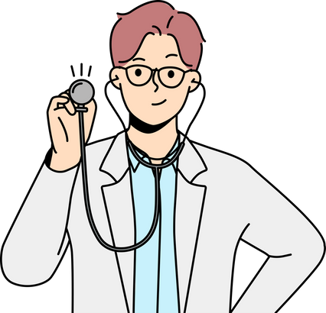
III. Exercise
4. Where do they work?

Slide 10








III. Exercise
5. Reoder the words.
p/o/l/e/i/c
c/o/k/o
n/u/s/r/e
......................
......................
......................
p/u/p/l/i
f/i/r/e/m/n/a
p/o/l/i/t
......................
......................
......................

Slide 11


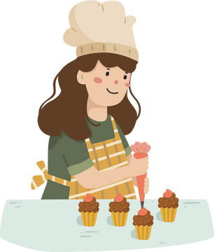

III. Exercise
6. Fill in the missing letters.
dent_st
f_rmer
pil_t
chem_st
b_ker
d_tor

Slide 12







III. Exercise
7. Tick the correct answer.
1
2
3
teacher police
cook
farmer pilot doctor
baker dentist
doctor
5
6
4
pilot police nurse
teacher
pupil
farmer
baker dentist
chem

Slide 13



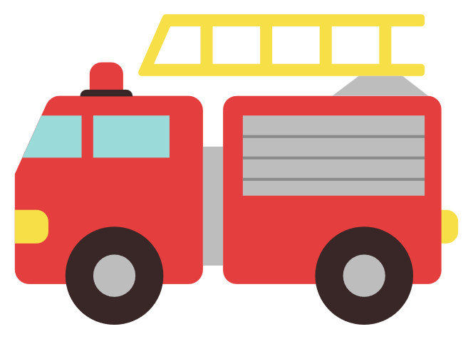


III. Exercise
8. Draw lines to match.
1
2
3
4
5
a
b
c
d
e

