Slide 1


Unit 5: INVENTIONS
Lesson 5: Listening
RoboVacuum

Slide 2

Unit
1
1
FAMILY LIFE
Family Life
Unit
OBJECTIVES
Listen for specific information about how to use an invention.

Slide 3
Table of contents
01
02
03
Warm-up
Pre-listening
While-listening
04
Post-listening
05
Consolidation

Slide 4
Warm-up
01
Guessing game

Slide 5

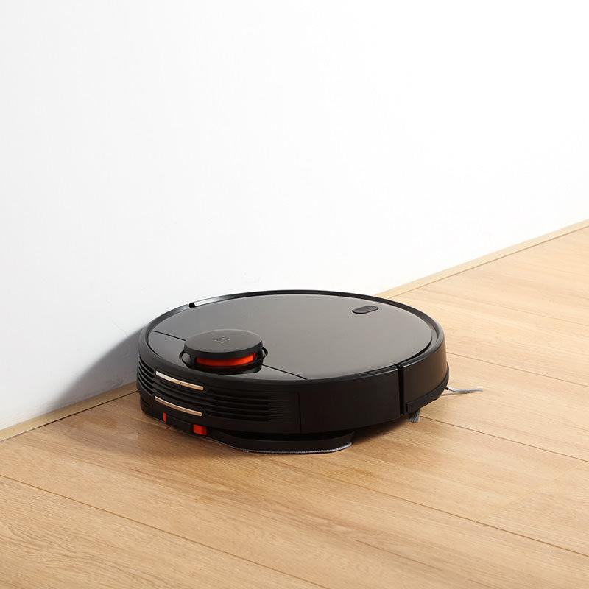
GUESSING GAME
What is it?
It is a household appliance.
It has wheels.
It sucks up dirt and dust.

Slide 6
Pre-listening
02

Slide 7


VOCABULARY
button (n)
/ˈbʌtn/
a small part of a machine that you press to make it work

Slide 8

VOCABULARY
charge (v)
/tʃɑːdʒ/
to pass electricity through something so that it is stored there; to take in electricity so that it is stored and ready for use

Slide 9

VOCABULARY
stain (n)
/steɪn/
a dirty mark on something which is difficult to remove.

Slide 10


Slide 11


Slide 12
I spy with my little eye ...

Slide 13

I spy with my little eye ...

Slide 14

something beginning with ...
stain
There is a dirty _____ on your smartphone. Wipe it away.
?

Slide 15
I spy with my little eye ...

Slide 16

something beginning with ...
Press the ______ to start the device.
button
?

Slide 17
I spy with my little eye ...

Slide 18

something beginning with ...
charge
You need to _______ your mobile phone. The battery is very low.
?

Slide 19
While-listening
03

Slide 20
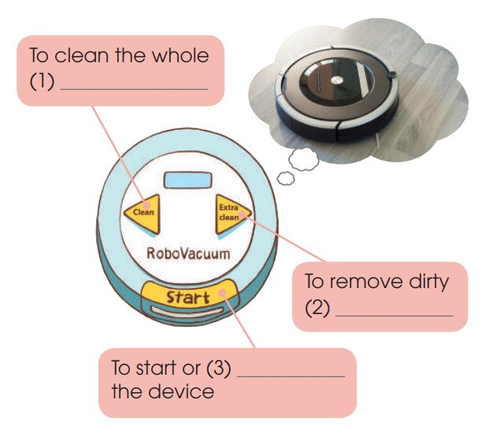
WHILE-LISTENING
2
Listen to a conversation about RoboVacuum. Fill in each gap in the diagram below with one word.
room
stains
stop

Slide 21
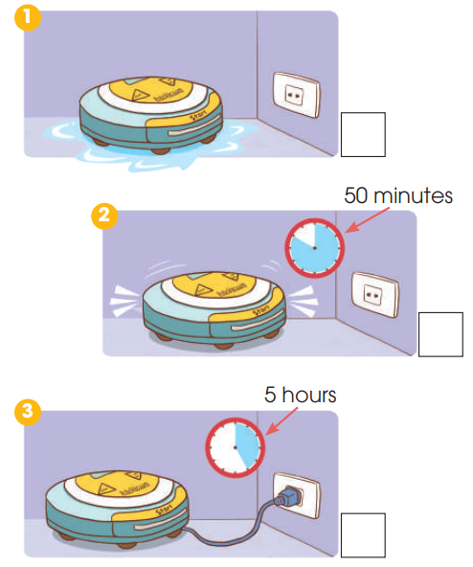
WHILE-LISTENING
WHILE-LISTENING
3
Listen again. Put a tick next to the correct way and a cross next to the wrong way to use RoboVacuum.
🗶
✔
✔

Slide 22
Post-listening
04

Slide 23
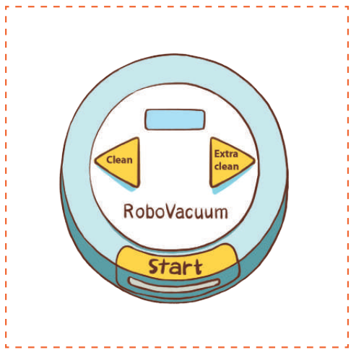
POST-LISTENING
4
What other buttons do you want RoboVacuum to have? Add them to the picture below and tell your friends about them.
I want my Robo Vacuum to have a Timer button on the top. First, you press it. Then, you set the time by pressing the minute and second buttons on the right.

Slide 24
Consolidation
05

Slide 25
CONSOLIDATION
1
Wrap-up
Listen for specific information about RoboVacuum.

Slide 26
CONSOLIDATION
2
Homework
Prepare for the next lesson: Unit 5 – Writing
2. Do exercises in the workbook

Slide 27
SEE YOU NEXT TIME !!

