Slide 2
Unit 8
WILDLIFE CONSERVATION
LESSON 4
SPEAKING
Activities for conserving wildlife

Slide 3
LESSON 4
SPEAKING
WARM-UP
Game: Yes or No
Task 1: Rank each activity in order of its importance
CONTROLLED PRACTICE
LESS-CONTROLLED PRACTICE
Task 2: Brainstorm a list of activities you want to organise for the event.
FREE PRACTICE
Task 3: Summarise your ideas and present the activities to the class.
CONSOLIDATION
Wrap-up
Homework

Slide 4
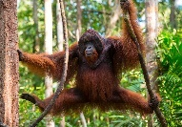
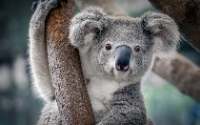
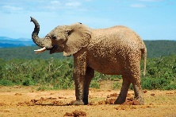
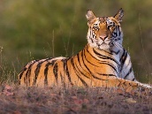
WARM-UP

Slide 5
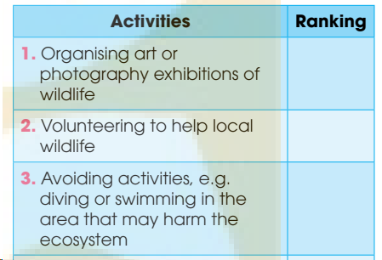
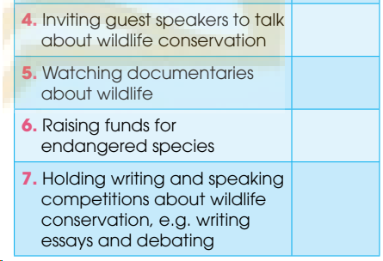
CONTROLLED PRACTICE
Are the following activities good for conserving wildlife? Rank each activity in order of its importance to conserving wildlife.
1

Slide 6

LESS-CONTROLLED PRACTICE
Work in groups. Read the notice. Then brainstorm a list of activities you want to organise for the event. Explain how the activities will help conserve wildlife. Use the list in 1 and the example below to help you.
2
Suggested answers:
A: Today, we’re discussing suitable activities for the World Wildlife Day. The aim is to raise students’ awareness of wildlife conservation. Does anyone have any interesting ideas?
B: I think we should start the event with a wildlife painting competition.
C: I like your idea, but how will painting help conserve wildlife?
B: Well, ...

Slide 7

FREE PRACTICE
Work in groups. Summarise your ideas and present the activities for the World Wildlife Day to the class. Vote for the best ideas.
3

Slide 8
CONSOLIDATION
1
Wrap-up
What have you learnt today?
Some lexical items about conserving wildlife.
Talk about how to conserve wildlife.

Slide 9
CONSOLIDATION
2
Homework
Do exercises in the workbook.
Write a paragraph about how to conserve wildlife.

Slide 10
Website: hoclieu.vn
Fanpage: facebook.com/www.tienganhglobalsuccess.vn

