Slide 1

Unit 1: My World
Lesson: Right on!
Page 25

Slide 2
Lesson Outline
Warm-up
Project
Consolidation
Wrap-up

Slide 3
Objectives
By the end of this lesson, students will be able to…
complete a quiz.
prepare a poster.
talk about what makes a good friend.
give a presentation on what makes a good friend.
talk about the value of friendship (optional).

Slide 4

WARM-UP

Slide 5
In your opinion, what makes a good friend?

Slide 6

It’s time to learn …

Slide 7
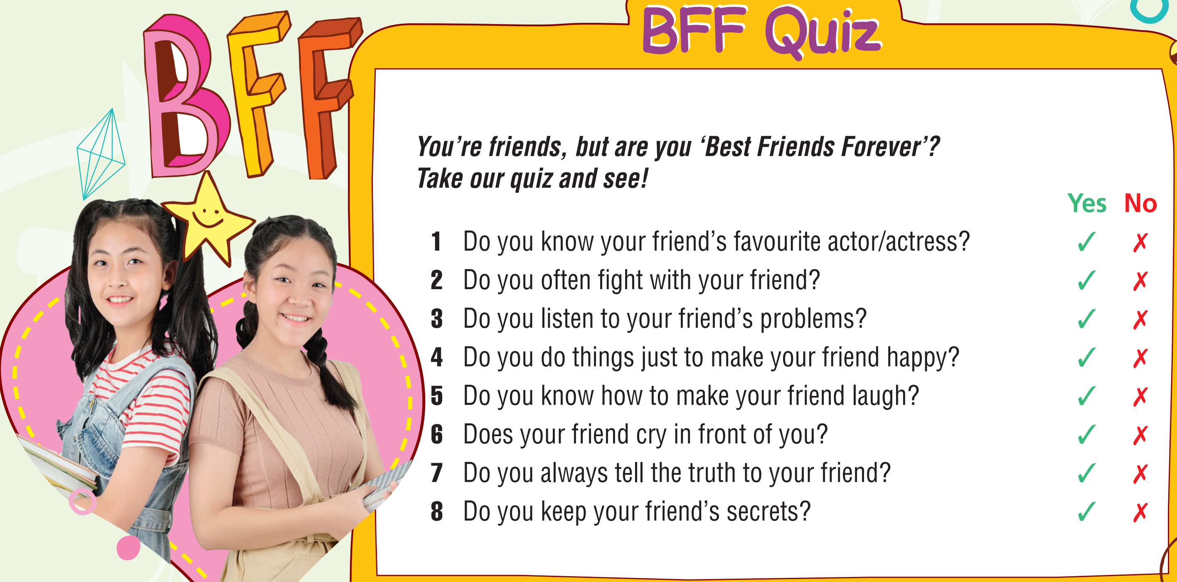
1 Are you a good friend? Take the quiz to find out.

Slide 8
Now, check your scores.
8-7 ✓s = BFFs
5-6 ✓s = good friends
3-4 ✓s = just friends
1-2 ✓s = needs work!
Are you a good friend?

Slide 9

2 It’s International Friendship Day. Find a good quote and prepare a poster for the class. Use the key words friendship quotes.
Suggested quotes
- “A real friend is one who walks in when the rest of the world walks out.” Walter Winchell
- “Walking with a friend in the dark is better than walking alone in the light.” Helen Keller
- “One of the most beautiful qualities of true friendship is to understand and to be understood.” Lucius Annaeus Seneca
- “One loyal friend is worth ten thousand relatives.” Euripides
- “A friend is someone who gives you total freedom to be yourself.” Jim Morrison

Slide 10
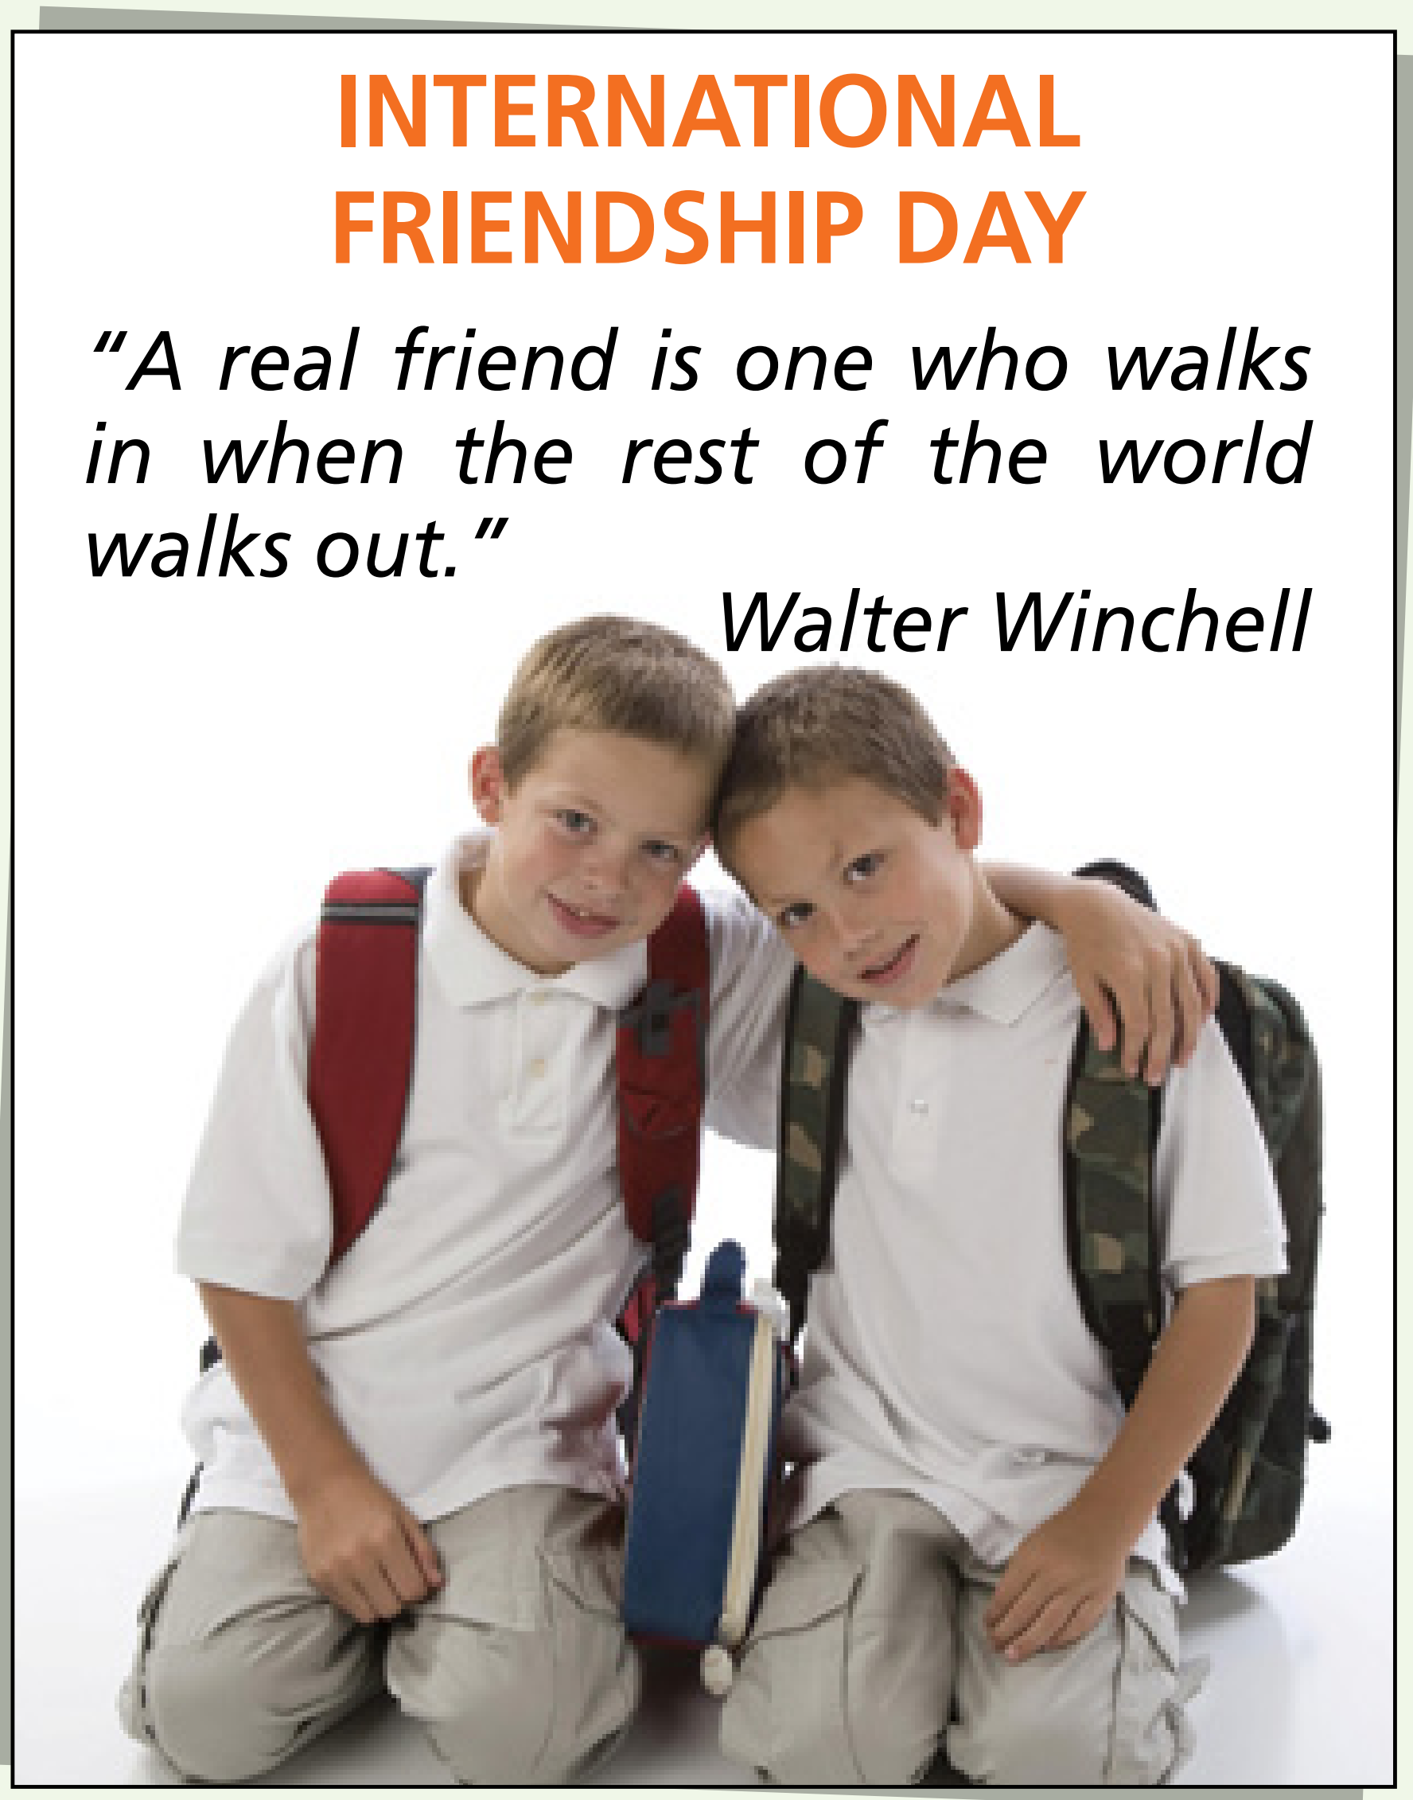
Suggested poster

Slide 11



3 What makes a good friend? Put the ideas in the list under the headings. Add two more of your own.
helps you
lies to you
cares about you
is fun to be with
makes you sad
is there for you
doesn’t share their things
listens to your problems

Slide 12

4 Use the ideas in Exercise 3 to prepare and give a presentation on how to be a good friend.
Suggested presentation
Ralph Waldo Emerson said: “The only way to have a friend is to be one.” But the question is: how can someone be a good friend?
First of all, always be there for your friend. For example, if someone starts telling lies about them, speak up for your friend.
Next, always keep your promises. And of course, don’t share your friend’s secrets with others.
Last but not least, listen to your friend. When your friend is talking to you, pay attention to what they say. Listening to your friend shows you care about them.
To sum up, a good friend is always there for your friend, always keeps your promises and listens to your friends.

Slide 13

Suggested answer
A: “A friend in need is a friend indeed.” Well, what does it mean?
B: I think it means that when you have problems, a friend helps you. This shows he/she is a good friend.
C: I agree. A good friend needs to be there for his/her friend in both good and bad times.
D: You’re right. A true friend doesn’t go away when his/her friend is in trouble. He/She stays and helps his/her friend.

Slide 14

CONSOLIDATION

Slide 15
Write a paragraph (60-80 words) about your best friend. Why is he/she your best friend?

Slide 16

WRAP-UP

Slide 17
Today’s lesson
Vocabularies
Friendship
Structures/ Sentence patterns
Sentences to make presentation

Slide 18
Homework
Practise the vocabularies and structure and make sentences using them.
Prepare the next lesson (page 26 SB)

Slide 19

Lesson 3
Stay positive and have a nice day!

