Slide 2



REVIEW
1
UNITS 1 – 2 – 3
LESSON 2: SKILLS
1

Slide 3
LESSON 2: SKILLS
LESSON 1: GETTING STARTED
WARM-UP
Chatting
Task 1: Choose A, B, or C for each blank in the email below.
Task 2: Read the text and answer the questions.
READING
Task 3: Interview two of your classmates about what they like and dislike about your school. Report their answers.
SPEAKING
LISTENING
Task 4: An and Mi are talking on the phone. Listen and fill each blank with one word.
Task 5: Write an email of about 50 words to your friend. Tell him/ her about a family member. Use these questions as cues.
WRITING
CONSOLIDATION
Wrap-up
Homework

Slide 4

WARM-UP
CHATTING
1. Do you have any pen pals?
2. How do you communicate with your pen pal?
3. Do you often write emails to your pen pal?

Slide 5
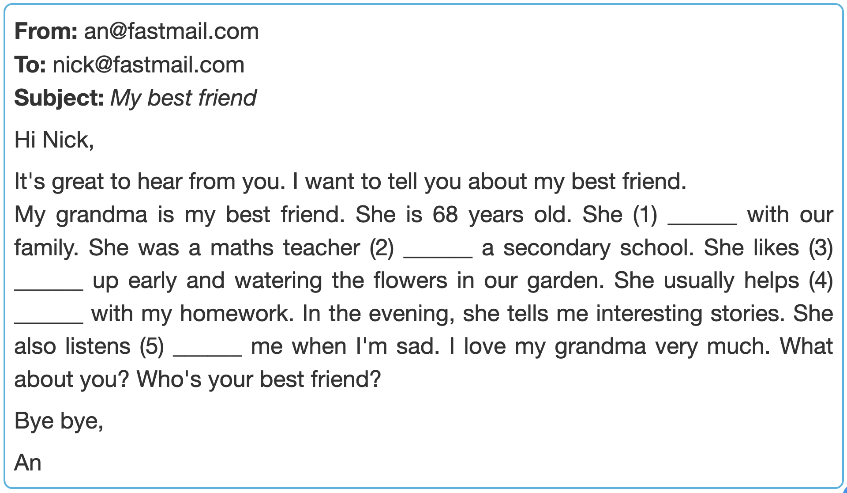
PRACTICE - READING
1
Choose A, B, or C for each blank in the email below.
1.
A. lives
B. works
C. goes

Slide 6
PRACTICE - READING
1
Choose A, B, or C for each blank in the email below.
2.
A. for
B. on
C. at

Slide 7
PRACTICE - READING
1
Choose A, B, or C for each blank in the email below.
3.
A. going
B. staying
C. getting

Slide 8
PRACTICE - READING
1
Choose A, B, or C for each blank in the email below.
4.
A. I
B. me
C. my

Slide 9
PRACTICE - READING
1
Choose A, B, or C for each blank in the email below.
5.
A. with
B. to
C. for

Slide 10
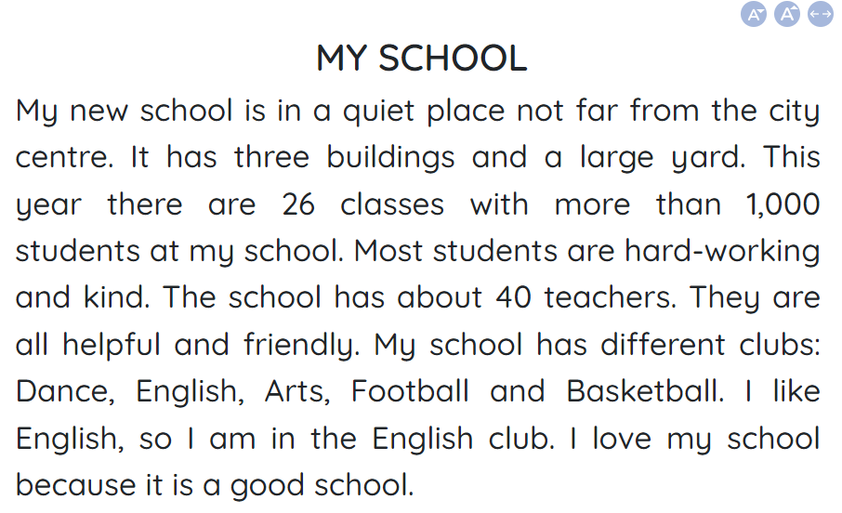
READING
2
Read the text and answer the questions.

Slide 11
READING
2
Read the text and answer the questions.
1. Where is the writer's new school?
→ It's in a quiet place not far from the city centre.
2. What are the students like?
→ They're hard-working and kind.
3. What are the teachers like?
→ They're helpful and friendly.
4. How many clubs are there in the school?
→ There are 5 clubs.
5. Why does the writer love the school?
→ Because it's a good school.

Slide 12
SPEAKING
3
Interview two of your classmates about what they like and dislike about your school. Report their answers.
 | What he / she likes + reasons | What he / she dislikes + reasons
Classmate A
Classmate B

Slide 13

LISTENING
4
An and Mi are talking on the phone. Listen and fill each blank with one word.
1. Everybody is at ______.
2. Mi's mother is watering the ______ in the garden.
3. Mi's father is in the ______ room.
4. Her younger brother is ________ in her bedroom.
5. Vi is watching ____.
home
plants
living
sleeping
TV

Slide 14
PRACTICE - WRITING
5
Write an email of about 50 words to your friend. Tell him/ her about a family member. Use these questions as cues.
1. Who is the person?
2. How old is he / she?
3. What does he / she look like?
4. What is he / she like?
Hi _____,
Thanks for your email. Now I'll tell you about my ______.
__________________________________________________________
Write me soon and tell me about a member in your family.
Best,

Slide 15

CONSOLIDATION
1
Wrap-up
What have we learnt in this lesson?
Reading
Speaking
Listening
Writing

Slide 16

CONSOLIDATION
2
Homework
- Do exercises in the workbook.
- Prepare for Unit 4 – Getting started

Slide 17






Website: hoclieu.vn
Fanpage: facebook.com/www.tienganhglobalsuccess.vn/

