Slide 2


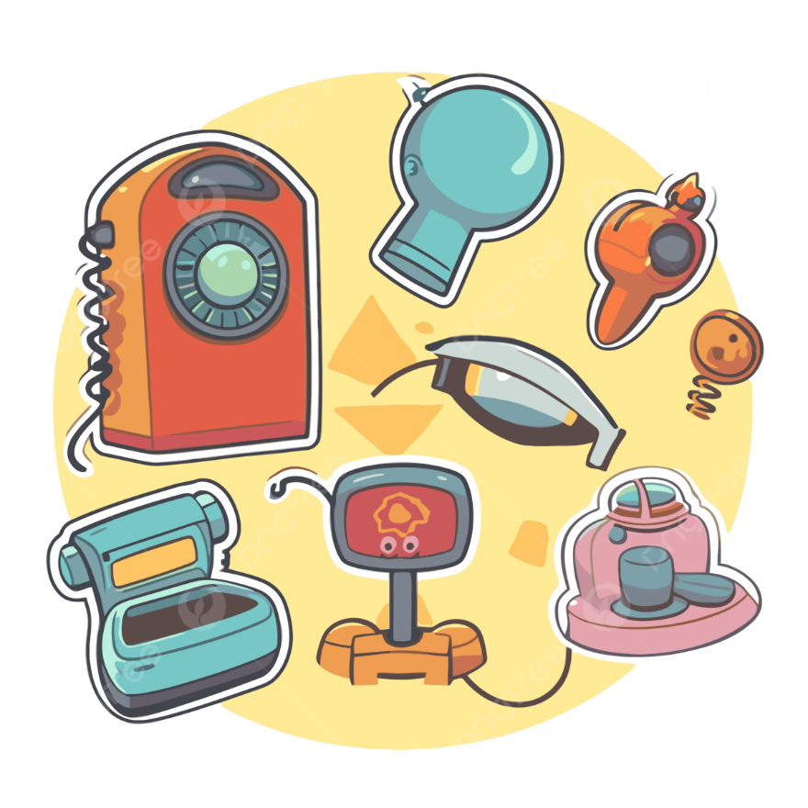
Unit
11
ELECTRONIC DEVICES
LESSON 2: A CLOSER LOOK 1
1

Slide 3
LESSON 2: A CLOSER LOOK 1
LESSON 1: GETTING STARTED
WARM-UP
Warm up: Brain storming
Vocabulary
VOCABULARY
Task 1: Match the electronic devices with the correct pictures.
Task 2: Complete the sentences with the material words from the box.
Task 3: Circle the correct words or phrases to complete the following sentences.
PRACTICE
Task 4: Listen and repeat the sentences. Pay attention to the stress pattern of each sentence.
- Task 5: Write each sentence in the suitable box. Then listen, check, and repeat.
PRONUNCIATION
CONSOLIDATION
Wrap-up
Homework

Slide 4
WARM-UP
BRAIN
STORMING

Slide 5

PRESENTATION
robotic vacuum cleaner (n)
/roʊˈbɑː.t̬ɪk ˈvæk.juːm ˈkliː.nɚ/
robot hút bụi tự động

Slide 6

PRESENTATION
camcorder (n)
/ˈkæmˌkɔːr.dɚ/
máy quay điện tử

Slide 7

PRESENTATION
cooper (n)
/ˈkuː.pɚ/
đồng

Slide 8
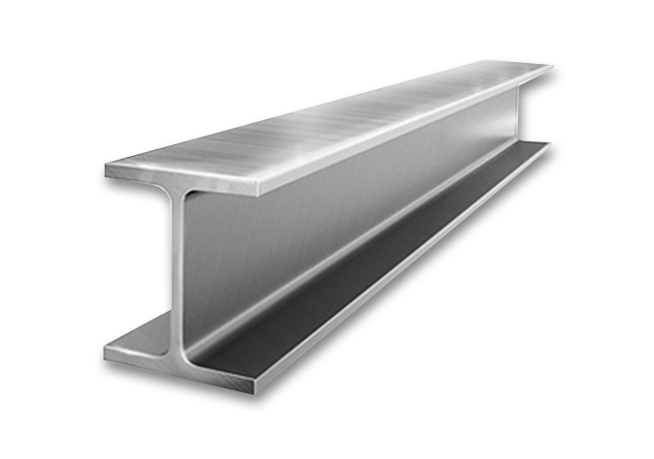
PRESENTATION
steel (n)
/stiːl/
thép

Slide 9
PRESENTATION
New words | Pronunciation | Meaning
1. robotic vacuum cleaner (n) | /roʊˈbɑː.t̬ɪk ˈvæk.juːm ˈkliː.nɚ/ | robot hút bụi tự động
2. camcorder (n) | /ˈkæmˌkɔːr.dɚ/ | máy quay điện tử
3. cooper (n) | /ˈkuː.pɚ/ | đồng
4. steel (n) | /stiːl/ | thép

Slide 10
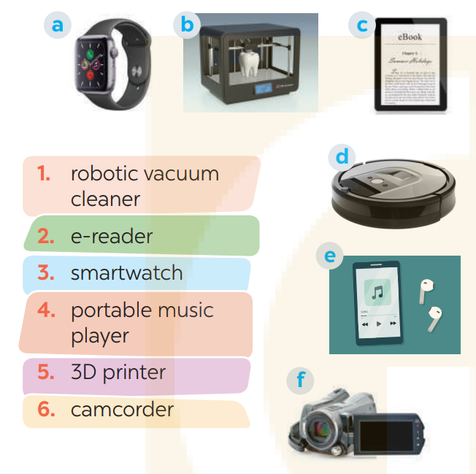
PRACTICE
1
Match the electronic devices with the correct pictures.
1. D
2. C
3. A
4. F
5. B
6. E

Slide 11
PRACTICE
2
cooper
Complete the sentences with the material words from the box.
cooper
1. We often use _______________________, which is a soft reddish-brown metal, to make electric wire, pipes, and coins. 2. Today, ____________________ is often used to make cases of electric devices because it doesn’t conduct electricity and it is light, and easily be shaped into many different forms. 3. We often use _____________________ in the construction industry because it is a strong and hard metal. 4. We use _______________________, which comes from rubber trees, for making tyres, boots, etc. 5. The kids need a piece of ______________________ to easily cut shapes and make toys.
plastic
steel
plastic
cardboard

Slide 12
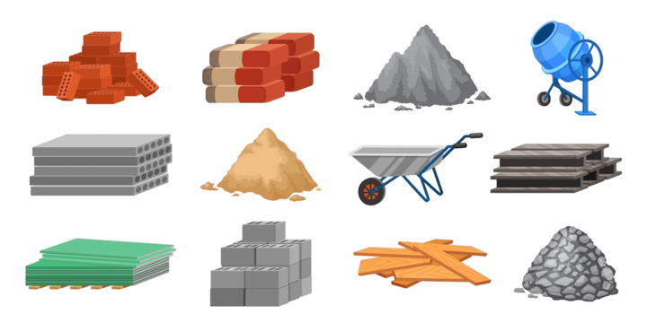
PRACTICE
What do you call these materials in Vietnamese?

Slide 13
PRACTICE
3
Circle the correct words or phrases to complete the following sentences.
1. The most common use for rubber / iron is for producing tyres for cars, motorbikes, bicycles, etc. 2. The most popular material for the construction of buildings and bridges is plastic / steel because it is strong enough to support heavy loads. 3. Today 3D printers / photocopiers allow us to create three-dimensional objects, e.g. medical implants, clothes, cars, etc. 4. We use copper / cardboard to make food packaging such as cereal and pasta boxes, as it is food-safe and not harmful to the environment. 5. They use camcorders / portable music players for live-streaming video content such as concerts, live events, and webinars.

Slide 14
PRONUNCIATION
4
Listen and repeat the sentences. Pay attention to the stress pattern of each sentence.
1. Don’t talk! 2. Don’t worry! 3. Keep silent! 4. Look out! 5. Remember!

Slide 15
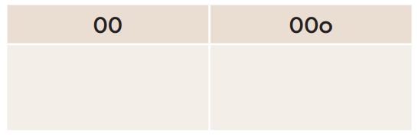
PRONUNCIATION
5
Write each sentence in the suitable box. Then listen, check, and repeat.
1. I see!
2. Be quiet! 3. Say sorry!
4. Watch out! 5. That long?
6. Speak louder!
1. I see!
2. Be quiet!
4. Watch out!
3. Say sorry!
6. Speak louder!
5. That long?

Slide 16
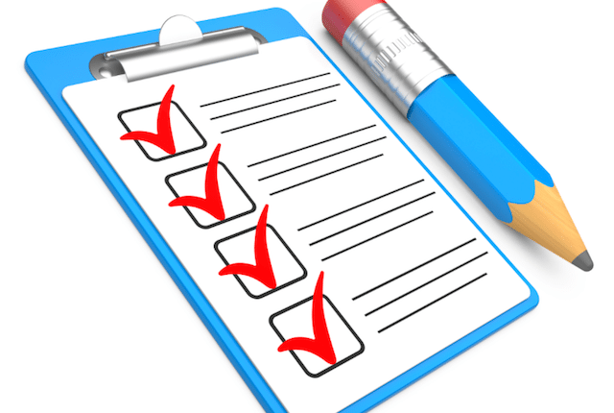
CONSOLIDATION
1
Wrap-up
What have we learnt in this lesson?
Use the lexical items related to the topic Local community;
Pronounce the sentence stress correctly;

Slide 17

CONSOLIDATION
2
Homework
- Do exercises in the Workbook.

Slide 18
Website: hoclieu.vn
Fanpage: facebook.com/www.tienganhglobalsuccess.vn/

