Slide 1

Unit 6: Be green
Lesson 6b: Grammar
Page 99

Slide 2
Lesson Outline
Warm-up
Grammar
Consolidation
Wrap-up

Slide 3

Objectives
By the end of this lesson, students will be able to:
To revise/practise
the Present Simple
the Present Continuous
the Past Simple
the Future Simple and be going to.

Slide 4

WARM-UP

Slide 5
Identify the tense and its use of each example
Actions happening now/around the time of speaking
Future plans
Making predictions about what we think
will happen in the future
completed actions that happened at a specific time in the past
Habits, routines
Fixed arrangement in near future
Timetables
Present Simple
Examples | Uses
I go to the Environment Club every week. Our meeting starts at 4:00.

Slide 6
Identify the tense and its use of each example
Actions happening now/around the time of speaking
Future plans
Making predictions about what we think
will happen in the future
completed actions that happened at a specific time in the past
Habits, routines
Fixed arrangement in near future
Timetables
Present Continuous
Examples | Uses
He is planting trees now. We’re cleaning up the beach tomorrow.

Slide 7
Identify the tense and its use of each example
Actions happening now/around the time of speaking
Future plans
Making predictions about what we think
will happen in the future
completed actions that happened at a specific time in the past
Habits, routines
Fixed arrangement in near future
Timetables
Past Simple
Examples | Uses
He put out the rubbish yesterday afternoon.

Slide 8
Identify the tense and its use of each example
Actions happening now/around the time of speaking
Future plans
Making predictions about what we think
will happen in the future
completed actions that happened at a specific time in the past
Habits, routines
Fixed arrangement in near future
Timetables
Future Simple
Examples | Uses
People won’t use plastic in the future.

Slide 9
Identify the tense and its use of each example
Actions happening now/around the time of speaking
Future plans
Making predictions about what we think
will happen in the future
completed actions that happened at a specific time in the past
Habits, routines
Fixed arrangement in near future
Timetables
be going to
Examples | Uses
He’s going to volunteer in the Amazon next summer.

Slide 10

PRESENTATION

Slide 11
Tenses | Examples | Forms
Present Simple | I go to the Environment Club every week. Our meeting starts at 4:00.
Present Continuous | He is planting trees now. We’re cleaning up the beach tomorrow.
Past Simple | He put out the rubbish yesterday afternoon
Future Simple | People won’t use plastic in the future
be going to | He’s going to volunteer in the Amazon next summer.
He/She/It + V_s/es
You/I/We/They + V
He/She/It + is + V_ing I + am + V_ing
You/We/They + are + V_ing
He/She/It/We/You/I/They + V_2/ed
He/She/It/We/You/I/They + will/won’t + V
He/She/It + is + going to + V
You/We/They + are + going to + V
I + am + going to + V

Slide 12

PRACTICE

Slide 13
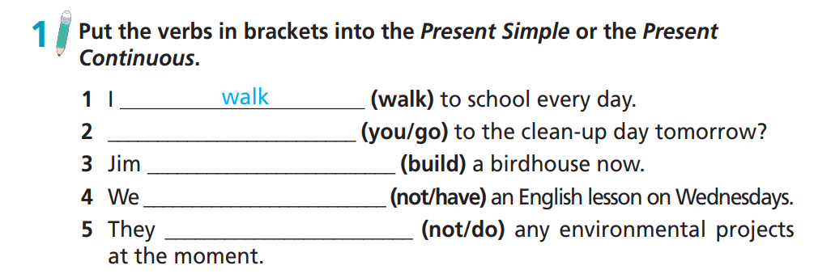
Are you going to
is building
don’t have
aren’t doing

Slide 14

Extra Practice
WB p. 49
★ Choose the correct option.
1. Jenny plants/is planting a tree every year on her birthday.
2. We don’t go/aren’t going to the clean-up day tomorrow.
3. Does the recycling club meet/ Is the recycling club meeting this afternoon?
4. Jim doesn’t use/isn’t using the computer now.
5. They take/are taking a break at 12:30 every day.

Slide 15
Extra Practice
WB p. 49
Put the verbs in brackets into the Present Simple or the Present Continuous.
1 ___________________ (Julia/walk) to school every morning?
2 My little brother ___________________ (love) insects.
3 __________________ (you/watch) this TV programme right now?
4 I ___________________ (not/attend) the meeting tonight.
5 We ___________________ (not/grow) our own vegetables because we haven’t got a garden.
Does Julia walk
loves
Are you watching
am not attending
don’t grow

Slide 16

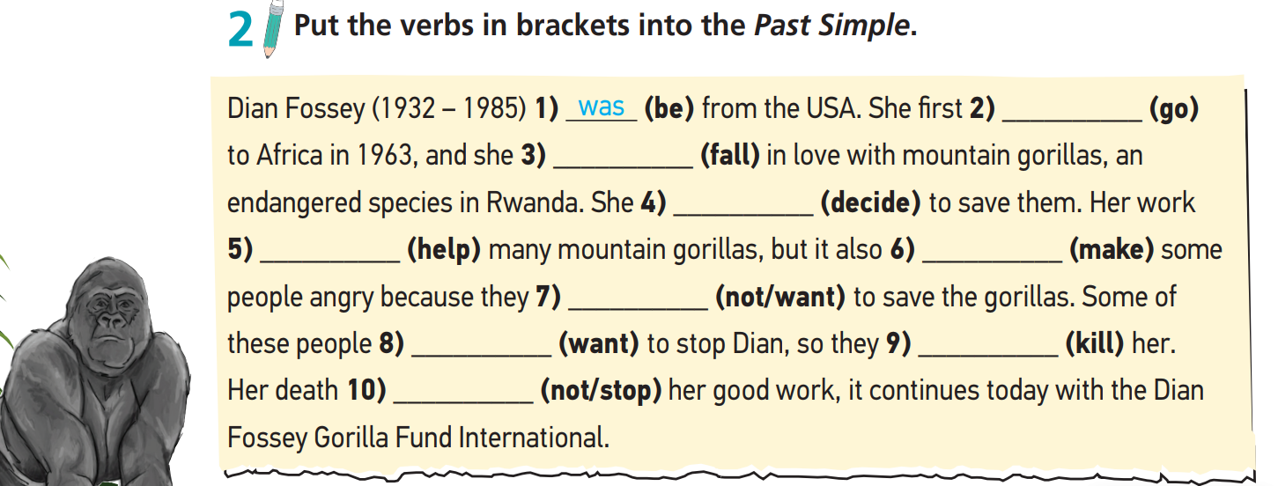
went
fell
decided
helped
made
didn’t want
wanted
killed
didn’t stop

Slide 17
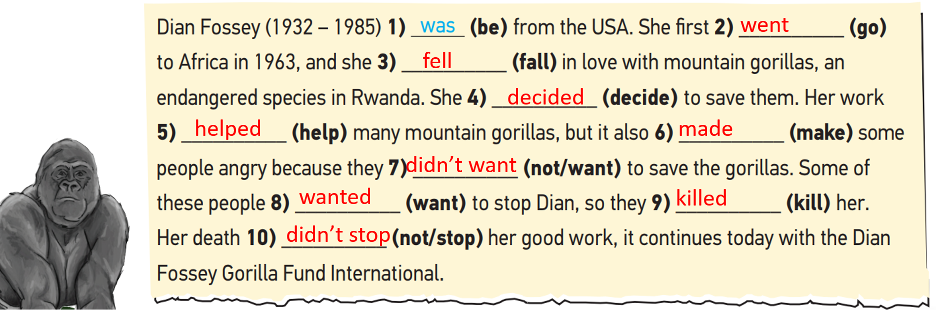
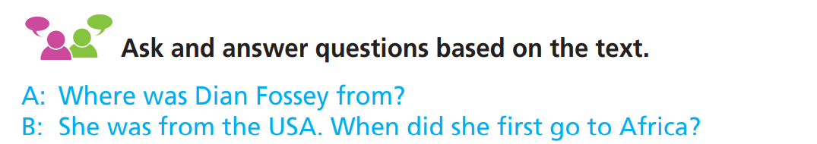

Slide 18
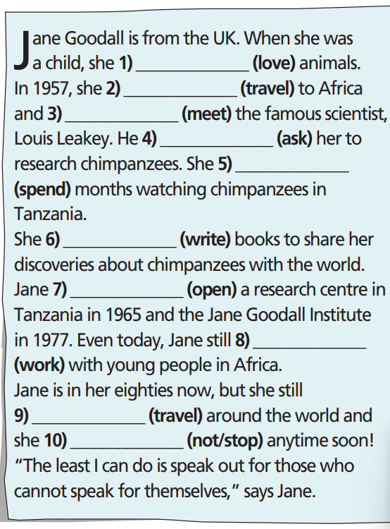

Extra Practice
WB p. 49
loved
travelled
met
asked
spent
wrote
opened
works
travels
Isn’t going to stop

Slide 19
PRODUCTION

Slide 20

Take turns to ask and tell a story about a holiday you went on last year. Use a variety of tenses. You can use the following prompts.
Where did you do? When?
What is special about this place?
Where did you stay?
Who did you go with?
What did you do?
Who did you meet?
What did you see?
8. (Your own ideas)

Slide 21
Report on partner’s last holiday and his/her plan for the next one.
Hi, my name is ……. My friend’s name is ……. Last summer, he/she went on a holiday to Phong Nha – Kẻ Bàng park with his/her family. Phong Nha – Kẻ Bàng is famous for its largest cave in the world – Son Dong. They stayed at a hotel near the park. They spent two days discovering the cave with a guide and they saw all sorts of amazing things such as ….

Slide 22

CONSOLIDATION

Slide 23
Write about the your last holiday and your plan for the next one. Remember to include “Where? When? What? Who? How?” and use a variety of tenses. (Please write at least 40 words).
E.g. Last summer, I went on a holiday to Phong Nha – Kẻ Bàng park with my family. The park is famous for its largest cave in the world – Son Doong. We stayed at a hotel near the park. We spent two days discovering the cave with a guide. We saw all sorts of amazing things such as …. We are going to go Nha Trang on the next holiday. I hope I will stay in a hotel near the beach. I think we will have a lot of fun there.

Slide 24

WRAP-UP

Slide 25
Today’s lesson
Grammar
To revise/practise the Present Simple, the Present Continuous, the Past Simple, the Future Simple and be going to.

Slide 26
Homework
Review the grammar points and make sentences using them.
Do the exercises on page 49 WB.
Prepare the next lesson (page 99 SB).
Complete the grammar note on TA 7 Right on Notebook (page 46).

Slide 27
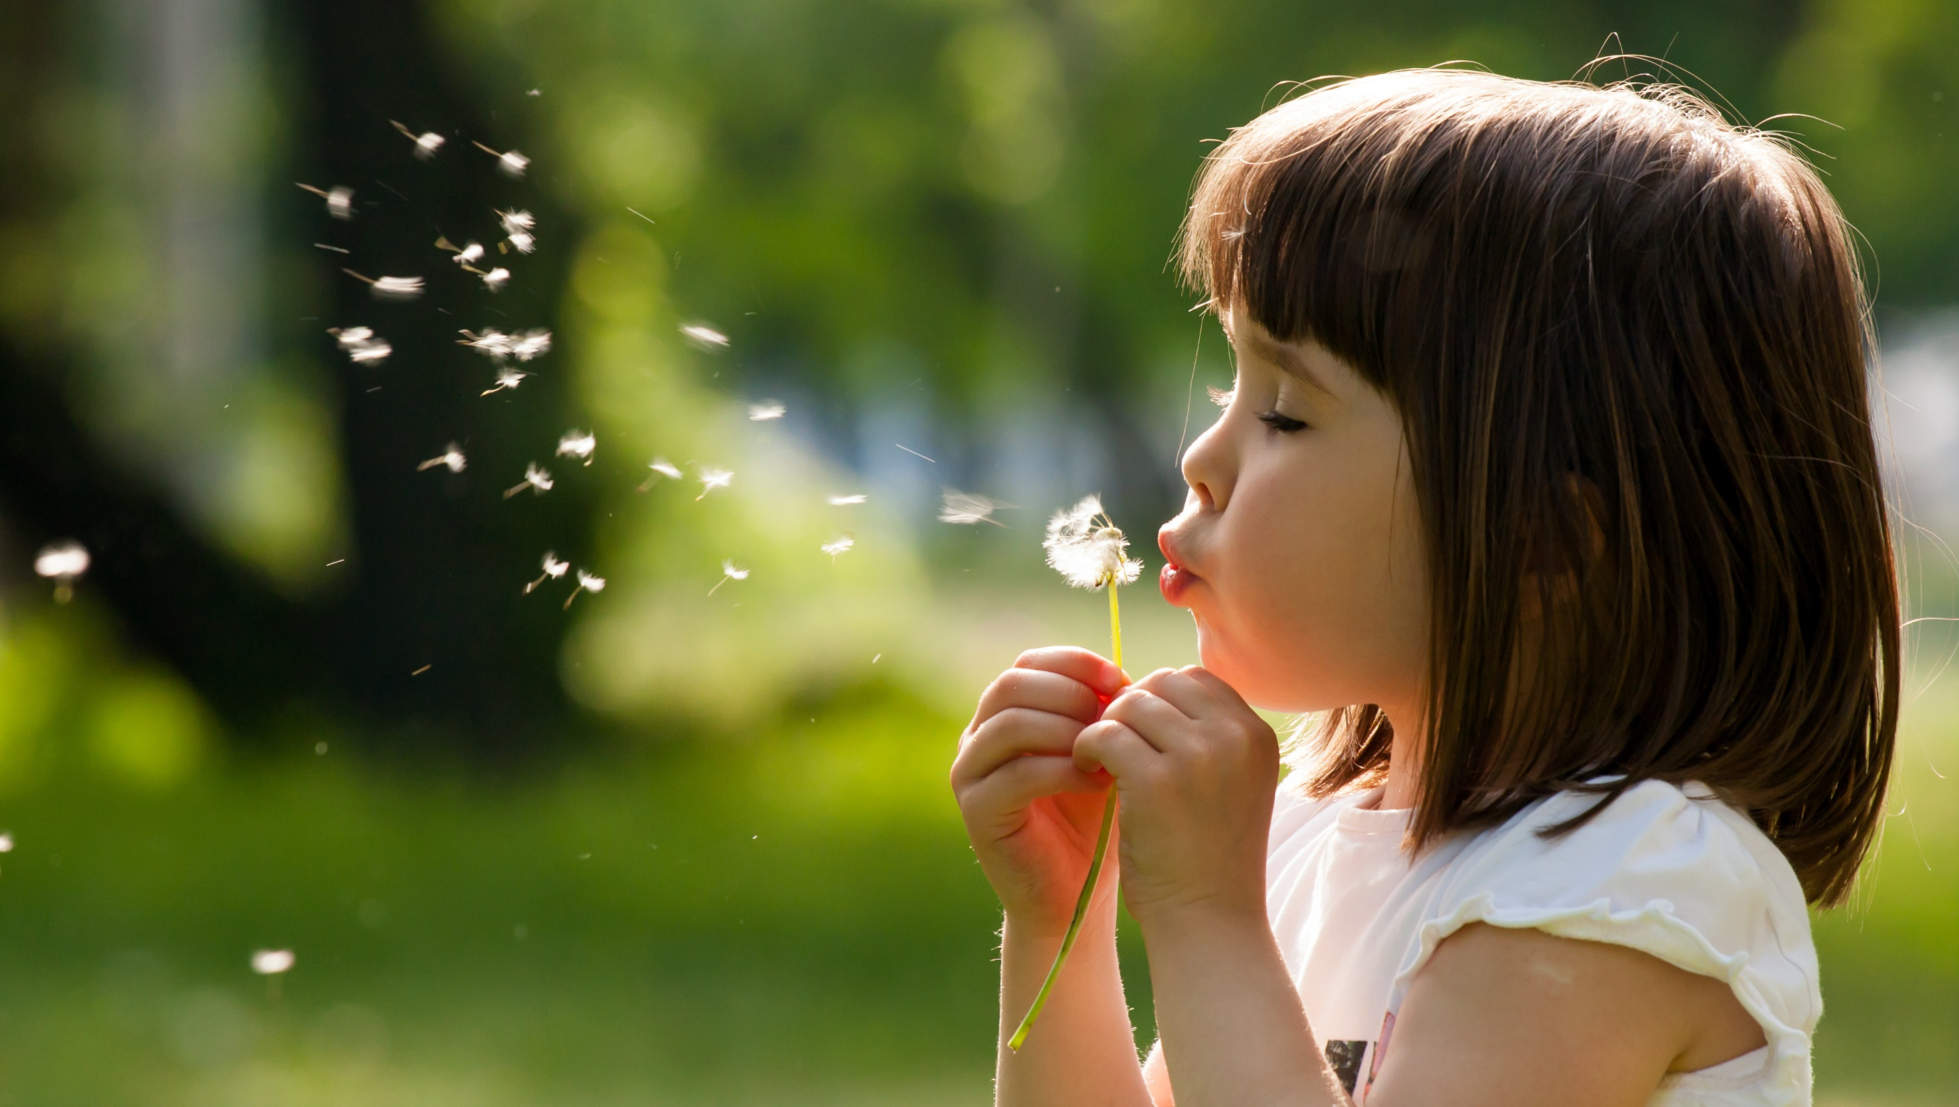
Enjoy your day!

