Slide 1


ROAD TO HOME
PLAY

Slide 2


































1
2
3
4
5
6
7
8
9
10
11
12
13
14
15
16
17
18
19
20

Slide 3





QUESTION
QUESTION
ANSWER
ANSWER
RETURN

Slide 4



QUESTION
QUESTION
ANSWER
ANSWER
RETURN

Slide 5
QUESTION
QUESTION
ANSWER
ANSWER
RETURN

Slide 6
QUESTION
QUESTION
ANSWER
ANSWER
RETURN

Slide 7
QUESTION
QUESTION
ANSWER
ANSWER
RETURN

Slide 8
QUESTION
QUESTION
ANSWER
ANSWER
RETURN

Slide 9
QUESTION
QUESTION
ANSWER
ANSWER
RETURN

Slide 10
QUESTION
QUESTION
ANSWER
ANSWER
RETURN

Slide 11
QUESTION
QUESTION
ANSWER
ANSWER
RETURN

Slide 12
QUESTION
QUESTION
ANSWER
ANSWER
RETURN

Slide 13
QUESTION
QUESTION
ANSWER
ANSWER
RETURN

Slide 14
QUESTION
QUESTION
ANSWER
ANSWER
RETURN

Slide 15
QUESTION
QUESTION
ANSWER
ANSWER
RETURN

Slide 16
QUESTION
QUESTION
ANSWER
ANSWER
RETURN

Slide 17
QUESTION
QUESTION
ANSWER
ANSWER
RETURN

Slide 18
QUESTION
QUESTION
ANSWER
ANSWER
RETURN

Slide 19
QUESTION
QUESTION
ANSWER
ANSWER
RETURN

Slide 20
QUESTION
QUESTION
ANSWER
ANSWER
RETURN

Slide 21
QUESTION
QUESTION
ANSWER
ANSWER
RETURN

Slide 22
QUESTION
QUESTION
ANSWER
ANSWER
RETURN

Slide 23



Slide 24
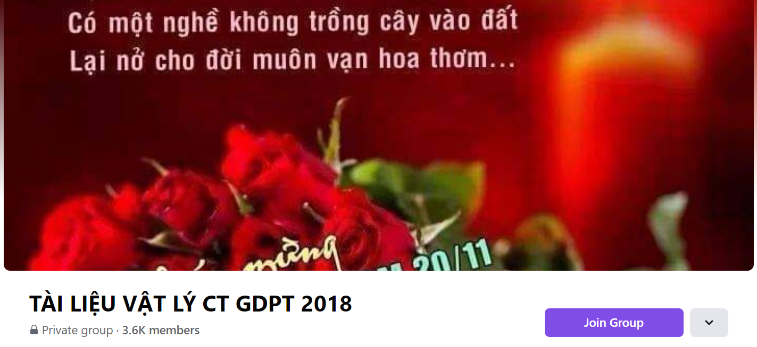
SƯU TẦM: ĐOÀN VĂN DOANH, NAM TRỰC, NAM ĐỊNH
LINK NHÓM DÀNH CHO GV BỘ MÔN VẬT LÝ TRAO ĐỔI TÀI LIỆU VÀ CHUYÊN MÔN CT 2018
https://www.facebook.com/groups/299257004355186

