Slide 2
Unit 5
THE WORLD OF WORK
LESSON II
LANGUAGE

Slide 3
LESSON II
LANGUAGE
WARM-UP
⬧ Sentence Scramble
⬧ Task 1. Listen and repeat. Pay attention to the stressed words.
⬧ Task 2. Listen and underline the stressed auxiliary and modal verbs in the following sentences. Then practise saying the sentences in pairs.
PRONUNCIATION
VOCABULARY
⬧ Task 1. Match the words with their meanings.
⬧ Task 2. Complete the sentences with the words in 1.
⬧ Task 1. Combine the following simple sentences, using the words in brackets.
⬧ Task 2. Work in pairs. Add more clauses to the following sentences to make compound or complex sentences.
GRAMMAR
CONSOLIDATION
⬧ Wrap-up
⬧ Homework

Slide 4
WARM-UP
Put the words/ phrases into the correct order to make a meaningful sentence.
1. employees./ He/ a/ manages/ team/ of/
2. deadline/ is/ to complete it./ tomorrow,/ The project/ so/ we/ must work/ extra hours
3. work/ works from home./ and/ she/ I/ in an office,
4. After/ she/ the graphic design work./ can assist/ finishes programming,/ she/ him/ with

Slide 5
WARM-UP
Check your answers
1. He manages a team of employees.
2. The project deadline is tomorrow, so we must work extra hours to complete it.
3. I work in an office, and she works from home.
4. After she finishes programming, she can assist him with the graphic design work.
☞ Simple sentence
☞ Compound sentence
☞ Complex sentence

Slide 6

PRONUNCIATION
1
Listen and repeat. Pay attention to the stressed words.
1. I don’t like working with numbers, but my brother does.
2. I will help you with your maths homework if I can.
3. A: You haven’t submitted your application for the job yet.
B: I have.
4. My brother couldn’t ride a bike two months ago, but he can now.

Slide 7
PRONUNCIATION
2
Listen and underline the stressed auxiliary and modal verbs in the following sentences. Then practise saying the sentences in pairs.
1. I would help you find a job if I could.
2. When he started his first job, he wasn't used to working in an office, but he is used to it now.
3. A: Are you ready for the interview?
B: Yes. I am.
4. A: Is your father a teacher?
B: He was, but he’s retired now.

Slide 8
VOCABULARY
1
Match the words with their meanings.
worth doing, especially by making you feel satisfied that you have done something useful
challenging (adj)
a
1
money added to somebody’s salary as a reward for good work
relevant (adj)
b
2
difficult in an interesting way that tests our ability
bonus (n)
c
3
employ (v)
related to a subject or to something happening or being discussed
4
d
rewarding (adj)
to have someone work or do a job for you and pay them for it.
5
e

Slide 9
VOCABULARY
Form | Pronunciation | Meaning | Vietnamese equivalent
1. challenging (adj) | /ˈtʃælɪndʒɪŋ/ | difficult in an interesting way that tests our ability | thách thức
2. relevant (adj) | /ˈreləvənt/ | related to a subject or to something happening or being discussed | liên quan
3. bonus (n) | /ˈbəʊnəs/ | money added to somebody’s salary as a reward for good work | tiền thưởng
4. employ (v) | /ɪmˈplɔɪ/ | to have someone work or do a job for you and pay them for it. | tuyển dụng
5. rewarding (adj) | /rɪˈwɔːdɪŋ/ | worth doing, especially by making you feel satisfied that you have done something useful | xứng đáng

Slide 10



Pick a box
Answer the question
Get a random prize below
The winning team has the most points
100
Your point
Blow friend’s point
Swap point

Slide 11

PICK A BOX
1
2
3
2
4
5
6
1
3
2

Slide 12

VOCABULARY
2
Complete the sentences with the words in 1.
challenging
relevant
bonus
employ
rewarding
1. The company has to _____________ more workers to meet the production targets.

Slide 13

VOCABULARY
2
Complete the sentences with the words in 1.
challenging
relevant
bonus
employ
rewarding
2. Peter wants to become a pilot although he knows it is a ____________ job.

Slide 14

VOCABULARY
2
Complete the sentences with the words in 1.
challenging
relevant
bonus
employ
rewarding
3. Workers will receive a generous _____________ if they achieve their performance goals.

Slide 15
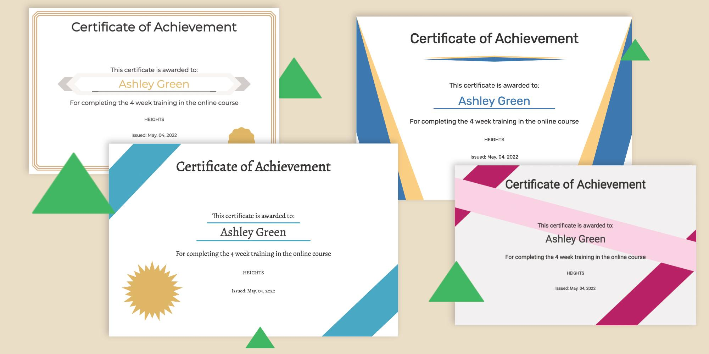
VOCABULARY
2
Complete the sentences with the words in 1.
challenging
relevant
bonus
employ
rewarding
4. Consider completing your course before you apply for this job because it will require _____________ qualifications.

Slide 16
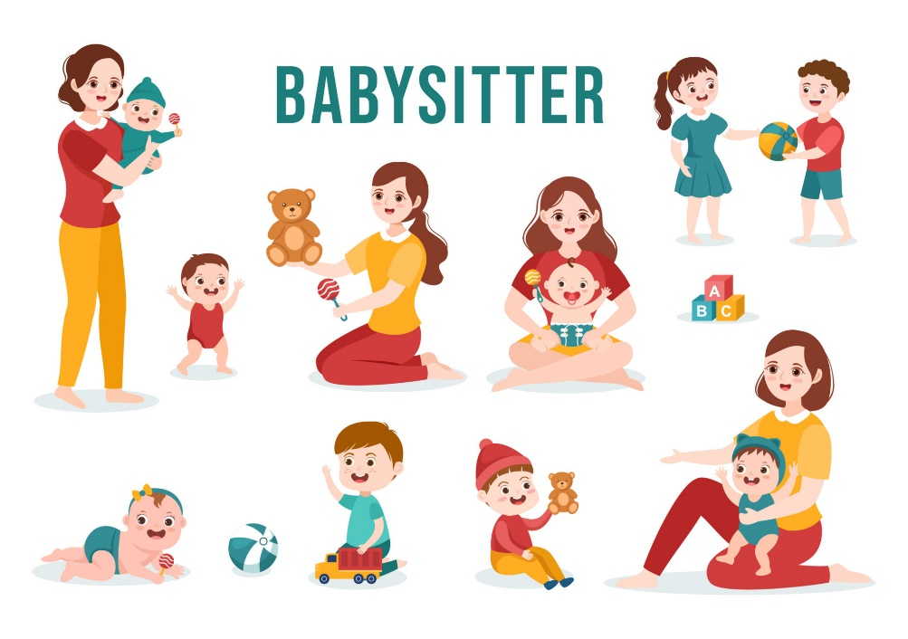
VOCABULARY
2
Complete the sentences with the words in 1.
challenging
relevant
bonus
employ
rewarding
5. Working as a babysitter could be a _____________ experience if you enjoy working with children.

Slide 17


Slide 18
VOCABULARY
2
Complete the sentences with the words in 1.
1. The company has to employ more workers to meet the production targets.
2. Peter wants to become a pilot although he knows it is a challenging job.
3. Workers will receive a generous bonus if they achieve their performance goals.
4. Consider completing your course before you apply for this job because it will require relevant qualifications.
5. Working as a babysitter could be a rewarding experience if you enjoy working with children.

Slide 19
GRAMMAR
Simple, compound, and complex sentences
A simple sentence includes ONE independent clause.
Example: My brother didn’t apply for the job.

Slide 20
GRAMMAR
Simple, compound, and complex sentences
A compound sentence includes TWO or MORE independent clauses joined by a coordinating conjunctive (e.g. and, but, or, nor, yet, so), a correlative conjunction (e.g. not only…but also), or a conjunctive adverb (e.g. as a result, moreover, in fact, on the other hand)
Example:
My brother didn’t apply for the job, but he was offered an apprenticeship.
Being a nurse is a very tiring job; moreover, you don’t earn a high salary.

Slide 21
GRAMMAR
Simple, compound, and complex sentences
A complex sentence includes ONE (or MORE) independent clause(s) and at least one dependent clause joined by a subordinating conjunction, (e.g. when, while, because, although, if, so that)
Example:
When I was younger, I wanted to become a driver.
Because my brother is often late for work, he is never promoted.

Slide 22
GRAMMAR
1
Combine the following simple sentences, using the words in brackets.
1. He left school with no academic qualifications. He found a well-paid job. (although)
2. People learn English well. They will have a better chance of getting a job. (if)
3. This job requires good language skills. It also requires communication skills. (not only … but also)
4. My dad attended a colling course. He can open his own restaurant. (so that)

Slide 23
GRAMMAR
1
Combine the following simple sentences, using the words in brackets.
1. He left school with no academic qualifications. He found a well-paid job. (although)
 Although he left school with no academic qualifications, he found a well-paid job.
 He found a well-paid job although he left school with no academic qualifications.

Slide 24
GRAMMAR
1
Combine the following simple sentences, using the words in brackets.
2. People learn English well. They will have a better chance of getting a job. (if)
 If people learn English well, they will have a better chance of getting a job.
 People will have a better chance of getting a job if they learn English well.

Slide 25
GRAMMAR
1
Combine the following simple sentences, using the words in brackets.
3. This job requires good language skills. It also requires communication skills. (not only … but also)
 This job requires not only good language skills but also communication skills.
4. My dad attended a colling course. He can open his own restaurant. (so that)
 My dad attended a cooking course so that he can open his own restaurant.1

Slide 26
GRAMMAR
2
Work in pairs. Add more clauses to the following sentences to make compound or complex sentences.
- I want to become a doctor.
- I admire teachers.
- There are jobs that no longer exist.
- Some jobs will be done by robots in the future.
Example:
I want to become a doctor because I want to help sick people.
Although my grades are not very good, I want to become a doctor.

Slide 27

GRAMMAR
2
Work in pairs. Add more clauses to the following sentences to make compound or complex sentences.
- I admire teachers.
I admire teachers because they work hard to educate students, and their impact on society is invaluable.
I admire teachers who devote their time and energy to shaping young minds, as their passion for education can inspire a lifelong love of learning in students.

Slide 28

GRAMMAR
2
Work in pairs. Add more clauses to the following sentences to make compound or complex sentences.
- There are jobs that no longer exist.
There are jobs that no longer exist, but new opportunities have emerged in the ever-changing workforce.
There are jobs that no longer exist because advancements in technology have rendered them obsolete, leading workers to adapt and acquire new skills for the evolving job market.

Slide 29
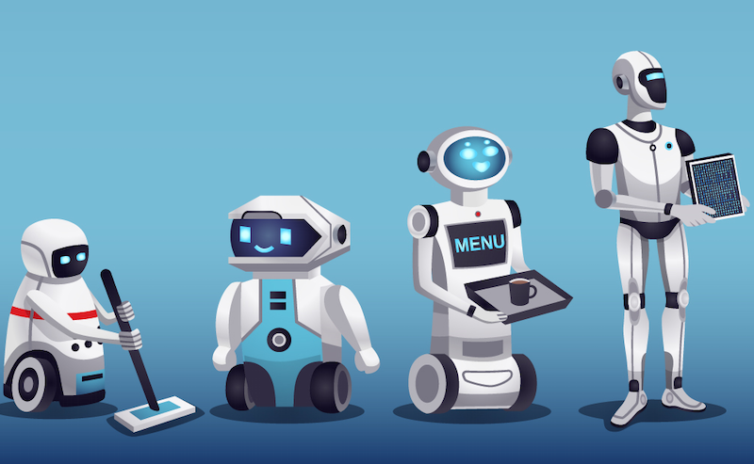
GRAMMAR
2
Work in pairs. Add more clauses to the following sentences to make compound or complex sentences.
- Some jobs will be done by robots in the future.
Some jobs will be done by robots in the future, but humans will still be needed for tasks that require human interaction and decision-making.
Although robots will take over certain jobs in the future, humans will remain indispensable in occupations that demand creativity, emotional intelligence, and complex problem-solving abilities.

Slide 30
CONSOLIDATION
1
Wrap-up
What have you learned today?
Pronunciation: Stressing auxiliary and modal verbs
Vocabulary: Work
Grammar: Simple, compound, and complex sentences (review and extension)

Slide 31
CONSOLIDATION
2
Homework
Do exercises in the workbook.
Learn by heart some vocabulary related to work.
Do more exercises about simple, compound, and complex sentences.
Prepare for the next lesson.

Slide 32
Website: hoclieu.vn
Fanpage: facebook.com/www.tienganhglobalsuccess.vn

