Slide 1


Slide 2
Unit
7
Education options for
school-leavers
Unit
FAMILY LIFE
COMMUNICATION AND CULTURE / CLIL
LESSON 7

Slide 3
LESSON 7
COMMUNICATION AND CULTURE / CLIL
WARM-UP
Watch a video
Task 1: Listen and complete the conversation.
Task 2: Make similar conversations.
EVERYDAY ENGLISH
CULTURE
Task 1: Complete the table.
Task 2: Discussion.
CONSOLIDATION
Wrap-up
Homework

Slide 4
WARM-UP
Watch a video and answer the questions
1. How many people are there in the conversation?
2. What is the man doing?

Slide 5
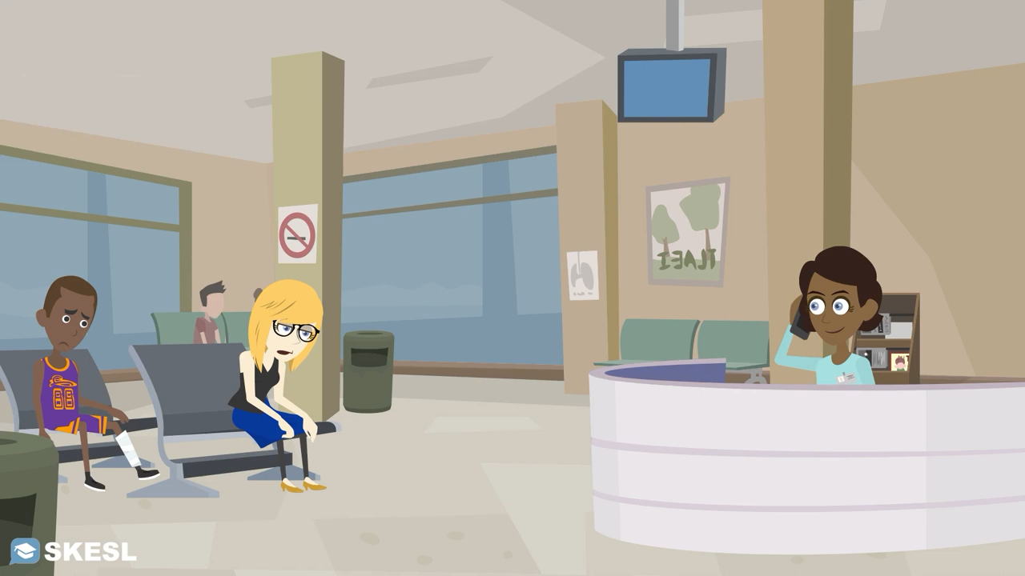
WARM-UP
Watch a video and answer the questions
Notes:
Link: https://www.youtube.com/watch?v=qG9oD9qxX6g

Slide 6
WARM-UP
Watch a video and answer the questions
1. How many people are there in the conversation?
2. What is the man doing?
There are two people in the conversation.
The man is calling to make an appointment with the doctor.

Slide 7

EVERYDAY ENGLISH
1
Listen and complete the conversation with the expressions in the box. Then practise it in pairs.
A. suit you B. shall I come C. I have another appointment D. could I meet you
D
Lan: Ms Ha, (1) ________ on Thursday afternoon? I would like your advice on how to prepare for my university entrance exam next year.
Ms Ha: Sorry, (2) ________ at that time. But I’m free on Saturday morning.
Lan: That would be good for me. What time (3) ________ to see you?
Ms Ha: Would 9 o’clock (4) ________?
Lan: Yes, sounds good. Thank you, Ms Ha.
Ms Ha: OK, then. See you on Saturday in the staffroom.
C
B
A

Slide 8
EVERYDAY ENGLISH
Useful expressions
Making an appointment | Giving a positive response
• Will you be available on/at …? • I’d like to make/arrange an appointment with you on/at … • Would … suit you/be OK for you? • When’s convenient for you? | • All right, I’ll see you then. • OK, I’ll see you (next week) (at around 3 p.m.).
 | Giving a negative response and proposing another time/date
 | • Sorry, I’ve got another appointment at that time. How about …? • I’m afraid I can’t make it at that time. Are you free on/at …?

Slide 9
EVERYDAY ENGLISH
2
Make similar conversations for these situations.
Student A, a secondary school student, makes an appointment to see Student B, a university representative, to ask for advice on his/her education plans after leaving school. Student B can't make the suggested day/time and proposes another day/time.
Student B, a secondary school student, makes an appointment to see Student A, a career advisor, to ask for advice on vocational courses. Student A can't make the suggested day/ time and proposes another day/time.

Slide 10
CULTURE
1
Read the text and complete the table.
UK education after secondary school
Age at end of formal education | • 16 in the UK • stay until the age of (1) ________ in full-time education or do training in England
Vocational education | • lasts up to three years • also called career education or (2) _________________ • some students still go on to (3) _______________
Sixth form | • lasts two years • Students study subjects they are interested in or subjects related to higher education • Grades are used to apply for (4) _______________.
University education | Students study to get a (5) ____________________, a master’s degree, or a doctorate.
18
technical education
higher education
university courses
bachelor’s degree

Slide 11

CULTURE
2
Work in groups. Discuss the similarities and differences between education after leaving school in Viet Nam and in the UK.

Slide 12
CULTURE
2
Work in groups. Discuss the similarities and differences between education after leaving school in Viet Nam and in the UK.
Suggested answer
Similarities
Both systems provide vocational education after secondary school.
Students in both countries can start university at 18.
Differences:
In Viet Nam, students can leave school at 15 after they finish lower secondary school.
In some parts of the UK, students can leave school at 16.

Slide 13
CONSOLIDATION
1
Wrap-up
What have you learnt today?
The similarities and differences between education after leaving school in Viet Nam and in the UK.
Expressions for making an appointment

Slide 14
CONSOLIDATION
2
Homework
Do exercises in the workbook.
Prepare for Lesson 8 - Unit 7.

Slide 15

Website: hoclieu.vn
Fanpage: facebook.com/tienganhglobalsuccess.vn/

