Slide 2

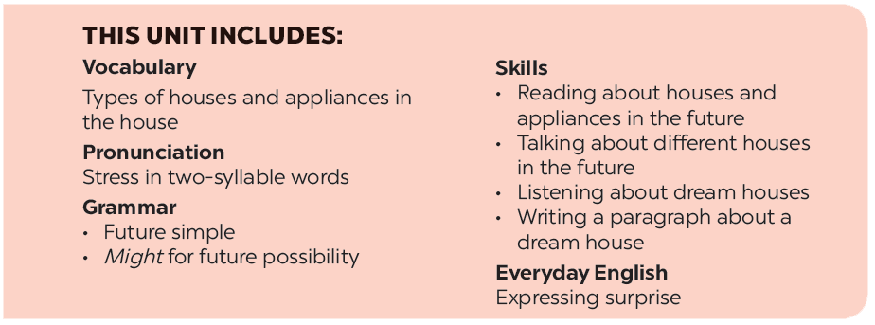

Slide 3







Vocabulary
Grammar
Write the words / phrases under the correct pictures.
Complete the sentences with will ('ll) or won’t.
Think about what the appliances will do in the future. Fill the table.
Complete the sentences with might or might not.

Slide 4
Vocabulary

Slide 5


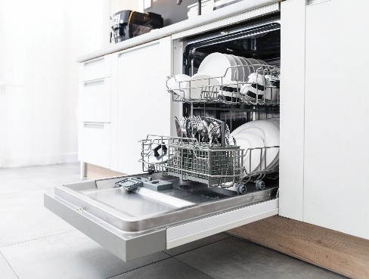
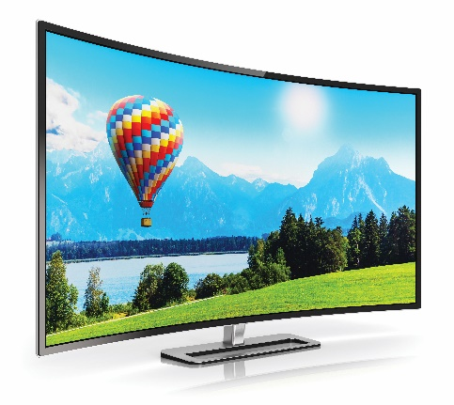

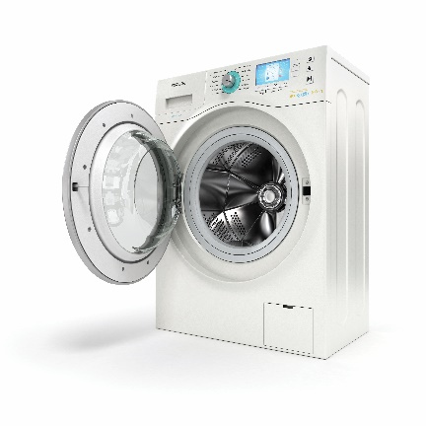
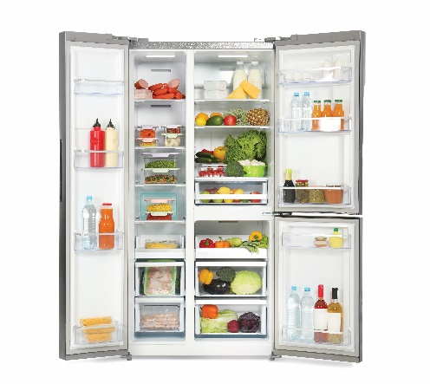
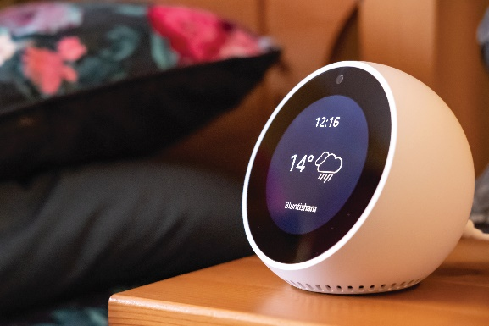
Write the words / phrases under the correct pictures.
computer
wireless tv
dishwasher
smart clock
fridge
washing machine
1. computer
2. dishwasher
3. wireless TV
1.
2.
3.
4. washing machine
5. fridge
6. smart clock
4.
5.
6.

Slide 6

Think about what the appliances will do in the future. Fill the table.
1. robots | Look after the house
2. washing machine
3. wireless tvs
4. super cars
5. smart clocks
6. dishwashers

Slide 7
Grammar

Slide 8

Complete the sentences with will ('ll) or won’t.
1.
Tomorrow is Sunday, so I
_______ have to get up early.
won’t have to get up early.
2.
will / ‘ll invite him to our party.
When I see Tom tomorrow, I
_______ invite him to our party.
will / ‘ll like her.
3.
You must meet Anna. I am sure you
_______ like her.
We
won’t start our dinner until Jack arrives.
4.
_______ start our dinner until Jack arrives.
will / ‘ll phone you when I get home from school.
5.
_______ phone you when I get home from school.
I
won’t pass his examination. He hasn’t studied yet.
6.
Tony
_______ pass his examination. He hasn’t studied yet.

Slide 9

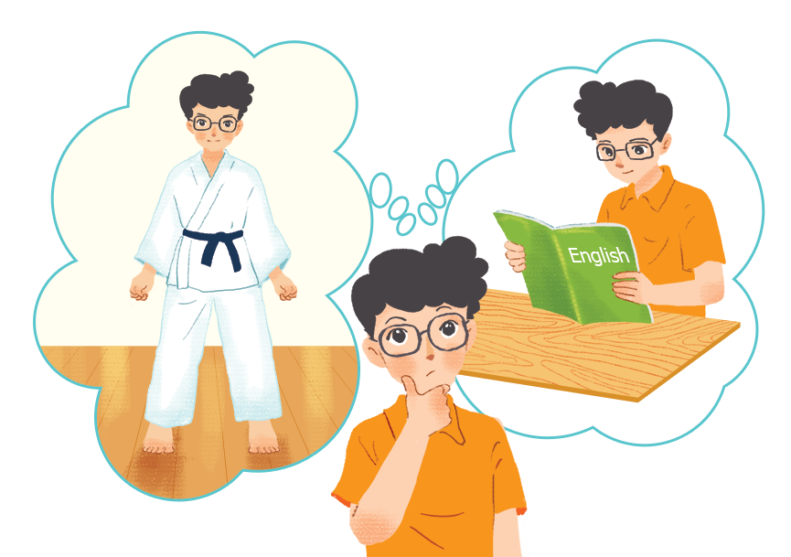
Complete the sentences with might or might not.
1.
I am still not sure where to go for my holiday.
I
_______ go to Da Lat.
might go to Da Lat.
2.
The weather is not very good.
It
_______ rain this afternoon.
might rain this afternoon.
_______ be a meeting on Friday
might not be a meeting on Friday
3.
There
because the teacher is ill.
_______ come to the party tonight
Ann
because she is busy.
4.
might not come to the party tonight
5.
Phong is thinking about what he will do on Sunday. He
at home and study English.
_______ stay
might not stay
_______ go to a judo club, or he _______ stay
might not go to a judo club, or he

Slide 10





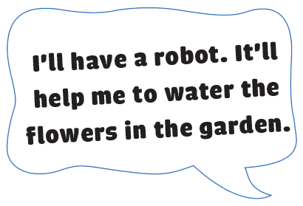



Think about an appliance you would like to have in the future.
Make a poster for your future appliance.
Write details about the appliance on the poster.
Share your poster with your class.

Slide 11


Think about an appliance you would like to have in the future.
Make a poster for your future appliance.
Write details about the appliance on the poster.
Share your poster with your class.

Slide 12
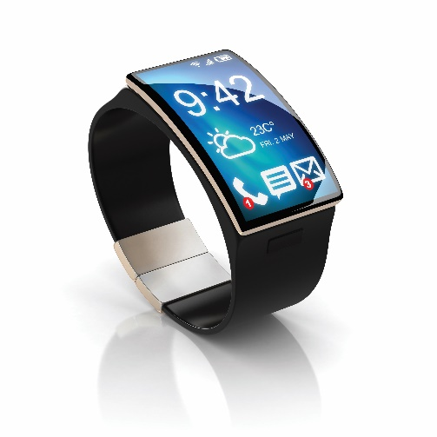
Think about an appliance you would like to have in the future.
Make a poster for your future appliance.
Write details about the appliance on the poster.
Share your poster with your class.

Slide 13
Now I can … |  |  | 
use the words related to types of houses and appliances in the house.
pronounce the two-syllable words correctly.
use future simple and might for future possibility.
express surprise.
read about houses and appliances in the future.
talk about different houses in the future.
listen about dream houses.
write a paragraph about a dream house.
✓
✓
✓
✓
✓
✓
✓
✓
✓
✓
✓
✓
✓
✓
✓
✓
✓
✓
✓
✓
✓
✓
✓
✓

Slide 14






Website: hoclieu.vn
Fanpage: facebook.com/www.tienganhglobalsuccess.vn/

