Slide 1


Slide 2

Unit
1
1
FAMILY LIFE
Unit
FAMILY LIFE
LESSON 4
SPEAKING
Why should / shouldn’t children do housework?

Slide 3

1
Family Life
Unit
OBJECTIVES
By the end of this unit, students will be able to:
explain why children should or shouldn’t do housework.
discuss and express their opinions about why children should or shouldn’t do housework.

Slide 4
LESSON 4
SPEAKING
GETTING STARTED
WARM-UP
Game: Matching time
Task 1: Fill in the table.
Task 2: Listen and complete the conversation.
PRE-SPEAKING
WHILE-SPEAKING
Task 3: Have conversations similar to the one in task 2.
CONSOLIDATION
Wrap-up
Homework

Slide 5
LESSON 4
SPEAKING
GETTING STARTED
WARM-UP
Game: Matching time

Slide 6
WARM-UP
MATCHING TIME
Work in 4 groups.
There are 10 pictures of household chores on the slides.
You have to match the pictures with the corresponding names of chores.
The fastest team with the correct answers can throw the ball.

Slide 7
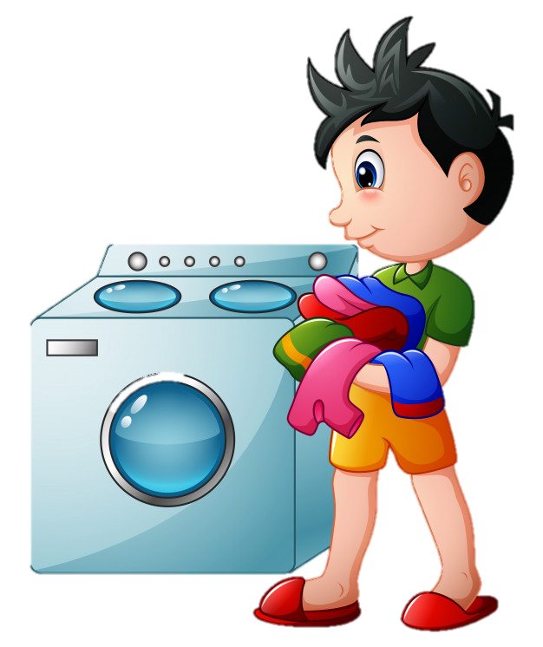
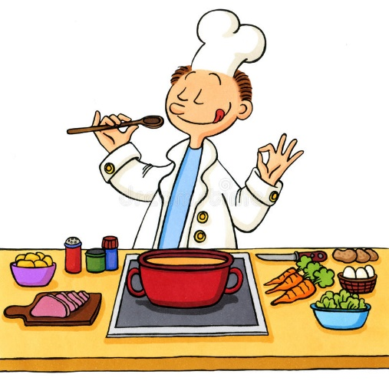
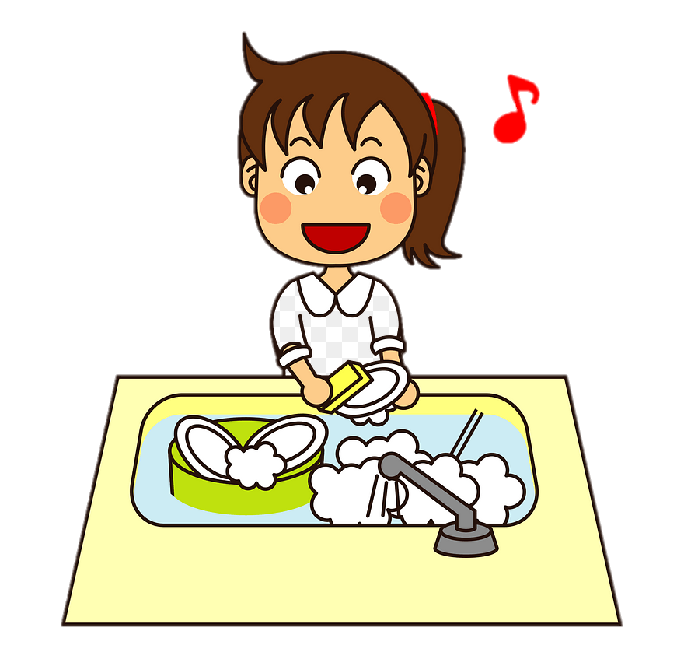
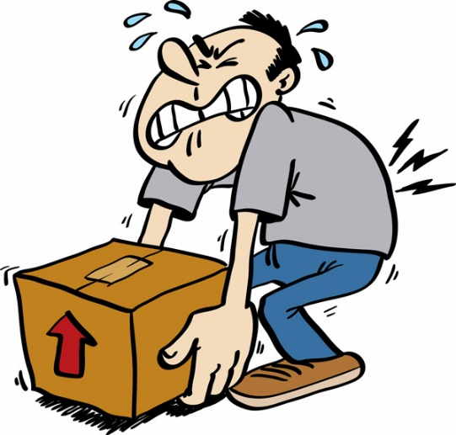
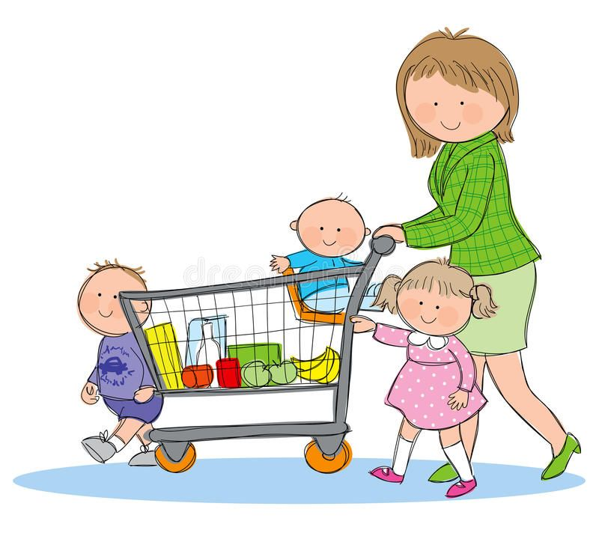
a. do the washing-up
b. shop for groceries
c. do the laundry
d. do the heavy lifting
e. cook
1
2
3
4
5

Slide 8
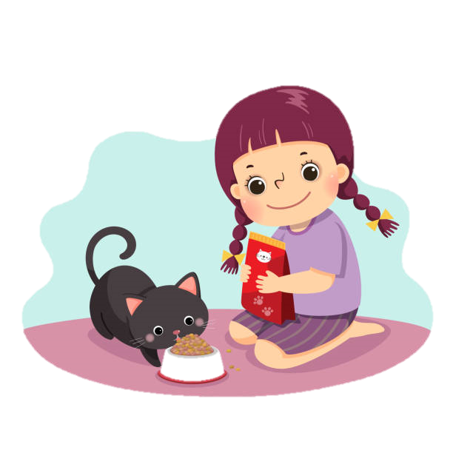
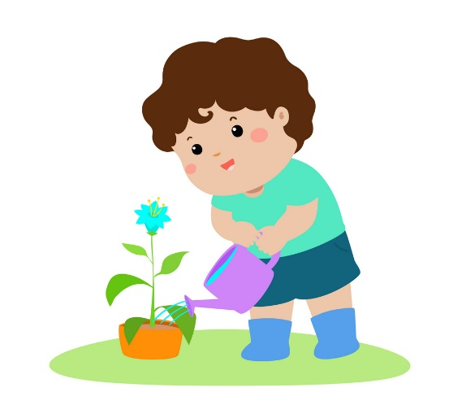
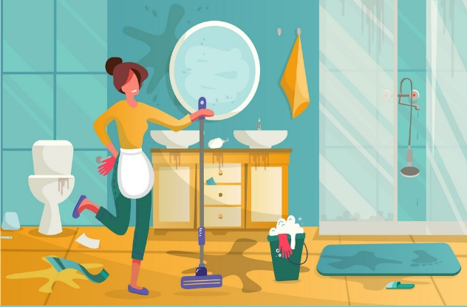
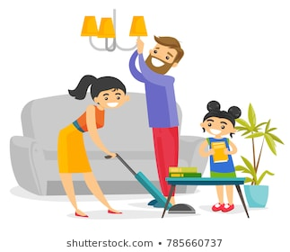
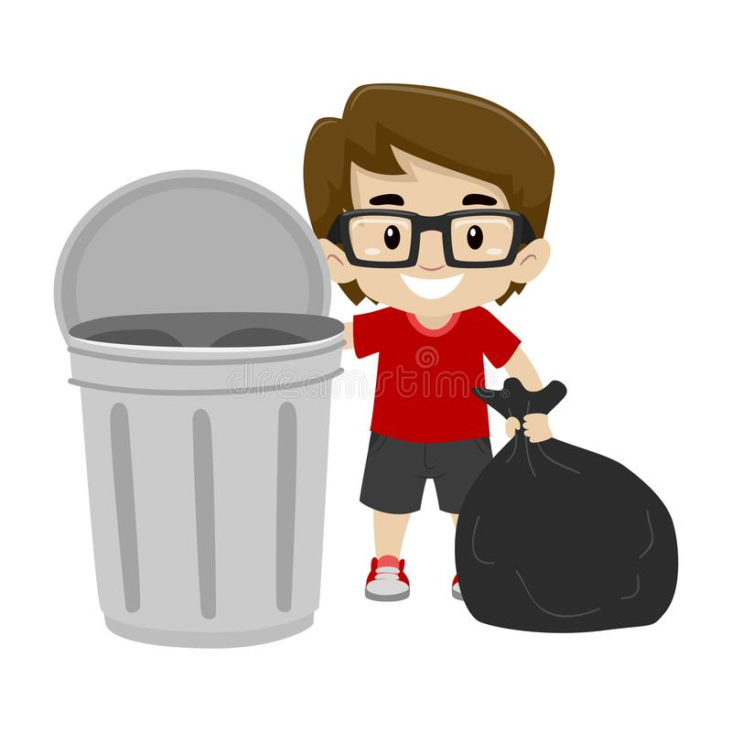
f. put out the rubbish
g. feed pets
h. water the plants
i. clean the house
j. clean the bathroom
6
7
8
9
10

Slide 9
PRE-SPEAKING
1
Below are reasons why children should or shouldn't do housework. Put them in the correct column. Add some more if you can.
Doing housework helps them develop life skills.
Doing housework teaches them to take responsibility.
Kids should be given plenty of playtime when they are young.
They may break or damage things when doing housework.
Doing housework helps strengthen family bonds.
They need more time to study and do homework.
Should | Shouldn’t
Doing housework helps them develop life skills.
Kids should be given plenty of playtime when they are young.
Doing housework teaches them to take responsibility.
They may break or damage things when doing housework.
Doing housework helps strengthen family bonds.
They need more time to study and do homework.

Slide 10

PRE-SPEAKING
2
Work in pairs. Complete the conversation between Anna, Nam, and Minh using some ideas from 1. Then listen to the conversation and check your answers.
Anna: Nam, why do you think children should do housework?
Nam: Because (1) __________________________________________
Anna: It’s true. Life skills such as cooking, cleaning or taking care of others are really necessary for kids when they grow up.
Nam: Yes, we should all have these basic life skills to be adults.
Anna: Now Minh, why do you think children shouldn’t do housework?
Minh: I think kids are kids. (2)_______________________________________________________
Nam: I don’t agree with you. I’m afraid too much playtime isn’t good for children.
Anna: Well, thank you both for sharing your ideas. They are very useful for my project.
doing housework helps them develop life skills.
They should be given plenty of playtime when they are young.

Slide 11
LESSON 4
SPEAKING
GETTING STARTED
WARM-UP
Game: Matching time
Task 1: Fill in the table.
Task 2: Listen and complete the conversation.
PRE-SPEAKING
WHILE-SPEAKING
Task 3: Have conversations similar to the one in task 2.

Slide 12
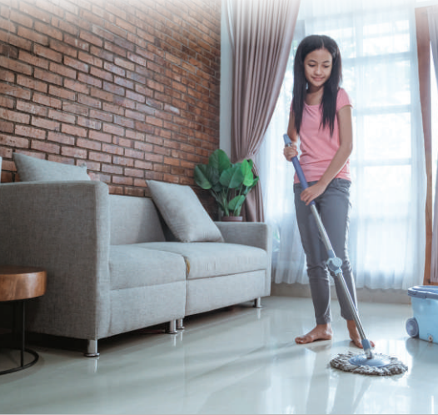
WHILE-SPEAKING
3
Work in groups. Have similar conversations exchanging opinions about whether children should or shouldn’t do housework. You can use the ideas from 1 and the reading text.

Slide 13
LESSON 4
SPEAKING
GETTING STARTED
WARM-UP
Game: Matching time
Task 1: Fill in the table.
Task 2: Listen and complete the conversation.
PRE-SPEAKING
WHILE-SPEAKING
Task 3: Have conversations similar to the one in task 2.
CONSOLIDATION
Wrap-up
Homework

Slide 14
CONSOLIDATION
1
1
Wrap-up
What we have learnt today?
Explain why children should or shouldn’t do housework.
Discuss and express opinions about why children should or shouldn’t do housework.

Slide 15

CONSOLIDATION
2
2
Homework
- Practice discussing the topic with your friends
- Prepare for the Listening lesson

Slide 16

Website: sachmem.vn
Fanpage: facebook.com/sachmem.vn/

