Slide 1

UNIT 9: ENGLISH IN THE WORLD
Period 71:
Lesson 2: A closer look 1

Slide 2
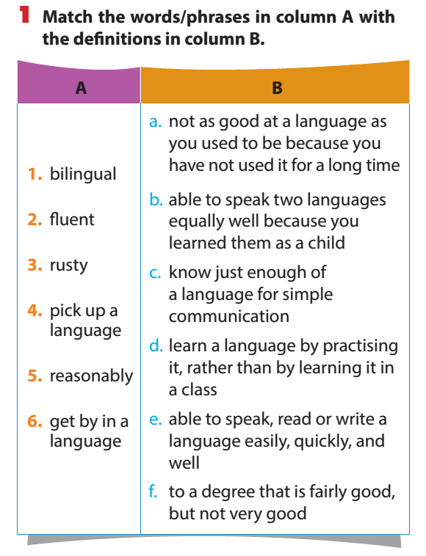

Slide 3

New words
Bilingual /ˌbaɪˈlɪŋɡwəl/ : người nói được hai ngôn ngữ
Pick up (a language): học ngôn ngữ theo cách tự nhiên từ môi trường xung quanh
Get by in (a language) : cố gắng sử dụng được 1 ngôn ngữ với những gì mình có

Slide 4
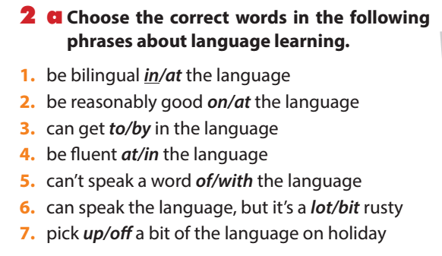

Slide 5
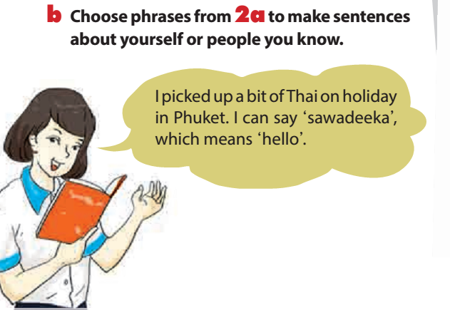

Slide 6
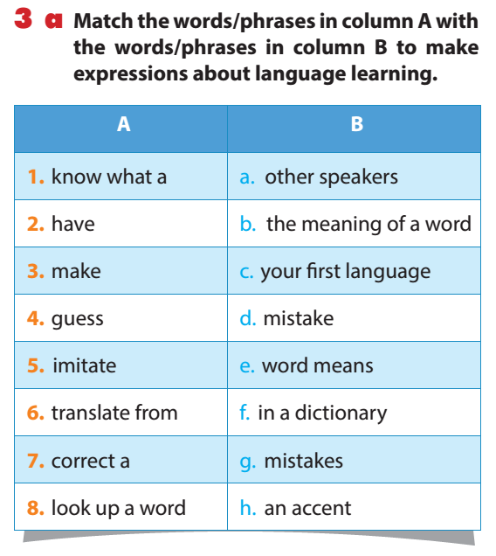

Slide 7

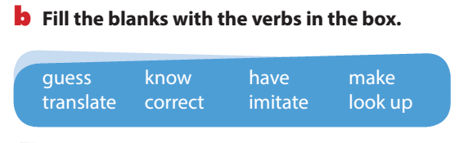
If you don’t (1) ________ what a word means, try to (2) ________ the meaning, or (3) ________ the word in your dictionary. All foreign speakers (4) ________ an accent, but that doesn’t matter. To make your pronunciation better, listen to English speakers and try to (5) ________ them. Don’t worry if you (6) ________ mistakes or don’t try to (7) ________ a mistake – that’s normal! It’s often useful to (8) ________ words from one language to the other, but it’s best when you can start to think in the new language.
know
guess
look up
have
imitate
make
correct
translate

Slide 8
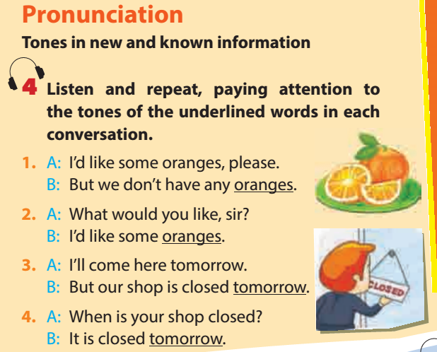


Slide 9
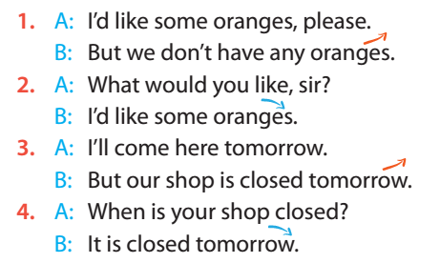

Slide 10
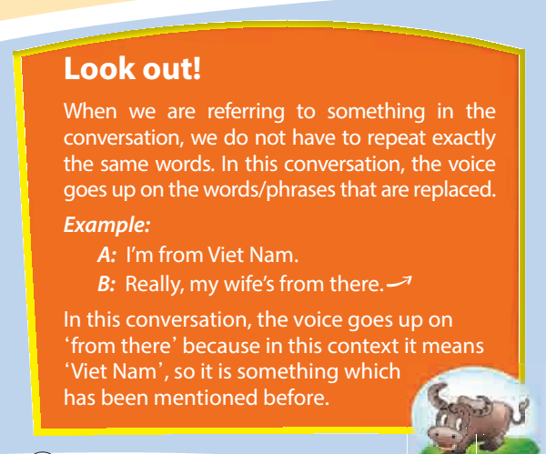

Slide 11
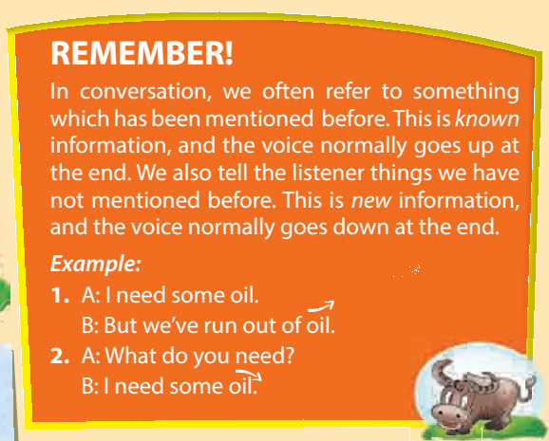

Slide 12
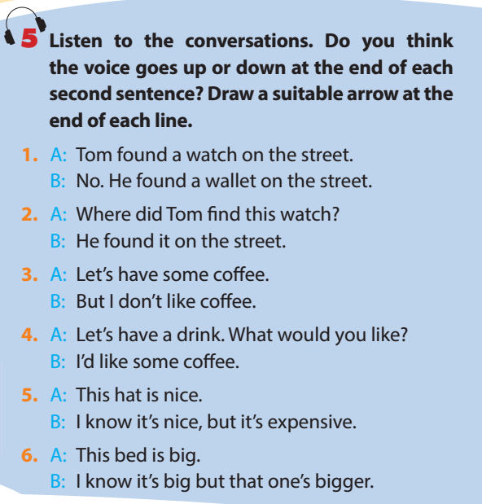

Slide 13
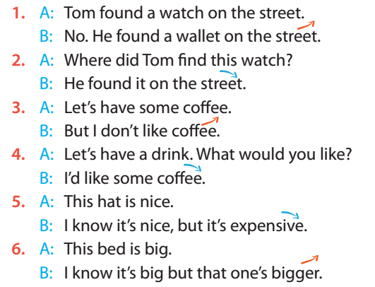

Slide 14
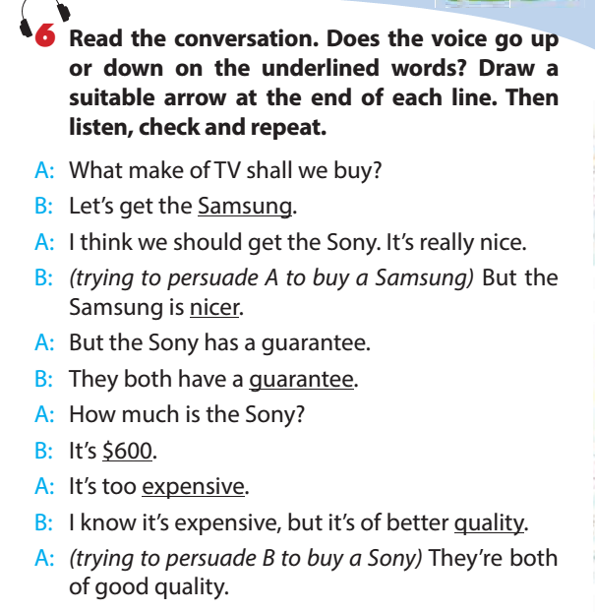


Slide 15
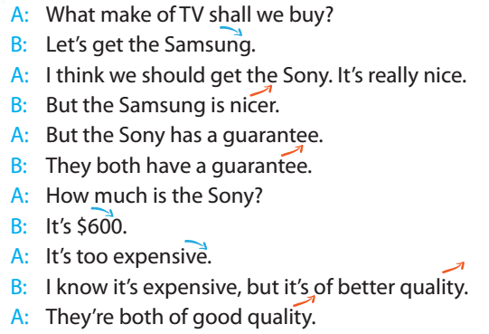

Slide 16

Home work
Learn by heart the new words
Practice Pronunciation

Slide 17

many thanks
many thanks
many thanks
many thanks
many thanks
many thanks
many thanks
many thanks
many thanks
many thanks
many thanks
many thanks

