Slide 1
Unit 19: The animal world
Lesson 1-Period 1

Slide 2
Table of Contents
02
Activity 4
01
Warm up
Listen and number
03
Activity 5
04
Activity 6
Look, complete and read
Let's sing
06
Game

Slide 3
1
Warm up
Guess the animals

Slide 4
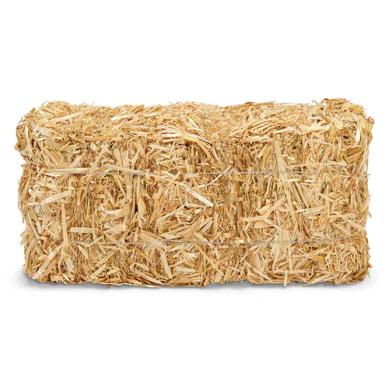
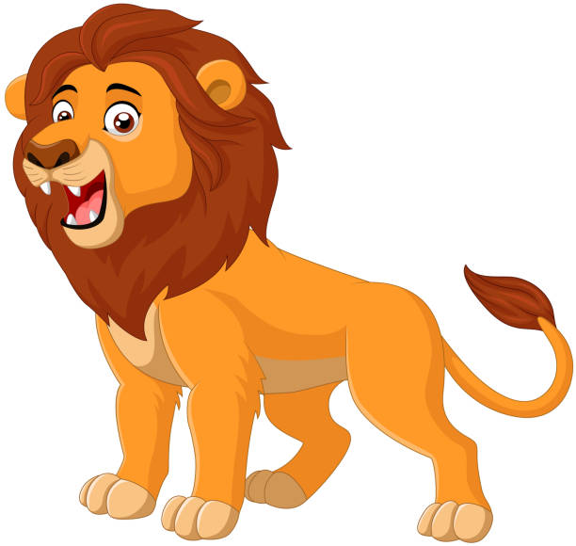
lion

Slide 5
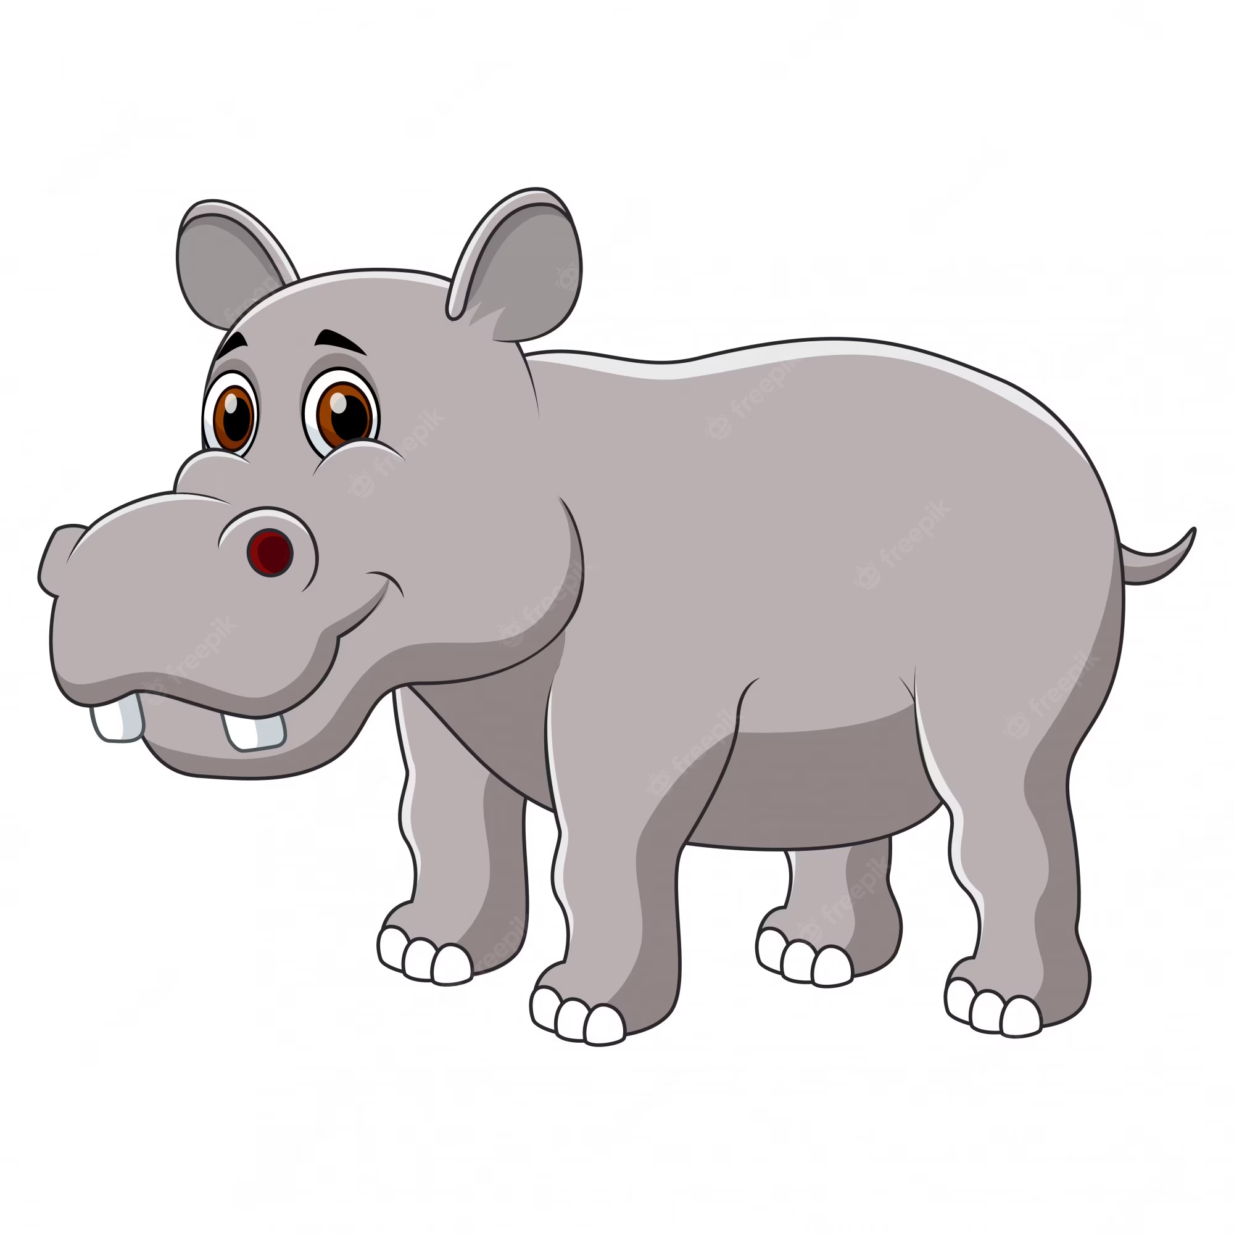
hippo

Slide 6
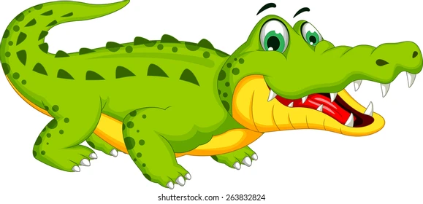
crocodile

Slide 7
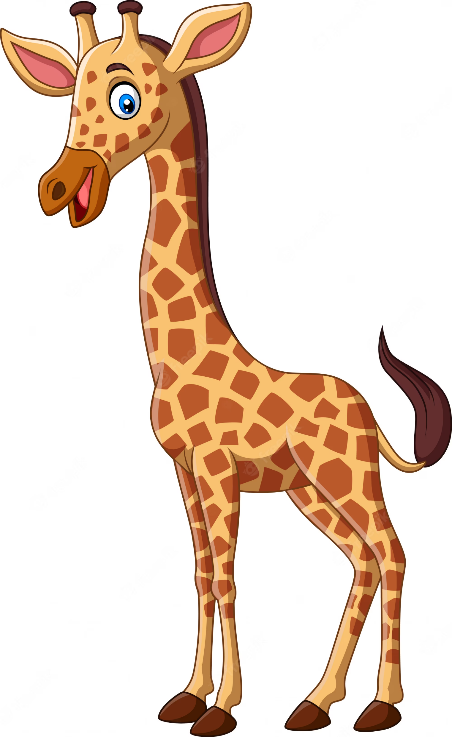
giraffe

Slide 8
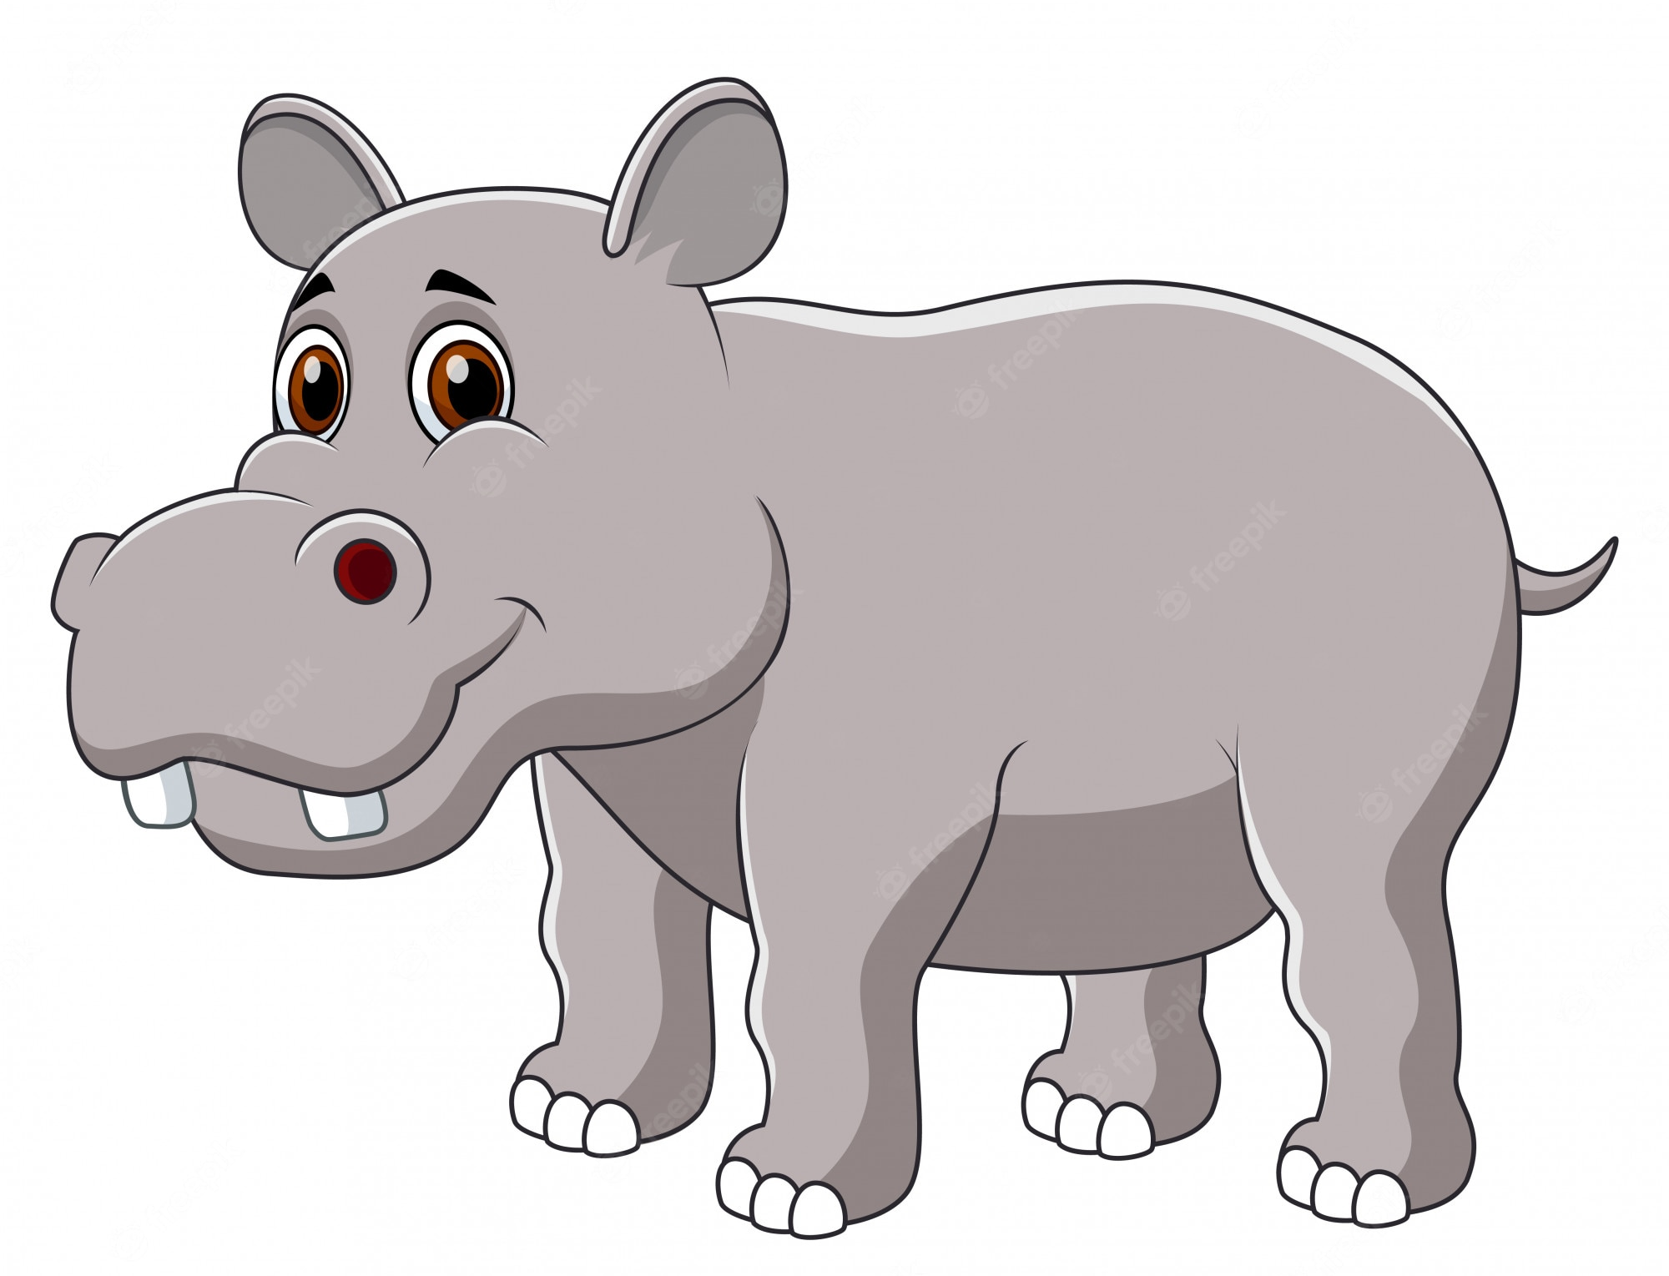
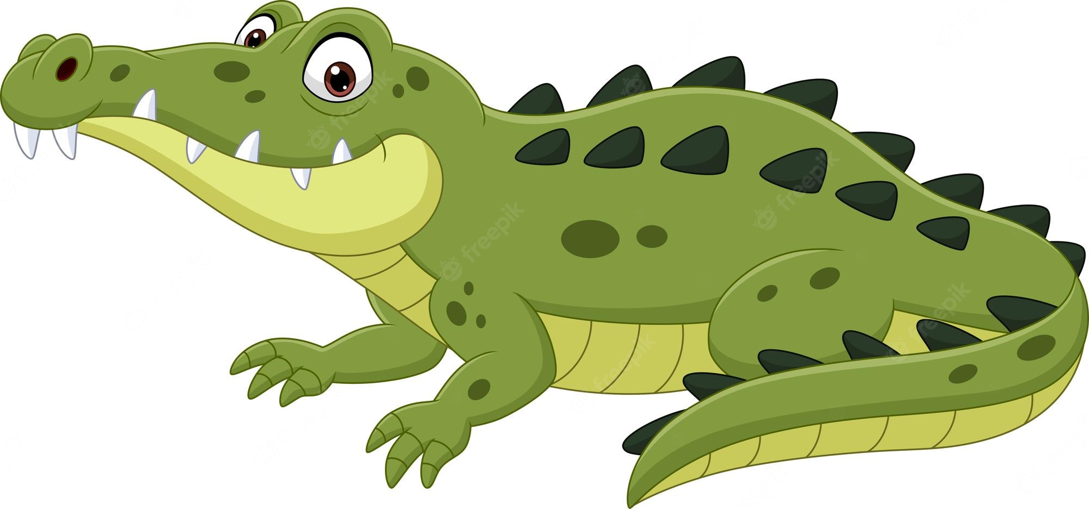
It is ...
They're ...
a hippo
hippos
a crocodile
crocodiles

Slide 9
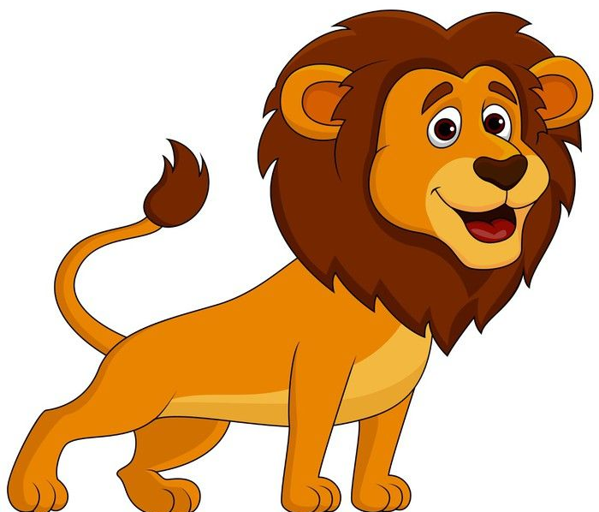
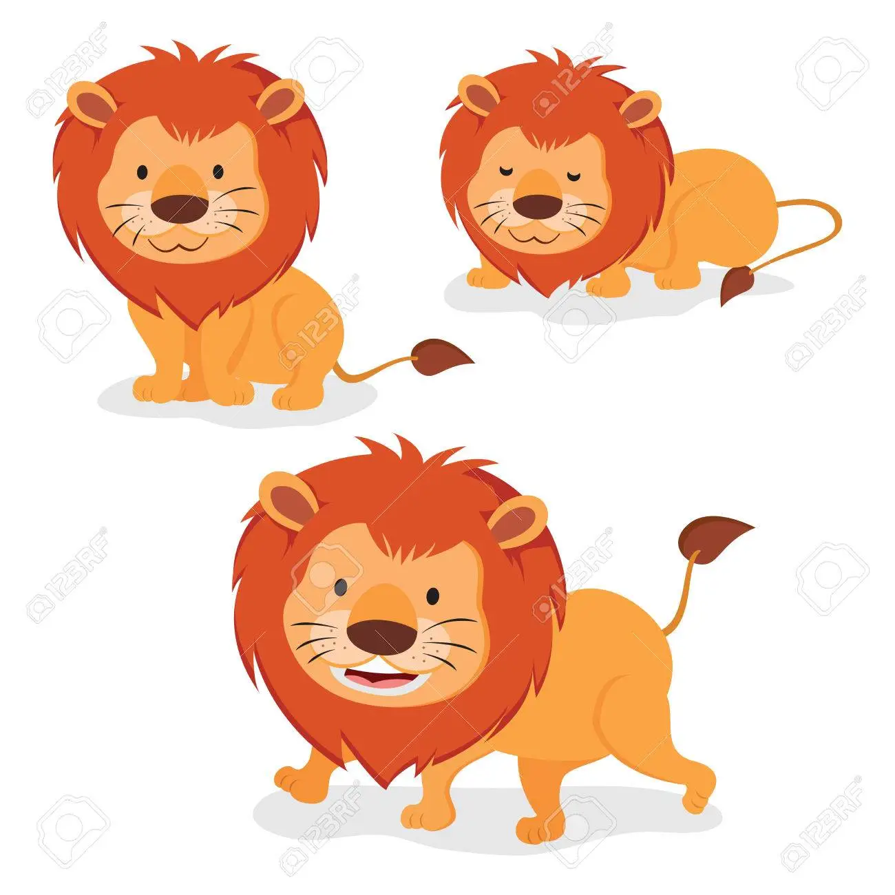
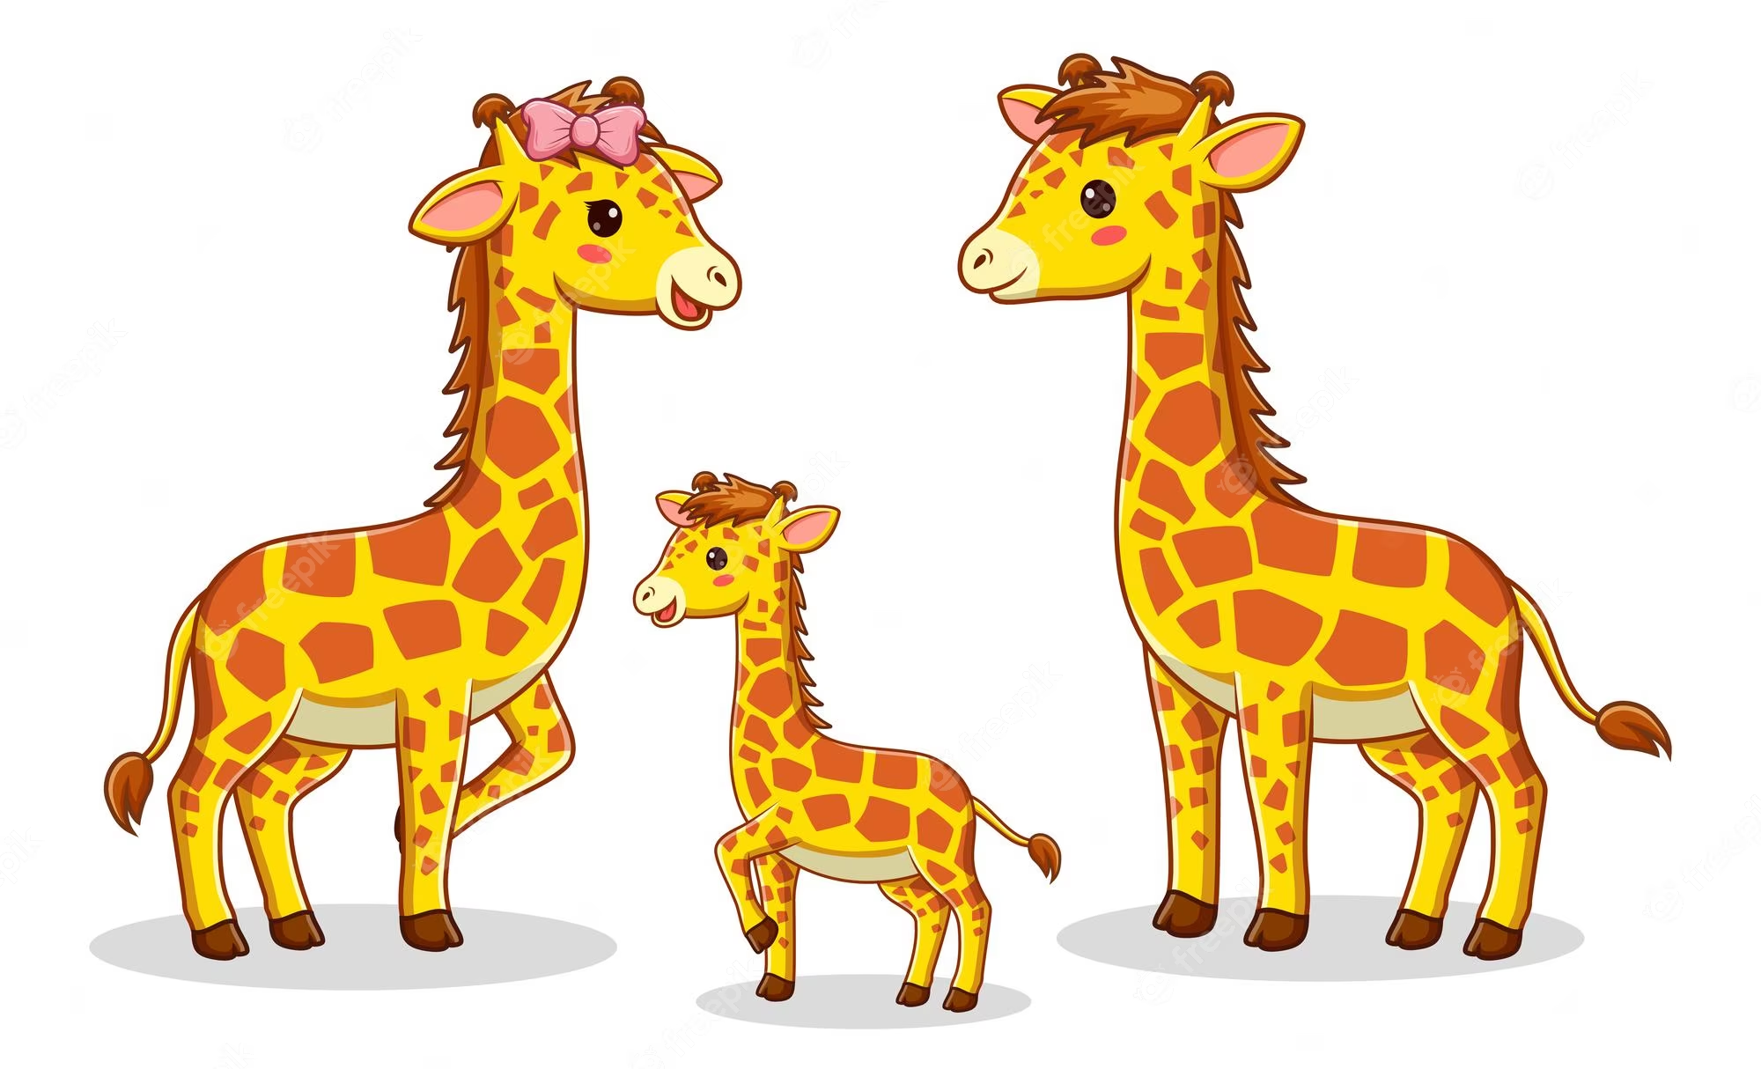
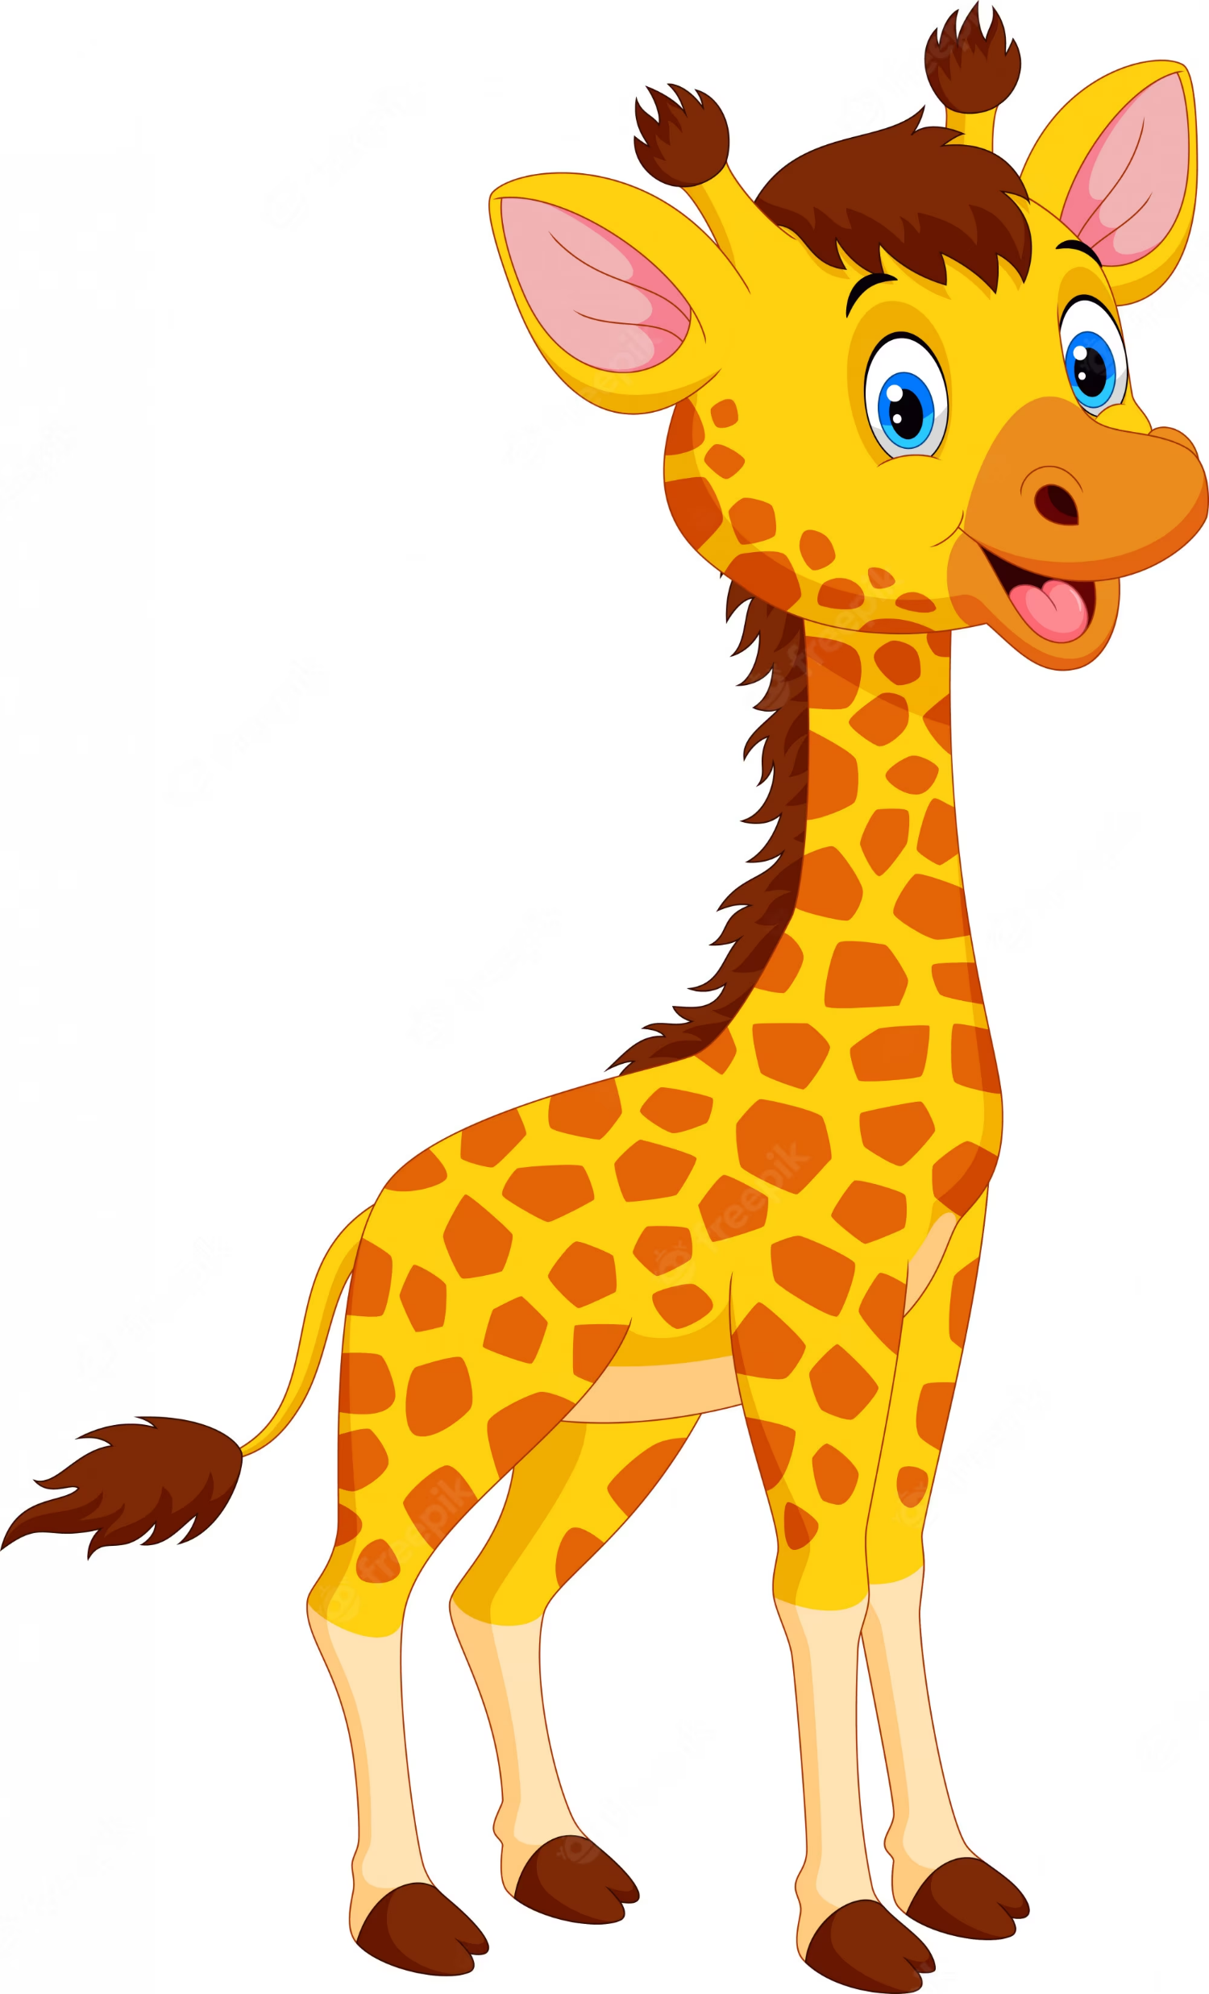
It is ...
They're ...
a lion
lions
a giraffe
giraffes

Slide 10
2
Activity 4
Listen and number

Slide 11
What are these animals?

Slide 12
Where's he from?

Slide 13
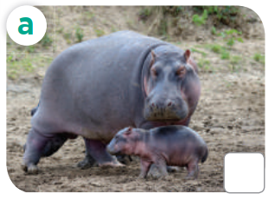
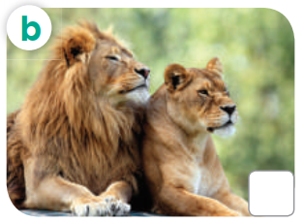
Look and answer

Slide 14
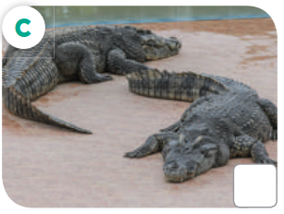
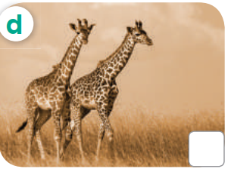
What are these animals?

Slide 15
Listen and number

Slide 16
Let's check!
2
3
4
1

Slide 17
Listen and repeat
2
3
4
1

Slide 18
Activity 5
3
Look, complete and read

Slide 19
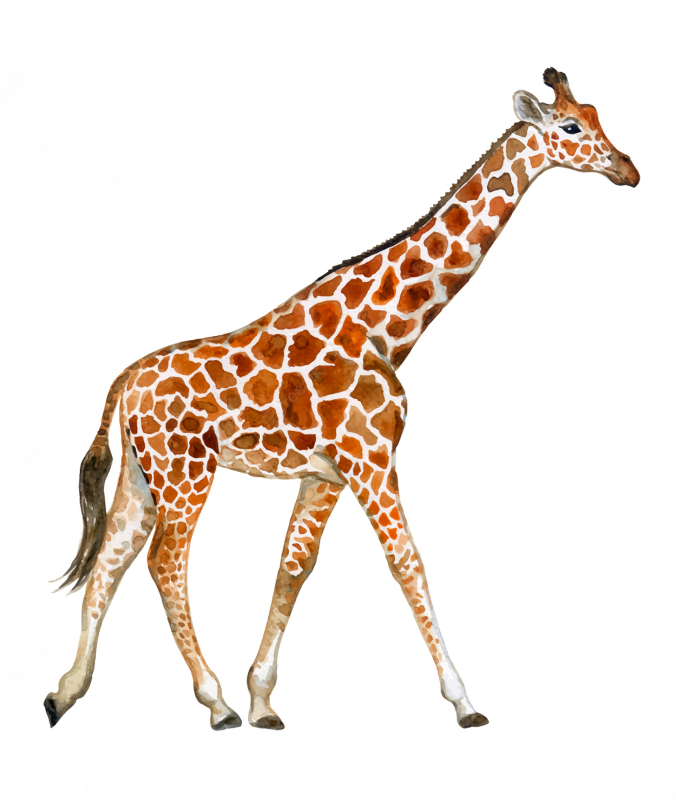
long neck
long legs

Slide 20
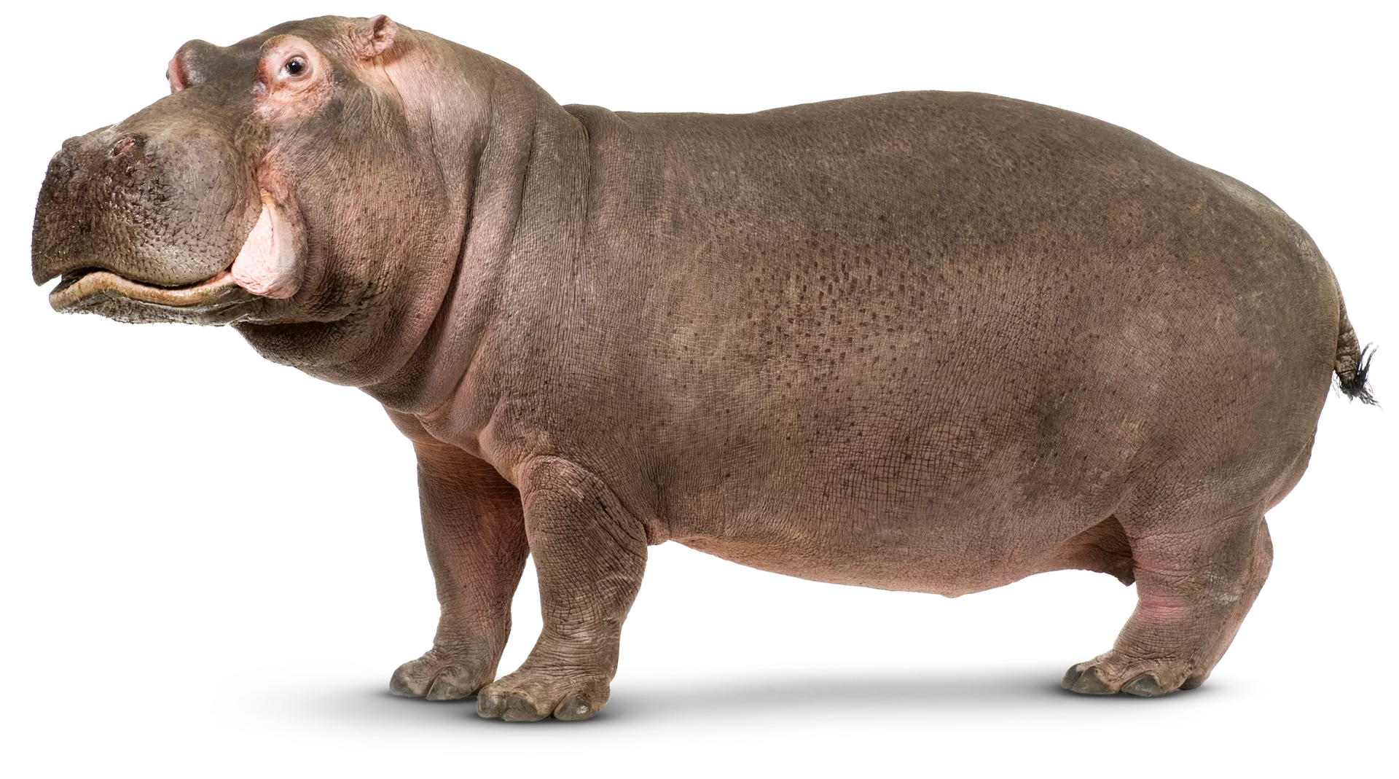
short legs

Slide 21
Read. What's the missing word?
lions

Slide 22
lions
crocodiles
are they
What
hippos
They're

Slide 23
Read aloud.
lions
crocodiles

Slide 24
Act it out.
are they
What
hippos
They're

Slide 25
4
Activity 6
Let's sing.

Slide 26
Read the lyrics
What animals do you see?

Slide 27
Listen.
Practice line by line.
Sing the song

Slide 28
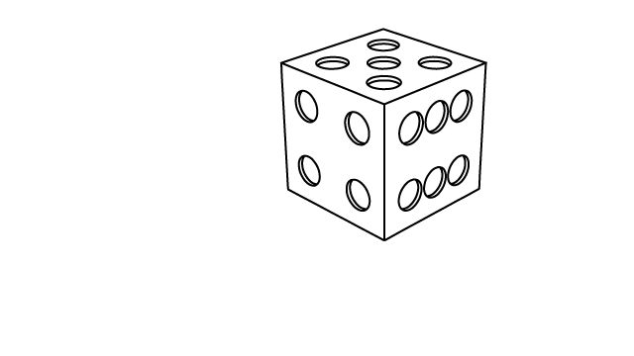
Fun time
5
Answer and roll the dice

Slide 29
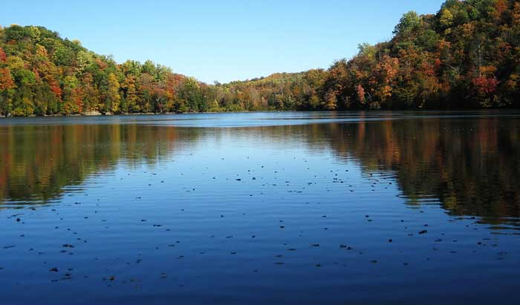
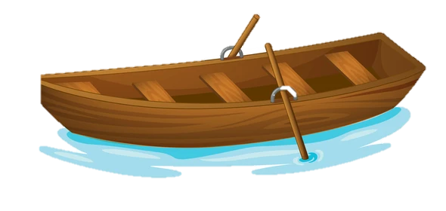
What are these animals?
A. It is a hippo.
B. They're a hippo.
C. They're hippos.

Slide 30
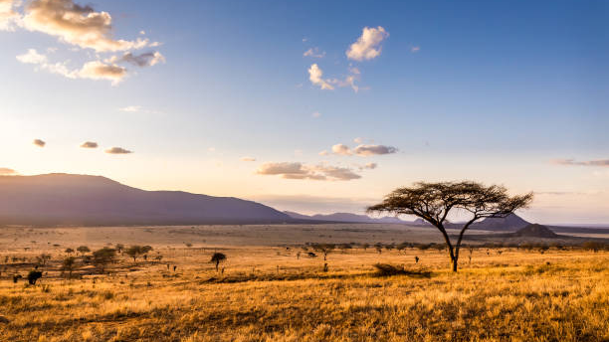
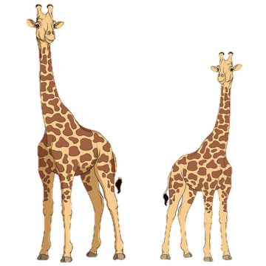
What are these animals?
A. It's a giraffe.
B. They're giraffes.
C. They're a giraffe.

Slide 31
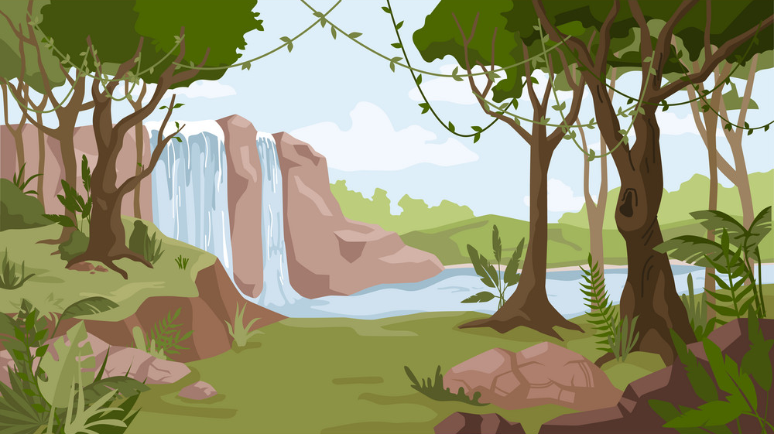
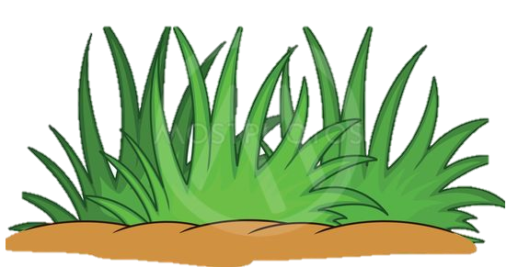
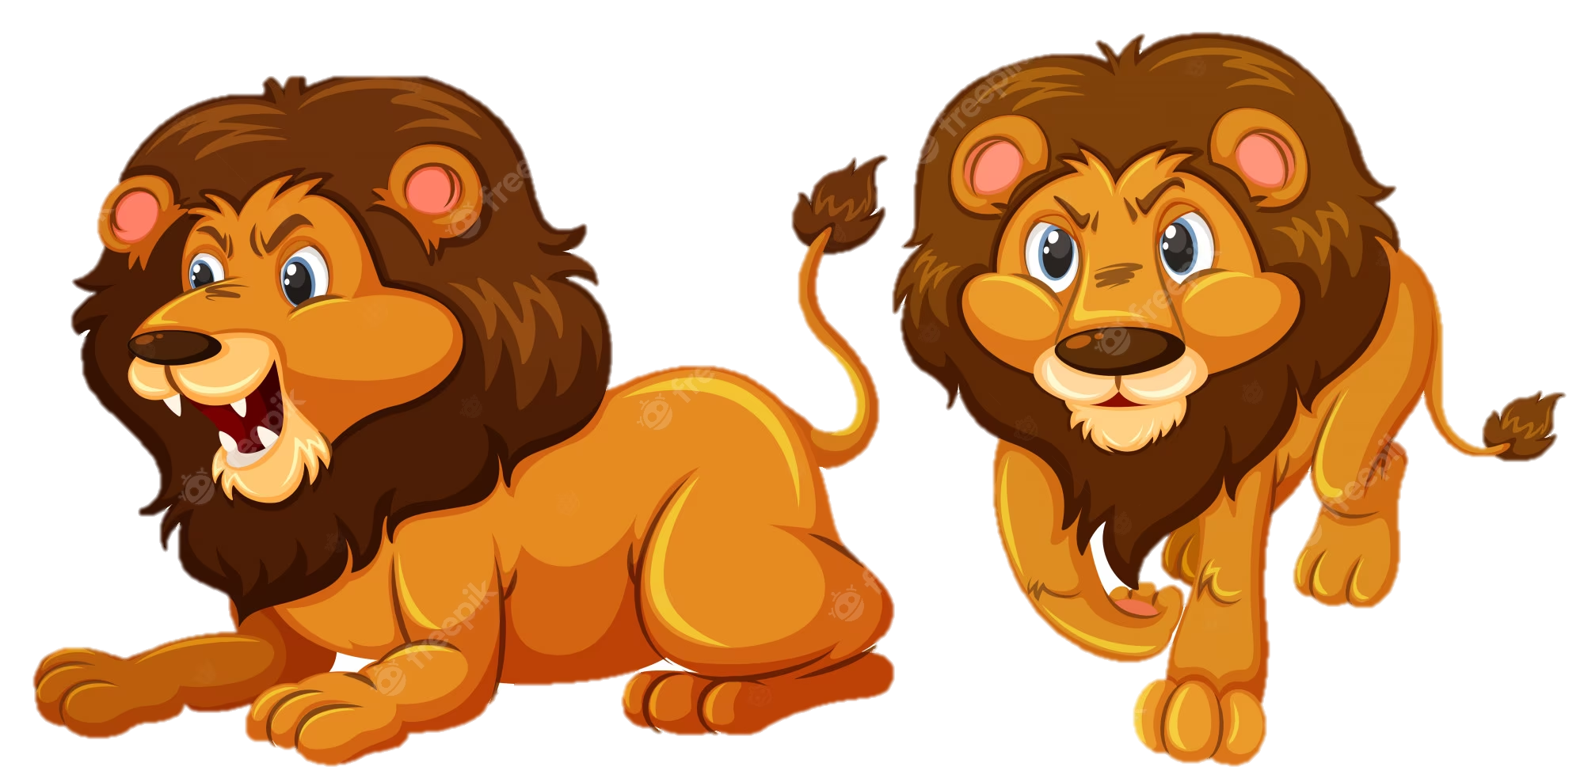
What .......... these animals?
- They are .........
A. are
B. is
A. am

Slide 32
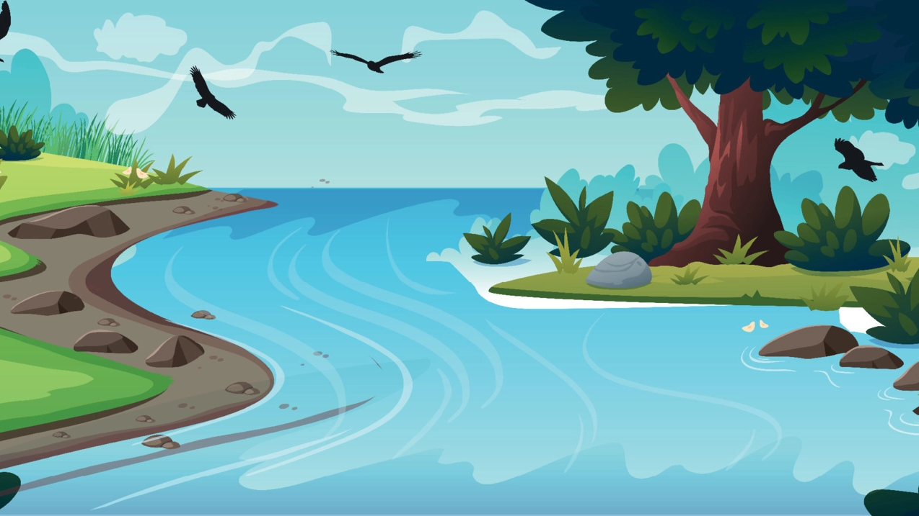
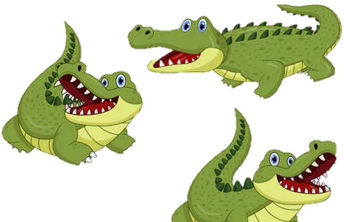
What are these animals?
A. They're hippos.
B. They're crocodiles.
C. It's a crocodile.

Slide 33
......... are these animals?
A. Who
B. How
C. What

Slide 34
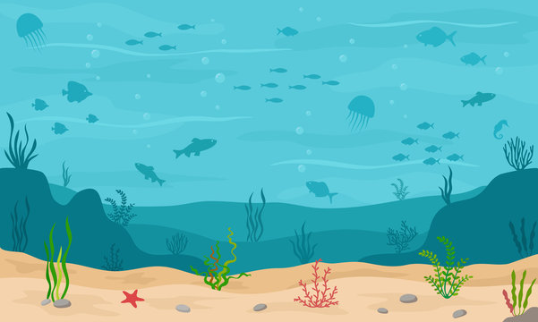
What are these............?
- They are .........
A. animals
B. animal
A. they

Slide 35
tienganh.sachmem.vn

Slide 36
THANK YOU

