Slide 2
Unit 1
Life stories we admire
LESSON 4
SPEAKING
National heroes of Viet Nam

Slide 3
LESSON 4
SPEAKING
WARM-UP
Guessing game
Task 1: Read the cards
Vocabulary
Task 2: Ask and answer to complete the notes
CONTROLLED PRACTICE
Task 3: Use your notes to tell the life story of General Vo Nguyen Giap or Vo Thi Sau
LESS-CONTROLLED PRACTICE
CONSOLIDATION
Wrap-up
Homework

Slide 4
WARM-UP
Guessing game
- Work as 2 groups.
- There are 4 questions, the answers of which provide four clues for the key word.
- Choose and answer the question.
- If you have a correct answer ➔ one point.
- If you can guess the key word ➔ 5 points.
- The team with more points is the winner.

Slide 5
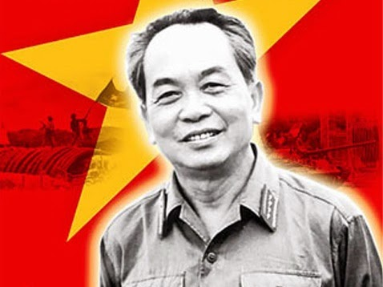
WARM-UP
WARM-UP
Answer the question in each puzzle.
1
2
3
4

Slide 6
WARM-UP
WARM-UP
Question 1
Which was a decisive Vietnamese military victory that
brought an end to French colonial rule in Vietnam?
➔ Dien Bien Phu
BACK

Slide 7
WARM-UP
WARM-UP
Question 2
Which province is home to the World Heritage Phong Nha - Ke Bang National Park?
➔ Quang Binh
BACK

Slide 8
WARM-UP
WARM-UP
Question 3
Fill in the blank:
They’re calling on all men and boys over the age of 18 to join the ______.
➔ army
BACK

Slide 9
WARM-UP
WARM-UP
Question 4
When did Nguyen Tat Thanh start his journey abroad from Nha Rong Wharf?
➔ 1911
BACK

Slide 10
WARM-UP
WARM-UP
KEY WORD: GENERAL VO NGUYEN GIAP

Slide 11
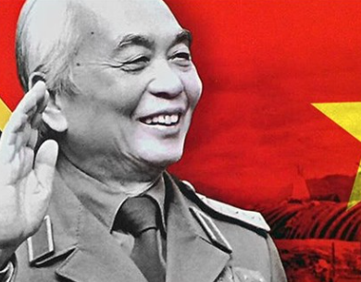
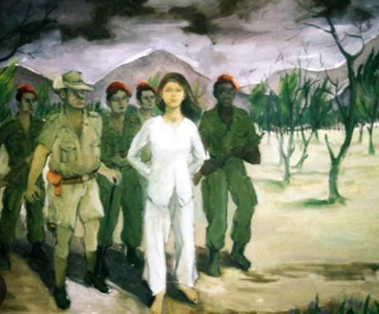
CONTROLLED PRACTICE
Work in pairs. One of you is A, the other is B. A reads the information card about General Vo Nguyen Giap. B reads the information card about Vo Thi Sau below.
1
Student A’s card
Student B’s card

Slide 12


VOCABULARY
the Communist Party of Viet Nam
/ðə ˈkɒmjənɪst pɑːti
əv viːetˈnɑːm/
the single political party in power in Viet Nam

Slide 13
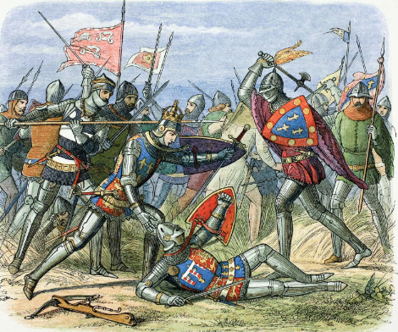
VOCABULARY
battle (n)
/ˈbætl/
a fight between armies, ships or planes, especially during a war

Slide 14

VOCABULARY
campaign (n)
/kæmˈpeɪn/
a series of planned activities that are intended to achieve a particular social, commercial or political aim

Slide 15
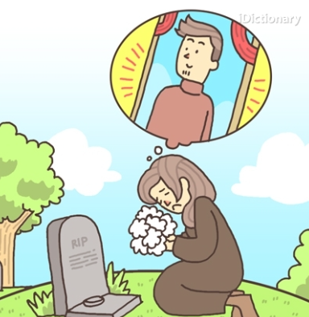
VOCABULARY
pass away
/ pɑːs əˈweɪ/
to die

Slide 16
VOCABULARY
Form | Pronunciation | Meaning | Vietnamese equivalent
1. the Communist Party of Viet Nam | /ðə ˈkɒmjənɪst pɑːti əv viːetˈnɑːm/ | the single political party in power in Viet Nam | Đảng Cộng sản Việt Nam
2. battle (n) | /ˈbætl/ | a fight between armies, ships or planes, especially during a war | trận chiến
3. campaign (n) | /kæmˈpeɪn/ | a series of planned activities that are intended to achieve a particular social, commercial or political aim | chiến dịch
4. pass away | / pɑːs əˈweɪ/ | to die | qua đời

Slide 17


CONTROLLED PRACTICE
Work in pairs. A should ask B questions to complete his/her card about Vo Thi Sau. Then B should do the same to complete his/her card about General Vo Nguyen Giap. Then compare your notes.
2
Example questions
Who is/was …?
When did he/she …?
How old was he/she when …?
What happened in …?

Slide 18
LESS-CONTROLLED PRACTICE
3
Use your notes to tell the life story of General Vo Nguyen Giap or Vo Thi Sau to the class. Vote for the best-told story.
Suggested answer:
We’d like to talk about the life of Vo Thi Sau, a national heroine of our country. She was born in 1933 in Ba Ria Province. At the age of 15, she joined the Viet Minh, the league for the independence of Viet Nam from French rule. In 1947, she was brave enough to carry out attacks against French soldiers. She managed to kill some of them by throwing grenades at them. Unfortunately, in another unsuccessful attempt in 1949, she was caught and put in prison. She was sentenced to death at Con Son Prison, Con Dao Island at the age of 19. Although she died nearly 80 years ago, many generations in Viet Nam still admire Vo Thi Sau for her great bravery and sacrifice for the independence of our country.

Slide 19
CONSOLIDATION
1
Wrap-up
What have you learnt today?
An overview about the lives of a famous hero and heroine in Viet Nam;
Vocabulary to talk about the lives of a famous hero and heroine in Viet Nam.

Slide 20
CONSOLIDATION
2
Homework
- Write a paragraph about the life of a national hero that you admire.
- Do exercises in the workbook.
- Prepare for the next lesson – Listening.

Slide 21
Website: hoclieu.vn
Fanpage: facebook.com/www.tienganhglobalsuccess.vn

