Slide 1

Unit 9: English in the World
Lesson 2.1: Vocabulary & Listening
Page 76

Slide 2



Unit 9 Lesson 2.1
LESSON OUTLINE
Consolidation

Slide 3
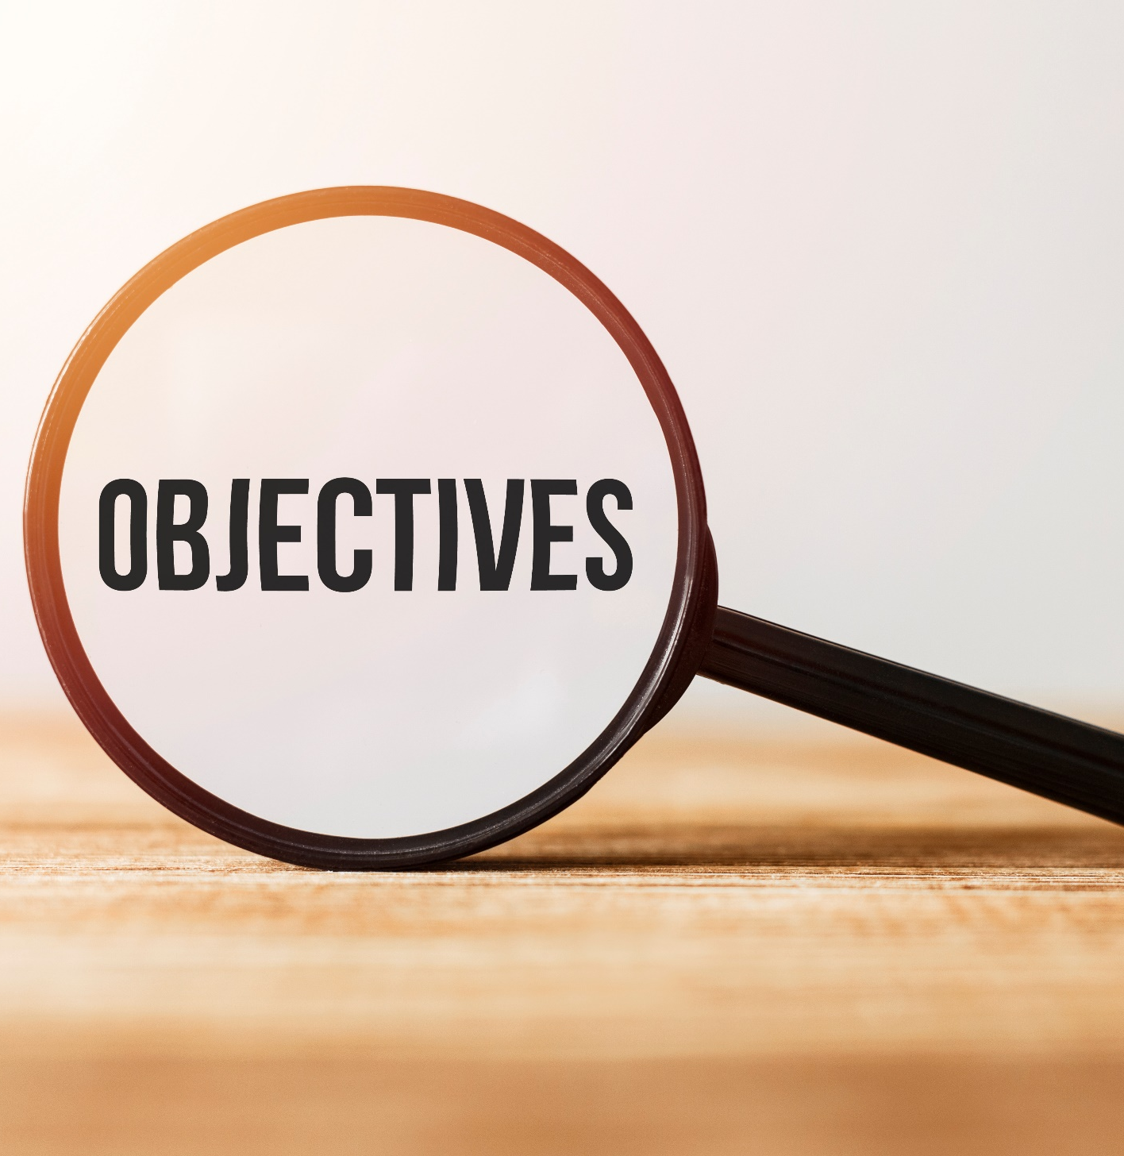
Unit 9 Lesson 2.1
By the end of this lesson, students will be able to…
talk about holidays.
practice listening for main. ideas and specific information.

Slide 4

Unit 9 Lesson 2.1
New words
souvenir
sightseeing
swimsuit
postcard
photo
beach
wallet

Slide 5

Unit 9 Lesson 2.1
WARM UP

Slide 6

Unit 9 Lesson 2.1
Work in pairs.
What do you usually do when you go on holiday?

Slide 7
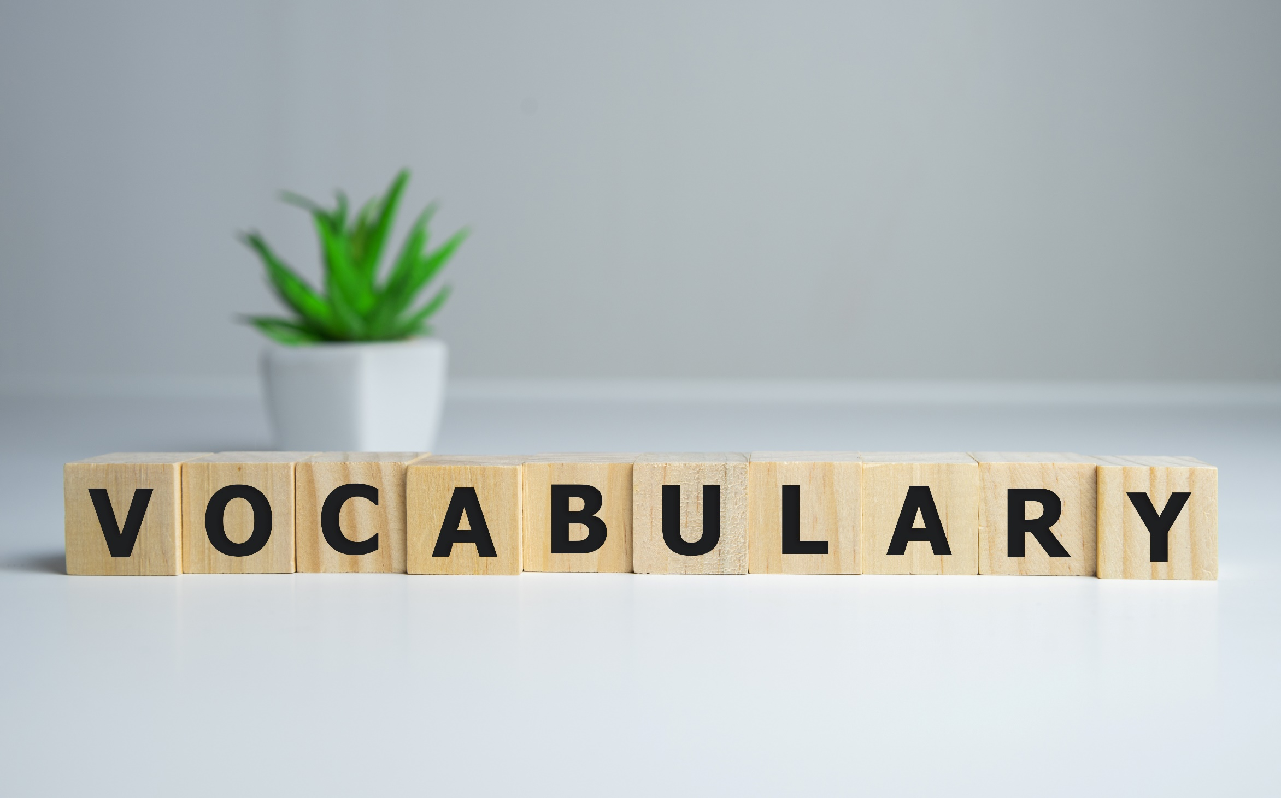

Unit 9 Lesson 2.1

Slide 8


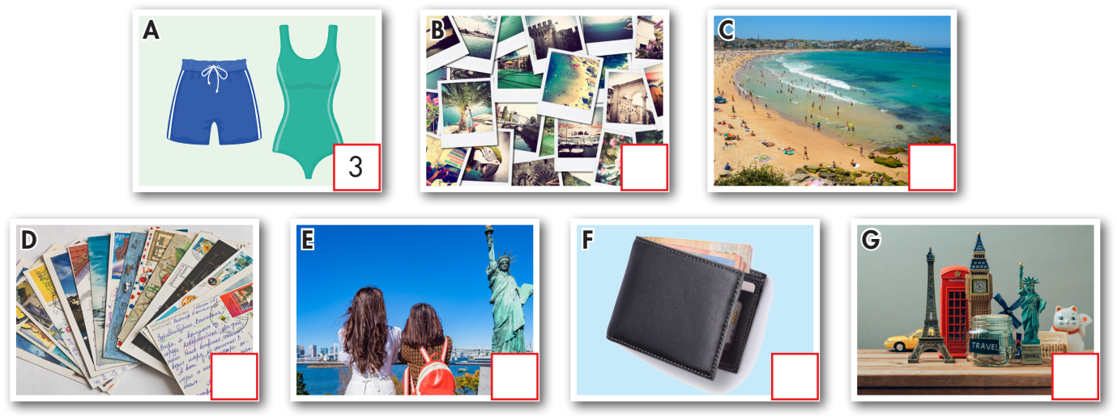
Unit 9 Lesson 2.1
5
6
4
2
7
1

Slide 9

Unit 9 Lesson 2.1
Listen and repeat. Click each phrase to hear the sound.
souvenir (n) /suːvəˈnɪr / quà lưu niệm
sightseeing (n) /ˈsaɪtˌsiːɪŋ / tham quan, ngắm cảnh
swimsuit (n) /ˈswɪmsuːt/ đồ bơi
postcard (n) /ˈpoʊstkɑːrd/ bưu thiếp
photo (n) /ˈfoʊtoʊ/ hình ảnh
beach (n) /biːtʃ/ bãi biển
wallet (n) /ˈwɑːlɪt/ ví
Notes:
GV click vào từng cụm nghe âm thanh

Slide 10
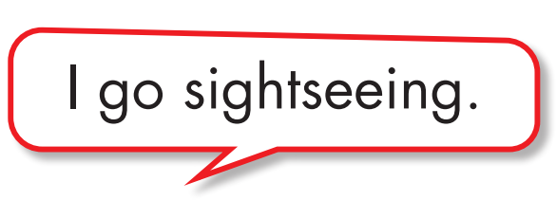
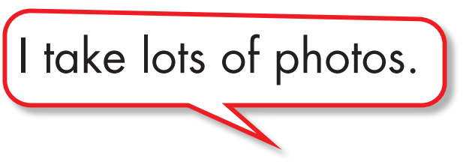

Unit 9 Lesson 2.1
Work in pairs.
b. Talk about the things you do on vocation.

Slide 11
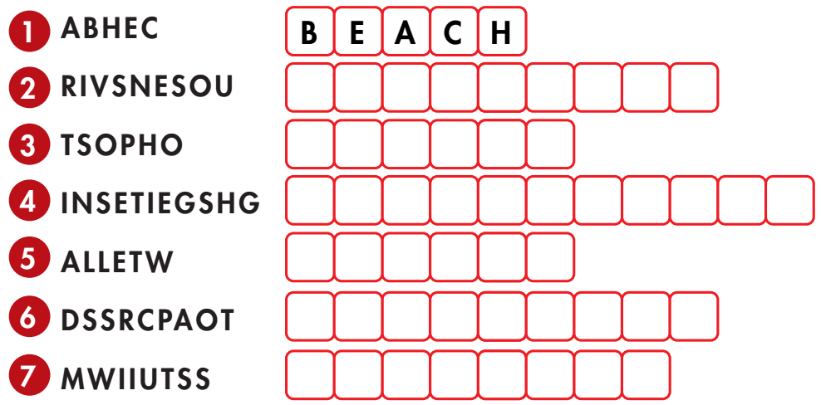
Unit 9 Lesson 2.1
Extra Practice
WB, page 52
Unscramble the words.
S O U V E N I R S
P H O T O S
S I G H T S E E I N G
W A L L E T
P O S T C A R D S
S W I M S U I T

Slide 12
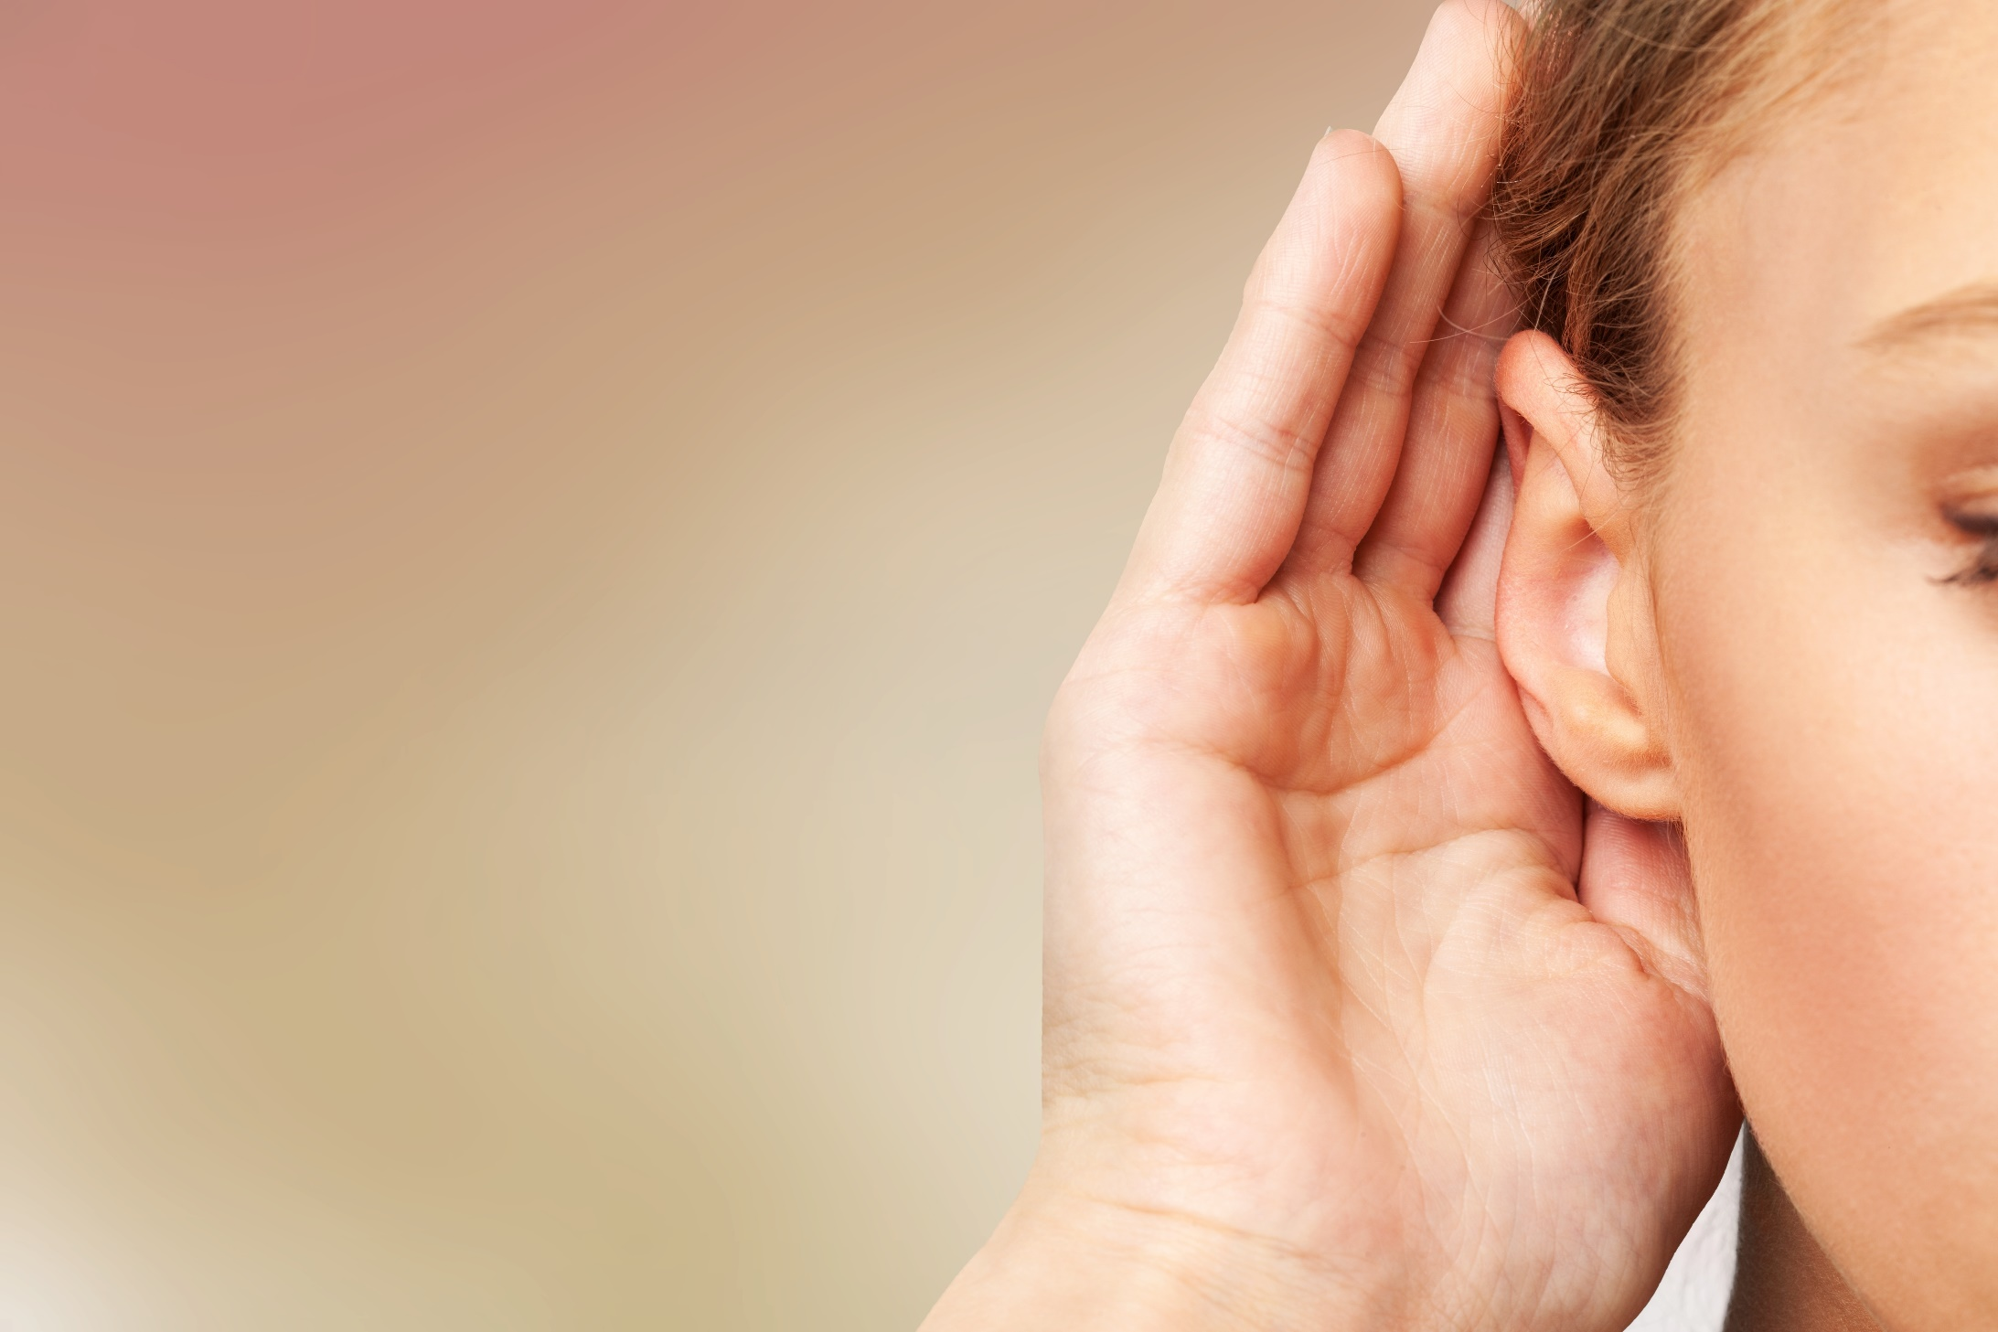

Unit 9 Lesson 2.1
It’s listening time….

Slide 13
Unit 9 Lesson 2.1
Pre - listening
Read the instruction quickly. Underline the key words. What are we going to do?
Listen and answer the question
a. Listen to Peter and Janet talking about their holidays.
Who enjoyed their holiday more?

Slide 14
Unit 9 Lesson 2.1
While - listening
Now listen and answer the question
Now listen and choose the correct answer.  FIRST TIME
a. Listen to Peter and Janet talking about their holidays.
Who enjoyed their holiday more?
☞ YOUR ANSWER?
☞ WHY?

Slide 15
Unit 9 Lesson 2.1
While - listening
Now listen again and check.  SECOND TIME
While you are listening, focus on what Peter and Jane talk
Peter: Hey Janet, how was your holiday in London?
Janet: I had a good time, but on the rest day, I lost my wallet
………..
Janet: I did and they were great! How was your trip to New York?
Peter: It was fantastic. We visited the Statue of Liberty and the Empire State building. Then we went to Central Park. It was really beautiful. The food in New York was great.
☞ THE ANSWER IS …
Peter

Slide 16
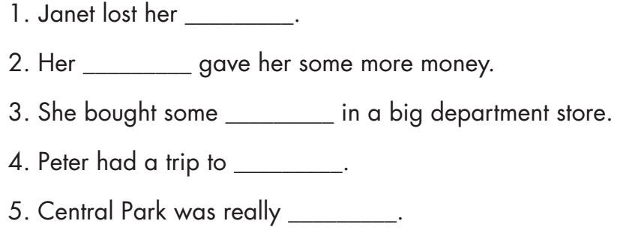
Unit 9 Lesson 2.1
Pre - listening
Read the instruction and questions quickly. Underline the key words. What are we going to do?
Listen and fill in the blanks

Slide 17
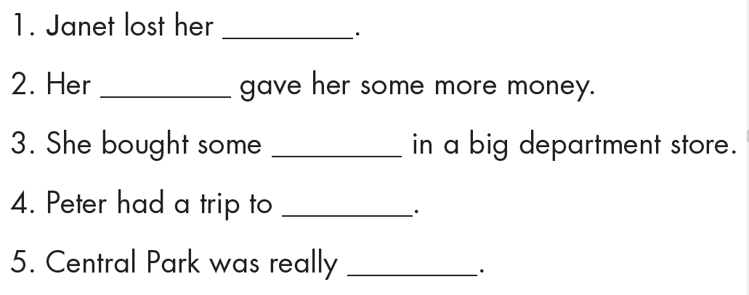
Unit 9 Lesson 2.1
While - listening
Now listen and circle True or False.  FIRST TIME
Now listen and fill in the blanks
☞ WHAT ARE YOUR ANWERS?

Slide 18
Unit 9 Lesson 2.1
While - listening
Now listen again and check.  SECOND TIME
wallet
mom
souvenirs
New York
beautiful
☞ WHY ARE THESE ANWERS?

Slide 19


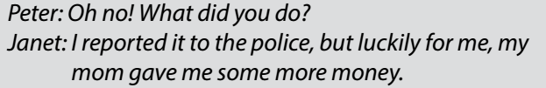

While - listening
Unit 9 Lesson 2.1
Now listen again and check.  THIRD TIME
wallet
mom
souvenirs

Slide 20
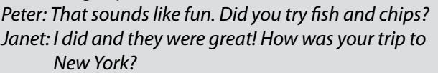

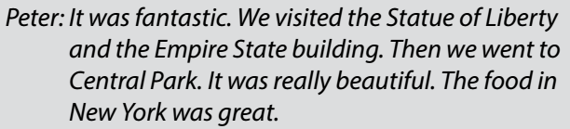
Unit 9 Lesson 2.1
Now listen again and check.  THIRD TIME
New York
beautiful

Slide 21
Unit 9 Lesson 2.1
Audio - Scripts
Practice the conversation with a partner.
Peter: Hey Janet, how was your holiday in London?
Janet: I had a good time, but on the rest day, I lost my wallet.
Peter: Oh no! What did you do?
Janet: I reported it to the police, but luckily for me, my mom gave me some more money.
Peter: How about the rest of your holiday?
Janet: We went sightseeing and I took photos of Big Ben. Then, I bought some souvenirs in a big department store.
Peter: That sounds like fun. Did you try sh and chips?
Janet: I did and they were great! How was your trip to New York?
Peter: It was fantastic. We visited the Statue of Liberty and the Empire State building. Then we went to Central Park. It was really beautiful. The food in New York was great.
Janet: So, you liked it a lot then?
Peter: Oh yes.
Janet: Well, it was great talking to you.
Peter: You, too! Bye!

Slide 22

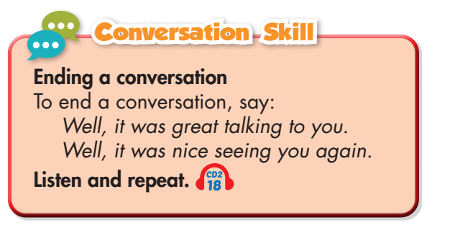
Unit 9 Lesson 2.1
Work in pairs
Post - listening
What did you like most about your last holiday?

Slide 23

FURTHER PRACTICE

Slide 24

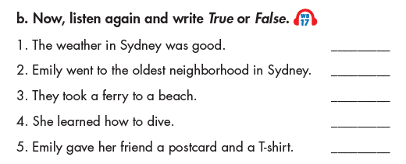
Unit 9 Lesson 2.2
Unit 9 Lesson 2.1
Extra Practice
WB, page 53
✓
✓
True
True
True
False
False

Slide 25
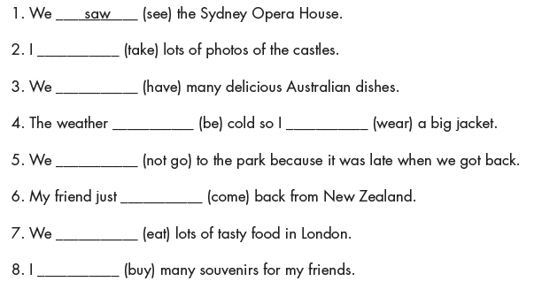
Unit 9 Lesson 2.2
Unit 9 Lesson 2.1
Fill in the blanks with the Past Simple form of the verbs.
took
had
was
wore
didn’t go
came
ate
bought
Extra Practice
WB, page 53

Slide 26

Unit 9 Lesson 2.1
CONSOLIDATION

Slide 27
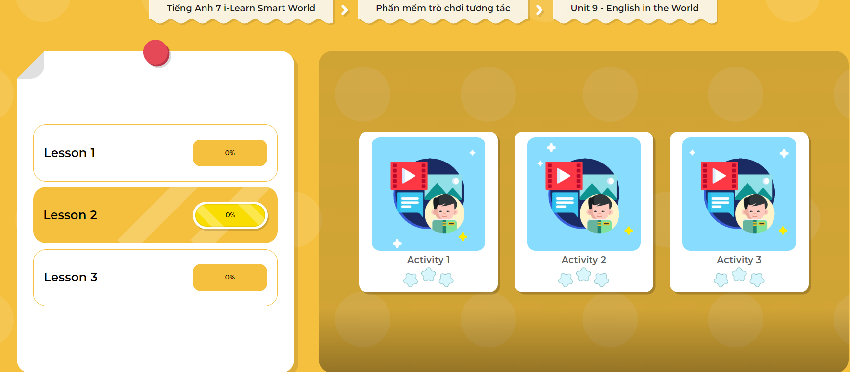
LET’S PLAY!
Click here to play the games!

Slide 28
Unit 9 Lesson 2.1
Write a paragraph about your last holiday. (70 words)

Slide 29

Unit 9 Lesson 2.1
WRAP-UP

Slide 30
Unit 9 Lesson 2.1
Today’s lesson
Vocabularies
souvenir
sightseeing
swimsuit
postcard
photo
beach
wallet

Slide 31
Unit 9 Lesson 2.1
Today’s lesson
Listening:
Listening for main ideas and specific information
Speaking:
Talking about last holiday

Slide 32
Unit 9 Lesson 2.1
Homework
Learn by heart vocabularies and make sentences using them.
Do the Listening exercise on page 52 WB.
Do the exercises in Tiếng Anh 7 i-Learn Smart World Notebook on page 56.
Prepare the next lesson (page 72 SB).
- Play consolidation games in Tiếng Anh 7 i-Learn Smart World DHA App on www.eduhome.com.vn

Slide 33

Lesson 3
Stay positive and have a nice day!

