Slide 1
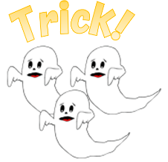
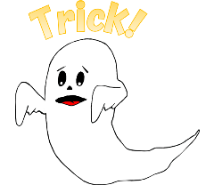
1
2
3
4
5
6
7
8
9
10
11
12
13
14
15
16
17
18
19
20
tekhnologic
Notes:
1 Ghost – 6, 9. 15, 16
3 Ghosts – 2, 13

Slide 2
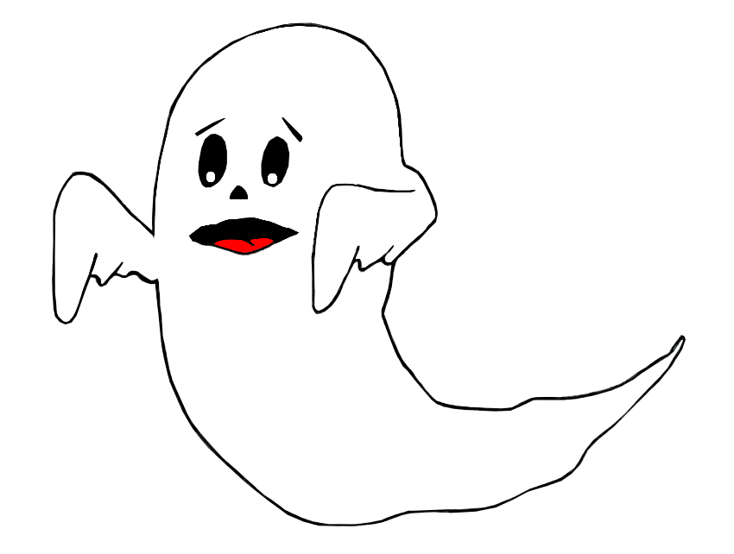
Trick!
Lose half your points!

Slide 3
Trick!
Lose all your points!

Slide 4
Question
Answer
Answer
Answer
Answer
tekhnologic
Notes:
A: Correct

Slide 5
Question
Answer
Answer
Answer
Answer
tekhnologic
Notes:
B: Correct

Slide 6
Question
Answer
Answer
Answer
Answer
tekhnologic
Notes:
C: Correct

Slide 7
Question
Answer
Answer
Answer
Answer
tekhnologic
Notes:
D: Correct

Slide 8
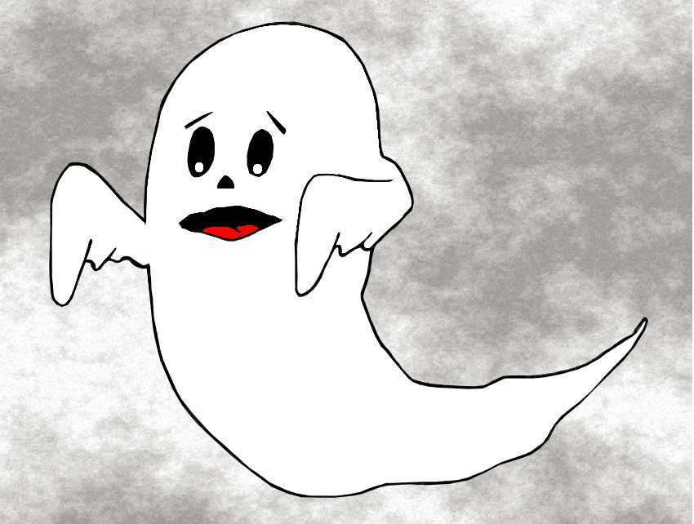
1
2
3
4
5
6
7
8
9
10
11
12
13
14
15
16
17
18

Slide 9
Challenge
Question

Slide 10
Word
?
Word

Slide 11
Word
Word
?
Word

Slide 12
Word
Word
?
Word
Word

Slide 13
SƯU TẦM: ĐOÀN VĂN DOANH, NAM TRỰC, NAM ĐỊNH
LINK NHÓM DÀNH CHO GV BỘ MÔN VẬT LÝ TRAO ĐỔI TÀI LIỆU VÀ CHUYÊN MÔN CT 2018
https://www.facebook.com/groups/299257004355186

