Slide 1
Gender Equality
Unit 6
Lesson 4: Speaking
Career choices

Slide 2

OBJECTIVES
Understand how to express opinions
Apply useful expressions to talk about
career choices

Slide 3
Table of contents
01
02
Warm-up
Controlled practice
03
04
Free practice
Consolidation

Slide 4
01
Warm-up
Personality quiz

Slide 5

WARM-UP
PERSONALITY QUIZ: Find your suitable career!
https://www.opencolleges.edu.au/careers/career-quiz

Slide 6
02
Controlled practice

Slide 7


Slide 8
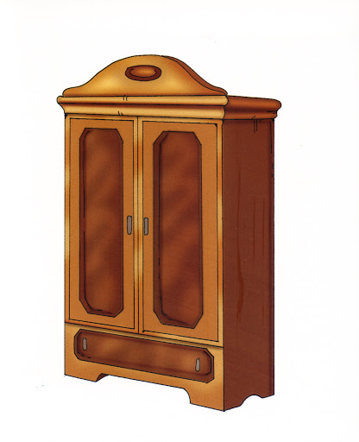

vocabulary
GAME
Notes:
8

Slide 9

kindergarten
medical school
surgeon
kindergarten
Notes:
9

Slide 10

treat
surgeon
equal
surgeon
Notes:
10

Slide 11
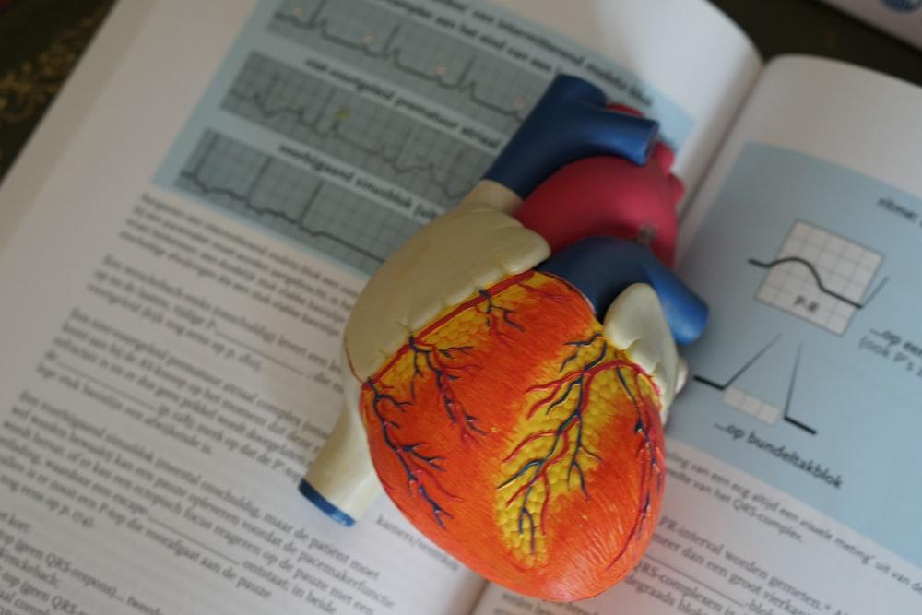

treat
gender
medical school
medical school
Notes:
11

Slide 12

gender
kindergarten
treat
gender
Notes:
12

Slide 13
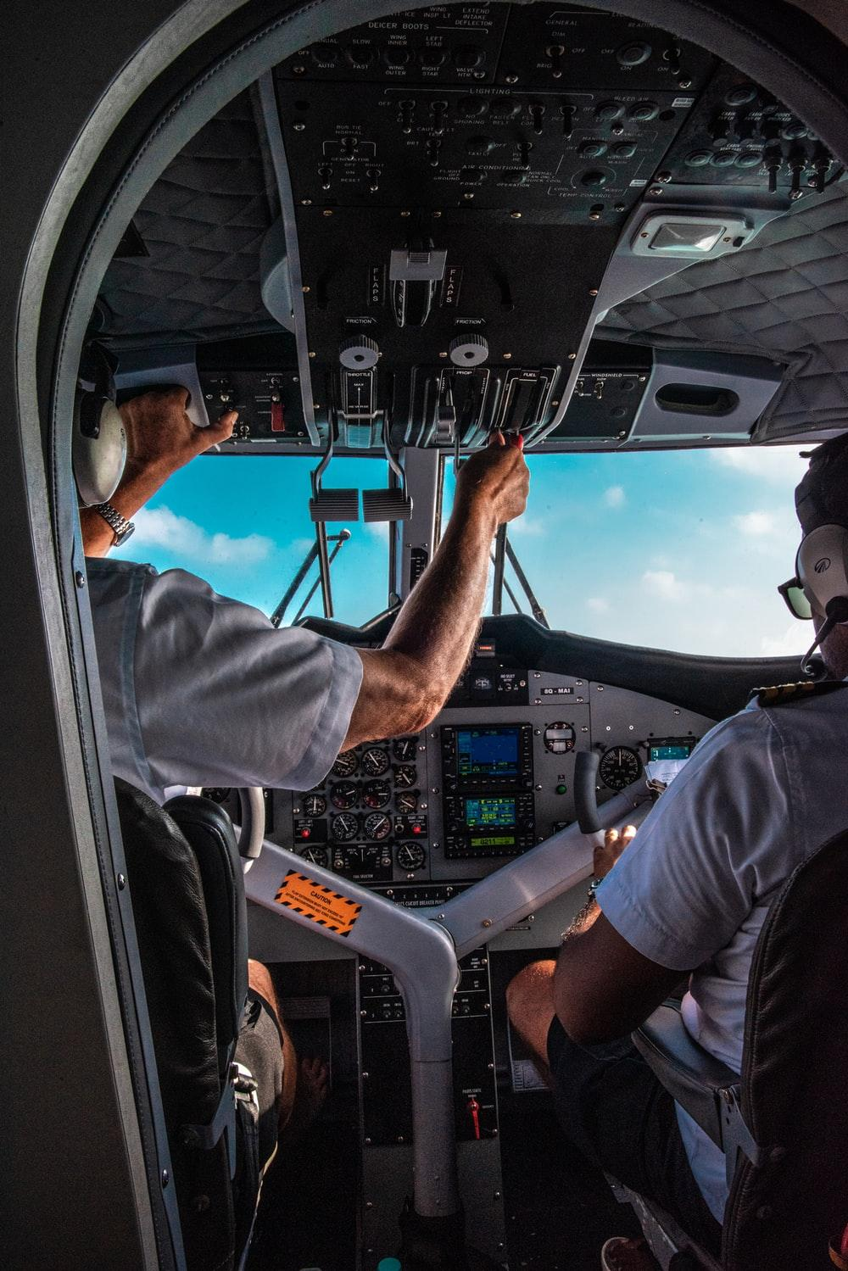
kindergarten
pilot
surgeon
pilot
Notes:
13

Slide 14
CONTROLLED PRACTICE
1
Work in pairs. Decide which jobs are traditionally done by men or women. Use the expressions given to help you.
Jobs | Men | Women
1. Surgeons
2. Shop assistants
3. Nurses
4. Airplane pilots
5. Firefighters
6. Kindergarten teachers
7. Engineers
8. Secretaries
Useful expressions:
I think / I believe (that)…
There are many more male (surgeons)
than female (surgeons).
Men / Women traditionally work as
(firefighters) …
(Nursing) jobs are done by men / women.
The (nurse's) job is traditionally done
by men / women.

Slide 15
CONTROLLED PRACTICE
2
Work in pairs. Discuss why the jobs in Task 1 are traditionally done by men or women. Use the ideas below to help you.
SUGGESTED IDEAS
Good physical strength Good communication skills Ability to work well under pressure Being kind, gentle and caring | Ability to work long hours Good persuasion skills Flexible working schedule More time to take care of their families

Slide 16
03
Free practice

Slide 17
FREE PRACTICE
3
Work in groups of three. Talk about your career choice(s).
Example:
A: I think I'll work as a shop assistant because people often say that I have good persuasion skills.
B: Good for you. I'd like to be a nurse because I enjoy helping people.
C: Sounds great. I'd like to be a surgeon. I believe I can work well under pressure and don't mind working long hours.

Slide 18
04
Consolidation

Slide 19
CONSOLIDATION
1
Wrap-up
Video:
https://www.youtube.com/watch?v=G3Aweo-74kY

Slide 20
CONSOLIDATION
2
Homework
Do exercises in the workbook
Prepare the presentation for the Project lesson.

Slide 21
SEE YOU NEXT TIME !!

