Slide 1


Slide 2

Unit
3
1
Unit
FAMILY LIFE
MUSIC
LESSON 8
LOOKING BACK AND PROJECT

Slide 3

Unit
1
1
FAMILY LIFE
Family Life
Unit
OBJECTIVES
Revise stress in two-syllable words
Revise vocabulary items learnt in the unit
Revise compound sentences
Revise verbs followed by to-infinitives and bare-infinitives
Develop students’ research and collaboration skills, and
practise giving an oral presentation

Slide 4
LESSON 8
LOOKING BACK AND PROJECT
Unit
GETTING STARTED
WARM-UP
Game: The last man standing
Pronunciation: Listen and mark the stressed syllables in words. Then read them out.
Vocabulary: Complete the text.
Grammar:
1. Match the two parts to make complete sentences.
2. Find the mistake in each sentence and correct it.
LOOKING BACK
PROJECT
Go Green Weekend
CONSOLIDATION
Wrap-up
Home work

Slide 5
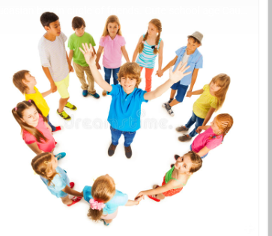
WARM-UP
Game: The last man standing

Slide 6
WARM-UP
Game: The last man standing
Rules:
10 students form a circle with a ball.
Take turns to speak out a word related to the topic Music and pass the ball to one student.
Toss it to another student as they name the word related to the theme.
If you repeat a word or can’t say any more words, you need to sit down.
The last student standing wins the game.

Slide 7
LESSON 8
LOOKING BACK AND PROJECT
Unit
GETTING STARTED
WARM-UP
Game: The last man standing
Pronunciation: Listen and mark the stressed syllables in words. Then read them out.
Vocabulary: Complete the text.
Grammar:
1. Match the two parts to make complete sentences.
2. Find the mistake in each sentence and correct it.
LOOKING BACK

Slide 8

LOOKING BACK
1
PRONUNCATION
Listen and mark the stressed syllables in the following words. Then read them out.
perform singer
concert famous
final enjoy

Slide 9
LOOKING BACK
2
VOCABULARY
Complete the text using the words and phrases in the box.
artists music concerts instrument fans
Our class survey revealed some surprising results about the students' (1) _______ habits. Most of them did not hesitate to say that they love music because they find it relaxing. Their favourite music is K-pop and British or American pop music as they are big (2) _______ of Korean and American (3) _______. Fourteen out of twenty students play a musical (4) _________ and most of them practise between one and three hours a week. Going to (5) _______ is usually popular among teenagers, but only eight people said that they like going to such music events.
music
fans
artists
instrument
concerts

Slide 10
LOOKING BACK
3
GRAMMAR
1. Match the two parts to make complete sentences.
1. She writes her own songs,
a. or we can stay at home to watch the final night of Vietnam Idol.
2. He participated in many
talent competitions,
b. so we decided to walk to the stadium.
3. We can go to a live concert at City Theatre,
c. and they always have deep meanings.
4. The traffic was really bad,
d. but the judges never liked his songs.

Slide 11
LOOKING BACK
3
GRAMMAR
There is a mistake in each sentence below.
Find the mistake and correct it.
1. She asked him attend the school performance. __________
2. Don’t let her to go to the music festival! __________
3. Their parents will never agree buy that expensive piano. __________
4. To develop her musical talent, her father made her to sing at family gatherings. __________
to attend
go
to buy
sing

Slide 12
LESSON 8
LOOKING BACK AND PROJECT
Unit
GETTING STARTED
WARM-UP
Game: The last man standing
Pronunciation: Listen and mark the stressed syllables in words. Then read them out.
Vocabulary: Complete the text.
Grammar:
1. Match the two parts to make complete sentences.
2. Find the mistake in each sentence and correct it.
LOOKING BACK
PROJECT
Go Green Weekend
CONSOLIDATION
Wrap-up
Home work

Slide 13
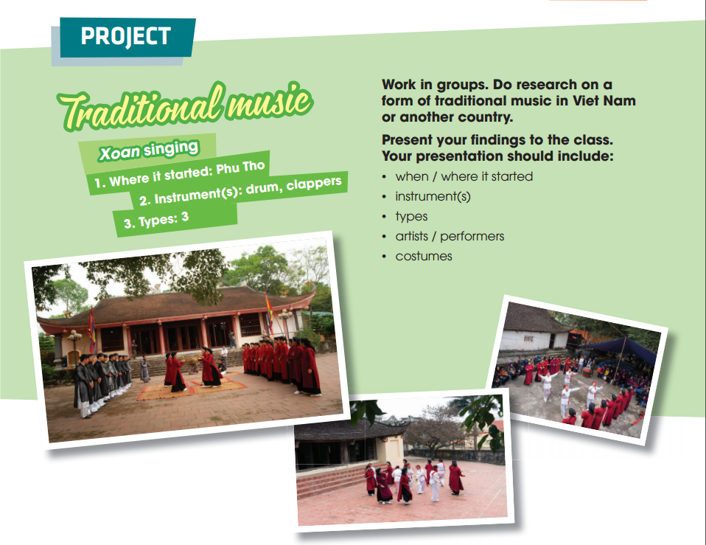
PROJECT

Slide 14
PROJECT
 | Tick where appropriate | Comments (in English or Vietnamese)
DELIVERY
- The presenters greeted the audience.
- The presenters spoke clearly and naturally.
- The presenters cooperated when delivering their talk.
- The presenters interacted with the audience.
- The presenters used some photos /pictures to illustrate their ideas.
- The presenters concluded their talk appropriately.
CONTENT: The presentation includes the following information about a form of traditional music:
- when/where it started
- instruments
- types
- artists/performers
- costumes
Checklist for peer assessment

Slide 15
PROJECT
 | Tick where appropriate | Comments (in English or Vietnamese)
DELIVERY
- I greeted the audience.
- I spoke clearly and naturally.
- I cooperated with my group members when delivering the talk.
- I interacted with the audience.
- I used some photos / pictures to illustrate my ideas.
- I concluded my part of the talk appropriately.
CONTENT: Our presentation includes the following information about a form of traditional music
- when/where it started
- instruments
- types
- artists/performers
- costumes
Checklist for self-assessment

Slide 16
LESSON 8
LOOKING BACK AND PROJECT
Unit
GETTING STARTED
WARM-UP
Game: The last man standing
Pronunciation: Listen and mark the stressed syllables in words. Then read them out.
Vocabulary: Complete the text.
Grammar:
1. Match the two parts to make complete sentences.
2. Find the mistake in each sentence and correct it.
LOOKING BACK
PROJECT
Go Green Weekend
CONSOLIDATION
Wrap-up
Home work

Slide 17
CONSOLIDATION
1
Wrap-up
Revise how to pronounce stress in two-syllable words correctly;
Revise the use of words/ phrases related to the topic Music;
Revise how to use conjunctions to make compound sentences correctly;
Revise some verbs followed by to-infinitives and bare-infinitives.
Do research on traditional music in Viet Nam or another country and give a group presentation about it.

Slide 18
CONSOLIDATION
2
Homework
Do exercises in the workbook
Prepare for Unit 4 - Lesson1

Slide 19

Website: hoclieu.vn
Fanpage: facebook.com/www.tienganhglobalsuccess.vn

