Slide 2
Unit 8
WILDLIFE CONSERVATION
LESSON 3
READING
Wildlife conservation news

Slide 3
LESSON 3
READING
WARM-UP
Spot the word
PRE-READING
Task 1: Discuss the questions.
Vocabulary
Task 2: Choose the most suitable headline.
Task 3: Match the highlighted words with their meanings.
Task 4: Choose the correct answer.
WHILE-READING
POST-READING
Task 5: Discuss the following questions.
CONSOLIDATION
Wrap-up
Homework

Slide 4
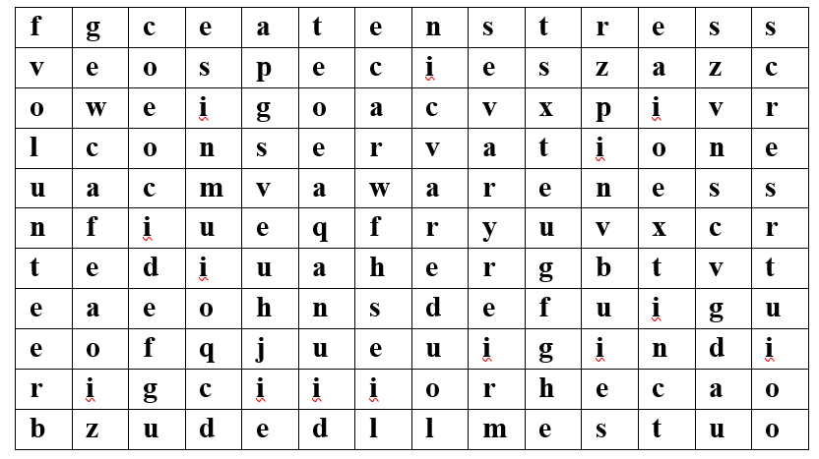
WARM-UP

Slide 5
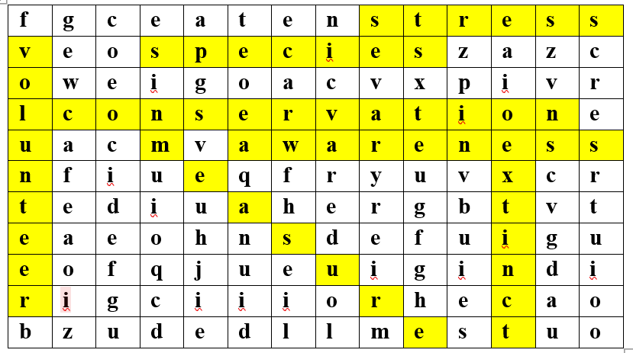
WARM-UP

Slide 6
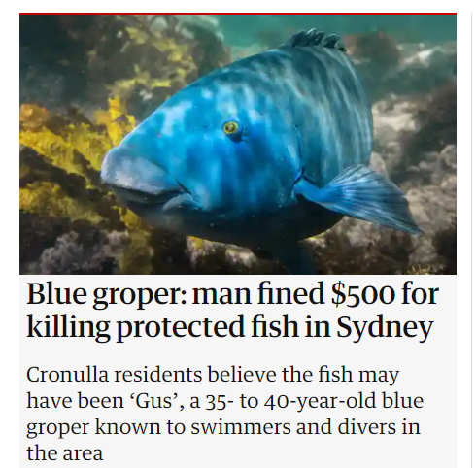
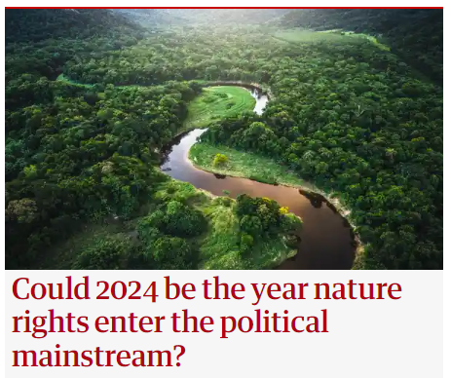
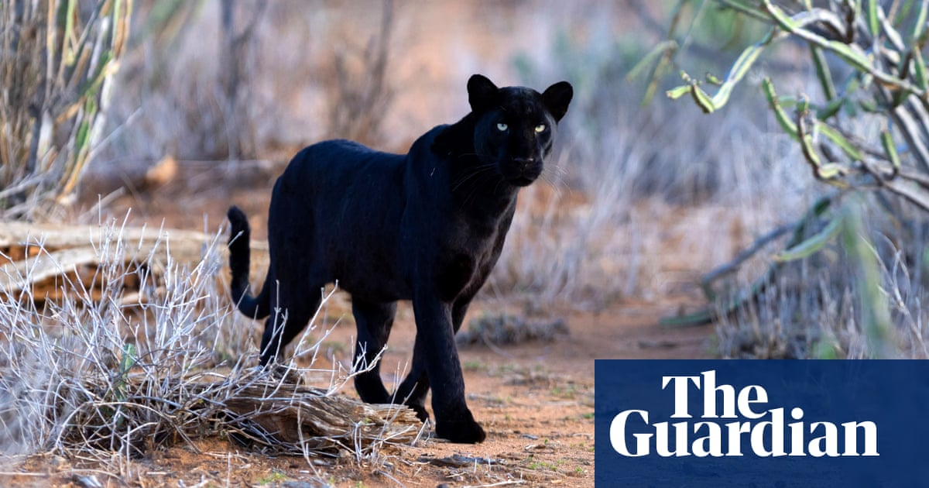
PRE-READING
1
Work in pairs. Discuss the following questions.
“Do you often read news stories about wildlife? If yes, what are they about?”

Slide 7
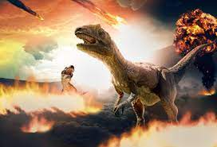

PRE-READING
extinction (n)
/ɪkˈstɪŋkʃən/
a situation in which a plant, an animal, a way of life, etc. stops existing

Slide 8
PRE-READING
measure (n)
/ˈmeʒə(r)/
an official action that is done in order to achieve a particular aim

Slide 9
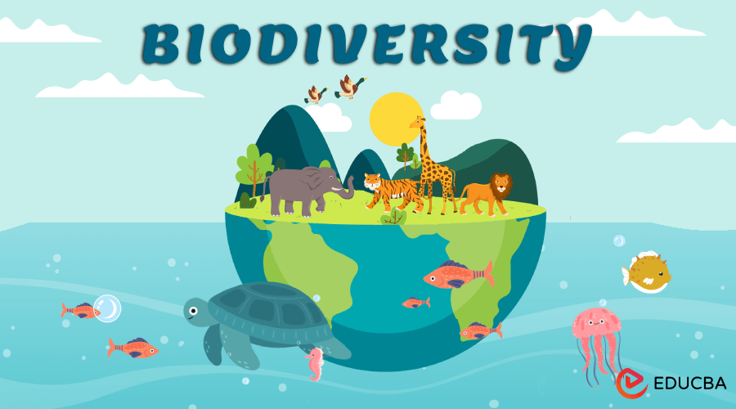
PRE-READING
biodiversity
/ˌbaɪəʊdaɪˈvɜːsəti/
the existence of a large number of different kinds of animals and plants which make a balanced environment

Slide 10
PRE-READING
entitle (v)
/ɪnˈtaɪtl/
give a title to a book, play, etc.

Slide 11
PRE-READING
Form | Pronunciation | Meaning | Vietnamese equivalent
1. extinction (n) | /ɪkˈstɪŋkʃn/ | a situation in which a plant, an animal, a way of life, etc. stops existing | Sự tuyệt chủng
2. measure (n) | /ˈmeʒə(r)/ | an official action that is done in order to achieve a particular aim | Biện pháp
3. biodiversity (n) | /ˌbaɪəʊdaɪˈvɜːsəti/ | the existence of a large number of different kinds of animals and plants which make a balanced environment | Sự đa dạng sinh học
4. entitle (v) | /ɪnˈtaɪtl/ | give a title to a book, play, etc. | Đặt tiêu đề

Slide 12
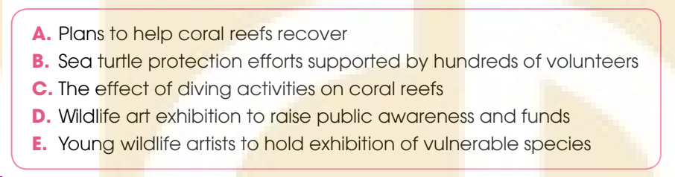
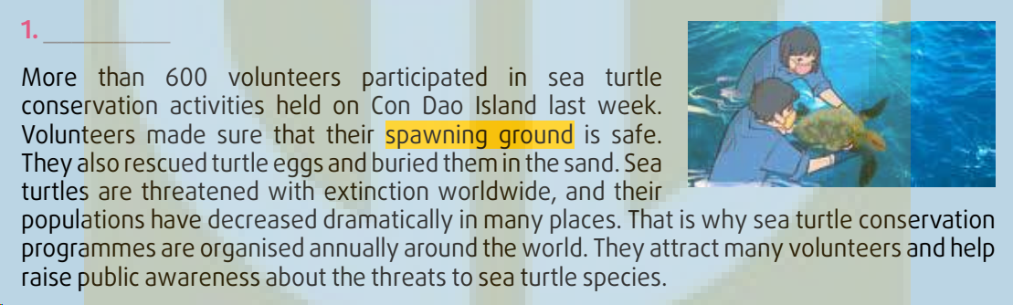
WHILE-READING
Read the news items and choose the most suitable headline for each one. There are TWO extra headlines.
2
1. B

Slide 13
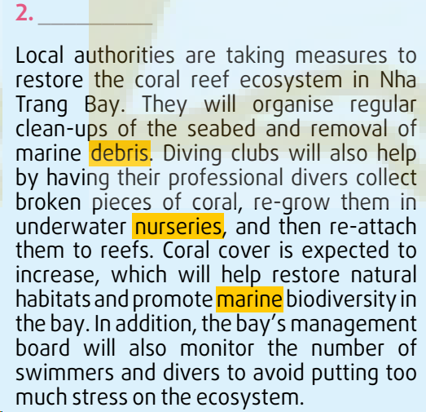
WHILE-READING
Read the news items and choose the most suitable headline for each one. There are TWO extra headlines.
2
2. A

Slide 14
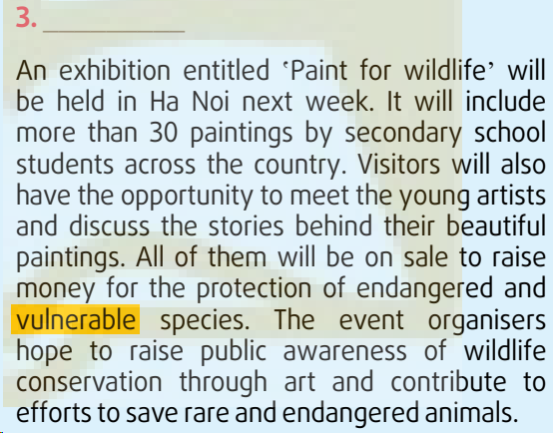
WHILE-READING
Read the news items and choose the most suitable headline for each one. There are TWO extra headlines.
2
3. D

Slide 15
WHILE-READING
Read the news items again and match the highlighted words and phrase with their meanings.
3
1
spawning ground
a
easily harmed or hurt physically or mentally
b
2
debris
places where young plants are grown for planting somewhere else
3
nurseries
c
a place where sea turtles and other animals such as fish and frogs leave their eggs
4
marine
d
related to the sea
5
vulnerable
broken pieces of something larger
e

Slide 16
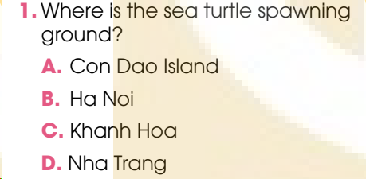
WHILE-READING
4
Read the news items again and choose the correct answer.

Slide 17
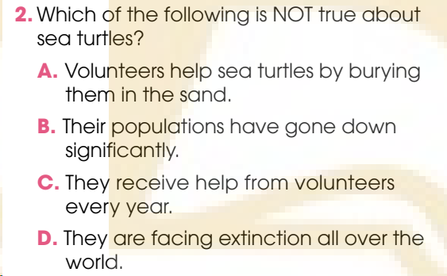
WHILE-READING
4
Read the news items again and choose the correct answer.

Slide 18
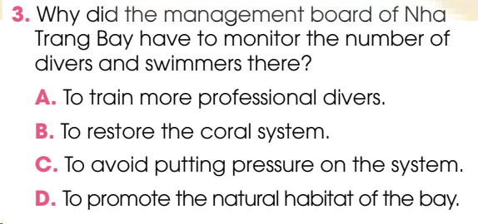
WHILE-READING
4
Read the news items again and choose the correct answer.

Slide 19
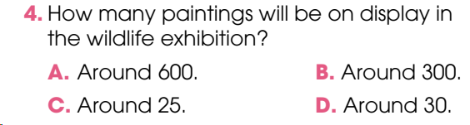
WHILE-READING
4
Read the news items again and choose the correct answer.

Slide 20
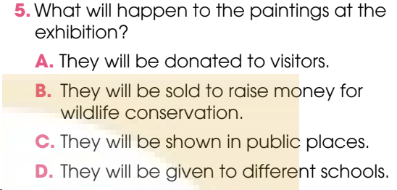
WHILE-READING
4
Read the news items again and choose the correct answer.

Slide 21
POST-READING
5
Work in groups. Discuss the following questions.
Which of the news items do you find most interesting or useful? Why?
Example:
- I find the news item No.3 most interesting because this is a great opportunity for art lovers gather together for a meaningful event. They can fulfil their passion for painting and at the same time help promote public awareness about wildlife conservation.
- I find the news item No.1 most interesting because the news item helps raise public awareness about sea turtles an endangered species that requires special protection. This also opens an opportunity for the volunteers who wish to work on such endangered species protection projects.

Slide 22
CONSOLIDATION
1
Wrap-up
What have you learnt today?
Some lexical items about green living
Reading for specific information

Slide 23
CONSOLIDATION
2
Homework
Do exercises in the workbook.
Collect some conservation news and show them to the whole class.

Slide 24
Website: hoclieu.vn
Fanpage: facebook.com/www.tienganhglobalsuccess.vn

