Slide 1


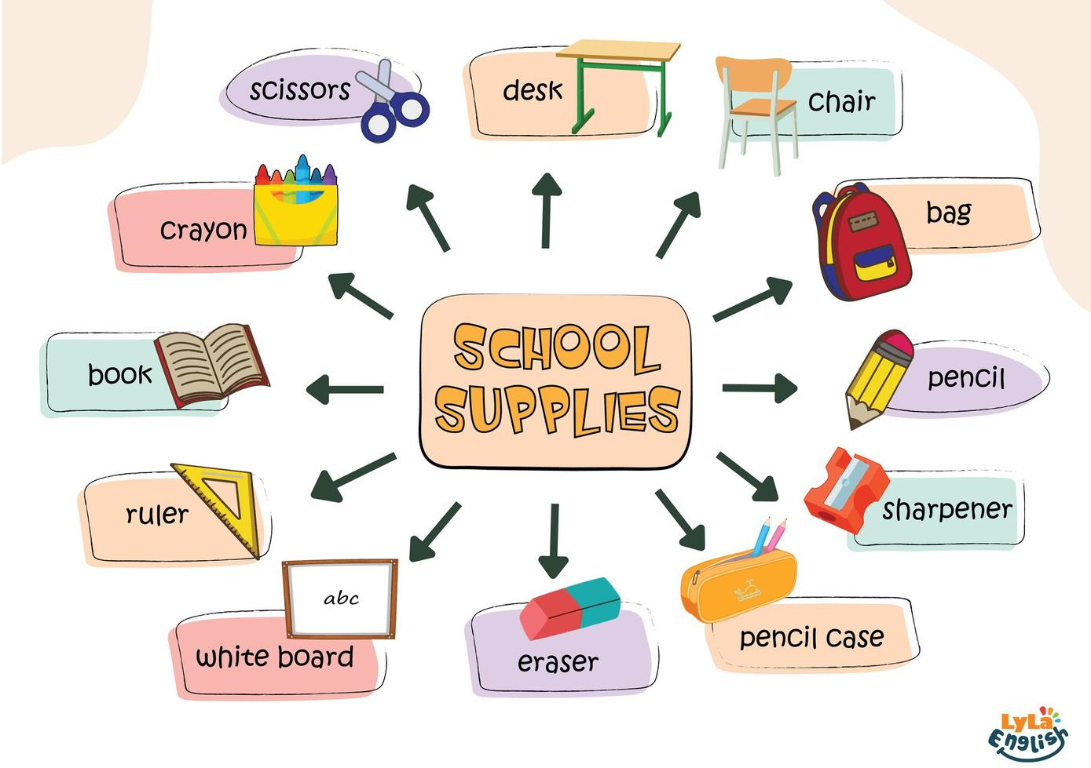

Slide 2
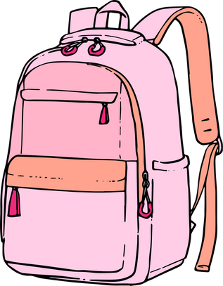


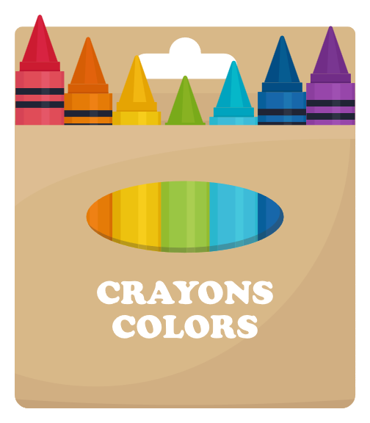
I. QUESTION
1.What is it?
- It’s a ....
2. What shape is this bag?
- It’s a ....
3. What color is it?
- It’s ...
4. What things are there in your bag?
- There are...
5. How many crayons are there? What are they?
- There are ...crayons:

Slide 3

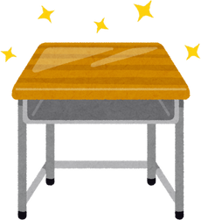
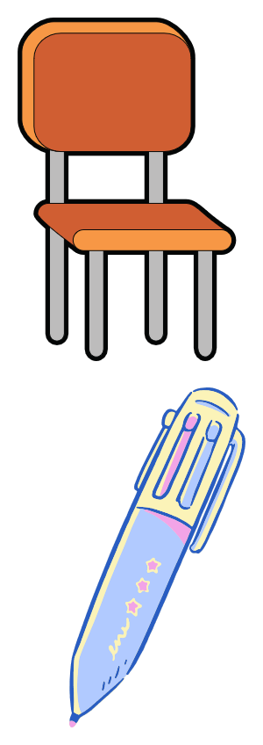
II. VOCABULARY
Pencil:..............................................
Ruler:..............................................
Desk:...............................................
Chair:..............................................
Pen:.................................................

Slide 4
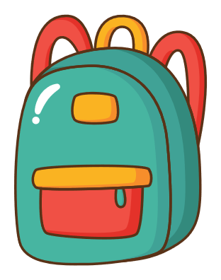

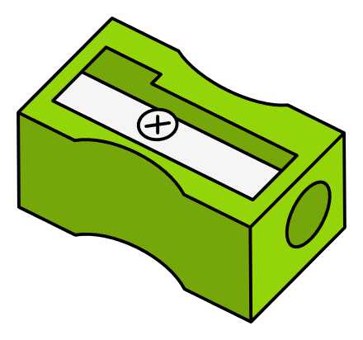

II. VOCABULARY
Bag:......................................................
Eraser:...................................................
Crayons:.................................................
Sharpener:..............................................
Book:.......................................................

Slide 5

III. EXERCISES:
1.Trace the words below:
Pencil
Book
Ruler
Crayon
Sharpener
Eraser
Glue
Desk

Slide 6
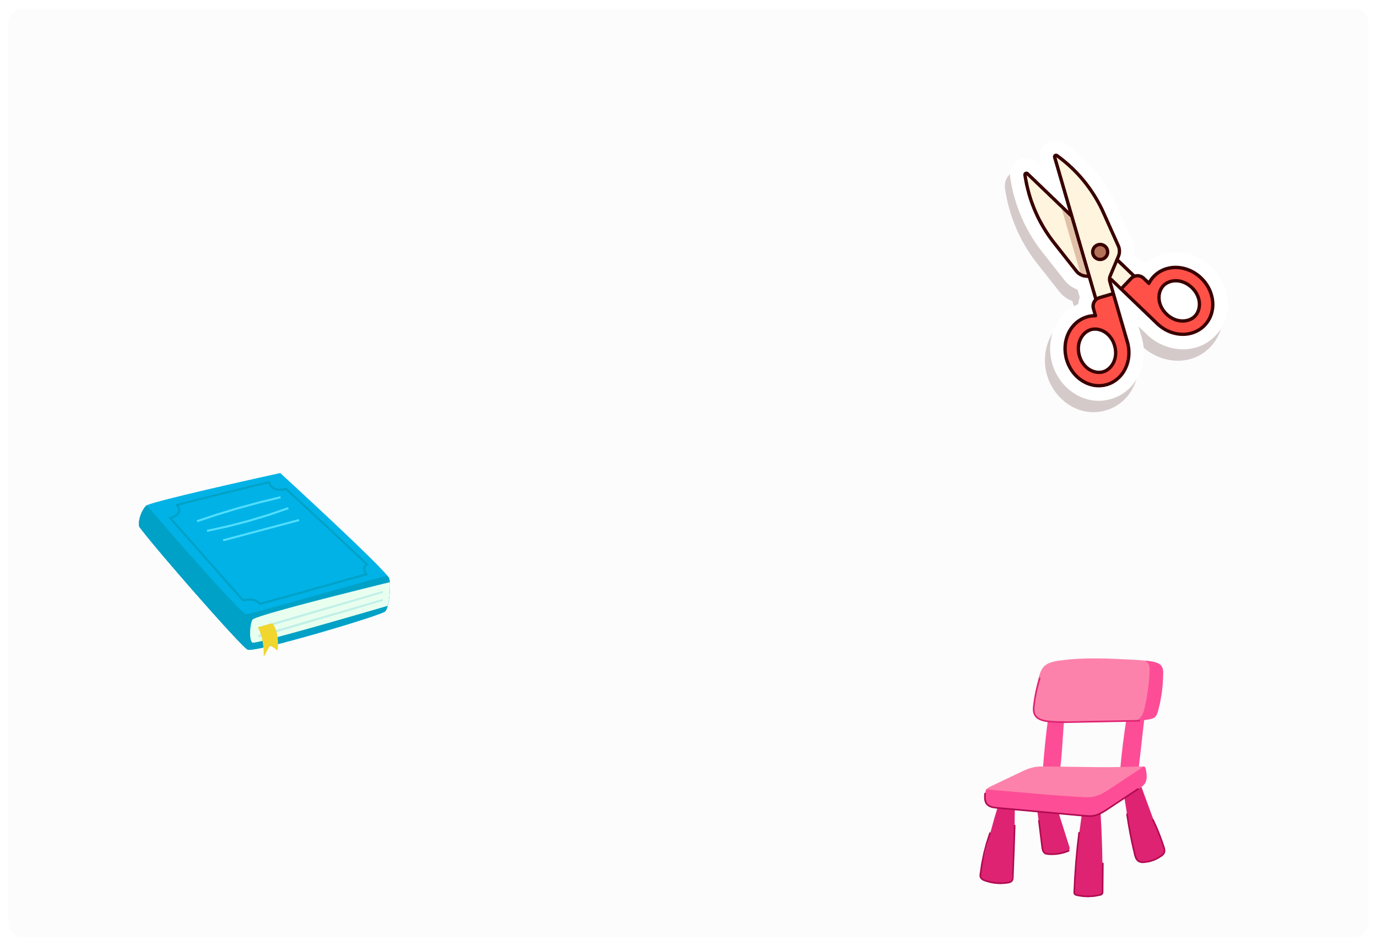
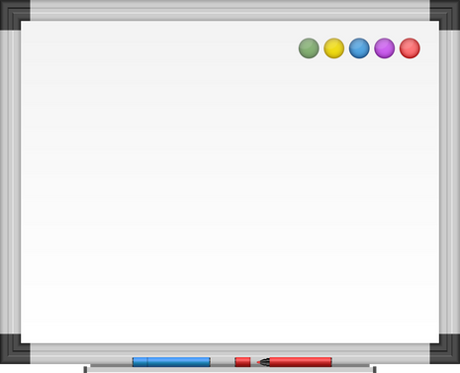


III. EXERCISES:
2. Match the words and pictures:
Chair
Book Scissors White board Ruler
Bag

Slide 7
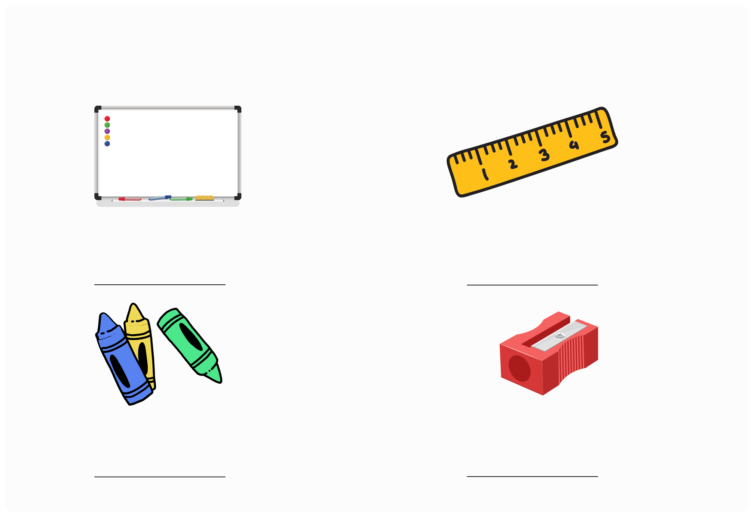
III. EXERCISES:
3. Reorder the words:
W/i/t/e/h - b/r/o/d/a
r/l/u/r/e
C/a/r/y/n/o
S/r/h/a/p/n/e/e/r

Slide 8
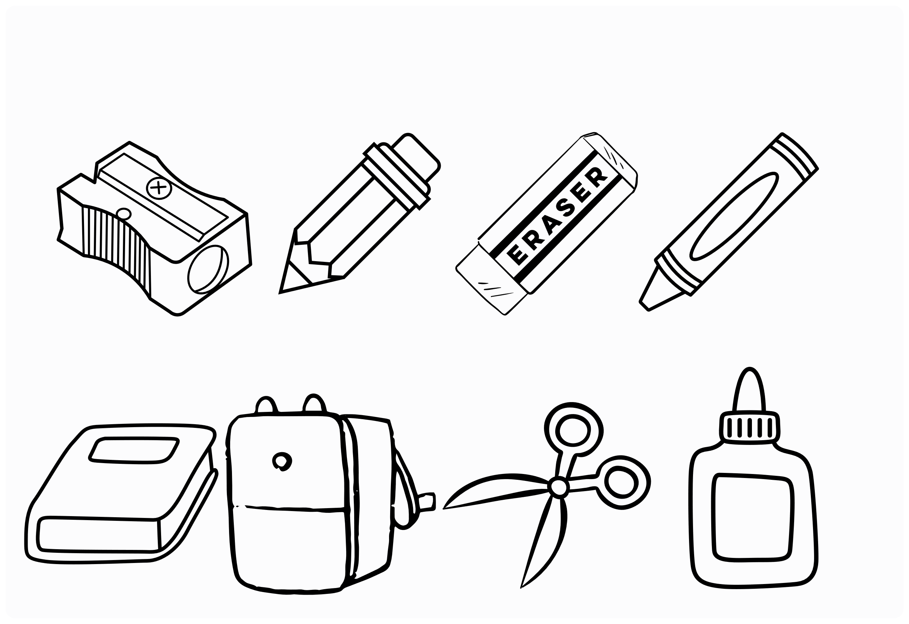
III. EXERCISES:
4. Color the school supplies do you have:

Slide 9
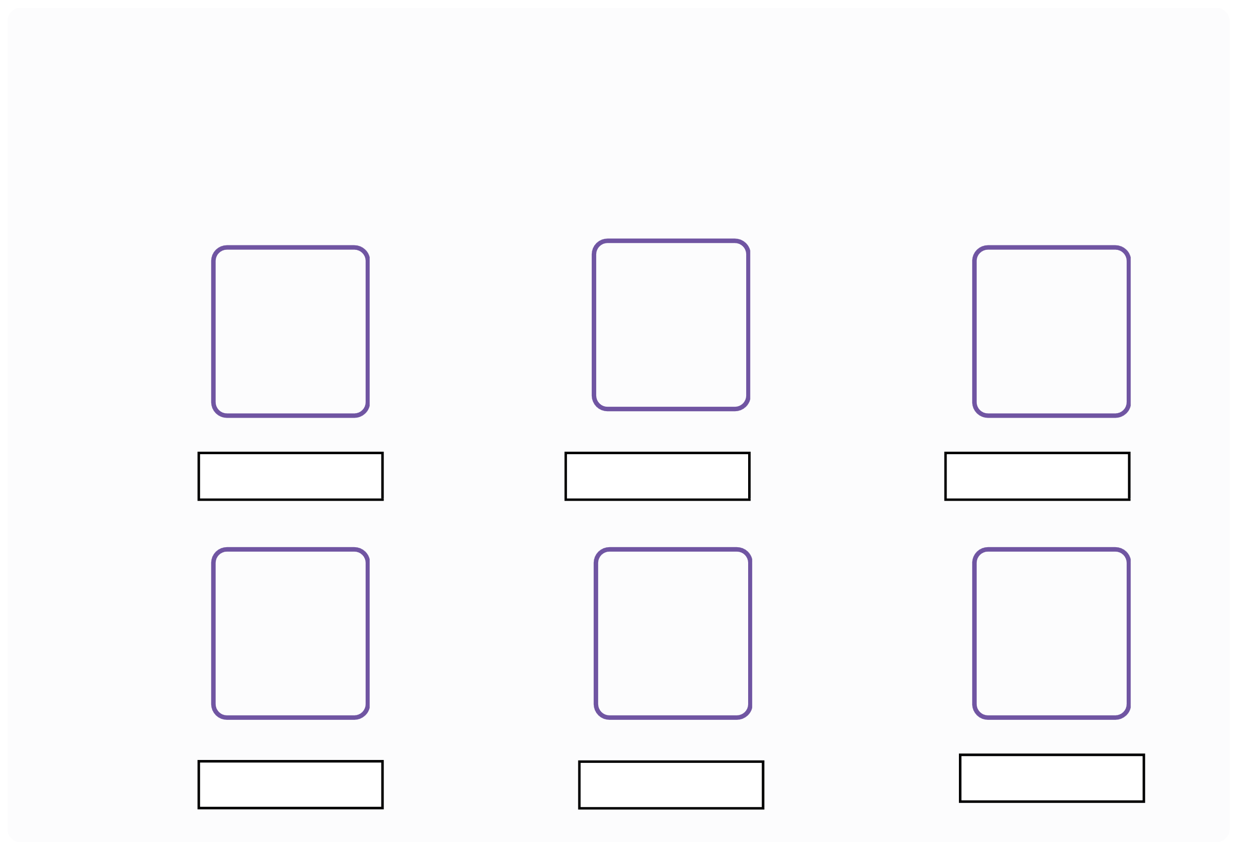
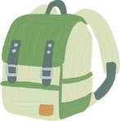
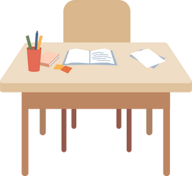
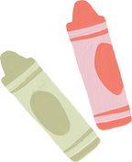
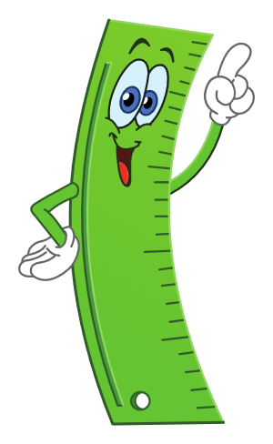

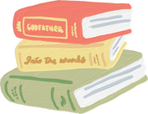
III. EXERCISES:
5. Write the missing letters:
B_ _
D_ _k
Cra_ _n
_ _ _k
P__cil
R_ _r

Slide 10

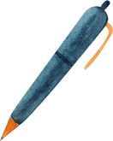
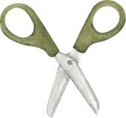
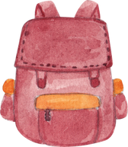
III. EXERCISES:
6. Find and line the similar picture:

Slide 11
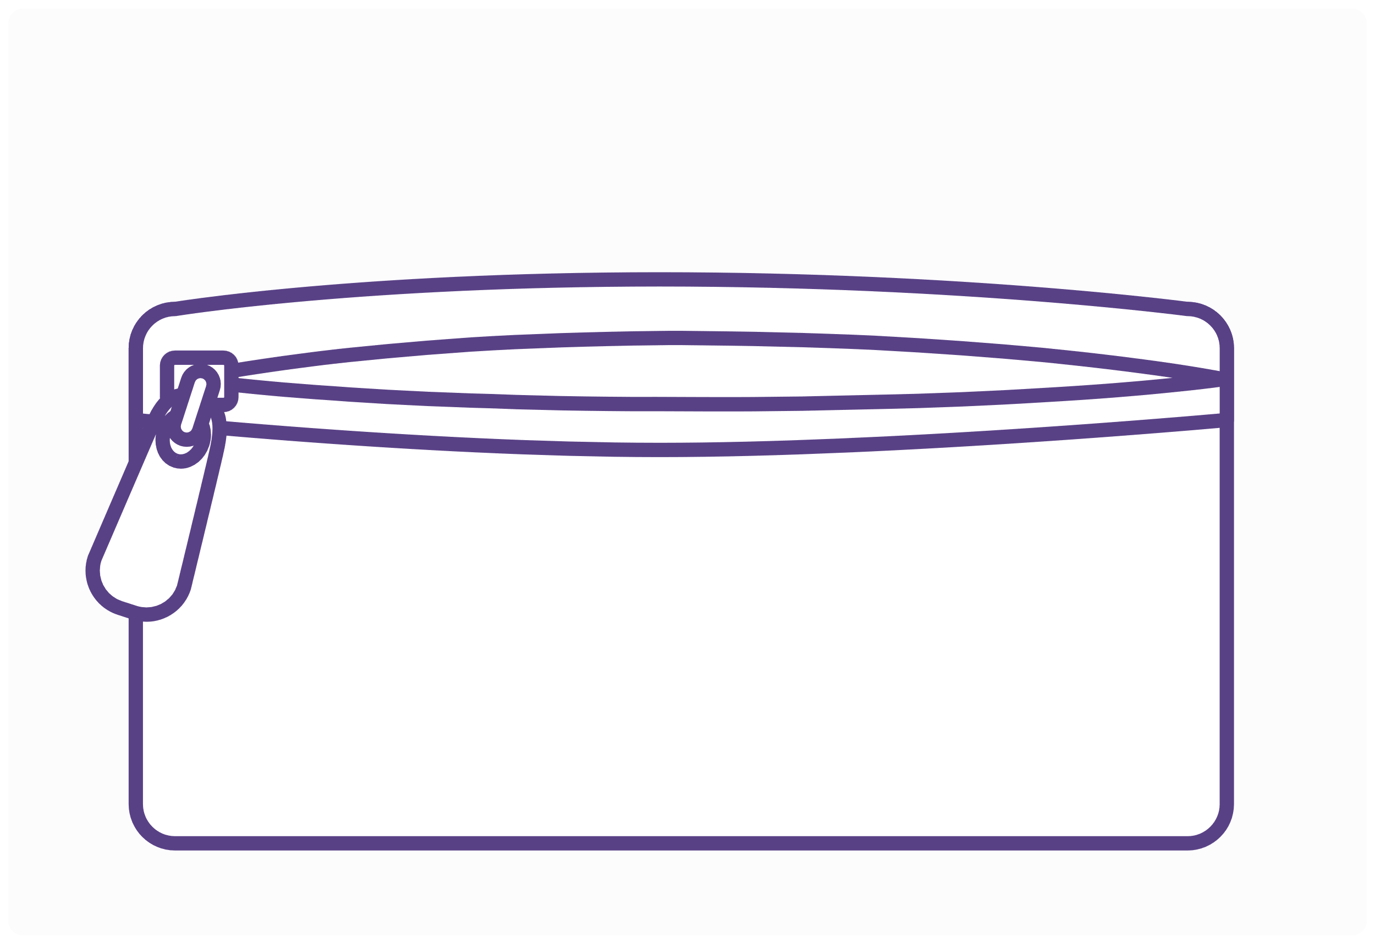
III. EXERCISES:
7. What’s in your pencil case? Draw and say:

Slide 12

III. EXERCISES:
8. Find the words below:
AKPENCILSEMQ BLANROAGENUN GISCMARKERSO BOINCRSDGLIT AETIVOREBOOE CRSCISSORSVB KARHRCIAAAMO PENGPAPERTOO ARILONYSBOOK CRGLUEOOYGLH KCHERPYNNRES PSHARPENERET
PEN CRAYON GLUE
ERASER
SHARPENER

