Slide 1

Unit 4: Holidays!
Lesson 4e: Grammar
Page 79

Slide 2
Lesson Outline
Warm-up
Grammar
Consolidation
Wrap-up

Slide 3
Objectives
By the end of this lesson, students will be able to…
use will for on-the-spot decisions and predictions based on what we think, believe or imagine, often with the verbs think, believe, etc.

Slide 4

WARM-UP

Slide 5

Work in pairs.
Discuss what you will do in the following situations:
The room is dark.
Someone is knocking on the door.
The phone is ringing.
Turn on the light.
Open the door.
Answer the phone.

Slide 6

It’s time to learn …

Slide 7

will
Presentation

Slide 8
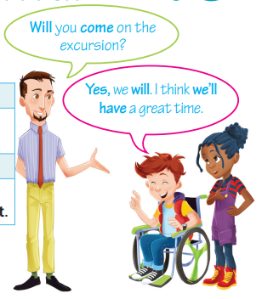
Read the following sentences. Then fill in the table about the structure will:
A: Will Tom go to the cinema with us?
B: No, he won’t. I think he will go swimming with Jason.
A: Will they take part in the swimming competition?
B: Yes, I think they will.
affirmative | negative
I/ You/ He etc. will (‘ll) try. | I/ You/ He etc. ………………….…… try.
interrogative | short answers
………. I/ you/ he etc. try? | Yes, I/ you/ he etc. ……... No, I/ you/ he etc. ……………
will not (won’t)
will
Will
won’t

Slide 9
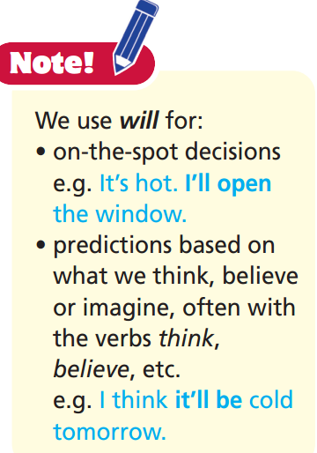
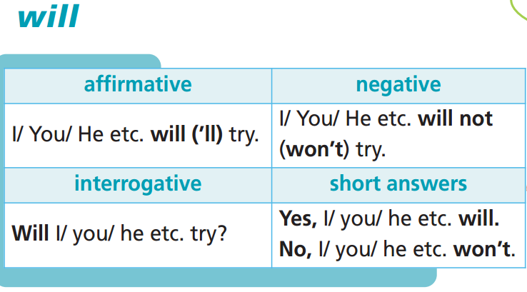
Remember:

Slide 10

Practice

Slide 11
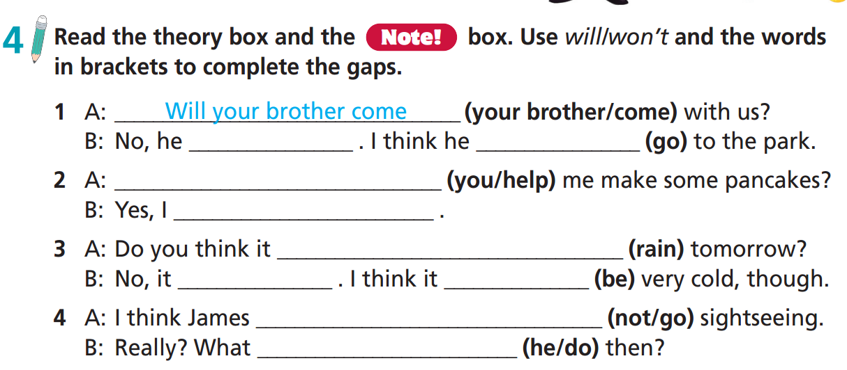
won’t
will go
Will you help
will
will rain
won’t
will be
won’t go
will he do

Slide 12
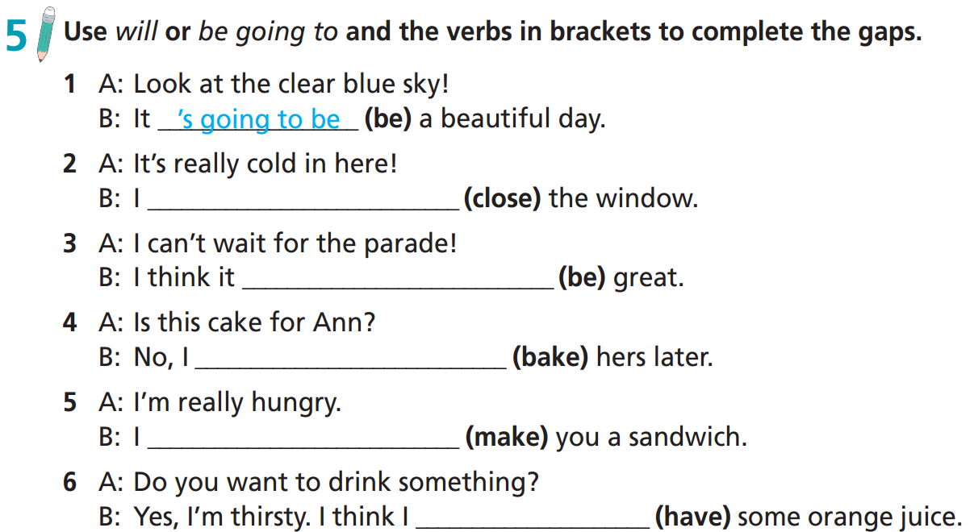
will close
will be
am going to bake
will make
will have

Slide 13
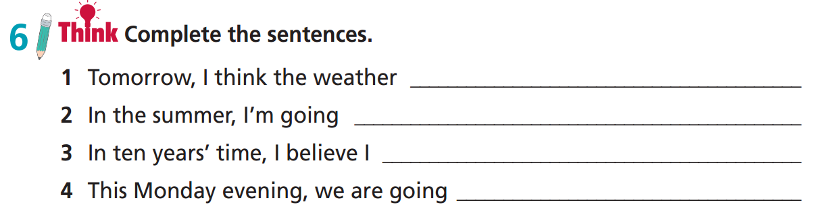
will be cloudy.
to go to Italy.
will be a teacher.
to watch a DVD.

Slide 14
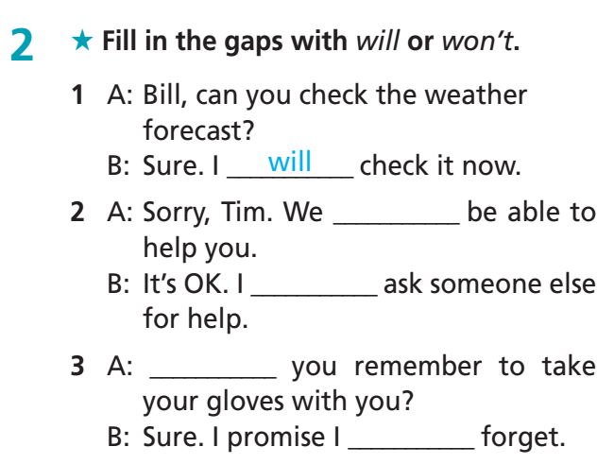
Extra Practice
WB page 42
won’t
will
Will
won’t

Slide 15
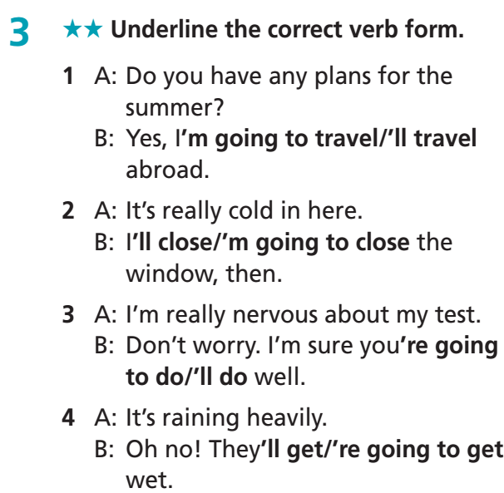
Extra Practice
WB page 42

Slide 16
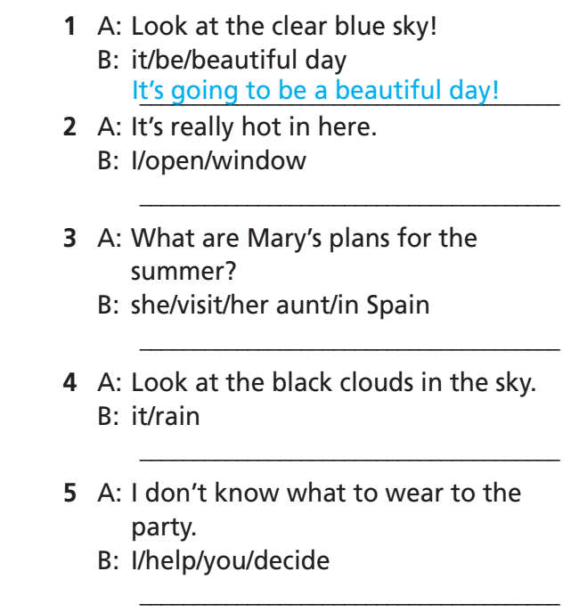

Extra Practice
WB page 42
I’ll open the window.
She’s going to visit her aunt in Spain.
It’s going to rain.
I’ll help you decide.

Slide 17
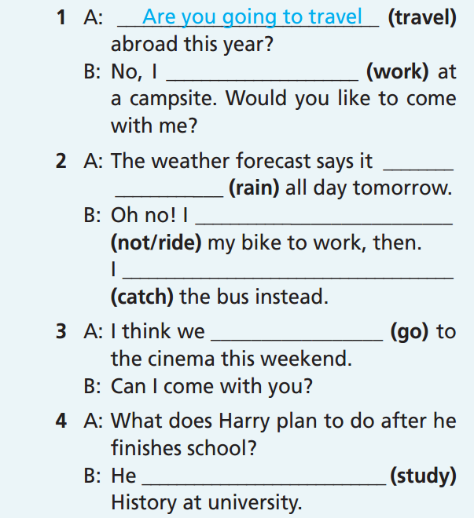
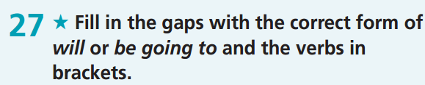
Extra Practice
Grammar bank
page 70
am going to work
is going to rain
won’t ride
will catch
will go
is going to study

Slide 18

Production

Slide 19
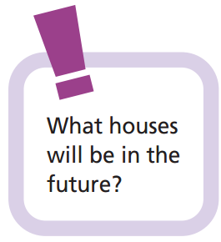
Work in groups.
E.g.
Houses will be smaller.
Houses will run and fly.
All the walls will be digital screens.
The rooms will change sizes easily and quickly.

Slide 20
What am I predicting?
Students work in groups of 4-5. The teacher asks each group to write their prediction about the future of one thing without mentioning its name. Then each group reads aloud their prediction, and the other groups guess what they are talking about, e.g. “They will get wider but thinner, and then they will finally become 3D” for “televisions”. If 1 group can give the correct guess, the writing group and the guessing group will get 1 point.
At the end of the activity, which group gets more points will be the winner.

Slide 21

CONSOLIDATION

Slide 22
Write a paragraph (50 – 70 words) about your life in the next 20 years. You can use the following information:
What will your house be in the future?
What job will you have? What will you do at work?
Who will you live with?
What kind of vehicles (e.g. car, motorbike, bikes, etc.) will you use?
What kind of clothes will you wear?
What activities will you often do?

Slide 23
Write a paragraph (50 – 70 words) about your life in the next 20 years. You can use the following information:
e.g.
My house will be small and modern. All the walls will be digital screens. I will be an accountant. I will work with numbers for companies. I will live with my husband and my children. I will use electric cars. I will wear shirts and skirts. I will often have video calls with my parents.

Slide 24

WRAP-UP

Slide 25
Today’s lesson
Grammar
use will for on-the-spot decisions and predictions based on what we think, believe or imagine, often with the verbs think, believe, etc.

Slide 26
Homework
Practise the vocabulary and make sentences using them.
Do the exercises in TA 6 Right on WB (p. 42).
Complete the grammar notes in TA 6 Right on Notebook (p. 42).
Prepare for the next lesson (p. 80 SB).

Slide 27
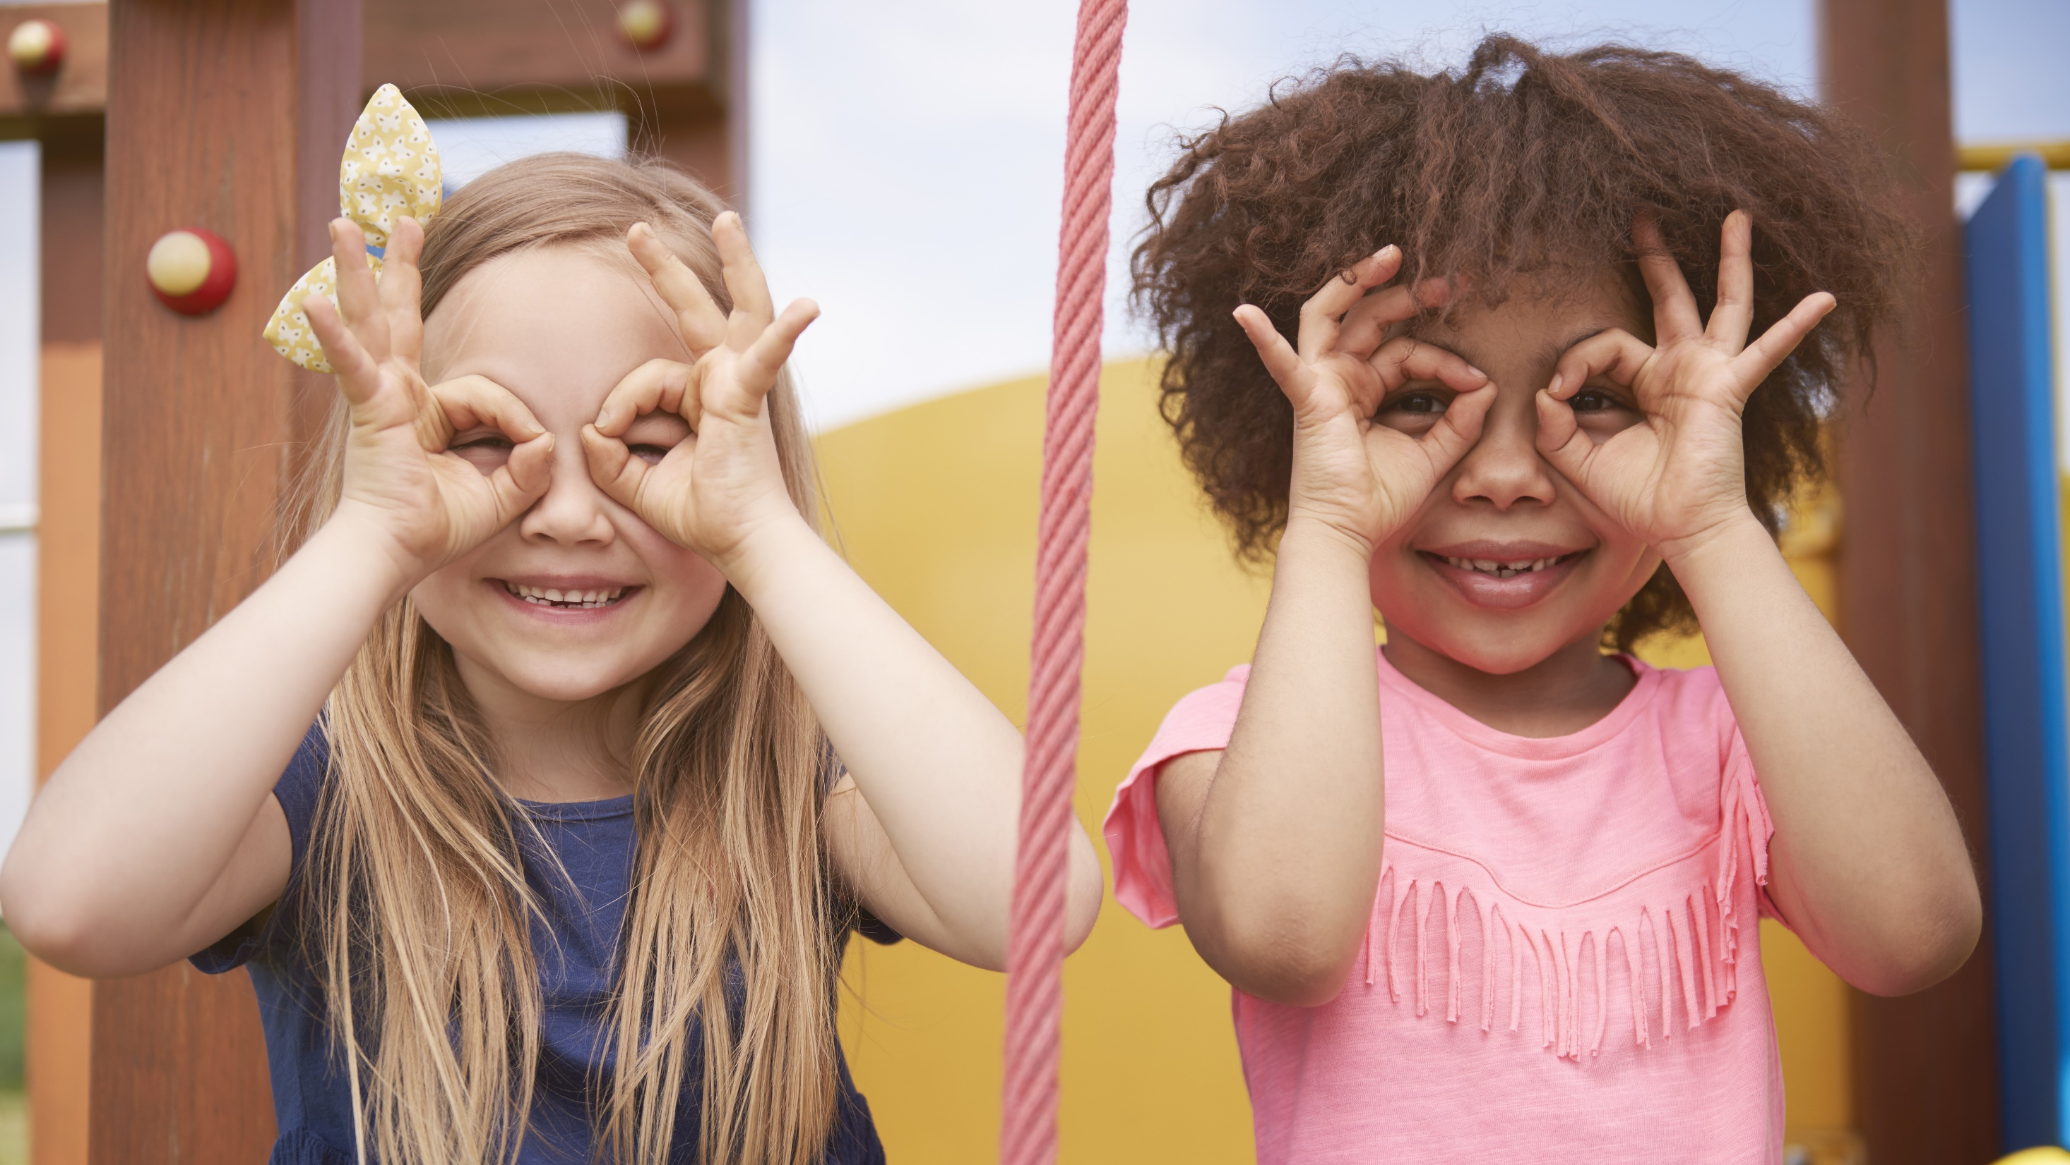
Enjoy your day!

